Slide 1
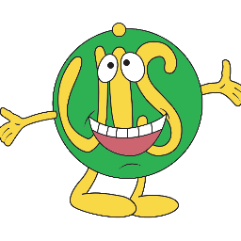
Your Reading partnership with Upton infant school

Slide 2
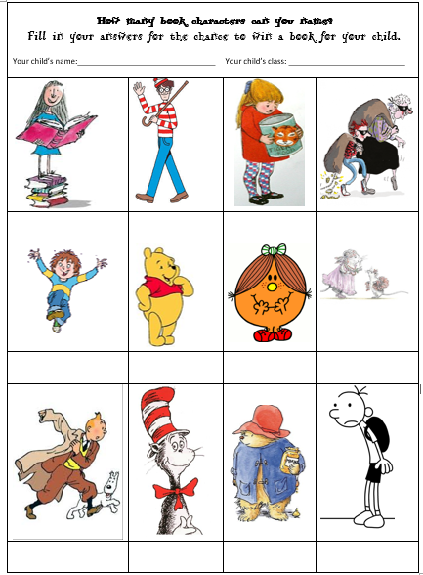


Slide 3
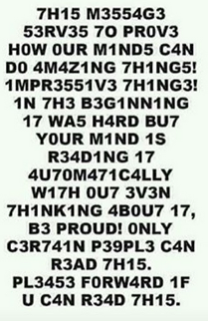

Slide 4
Our journey
Research shows that 90% of a parent’s interaction with their child is solely to do with routines and instructions.
Having conversations introduces children to new words and allows them to practise using different vocabulary.
- Print awareness
- Vocabulary
- Understanding how a book works
- Phonics
- Common exception words (red words)
- Building fluency
- Understanding the book

Slide 5
How we teach it at school
- Read, Write, Inc
- Guided Reading
- Whole Class Reading
- Independent Reading

Slide 6
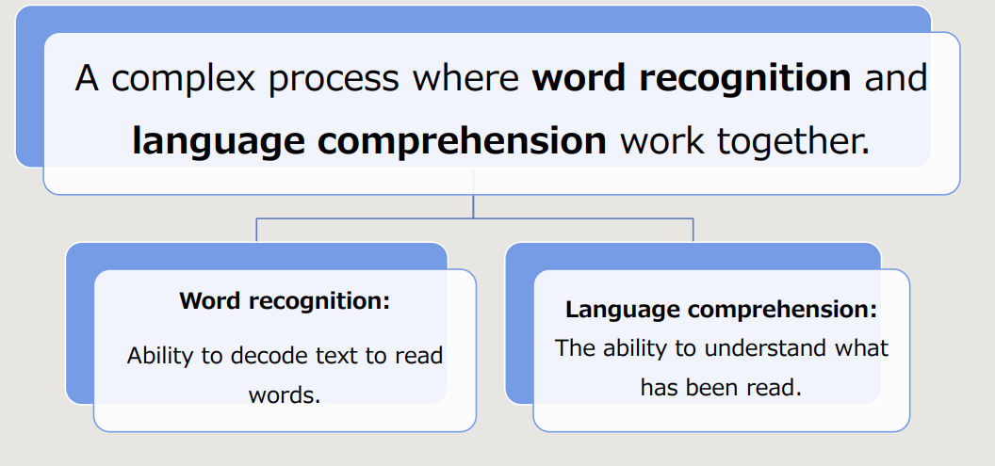
How children learn to read – the theory!

Slide 7
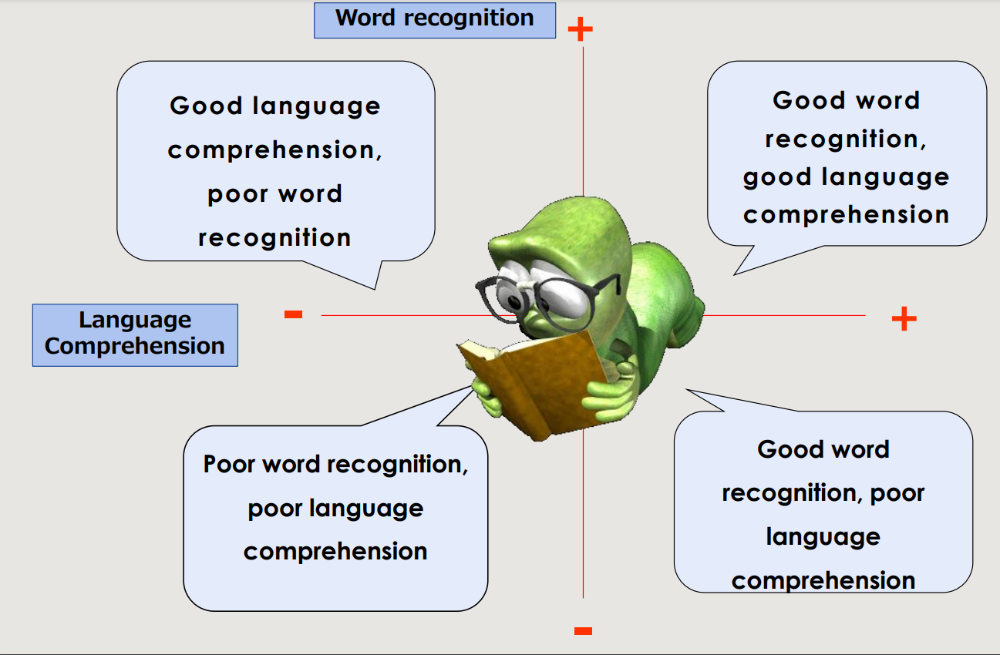

Slide 8

Read, write, inc
A complete literacy programme - systematic and structured.
Meets the demands of the new national curriculum, giving your children the best chance of success.
Read storybooks and non-fiction books closely matched to their developing phonic knowledge
Read with fluency, expression and understanding
Learn to spell using known sounds
Aim at the end of Year 1...
Children are accurate and speedy readers
One-to-one tutoring - no child is left behind.
It is important to remember that it is not a race through levels…there are many skills involved.
Children need to be exposed to words several times before they become fluent and automatic.

Slide 9
Fred talk speed sounds
Special friends...2
letters that make 1
sound
Say “hello” to Fred.
Fred can only talk in sounds...
He says “c_a_t.” Not cat.
We call this Fred Talk.

Slide 10
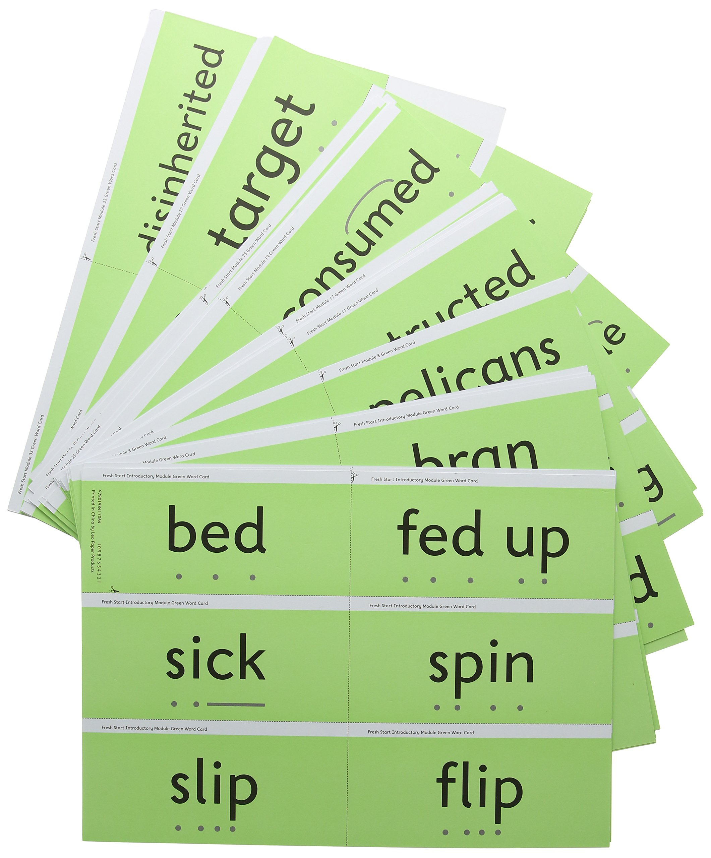

Fred fingers green words red words
Fred Fingers for spelling
*Say the word and
pinch on the sounds
Eyes for reading,
fingers for spelling
Red words
‘If it’s red it’s hard to Fred’
Green words – contain all the sounds we know
Fred in your head

Slide 11

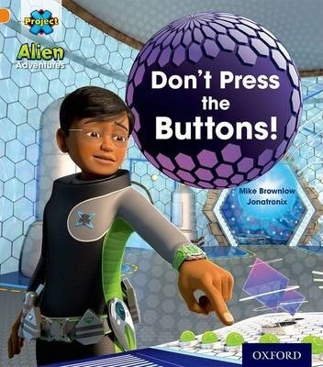
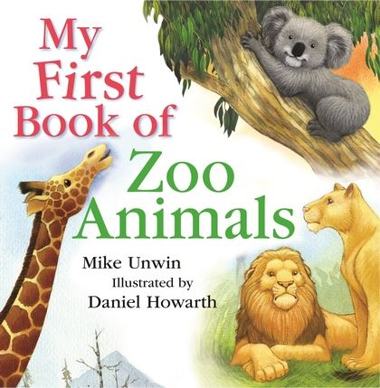
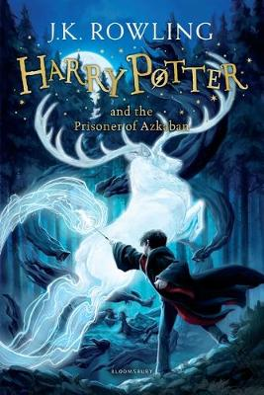

Book bags and Rwi homework
Learn to Read Help to Read Love to Read

Slide 12

Reading rewards
Book Bugs Reading Raffle Whole Class Reads
- 44 reads - Read at least 3x a week - Adult in the class checks
- Record in reading diary - One child picked a week which children have read 3x
- Collect from the office - Automatic prize at the end of - % of children who have
half term if your child has read read in the class
3x a week or more every week - class with the highest % gets
an extra playtime
Struggling to record the reads in the diary …..
Your child can record the books they have read themselves or you can ask your class teacher for a special sheet of stickers for them to use instead ☺

Slide 13
Reading with your child at home
Quiet place
Walk through the book first
Ask them to predict what they think will happen
Model reading
Encourage them to blend sounds together
Use the pictures
Practise word recognition
Ask questions during and after
Praise them
Make it fun!

Slide 14
Top tips for helping them
Display red words in key locations around the house and as your child walks by ask them to read them. Give ticks on the paper to celebrate success.
If your child can’t read a word – Pause, prompt, praise
- Encourage them to Fred Talk the word
- Split longer words into chunks
- Model Fred Talking it if they can’t read it
-Then tell them! Especially red words
If your child doesn’t understand what they have read
- Ask them to reread the whole sentence
- Talk about the words, pictures and what has already happened
- Read the sentence yourself and talk about it with your child
- Reread the same book a number of times to build confidence and fluency
You can find out more at https://www.ruthmiskin.com/en/find-out-more/parents/
Keep reading a wide range of books to your child, even when they can read themselves.

Slide 15


Top tips for helping them
Reluctant Readers
• Try paired reading (taking it in turns to read a word / page / paragraph)
• Try reading the book to your child first to help them gain confidence
• Read to your child and change words so they have to correct your mistakes
• Set a given amount of time for reading
• Use rewards (our reading challenge and raffle is designed to encourage reading)
• Don’t over correct
• Keep reading sessions short and enjoyable – make them a really treasured part of the day
• Try to find books that they enjoy and are interested in
• Show them that you enjoy reading too

Slide 16
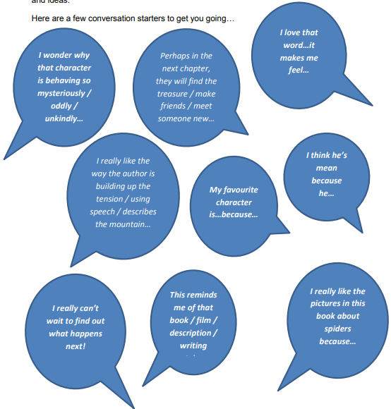
Encouraging story talk
Try doing the following when reading with your child:
• Talk about things you see in the book illustrations.
• Make connections between the story and your child’s life.
(“You’ve been to the zoo.”)
• Talk about the characters’ feelings.
(“Why do you think Bear is mad?”)
• Ask children who or what they might see on the next page.
• Ask children what they think might happen next.
Share your ideas, thoughts and feelings

Slide 17
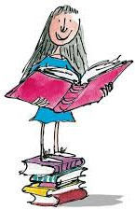
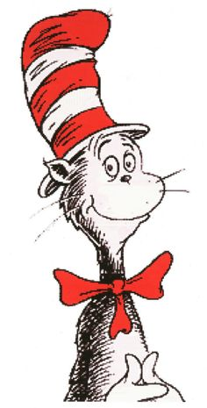

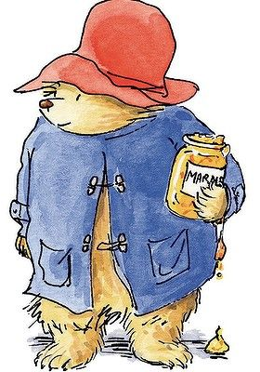
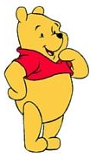

Slide 18
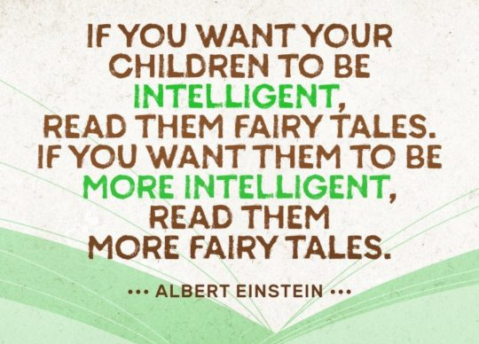
Reading to your child at home
https://www.youtube.com/watch?v=oQN-blu9-Jw

Slide 19

Reading to your child at home
Reading stories at home
Read favourite stories over and over again
Read some stories at a higher level than they can read themselves.
Practise pronouncing the sounds…
Remember no ‘fuh’ and ‘luh’!
Have fun with Fred Talk!
“What a tidy r-oo-m!”
“Where’s your c-oa-t?”
“Time for b-e-d!”

Slide 20
