Slide 1
Welcome to Year One

Slide 2


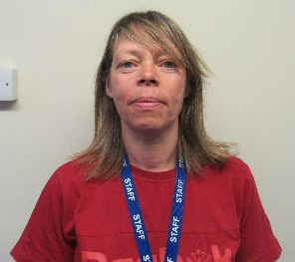
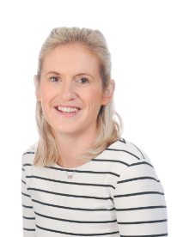
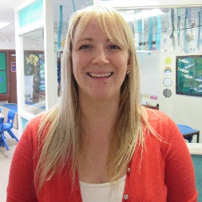


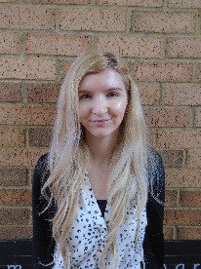
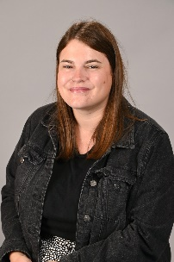
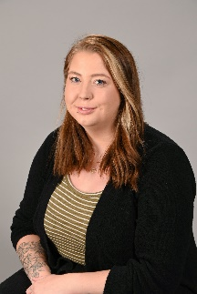


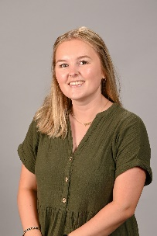
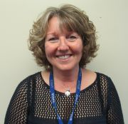
Who’s who
Mrs Elliott
Mrs Rose
Mrs Edge
Miss Leppington
Mrs Restall
Mrs Clippingdale
Miss Allen
Mrs Thompson
Mrs Clippingdale

Slide 3
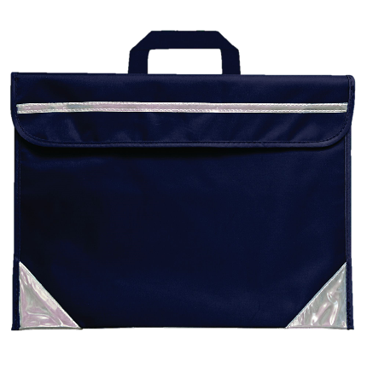
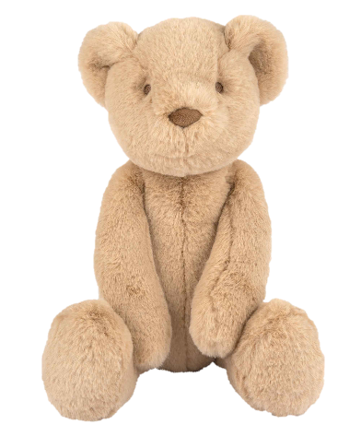
Belongings
Make sure everything is named!
No toys (unless spoken to teacher)

Slide 4
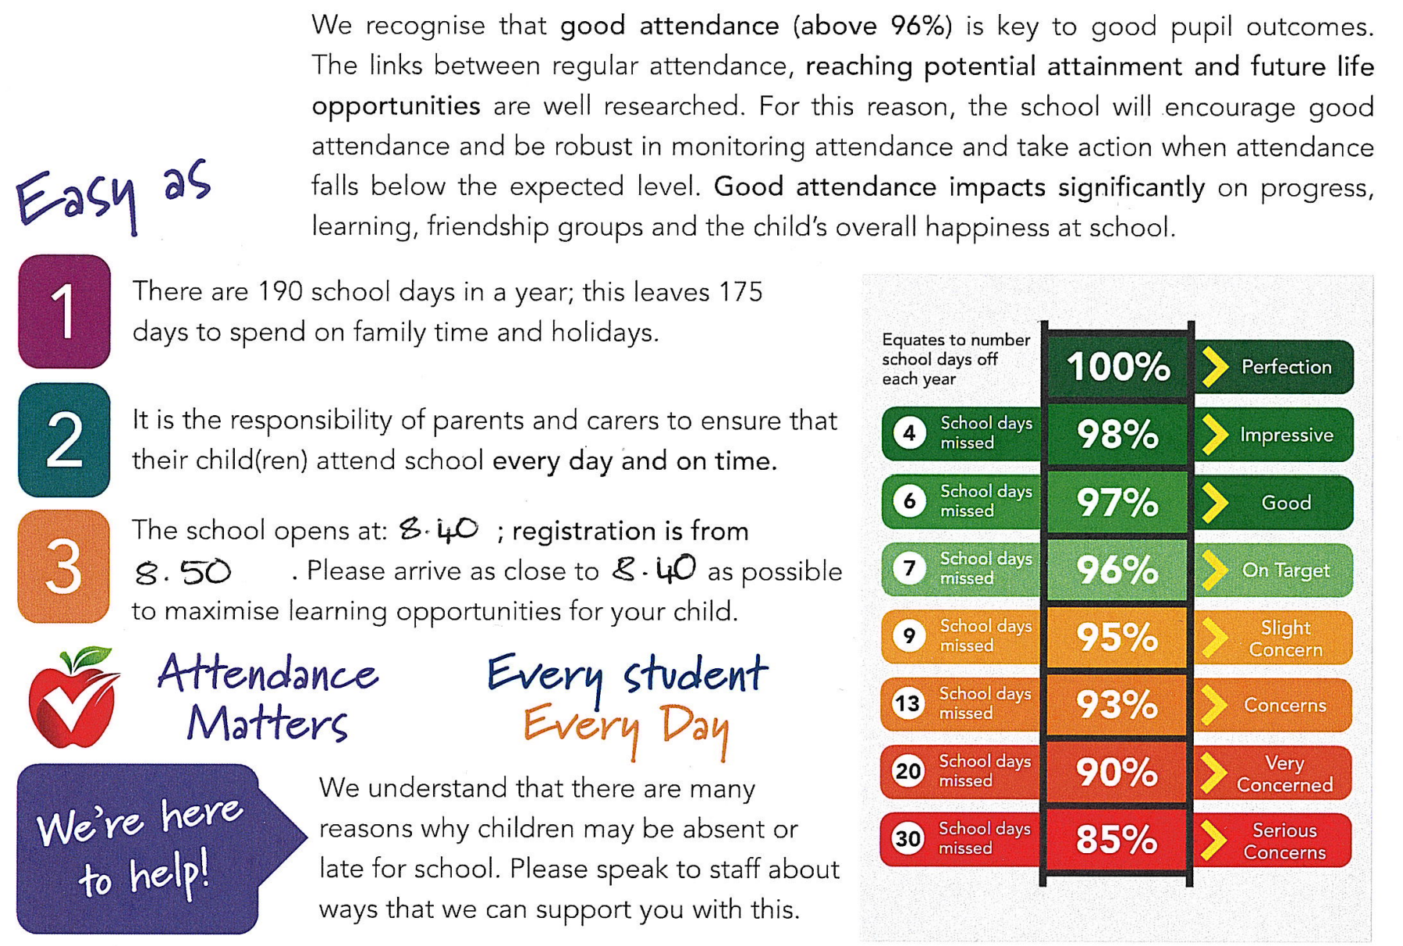
Attendance

Slide 5
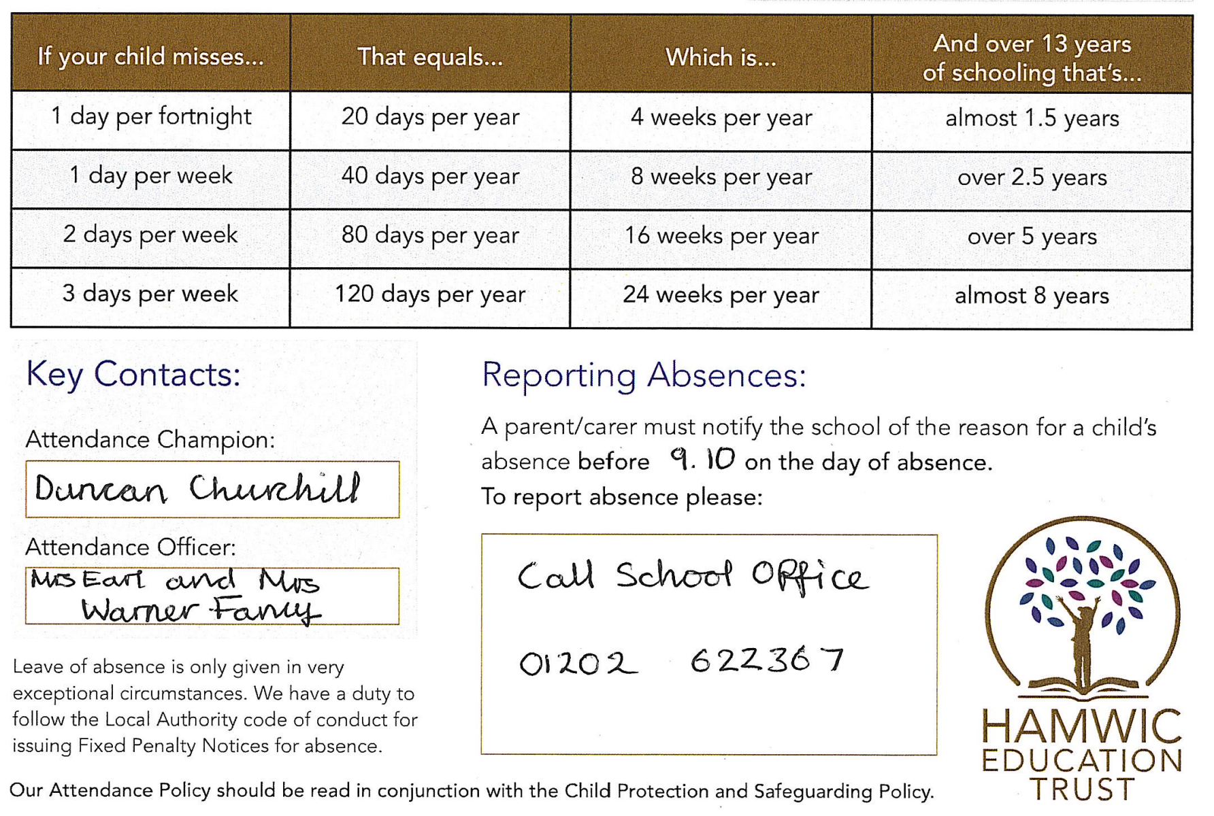
Attendance

Slide 6
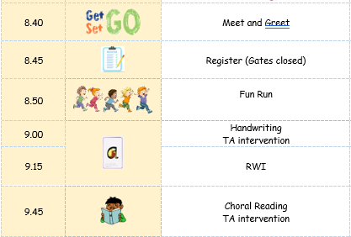
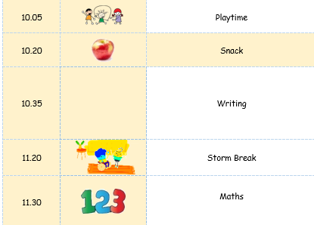
A day in Year 0ne
Morning

Slide 7
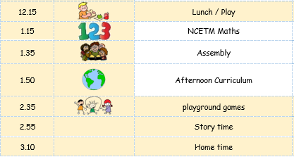
A day in Year One
Afternoon

Slide 8
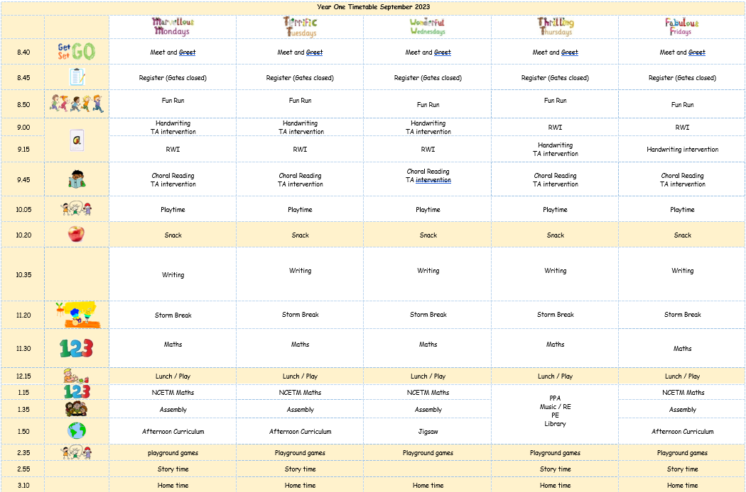
Weekly timetable

Slide 9
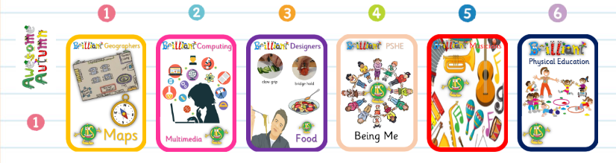

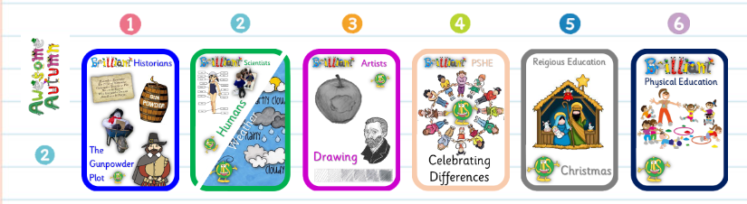

Our Autumn Learning

Slide 10
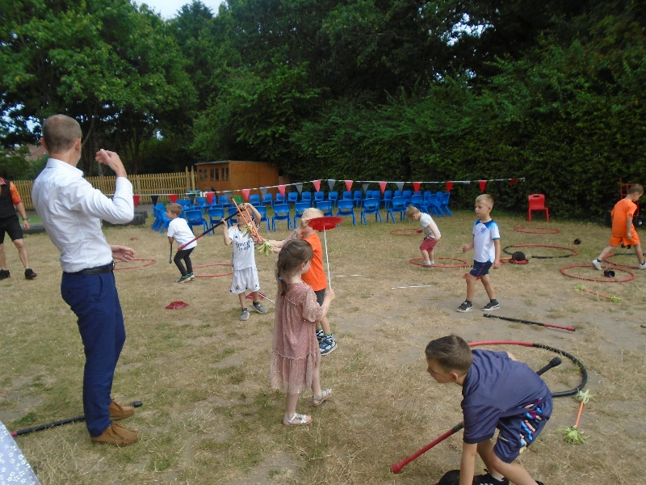
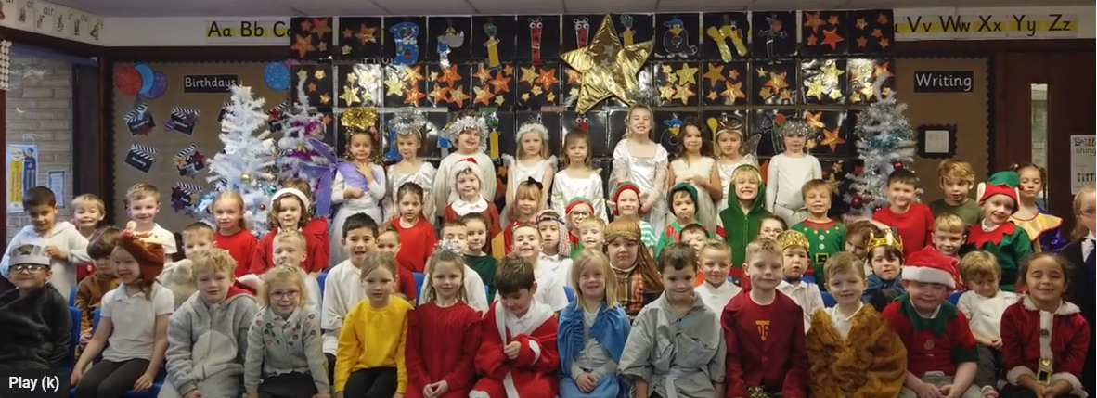
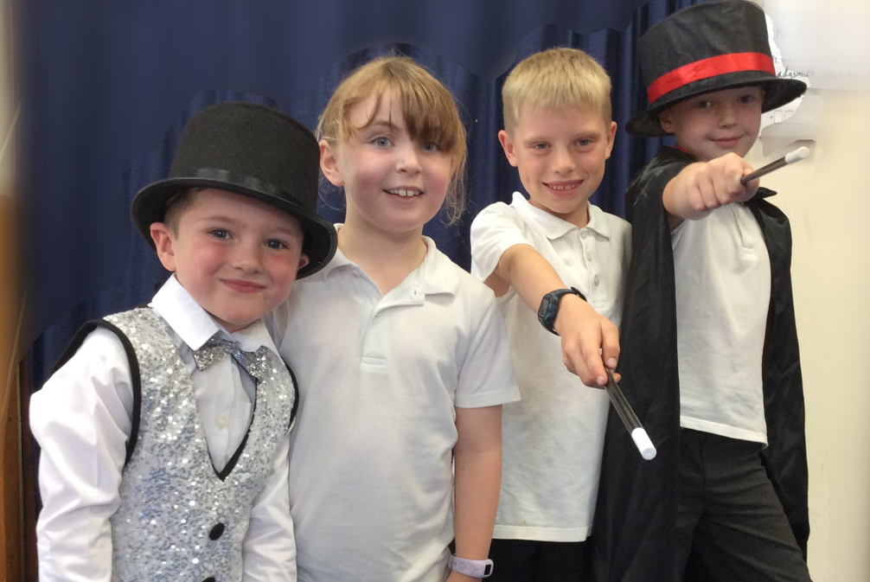
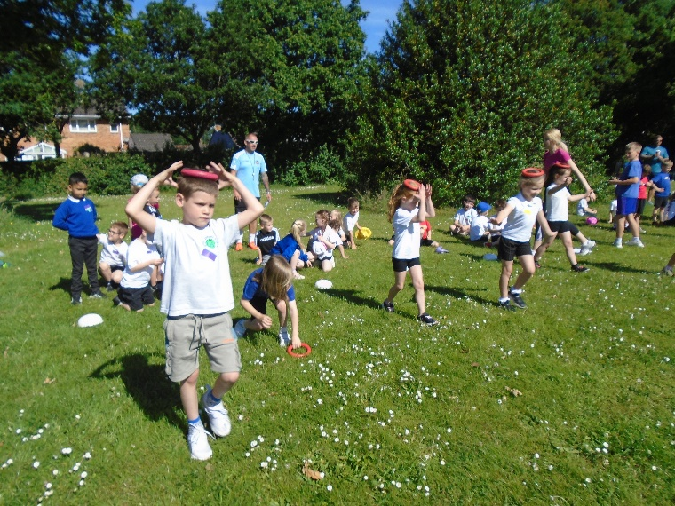
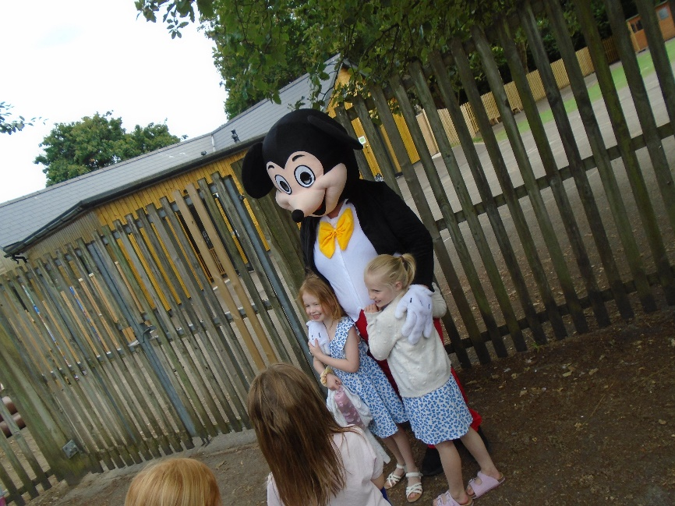
The year in a nutshell

Slide 11
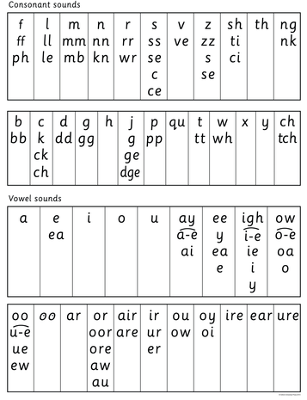
Phonics
As a school we follow RWI as a scheme to teach the children how to read. Read Write Inc includes a series of decodable storybooks that allow your child to practice reading words in sentences.
Your child will receive a Read Write Inc book with homework on a Thursday.
If your child is ‘off scheme’ they will be provided with a colour band book (assessed at their level) on a Thursday.
Books are changed on a Thursday.
Please can children bring their reading folder into the classroom first thing.
On a Thursday we count how many times your child has read at home. Please can they bring their reading diary and spelling book into the classroom.

Slide 12



Reading
In your child’s book bag, you should find a learn to read book from RWI or a scheme, love to read book from the library and a reading diary.
We would like your child to read at home at least 3x a week. Please record this in the diary. Please don’t feel like you have to write lots, a short comment or smiley face is fine.
It is still highly beneficial to continue reading to your child, even when they are able to read longer books for themselves. We love hearing about the books you share.
You can still collect book bugs – complete 4 double pages of the diary to earn your bug.
The reading raffle - any child who consistently reads 3x or more per week will get entered into a reading raffle for a prize.
Learn to read books and Love to read books will be changed on a Thursday.

Slide 13
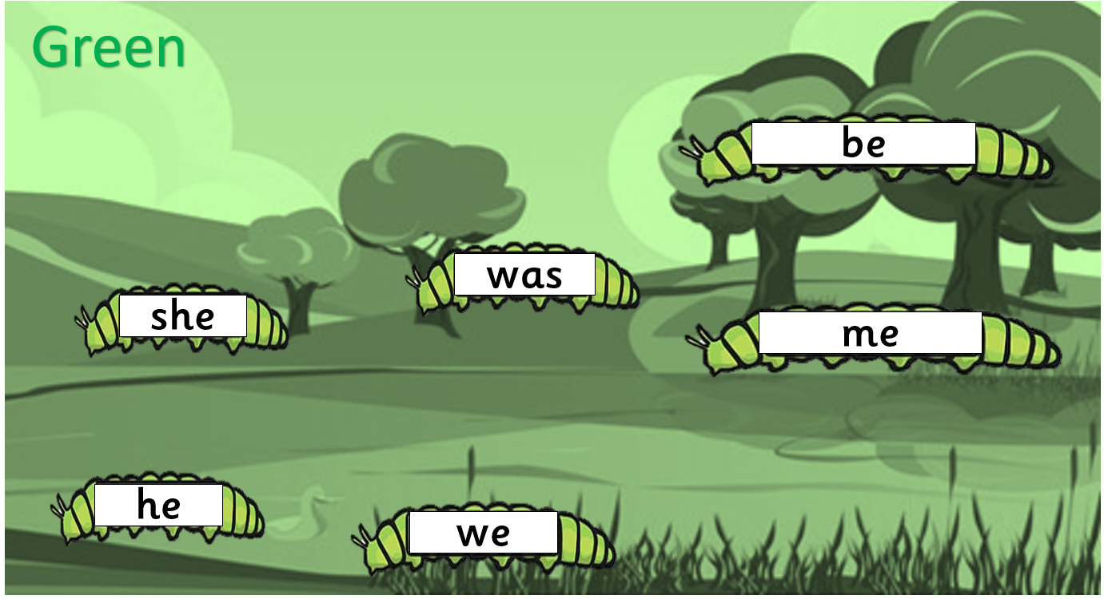
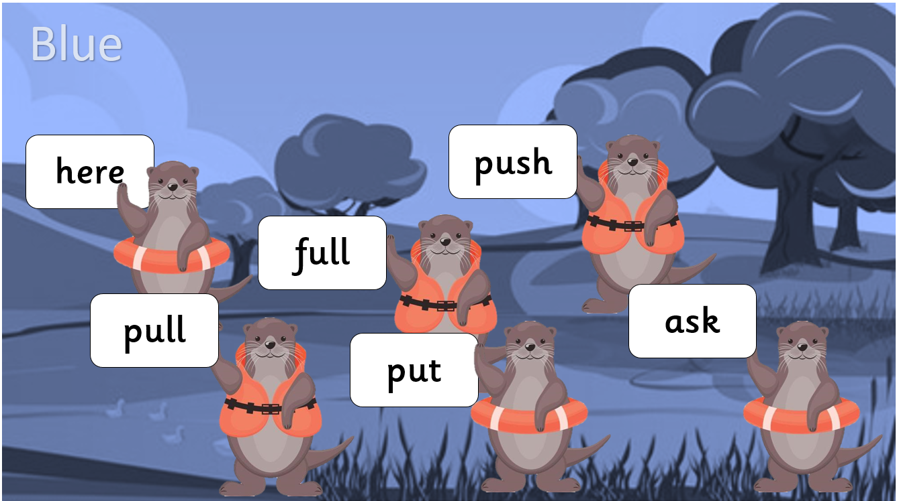
Spelling
Read, Write Inc. home learning sheets
Homework is sent home on a Thursday. It helps embed the learning taken place that week.
Common exception word cards
Common exception words are words that do not following regular spelling patterns. The government set a list for Year One and Two to learn. If you have practised with your child at home and are you are confident that they can spell all the words correctly, please let us know and we will give them the next card. We will also practise these words in class.

Slide 14





Writing
Writing is usually linked to an engaging text.
Often this will be over 2/3 weeks.

Slide 15
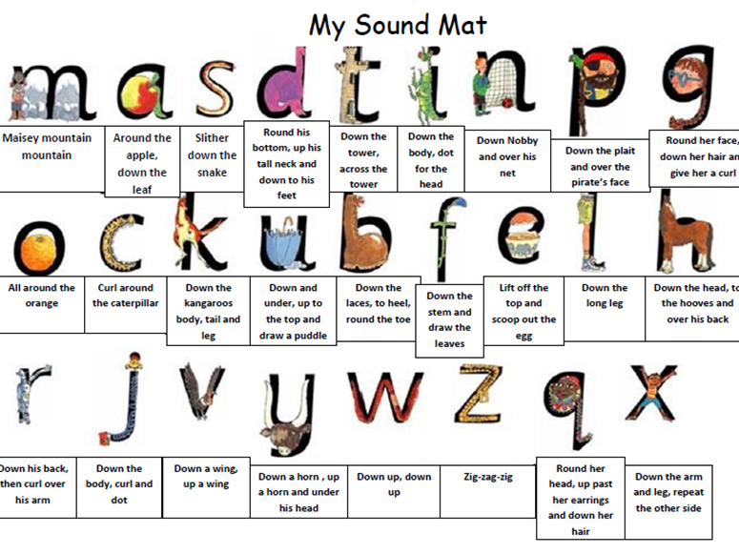
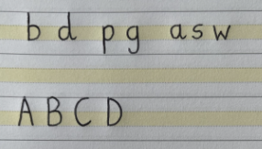
Writing
The children are taught to form their letters correctly using rhymes and visuals linked to our Read Write Inc scheme. We have created videos on our YouTube page to support this.
We use yellow lined paper in our school to help the children form capital letters, ascenders and descenders correctly.
https://www.youtube.com/@uptoninfantschoolletterfor2792

Slide 16
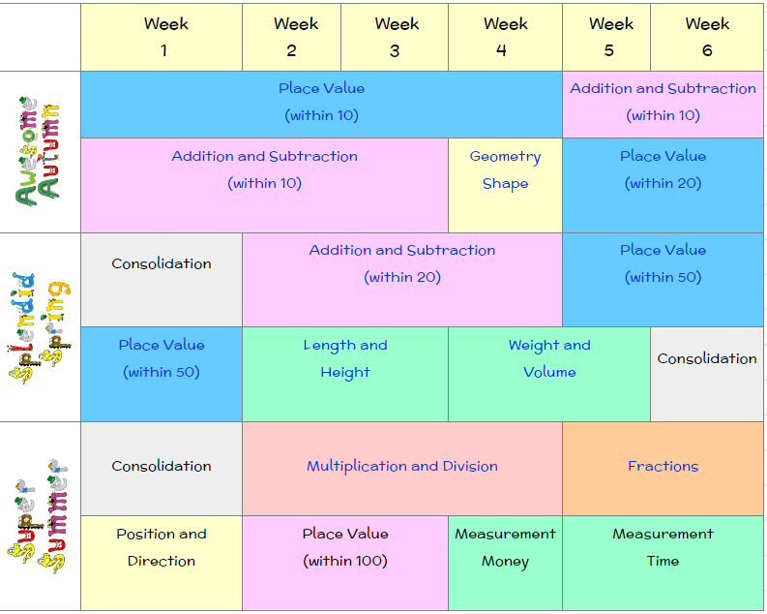
Maths

Slide 17
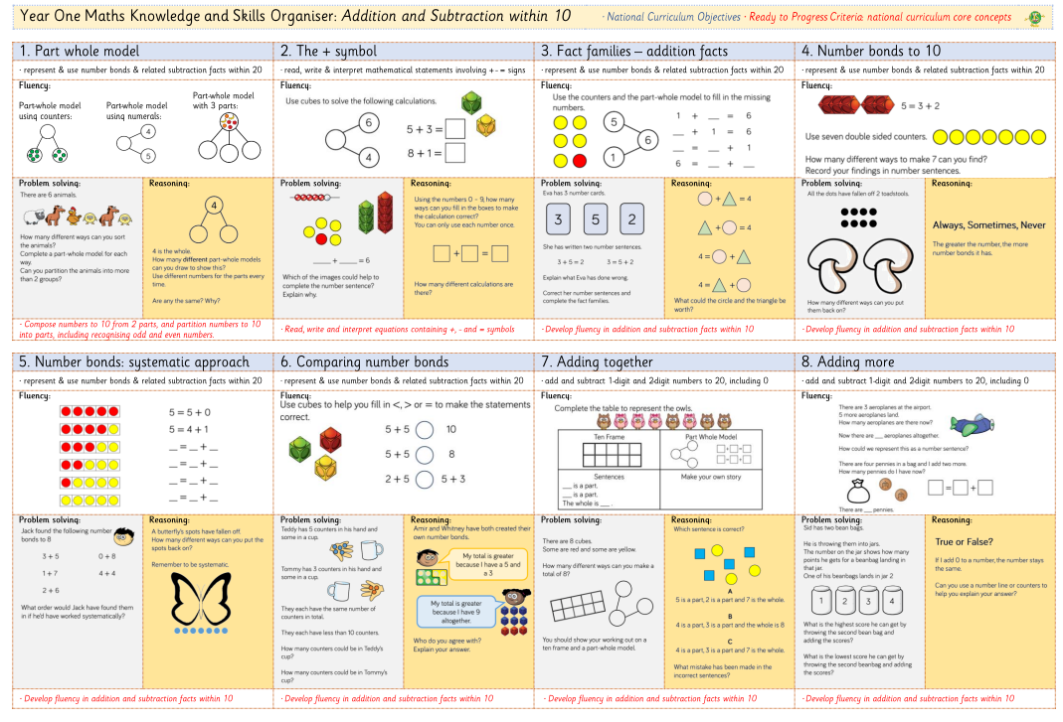
Maths

Slide 18
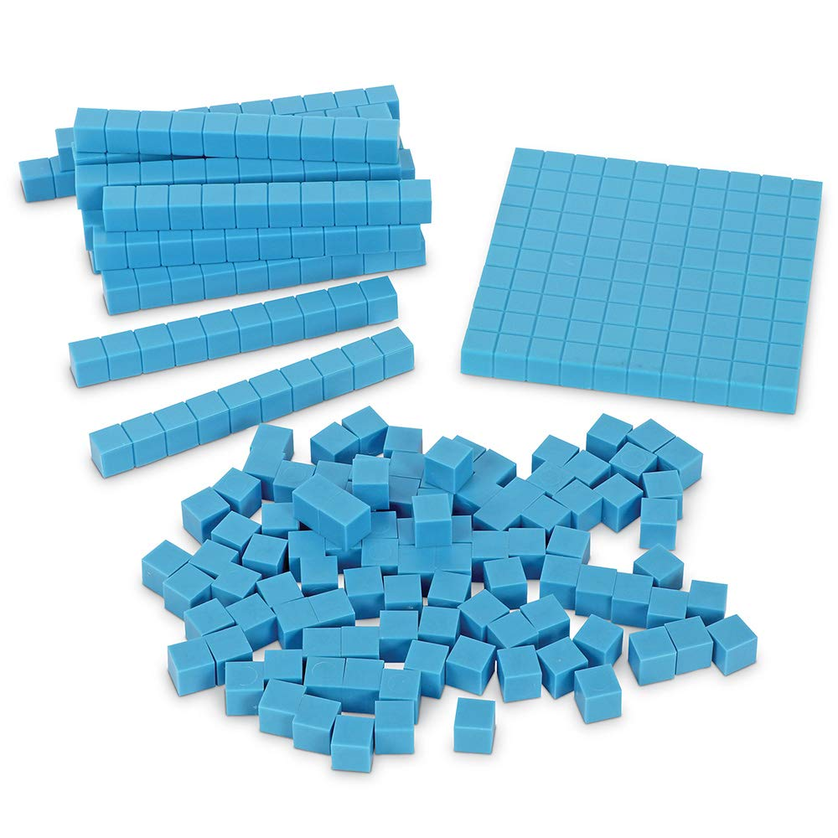

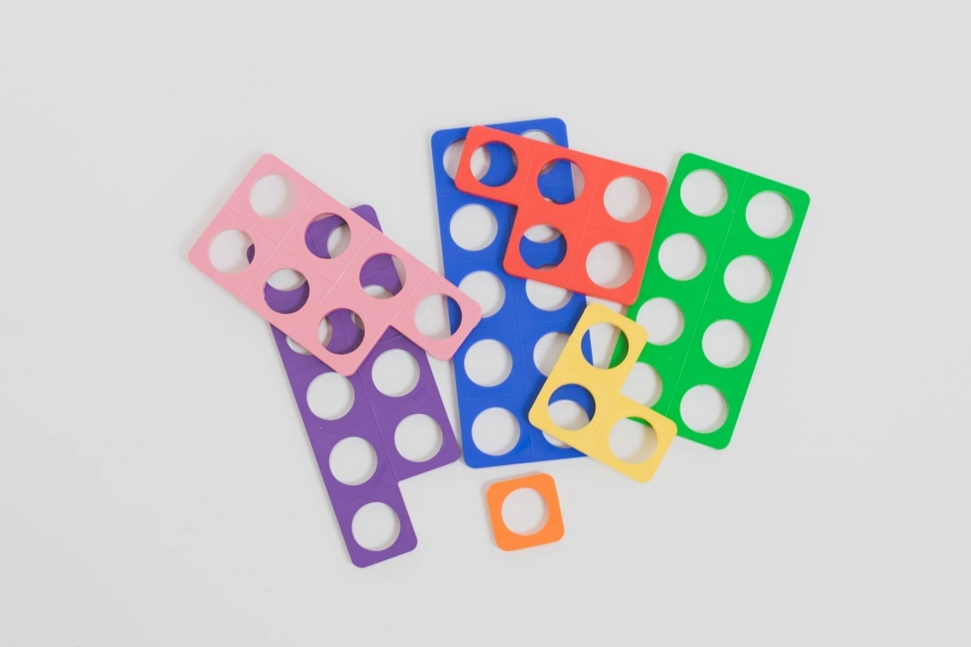
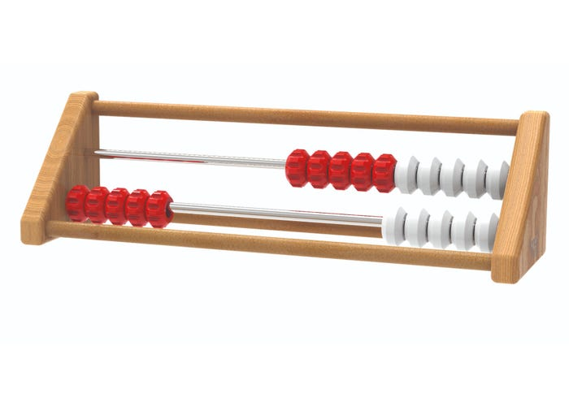
Maths

Slide 19
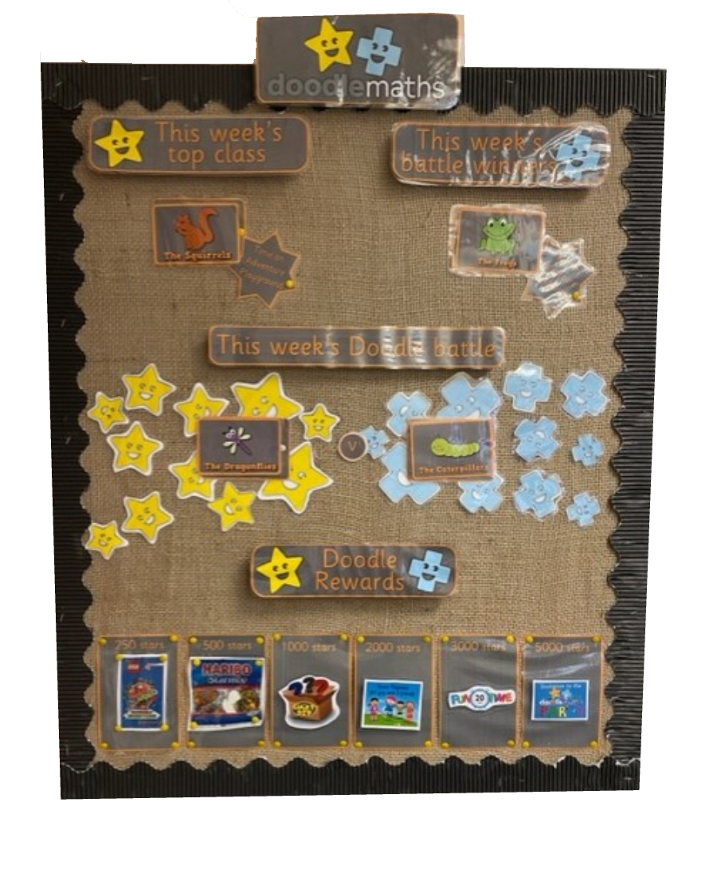

Doodle Maths

Slide 20

Assessment
In Year One, teachers assess children in a number of ways: live marking, questioning, formal and informal assessments, interventions, quizzes and quick tests etc.
Children are awarded PKS/WTS/EXS/GDS for each term. This determines whether a child is on track for their age.
Phonics screening (Usually takes place at the beginning of June)

Slide 21
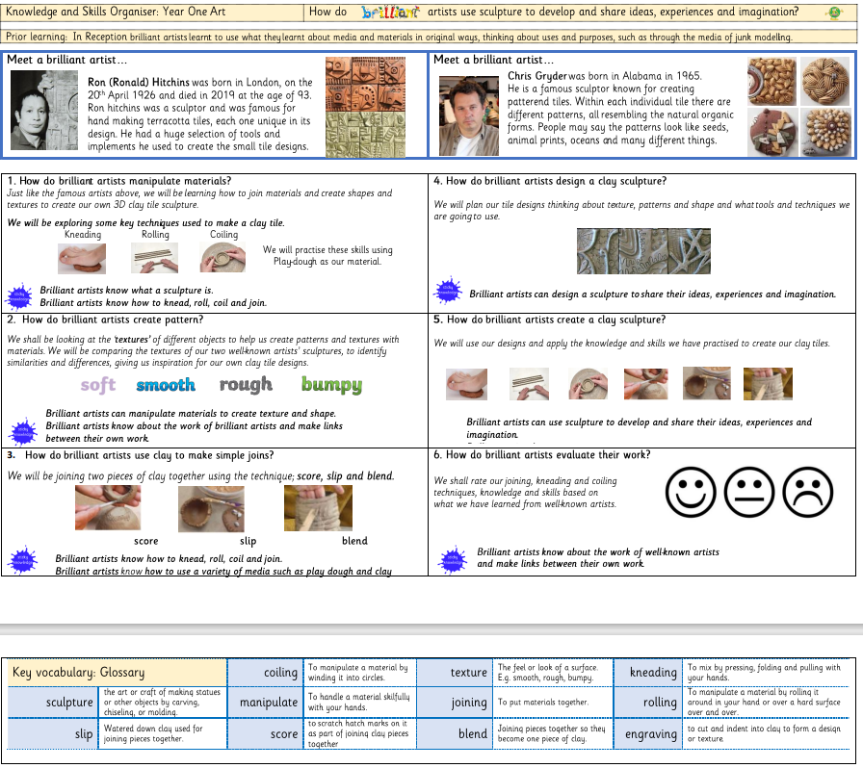
Approach to learning
We have created knowledge organisers for each subject. The purpose is to clearly outline learning outcomes and highlight progression of learning throughout your child’s school journey.

Slide 22
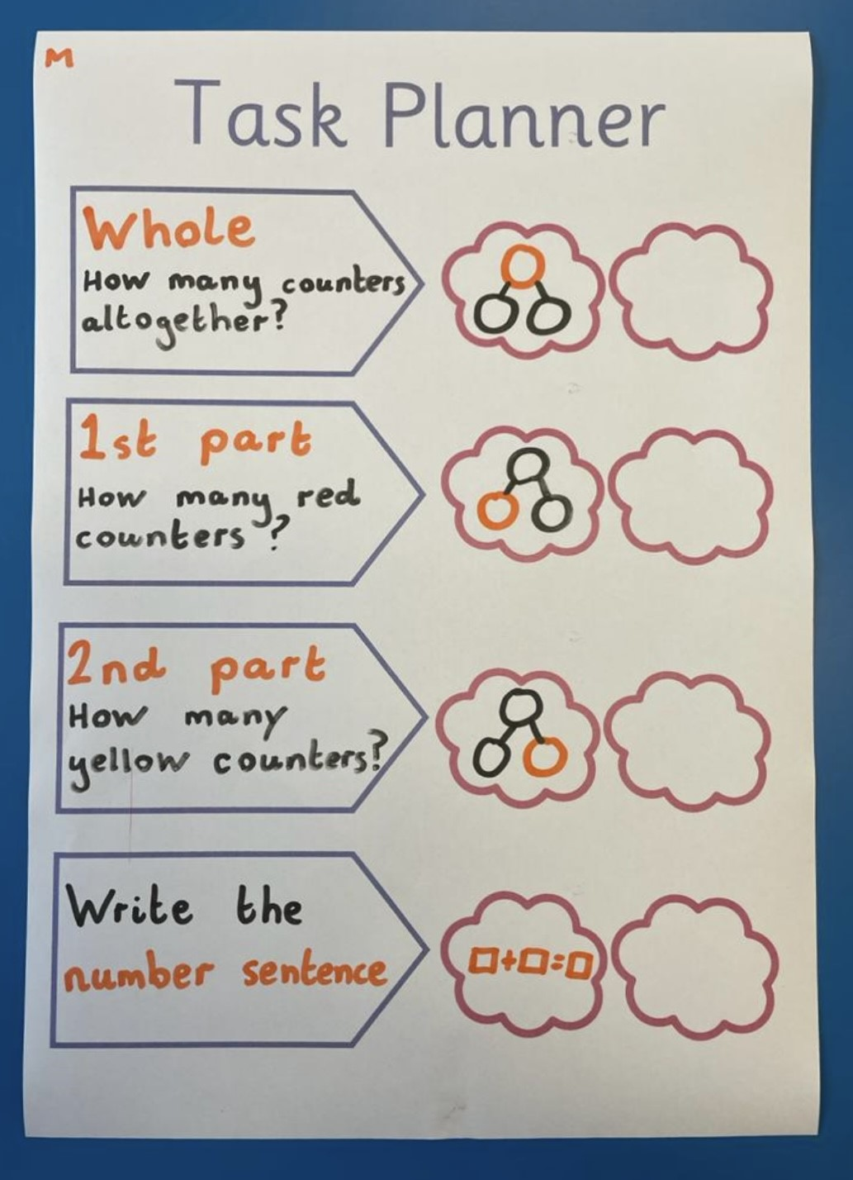
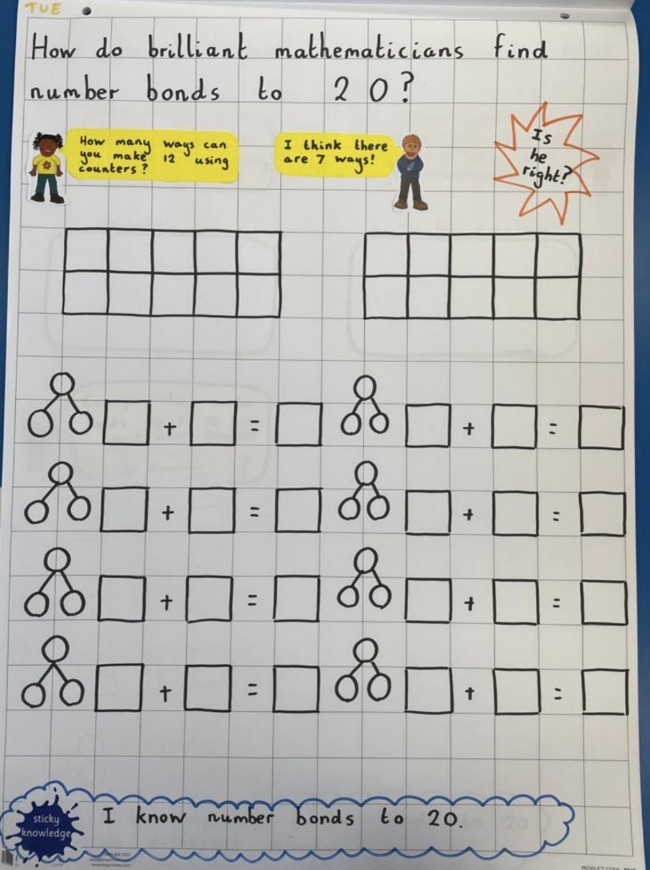
Approach to learning
We use visual flipcharts to support learning. Each flipchart has a question linked to the learning outcome and key vocabulary.
We also use visual task planners so the children are able to follow each step. Our aim is to reassure the children with their learning and promote independence.

Slide 23

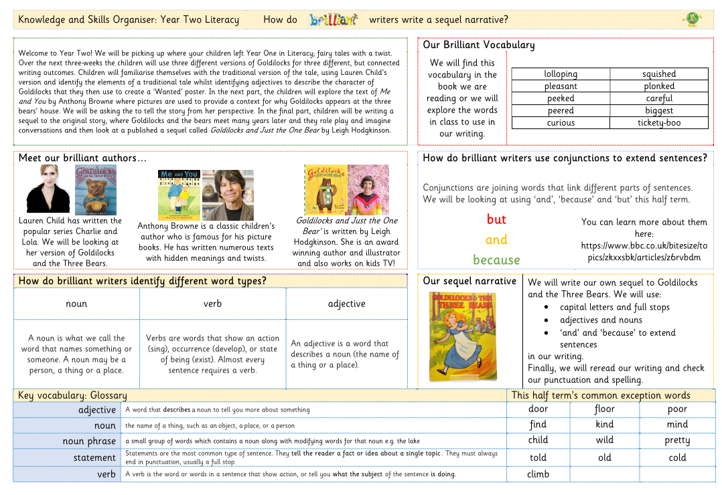

Home learning
Reading – 3x a week
Doodle Maths – Little and often!
Knowledge organisers –find them on the website

Slide 24
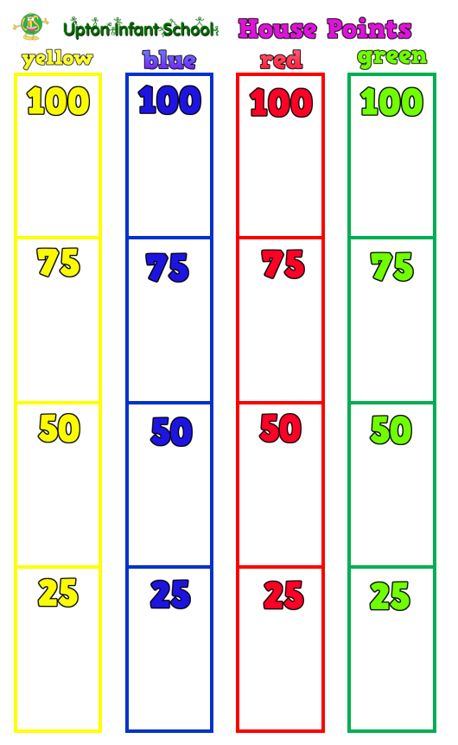
House points
Children are in one of four houses
They earn house points for being
- Ready
- Kind
- Responsible
They also earn points for excellent work
When a house earns 100 points, they earn a treat

Slide 25
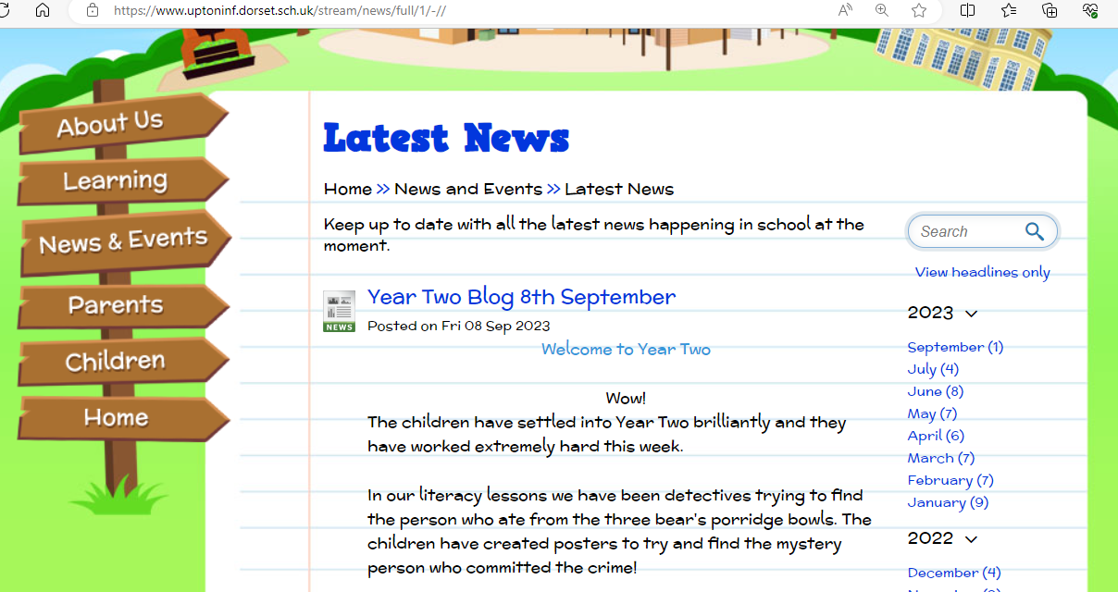
Information
There are a number of ways you can find out important information at our school.
Website: www.uptoninf.dorset.sch.uk
My Child at School (Bromcom)
Facebook
Email: office@uptoninf.dorset.sch.uk
Speak to us! (but after school is best)

Slide 26
Dates
Parents Consultations
23rd October & 24th October
12th February & 13th February
Christmas Concert
Tuesday 17th & Wednesday 18th December @ 1.30pm
Sports Day
19th June

