Slide 1


‘Belonging, Growth, Excellence.’

Slide 2
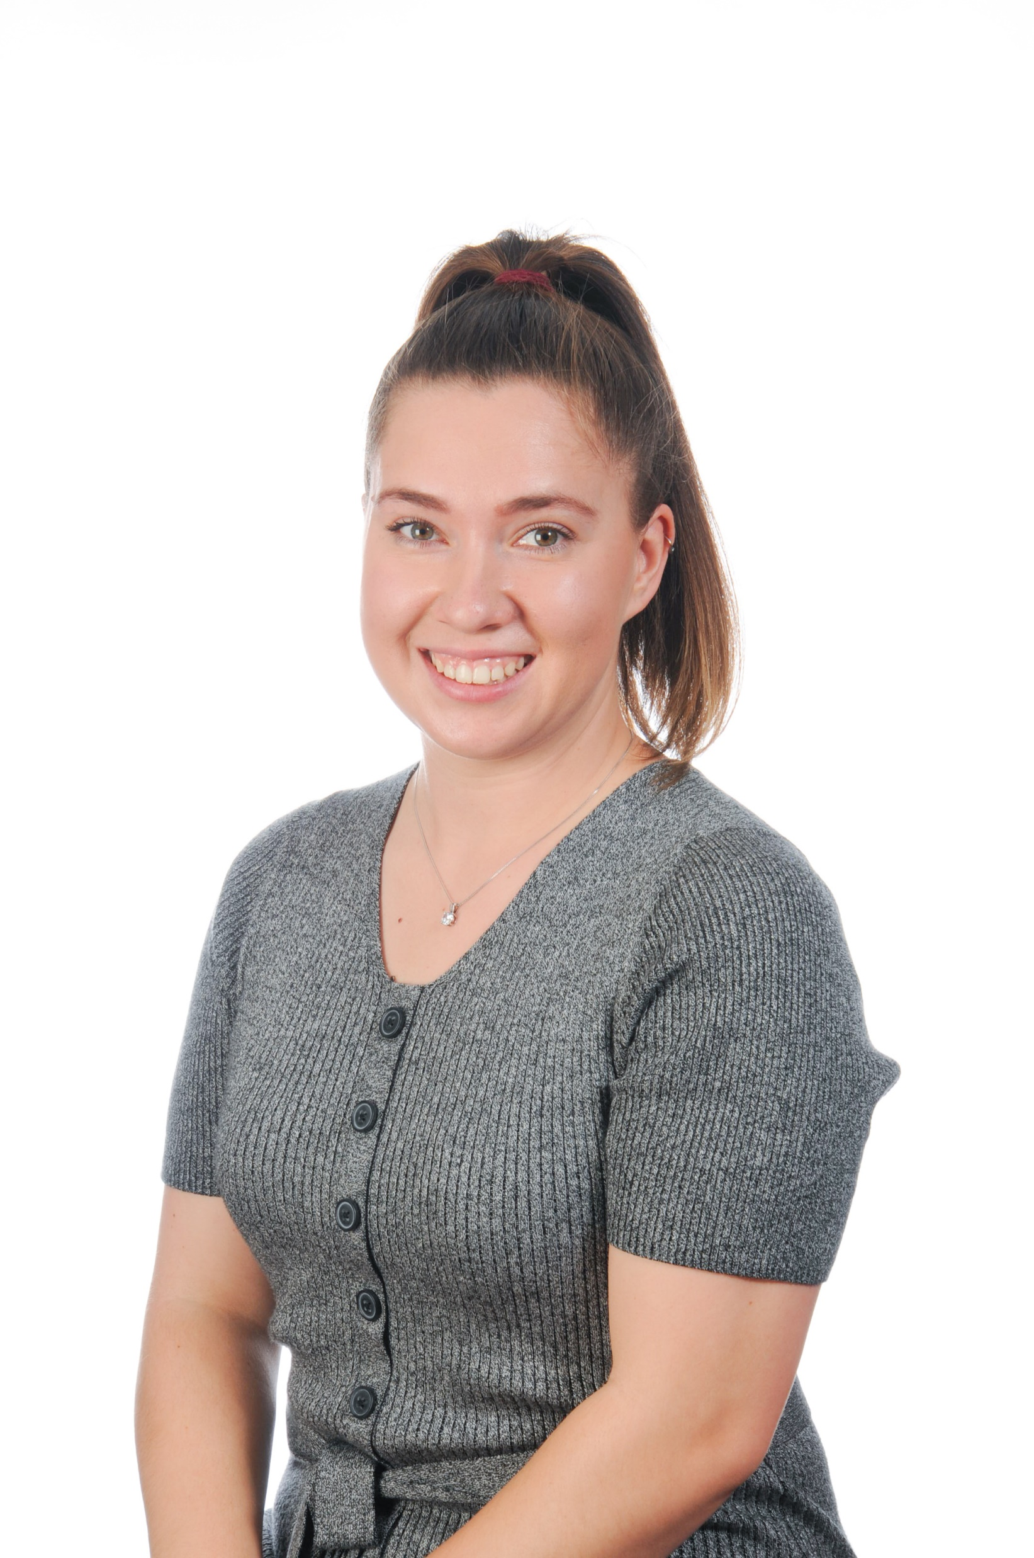
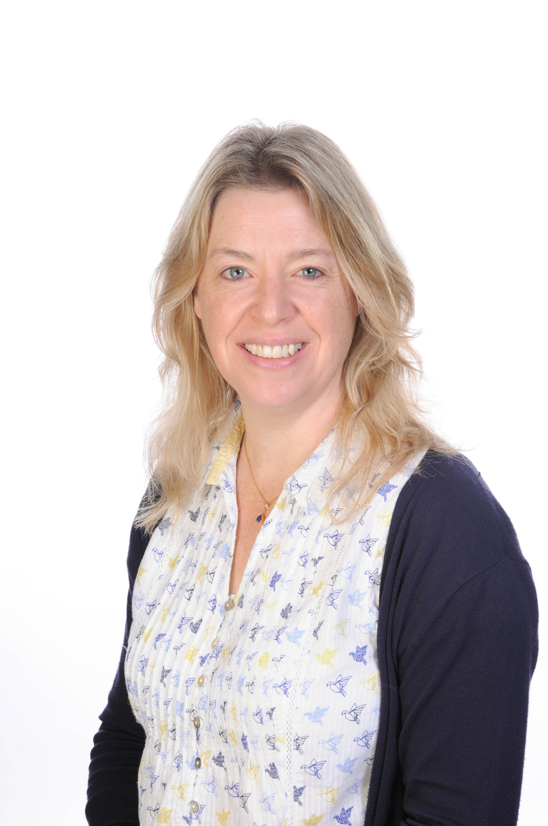
Meet the team
4 Alpacas
4 Pumas
4 Sun Bears
Miss Almond
Mrs Perry
Mrs Ramsden

Slide 3
Our TAs
Mrs Rickeard
Mrs Huxter
Mrs Buckland
Mrs Renshaw
Mrs Hares

Slide 4
School values
An Upton Junior child is…
Aspirational
Resilient
Curious
Notes:
Each week in celebration assembly we will be choosing a child to get the ARC certificate. This will be for someone who has shown that they are aspirational, resilient or curious.

Slide 5
New this year!!
Each week, we will be picking a VIP in our classes. These will be chosen on a Friday and the adults at home will be emailed. Then, the whole of the following week, that child will be celebrated as our VIP and get certain privileges and a special badge to wear. We will be asking them to bring in 5 things about themselves - these could be pictures, objects, photos, notes.... and they can then share these with their class.

Slide 6
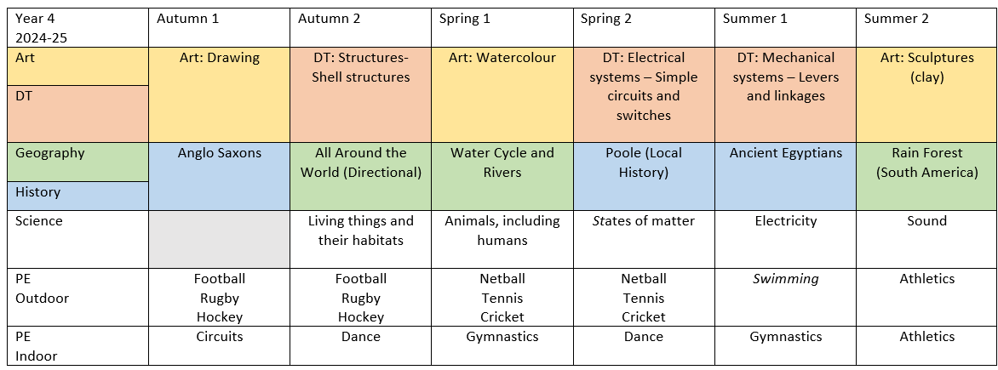
Curriculum Overview
Here are some of our main topics in Year 4.
Notes:
Autumn 1: Anglo Saxons; Ancient Technology Centre. This will cost, letter to come out shortly
Spring 2: Poole (local history); Maritime Archaeology and Trade in Poole
Summer 1: Swimming (free)
Summer 2: Pottery/clay workshop (free/small fee)
If you or anyone you know would be open to coming in and helping us with any of our topics, we would love to hear from you.

Slide 7
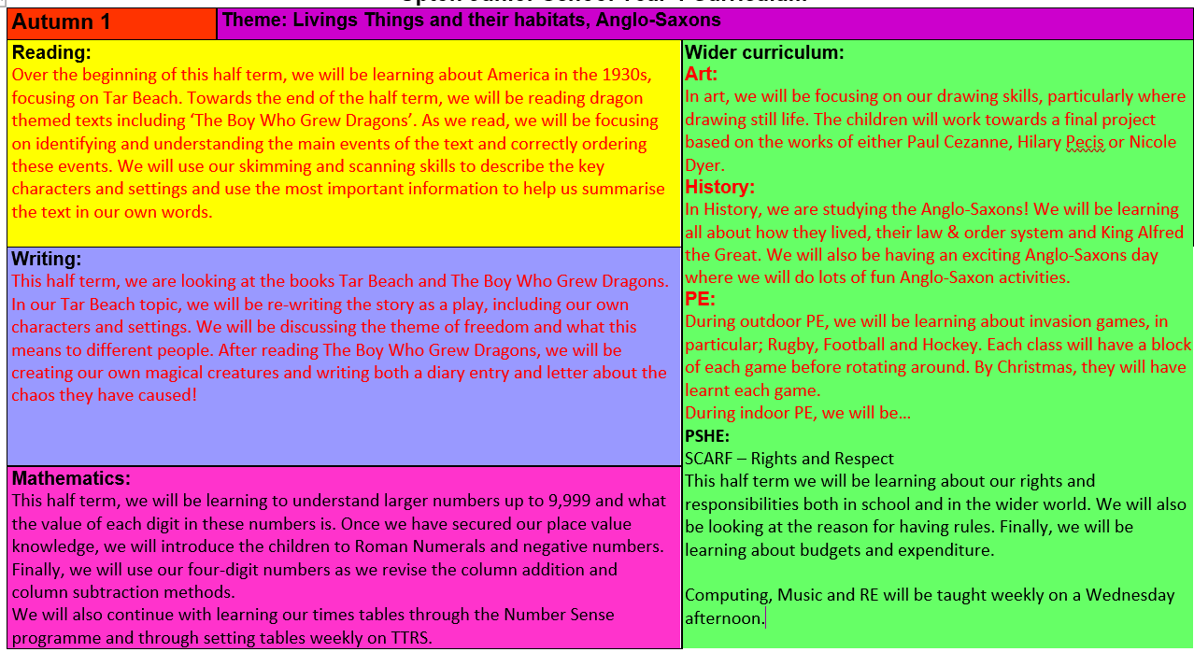
Alongside this presentation, the Autumn 1 overview will be uploaded onto the school website. This will inform you of the skills that we will covering for the core subjects and the wider curriculum.
If you have any further questions regarding the delivery of the curriculum, please ask.
Notes:
Year group page = half-termly overviews uploaded with more details.
Computing, Music & RE taught weekly on a rotation

Slide 8
Organisational Information
Our day looks like this:
Timings | Lessons
08:40 – 08:50 | Arrival and registration
09:00 – 09:30 | Lesson 1
09:30 – 10:40 | Lesson 2
10:40 – 10:55 | Break
11:00 – 12:15 | Lesson 3
12:15 – 13:15 | Lunch
13:15 – 15:15 | Lesson 4 and 5
Notes:
L1/2 – Reading and Writing
L3 – Maths & times tables
Grammar and Spelling will also be incorporated into these lessons.
We also have assembly on a Mon/Weds/Fri.
L4/L5 – Broader Curriculum Subjects

Slide 9
Homework and PE
Day | Requirements
Monday | Library book change
Tuesday | PE (outdoor) (earrings removed or taped)
Wednesday | Spelling test, new spellings taught and given out.
Thursday | PE (indoor) (earrings removed or taped)
Friday | TTRS due, 3x reads in reading records
Notes:
Reading Awards
CLASS CUP – class with highest % of 3x read given out weekly.
TTRS CUP – class with highest % of completed TTRS given out weekly
CLASS PRIZES/HPs – reading records (if have 3 entries in reading record)
HOUSE POINTS – class teacher arranges
HOMEWORK CLUB – TBC

Slide 10
Organisational Information
Our weekly set-up
Reading Records | Reading logs should be brought into school on Friday. Please make sure at least three entries are signed by a Friday. Children should also bring in any library books to be changed for our library visits on a Monday.
TTRS (Times Tables Rock Stars) | Weekly sessions will be set from Friday 3:30pm until the following Friday at 8:30am. This will be 20 minutes of ‘Garage’ per week. The children have time on a Monday afternoon to start these and time available in the IT suite on a Tuesday lunchtime.
Games and PE | Outdoor PE will be on Tuesdays, indoor PE sessions will take place every week on a Thursday afternoon and Children should wear PE kit to school on these days. Hair must be tied back and earrings must be removed or covered during PE. No other jewelry is allowed. Correct PE kit with a plain black jumper and/or jogging bottoms for warmth during colder months.
Notes:
No dangly earrings – studs only
TTRS 3.30 Fri until 8.30am following Friday
Ed Shed 3.30 Fri until 9am following Friday – spelling children have been assessed on their knowledge of Y2/3 words and placed accordingly. We will reassess them just before Christmas and regroup if needed.

Slide 11

Spelling Shed
Weekly spelling tests will continue this year. Spelling Shed logins will be stuck into children’s reading records. This will be where your child can access their weekly spellings.
We also send home a spelling list with your child each Wednesday so please ask them for it!
Notes:
We have already carried out a diagnostic assessment for Spelling and children will be grouped according to their ability.
Each week will get homework set on Ed Shed. Most children will get 10 words to learn, we will be learning the same words in school alongside homework during the week. We will test on a Wednesday.
New spelling will go live every Wednesday.

Slide 12
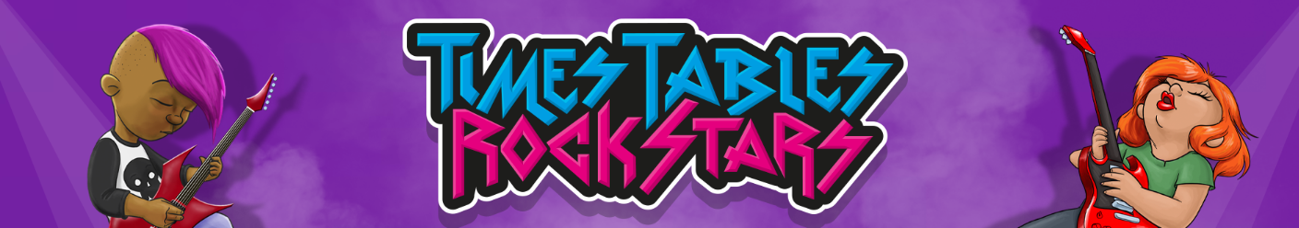
Times Table Rockstars
At the end of Year 4 (June), every child will be asked to complete the Year 4 Multiplication Check (MTC). This is a statutory requirement and the purpose of the MTC is to make sure the times tables knowledge is at the expected level.
The MTC is an online test where the pupils are asked 25 questions on times tables 2 to 12. For every question you have 6 seconds to answer and in between the questions there is a 3-second rest. Questions about the 6, 7, 8, 9, and 12 times table come up more often.
Therefore, it is really important that all children are completing TTRS weekly and learning their times tables.
Notes:
Garage – 20 mins per week. 5x m/o teaching times tables per week. TTRS Mon pm in school,
Adapted to the times tables that they are on
Will include multiplication and related division facts
Intervention for those that are struggling.

Slide 13
Other Information
Scooter and Bike permits: Please contact the office for a bike/scooter permit. We do encourage that children walk to school where possible (especially with the closure of St. Martins Road). Bikes and scooters are not to be ridden between the caterpillar and the school grounds due to large numbers of pedestrians in this area.
Medication: Any medication required to be administered in school must be given to the office by your child, and a school medical form must be completed. Please ensure inhalers in school are in date.
Phones: Your child must have permission in order to bring a phone into school. A form needs to be completed and brought back into school. Then, your child’s phone will be kept in the office. This is the same for any other electronic devices, including smart watches.
Notes:
Please contact the office about any of the above.

Slide 14
Contacting us:
Miss Almond: 4alpacas@uptonjun.dorset.sch.uk
Mrs Perry: 4pumas@uptonjun.dorset.sch.uk
Mrs Ramsden: 4sunbears@uptonjun.dorset.sch.uk
Office: 01202 622649
office@uptonjun.dorset.sch.uk
We will do our best to respond within 48 hours. Please bear with us. If it is urgent, or relates to that day, please contact the office.
Notes:
Facebook pages – useful but remember we are not on them!

Slide 15

Website
Notes:
Year 4 Page – key information, including this presentation.
Photos from main events
Curriculum overview for year
Termly overview
Useful links

Slide 16

Any questions?
Notes:
Before I send you in the direction of your child’s classroom, does anyone have any questions?

