Slide 1
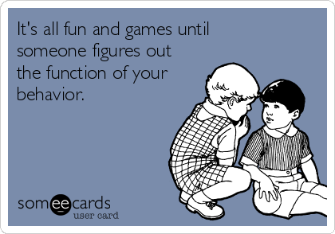
How can I learn to “listen” to behaviour?

Slide 2
Think about the differences between these 2 sets of assumptions, and the impact this will have.
Assumptions about learning errors
Assumptions about behaviour errors
Errors are accidental
Errors are inevitable
Errors signal the need for teaching
Students with learning difficulties need to be taught differently
Errors are deliberate
Errors should not happen
Errors should be punished
Students with behavioural difficulties should be punished

Slide 3
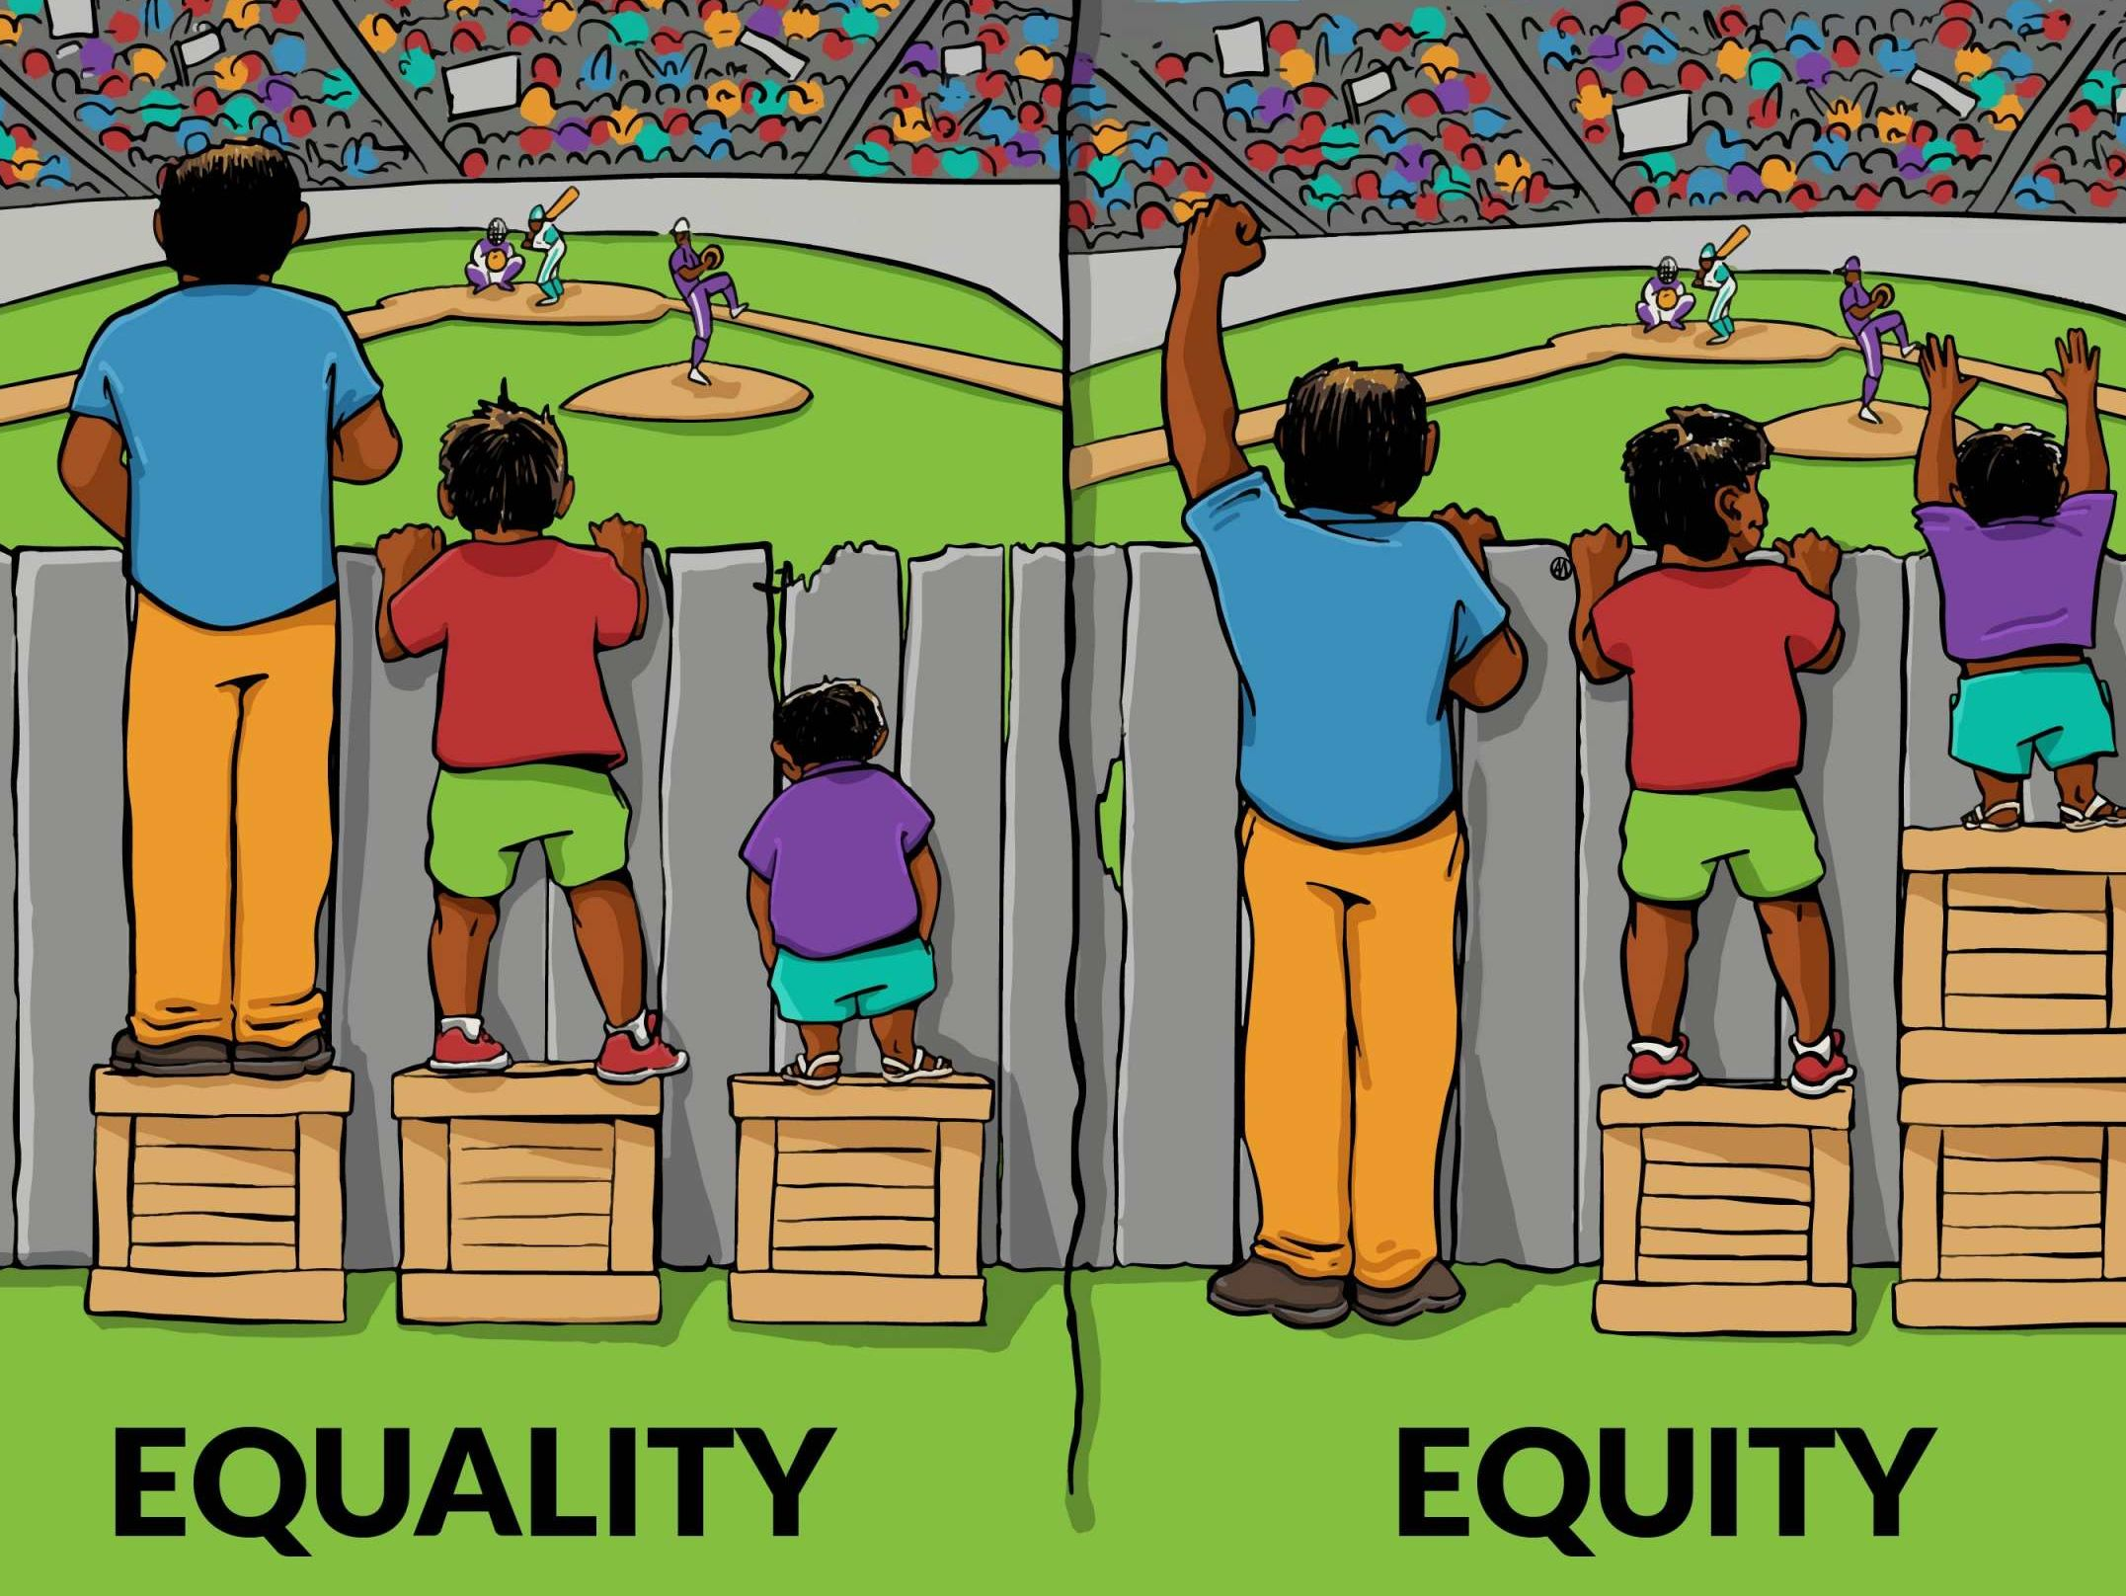

Slide 4
What is behaviour?
Discussion
Battery Bar Timer! Full Screen! (online-stopwatch.com)

Slide 5
What is behaviour?
The way in which one acts or conducts oneself, especially towards others:
"he will vouch for her good behaviour" ·
The way in which an animal or person behaves in response to a particular situation or stimulus:
"the feeding behaviour of predators"
The way in which a machine or natural phenomenon works or functions:
"the erratic behaviour of the old car"

Slide 6
Behaviour is Communication
Quick discussion: how, without saying anything, do you let your nearest and dearest know you are not happy with them?
Battery Bar Timer! Full Screen! (online-stopwatch.com)

Slide 7
Communication
Activity: on your table, discuss how babies and toddlers tell you what they need or want.

Slide 8
Behaviour IS communication
For young children, or children with additional needs, particularly those with a language development and/or a social communication need, what they DO may be the best way- or sometimes the only way- they can communicate with you.
So, learning to “listen to” behaviour and answer the questions the communication is posing is the best way to change difficult behaviour.

Slide 9
Behaviour Has a Purpose
Behaviour is a form of communication that can convey an important message. There is always a reason for the way we behave.
At times behaviours may be viewed as challenging to manage. However, behaviours don’t happen because the person is intentionally trying to be ‘difficult’, and they generally don’t “come out of the blue” even if the cause isn’t immediately obvious. Challenging (or distressed) behaviour often indicates that the person is unable to cope at that moment and can’t express why in a typical way. It’s frequently the result of a clash between the demands of the situation and the person’s skills to respond, and is influenced by how they feel, what’s happened before and what is happening around them at the time.
The impact of these behaviours is what makes them challenging, both for the person and those around them.
Understanding Behaviour - Autism Association of Western Australia

Slide 10
Functions of behaviour
Working with children and young people means we follow the convention that all behaviour serves a function, and that part of our job is to identify that function.
Once we have identified the function, we can address the need.
Sometimes behaviour is inappropriate but becomes labelled as ‘bad behaviour’. However, this CHALLENGING or DISTRESSED behaviour is also serving a function
Notes:
Why use challenging behaviour? No other way of communicating, or not listened to when using other wats?

Slide 11
Remember:
It’s the behaviour that is challenging, not the person.
There is always a reason for behaviour. If we want to change a behaviour, we first need to explore why it is happening and understand the function it serves for the person.
Just because behaviour has a purpose, doesn’t mean it’s being done on purpose.

Slide 13
Being a behaviour detective
Understanding behaviour

Slide 14
Why?
If you don’t understand WHY something is happening, the underlying cause cannot be addressed.
The behaviour will remain.

Slide 15
Possible reasons for pupils to display challenging behaviour
Problems understanding
Difficulty getting your message across
Physical pain or being under the weather
Unmet basic needs – toilet needs, thirst, hunger…
Fatigued or lethargic
Effects of medication
Specific medical conditions
Inability to self-regulate body temperature and sensitivity to physical feelings – sweating or restrictive clothing
Sensory processing differences – noise, visual, taste over or under stimulation
Sensory overload
Unmet sensory needs
Proprioception and personal spaces requirements
Unexpected people, places and events
Understanding of social rules
Social isolation and misunderstood attempts at social contact
Others misunderstanding of child’s needs
Anxiety
Incorrect differentiation, boredom, lack of opportunities to explore special interests
Notes:
Discuss that even very able young people may not be able to articulate these all the time, particularly if anxious
Arguments with partners

Slide 16
Brain responses
Limbic vs cortical response
The “wild brain”: fight or flight
Limbic System

Slide 17
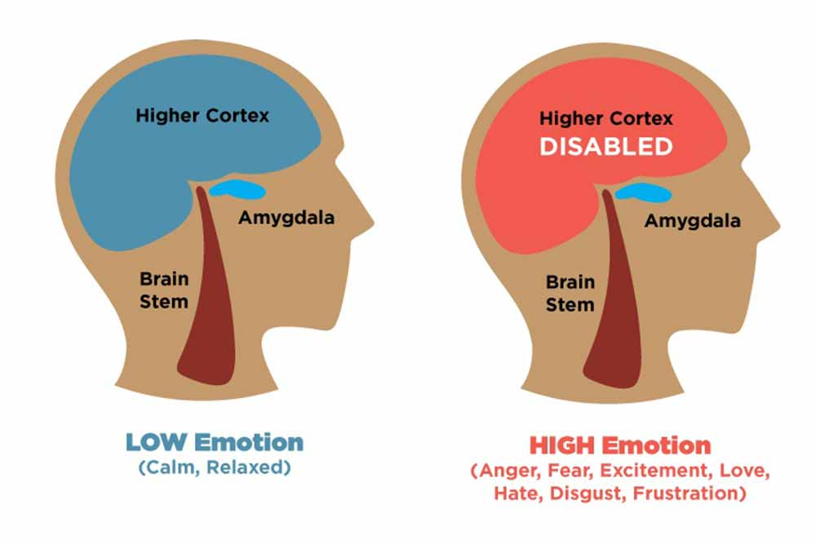

Slide 18
“Wild Brain”
Once behaviour has escalated past the orange into the red and black zone, it is important to remember that this is not the time to try reason with, explain to or try rationalize with our child. This state can be called “Wild Brain”: it has no reasoning, logic, memory, decision making.
When someone is in “Wild Brain”, we revert to the basics.
Are they safe?
Am I safe?
Is there a safety plan to refer to?
Is there a soothing strategy that can be implemented?
Wait for the behaviour to pass, do not engage them in this state and do not let people who don’t the child interfere.
Avoid any behaviour that can seem threatening, like body posture, eye contact, getting too close, raised voices: do not confront them.

Slide 19
There are 4 main functions of behaviour: SEAT
Sensory sensitivities or input Behaviour that challenges others may occur when it is rewarding to the senses – either by providing sensory input or removing sensory input. One child may rock back and forth because it is enjoyable for them and provides sensory input, while another individual might yell loudly in an effort to block out other noises if they are sensitive to sound.
Escape or avoidance of activities or people An individual may behave in a way to get something removed from their environment. For example, when Susan hits those around her during her reading lesson and then she is sent out of class. The reinforcing consequence here is getting removed from the task.
Social attention Behaviour may occur to gain attention from another person. Attention may be in the form of laughing at them, playing, comforting or scolding.
Tangible items and preferred activities An individual may engage in behaviour to get access to an item or activity.

Slide 20
Detective method 1: Iceberg analysis
A very quick way to look at behaviour

Slide 23
Iceberg analysis
Can you make it to the end? – YouTube
Start at 1.08, end at 1.14
Draw an iceberg. Write what you saw at the tip.
What should go under the surface?
Whole video. Can you make it to the end? - YouTube
Would you change anything on your iceberg?

Slide 24
Detective method 2: STAR
For individual incidents

Slide 25
STAR is similar to ABC- Antecedent, Behaviour, consequence, but is in more broken down sections so can be easier to fathom out what is going on!

Slide 28
S- Setting
This may be environmental or personal and may include:
the physical environment: how busy/noisy was it? what about lighting levels or sensory sensitivities?
social interactions and relationships within the environment: was there a perceived lack of control, fear of uncertainty or any conflict?
the activities that the child was doing
things that had happened earlier that day- or the day before, or earlier that week
the child’s physical state: hunger, thirst, tiredness, illness, communication difficulties, anxiety…
the child’s thoughts and mood, self-esteem, boredom …
any life events (loss, change, trauma …)

Slide 29
T- Trigger
These are the things that may ‘set off’ a particular behaviour and usually occur shortly beforehand. However, it’s also important to remember that a trigger can also be something that happened some time previously, or a build-up of ‘somethings’. This is why ‘S’ is so important. It may not be possible to complete the ‘triggers’ section initially, as the trigger may not immediately be evident. This could be completed later, on reviewing several days of recording. Points to consider are:
had the child been asked to do something?
were they requesting something from you, something they wanted?
had the activity just finished/started?
was something happening that the child dislikes or fears?
was it something the child associates with a particular event?
were there any additional factors, like time pressures?

Slide 30
A- Actions
Action is where you record the actual behaviour that challenges (the STAR approach emphasises that these must be observable)
You must include what you or other adults did, so you can see what you would do the same or differently another time.

Slide 31
R- Result/Response
This is where you record what follows the action. These may include
social result: a child gains attention/comfort or succeeds in avoiding unwanted social contact or successfully avoids a demand
occupational result: a child gets to do a desired activity or escapes an unwanted activity
sensory result: a child gains sensory satisfaction or avoids sensory overload
Did the behaviour result in them getting something they didn’t have before, e.g. object/food?
Results can be positive, negative or neutral for the young person and influence the likelihood of the action happening again (i.e. if the results are ‘rewarding’ to them, they increase the chances of the behaviour happening again).

Slide 32
Date & Time | Setting | Triggers | Actions | Response | Notes
Sat. 23/09/17 3.00pm | Child’s Bedroom. Child playing computer game. | Parent talking to child about concern. | Child has meltdown, hits, swears, shouts and hides. | Parent leaves, child avoids discussion and regains personal space. | Avoid discussions in child’s personal space / bedroom. Negotiate a time and place to talk. Think of less direct ways to communicate concerns.
Sund. 24/09/17 1.00pm | Lounge. Child watching TV show. | Parent asks child to sit with family at dinner table. | Child ignores request. Parent switches off TV. Child hides and shuts down. | Child avoids transition and possible sensory / social overload. | Negotiate with child re mealtimes, what to eat and where to eat. Consider allowing child to eat in a setting of their choice.
Mond. ​25/09/17 ​3.30pm | Local Shop. On way home from school. | Child wants parent to spend too much money in shop. | Parent refuses and child has a meltdown in the shop. | Child did not get the items, but this doesn’t stop a reoccurrence of the issue. | Negotiate with child on amount to spend in shop. Allow a small reserve amount if further negotiation needed. Discuss a drive in the car prior to going to the shop to allow a period of calm following school. Have treats in the car instead. Go to shop at quieter time and when child is not so overloaded e.g. in the evening.

Slide 33
Anxiety is normal
Anxiety is protective. It is a natural alarm system designed to ignite our fight/flight/freeze stress response in order to survive. However, it can become overactive when harmless things trigger this stress response with false alarms, disrupting its normal functioning, creating unnecessary and overwhelming feelings.
It is incredibly difficult to see children in such distress; however, accommodating children's fear too much to diminish their stress does not enable them to develop abilities to cope.
Likewise, ignoring their fear or telling them to "get over it" is also harmful, because it elicits shame and signifies that something is wrong with them for feeling this way and reinforces their inability to cope. With these responses, children tend to avoid their fears rather than learn to adapt and cope with uncomfortable feelings, which are believed to precipitate childhood anxiety

Slide 34
In a hypo-aroused state (the parasympathetic nervous system is engaged, which is the freeze response to stress/danger). In this state, we may feel overwhelmed with shame, numb to emotions, withdraw, feel depressed, or dissociate in order to cope with the situation or trigger.
Or we shoot up into a hyper-aroused state (the sympathetic nervous system is ignited, which is the fight/flight response to stress or danger). In this state, we may feel fizzy with intense hormonal activity; we may feel angry, chaotic, hypervigilant, or experience anxiety and the accompanying symptoms.
Expanding the "Window of Tolerance" | Psychology Today

Slide 35
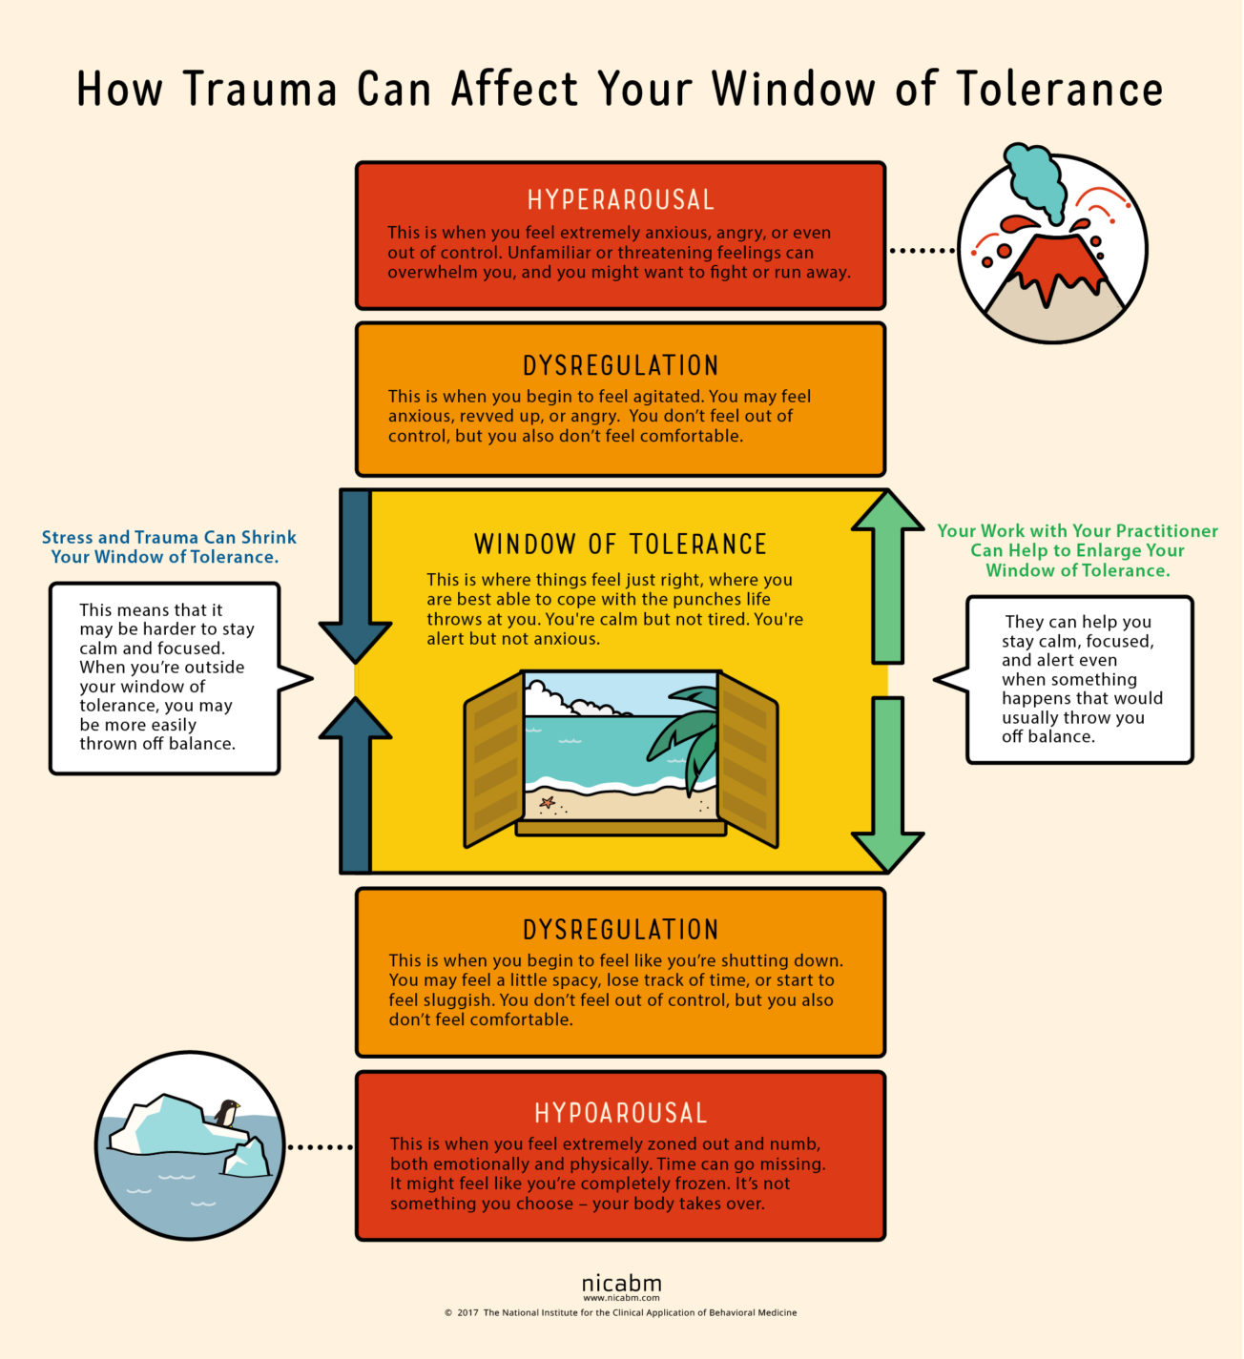

Slide 36
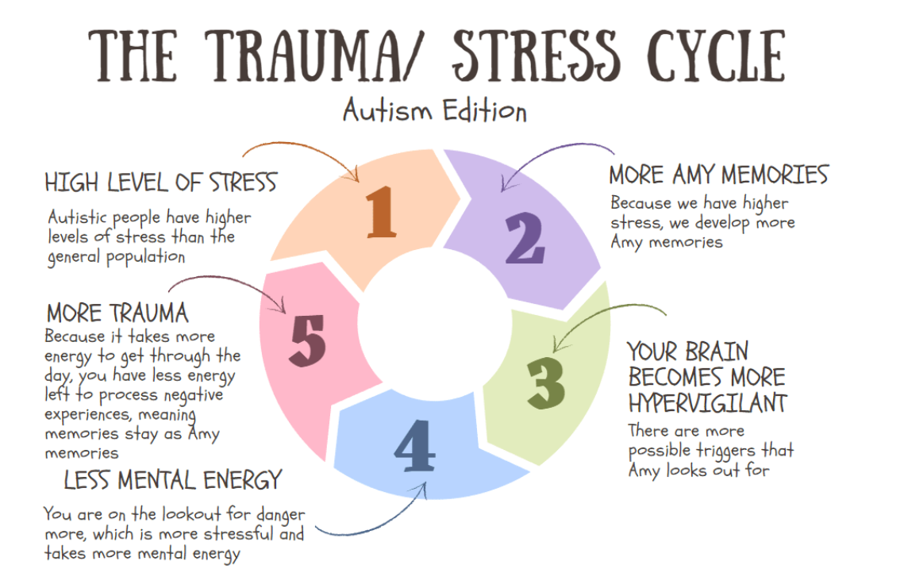
Amygdala Function and Location | Simply Psychology

Slide 37
https://www.youtube.com/watch?v=Q6G-OpGgo3c&safe=active
Train video
With a partner, fill in a STAR for the behaviour you saw in the train video.
What might happen the next time he goes to catch a train?
Can you think of equivalent
incidents in school?

Slide 38
Meltdowns are not an autistic trait; they are a trait of a ‘struggling autistic child’.
High levels of anxiety are not an autistic trait; they are a trait of a ‘struggling autistic child’.
Trauma is not an autistic trait; it is a trait of a ‘struggling autistic child’.

Slide 39
How does a meltdown feel?
(5) Experiencing meltdowns and shutdowns | Too Much Information and Us – Episode 4 - YouTube

Slide 40
Detective method 3: Functional analysis of behaviour
For starting to understand patterns

Slide 41
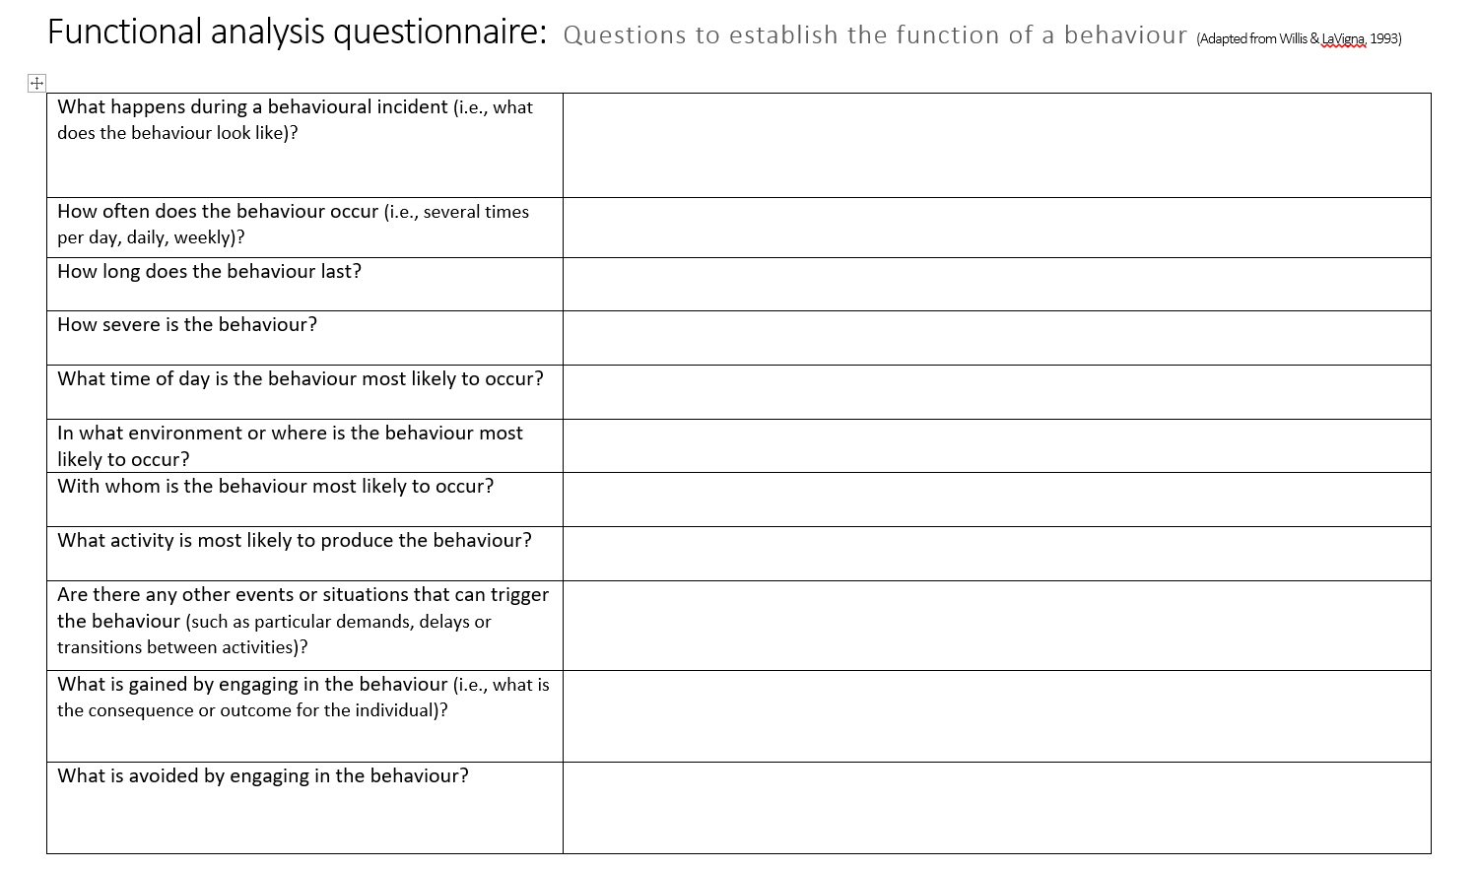

Slide 42
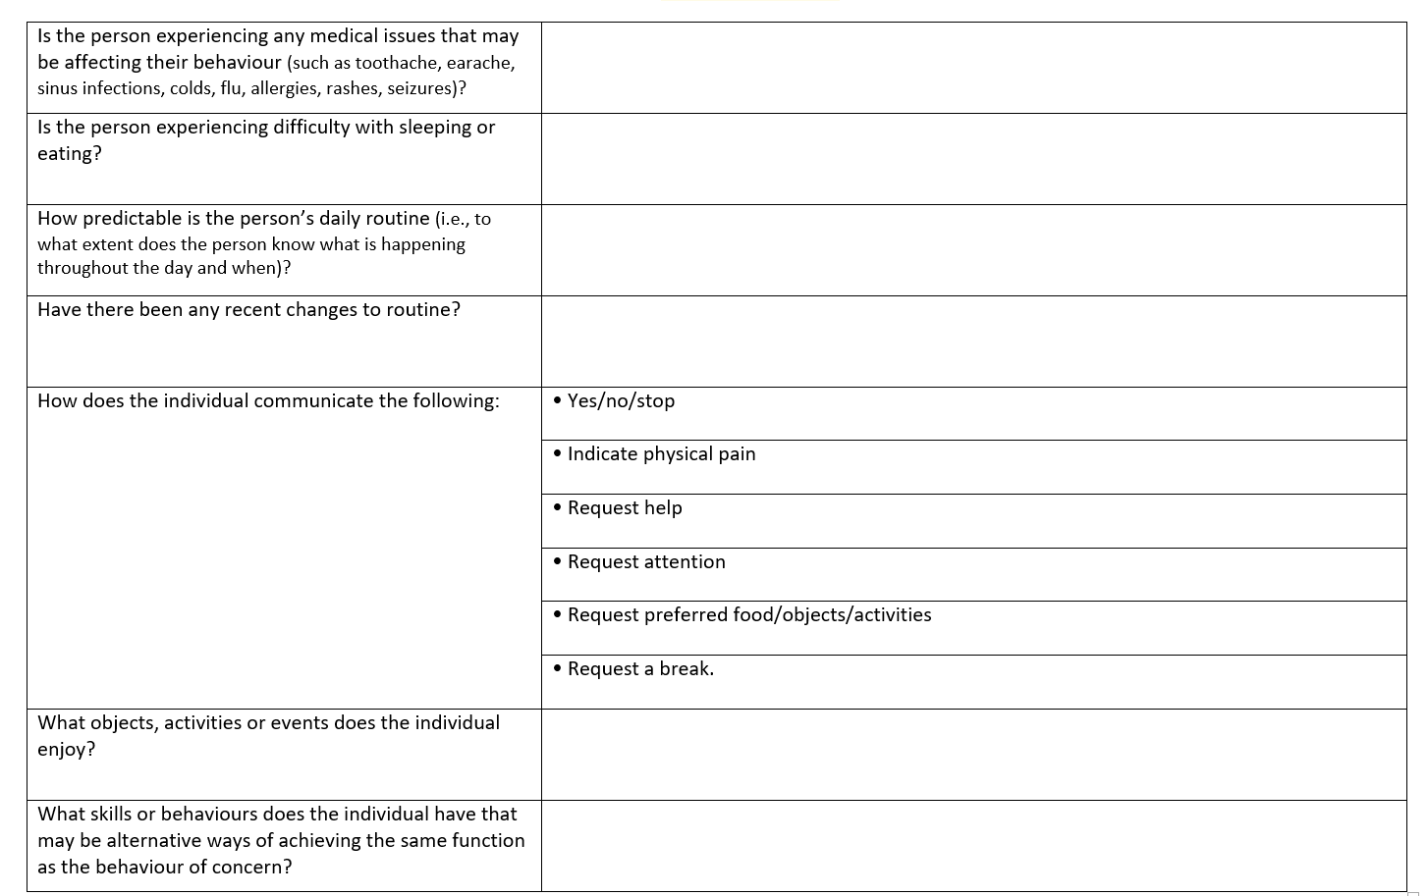

Slide 43
Detective Method 4: Behaviour tool
For when the function is hard to fathom!

Slide 45
Motivation assessment scale
See handout.

Slide 46
SEMH.co.uk Behavioural Indicator
SEMH.co.uk Behavioural Indicator with results

Slide 47
Positive Behaviour Support
Remember
All behaviour has a function
We need to identify the functions of behaviour
For a behaviour to change, we need to understand the function

Slide 48
Proactive strategies
To help prevent challenging behaviour occurring in the first place
Long term strategies
Teach new skills and behaviours
Improve pupils’ quality of life
Include environmental factors
Encourage pupils to be responsible for their own behaviour

Slide 49
Proactive strategies
May include :
Teaching communication skills and ensuring pupils can make themselves understood
Ensuring pupils have a predictable routine with visual support
Teaching self help skills, e.g. hand washing
Ensuring pupils have regular access to exercise and outside activities
Sensory support
Notes:
Group discussion – identify proactive strategies. Examples

Slide 50
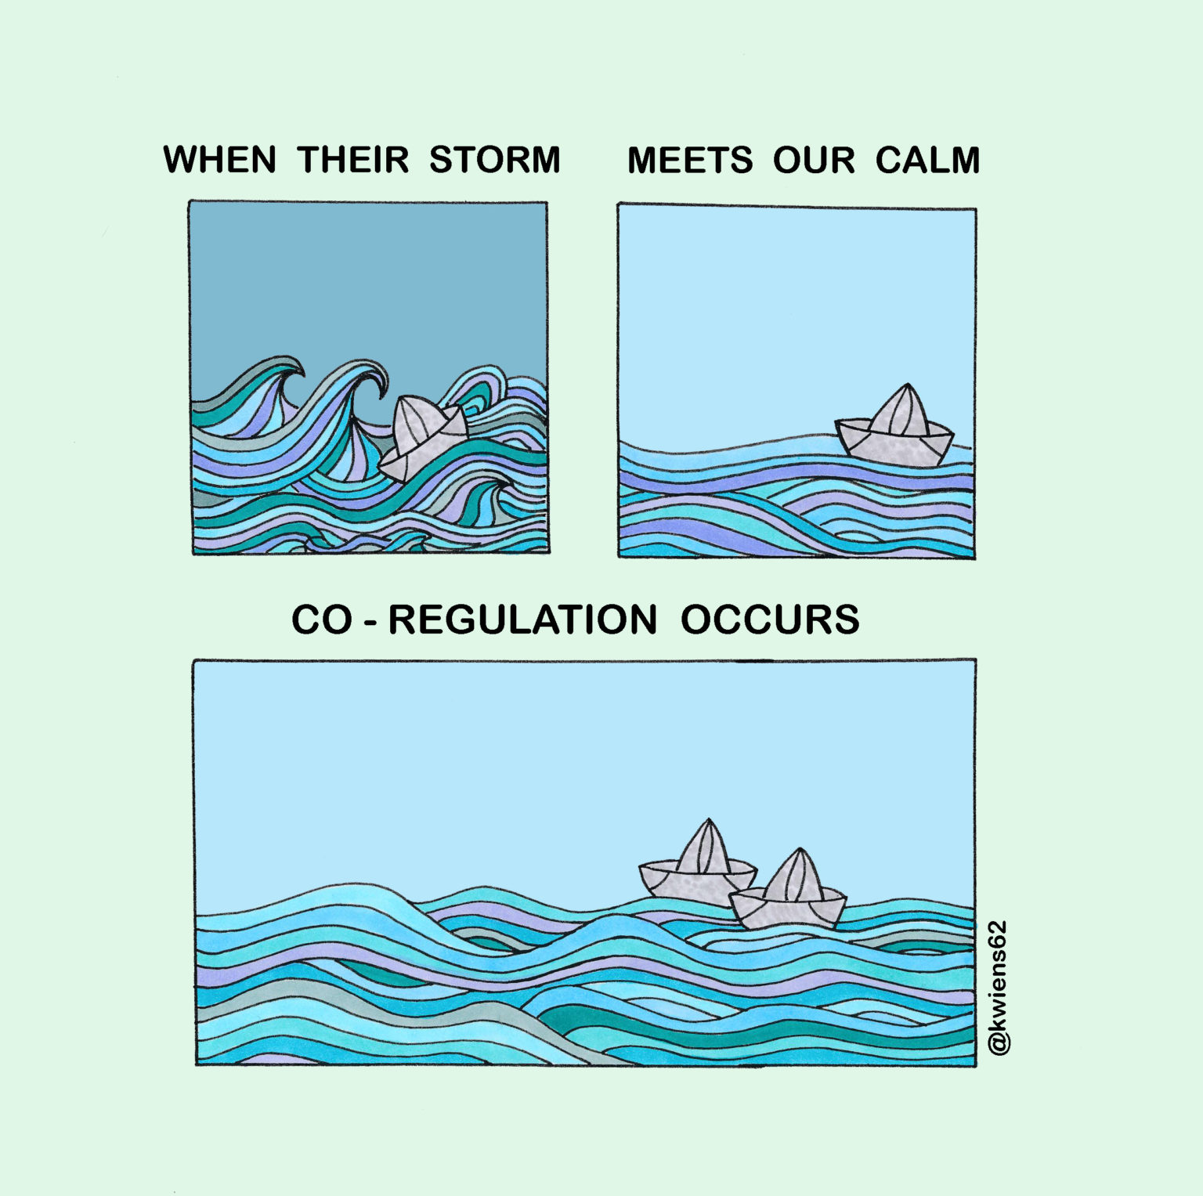

Slide 51
Active Strategies
Respond to early warning signs of challenging behaviour using non-verbal and verbal calming techniques
Know the individual
Need to be used consistently by all staff
Prevent escalation of behaviour to a crisis situation

Slide 52
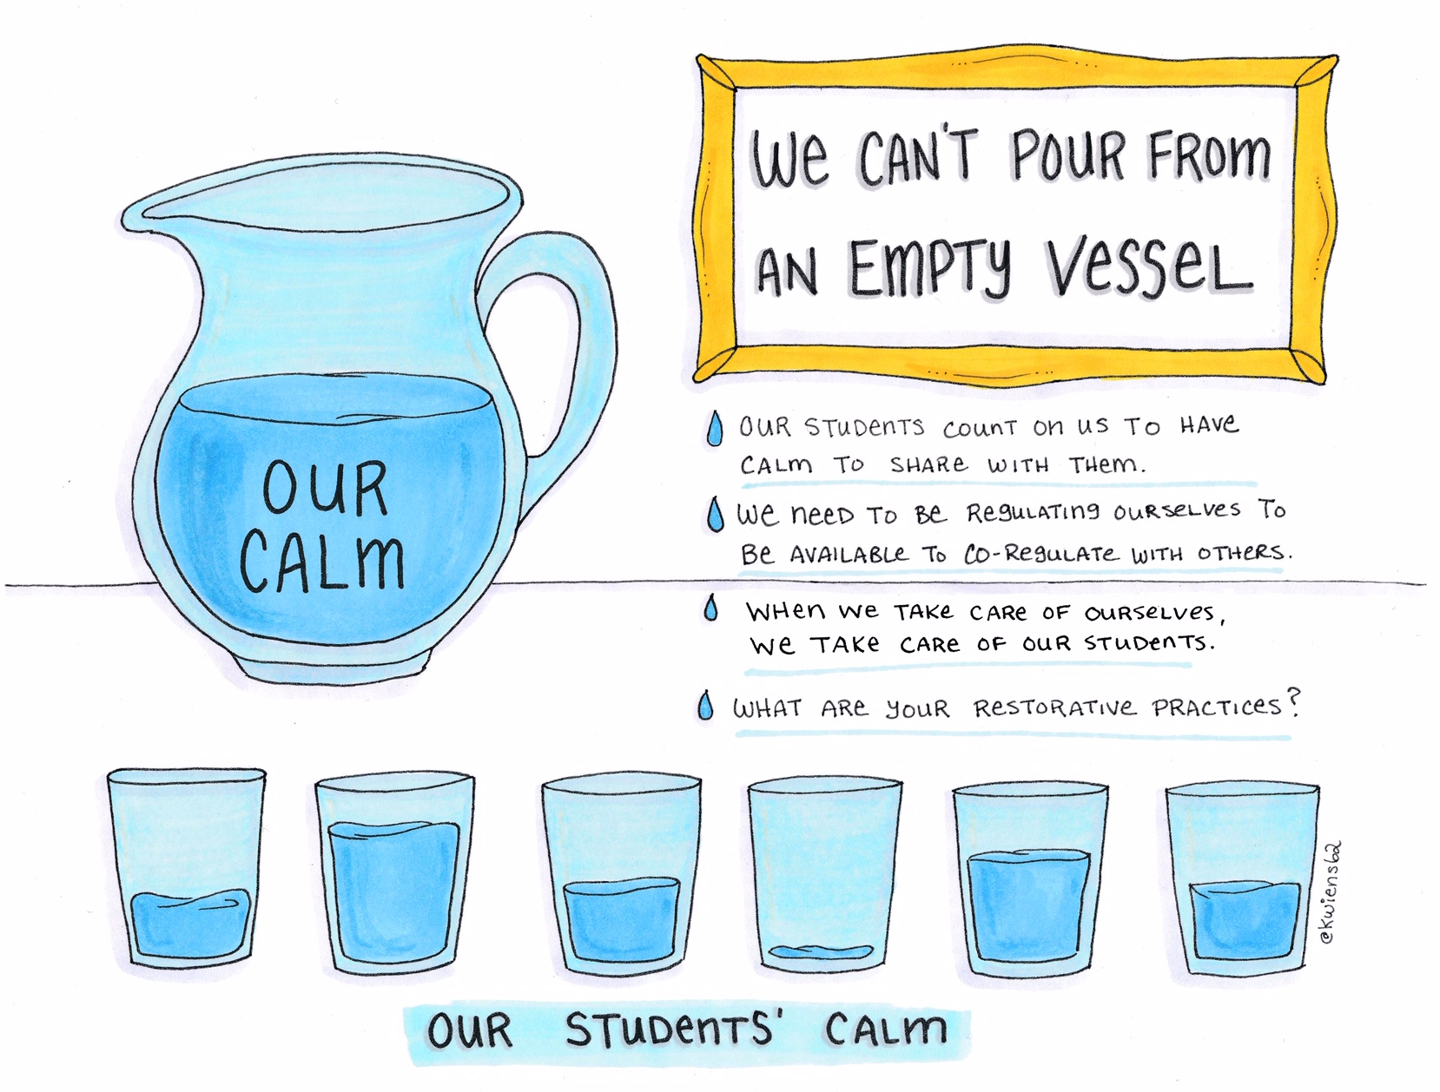

Slide 53
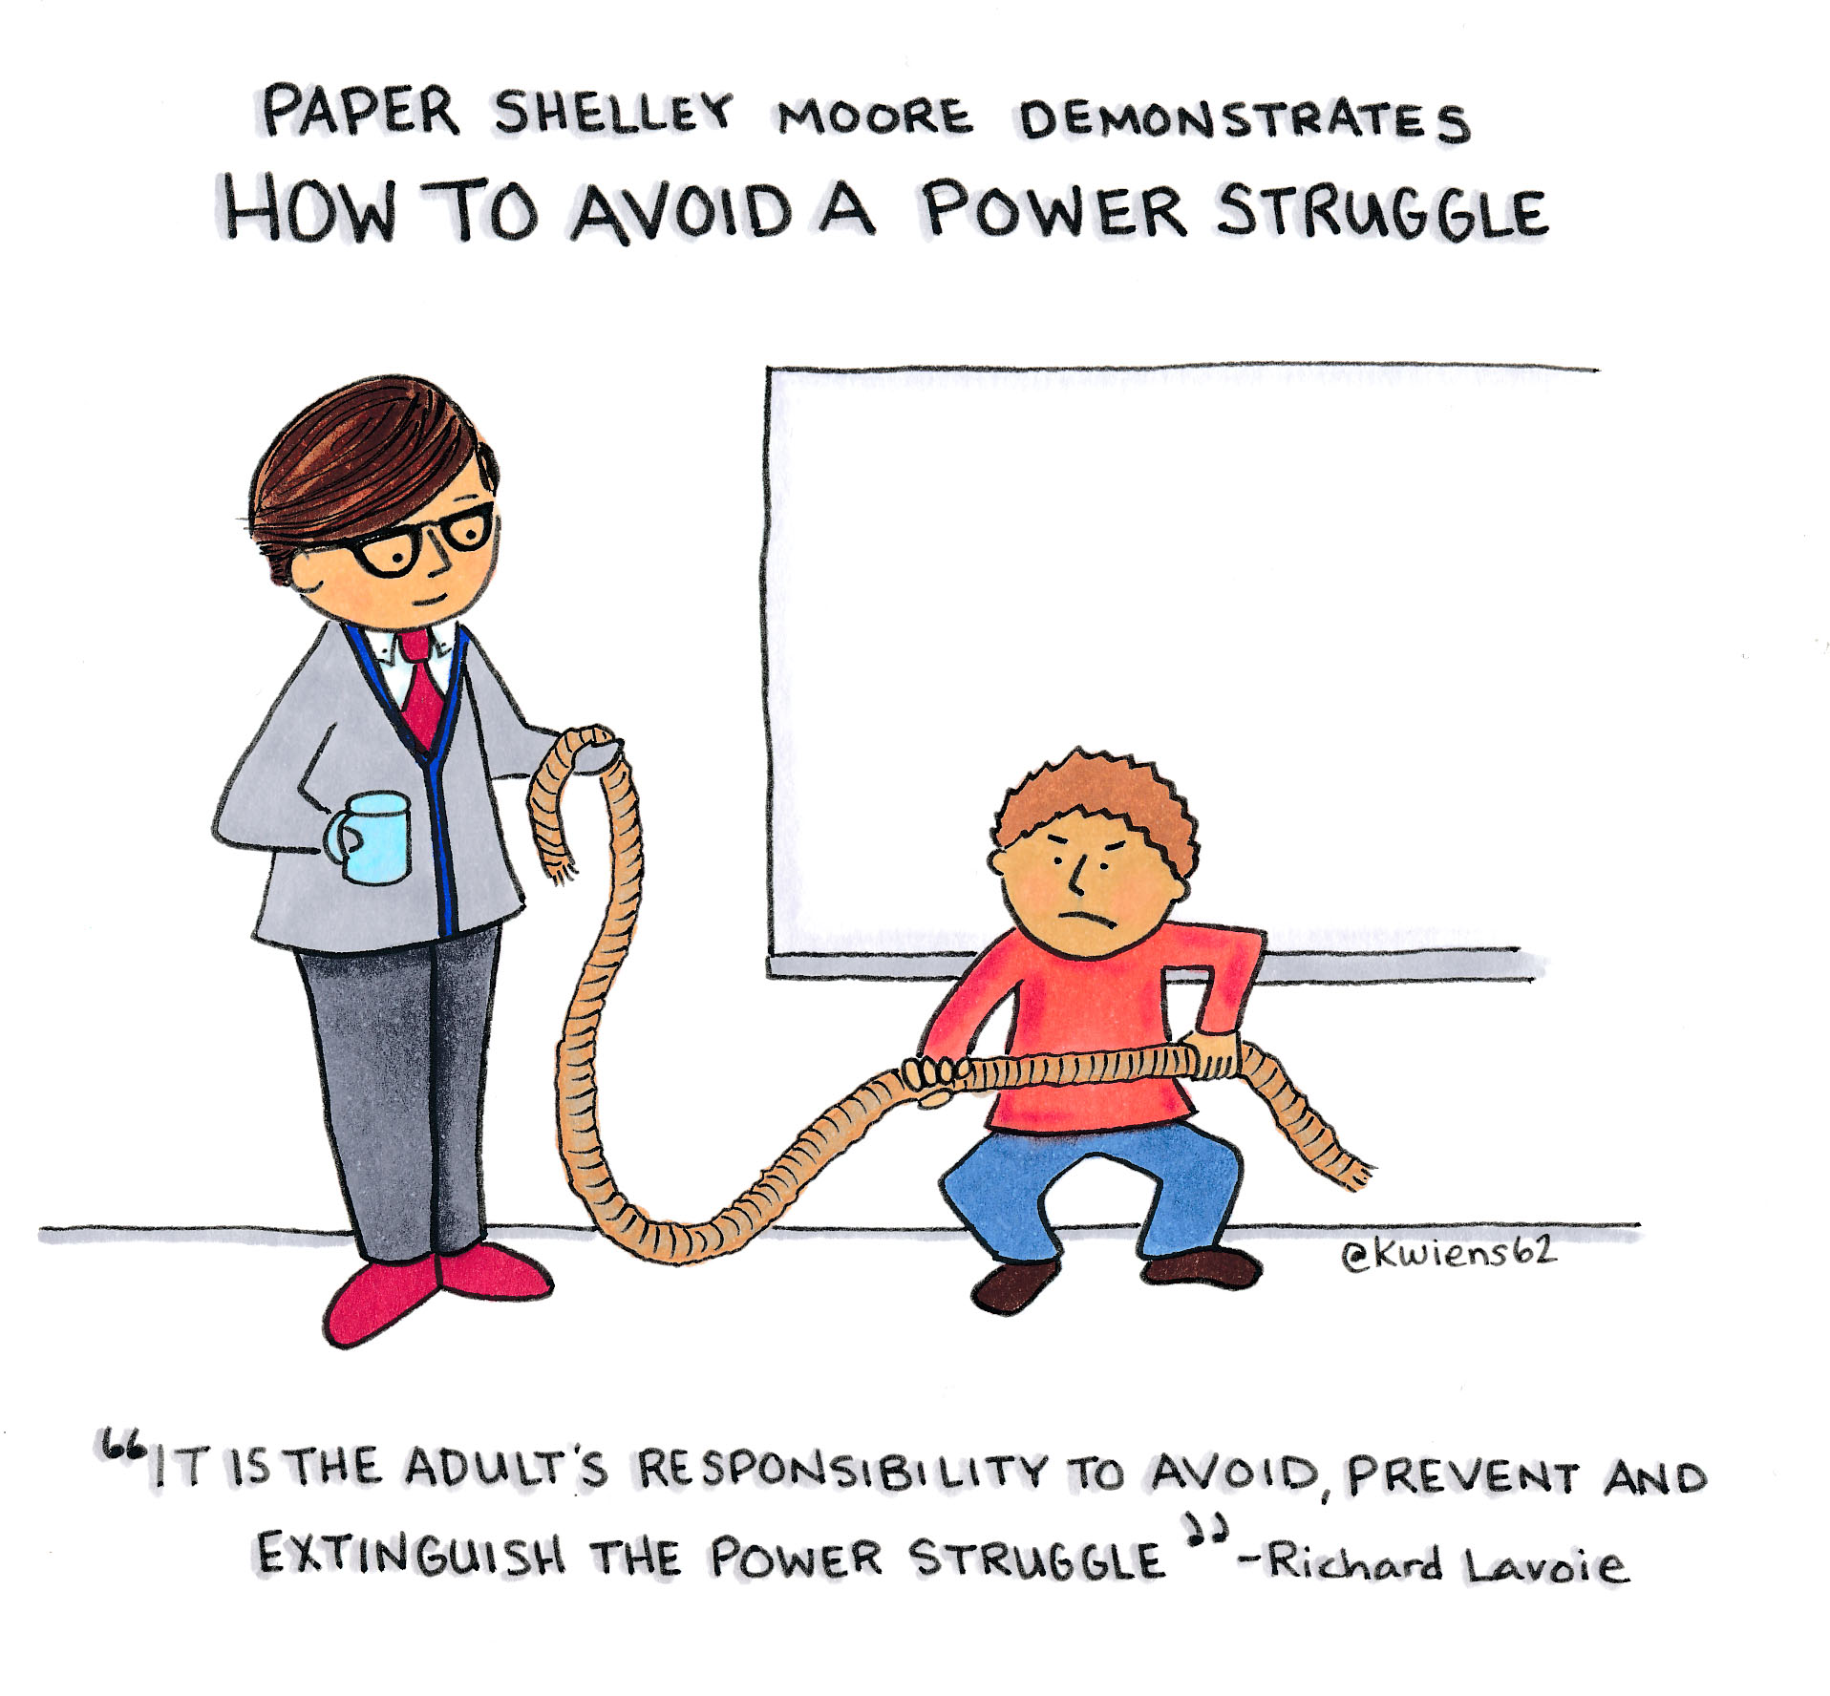
Active strategies
Consider the environment
Know yourself
Keep calm
Competent self-assurance
Listen
Be sensitive to a person’s self-esteem
Identify the persons feelings
Do not create a power struggle
Provide support
Notes:
Identify possible active strategies – verbal and non-verbal – discussion in groups

Slide 54
Active Strategies Verbal calming Techniques
Ventilation
Distraction
Reassurance
Understanding
Modelling
Humour
One to one
Coping Strategies
Natural consequences of behaviour
Positive language
Notes:
Examples

Slide 55
Active Strategies Non-verbal calming techniques
Redirect to another activity
Eye contact
Close proximity / Touch
Effective use of space
Body posture / facial expressions
Provide access to preferred objects and environments
Change of face
Notes:
Examples

Slide 56
Active Strategies
Avoid Escalators (Don’t do’s!!)
Don’t plant the suggestion of misbehaviour
Don’t threaten the consequences of a behaviour
Don’t present commands in the form of a question
Don’t restart confrontation by immediately demanding emotionally difficult actions
Don’t rehash incidents in front of the person
Notes:
Don’t dos – discussion of lead person, and don’t dos with staff.

Slide 57
Reactive strategies
MUST be part of a written plan detailing strategies to be used when behaviour occurs
Need to be clear and detailed to ensure everyone knows how to respond to challenges
Agreed with parents and staff teams
Consistent and well planned
May need to include physical interventions as a last resort
Notes:
Physical interventions to be covered by Team Teach training

Slide 58
Reactive strategies
Safety of all concerned is paramount
Ask for help if needed
The aim is to resolve the situation
Consider exit strategies – how do we move on?
Praise positive behaviour
Recovery, recording, debriefing
Notes:
Discussion of crisis situations

Slide 59
Follow up to incidents
Recovery for pupil and staff – incidents can be stressful for all concerned
Debriefing for staff, and for pupil where appropriate
Recording and reporting
Identify and meet needs – for support, training etc
Review behaviour plan / risk assessment
Forward planning

Slide 60
Positive Support Plan
Identify positives – starting points
Contain proactive, active and reactive strategies
Clear guidelines to ensure consistent approaches to behaviour
Shared document – all staff, parents and pupil where appropriate
Notes:
IBPs – what format? Look at examples. Discussion about formats

Slide 61
Thanks for taking part so well.

