Slide 1
Belonging Forum
20th^{th} October 2021

Slide 2
Where are we currently on Belonging Agenda?
Approaching 1 year since embarking on Anti-racism award and review of our school.
6 key areas of review:
Governance, Leadership and Strategy
School Environment
Professional Learning and Development
Hidden Curriculum
Pedagogy and Curriculum
Parents/Carers and Community Partnerships

Slide 3

Rights Respecting School

Slide 4
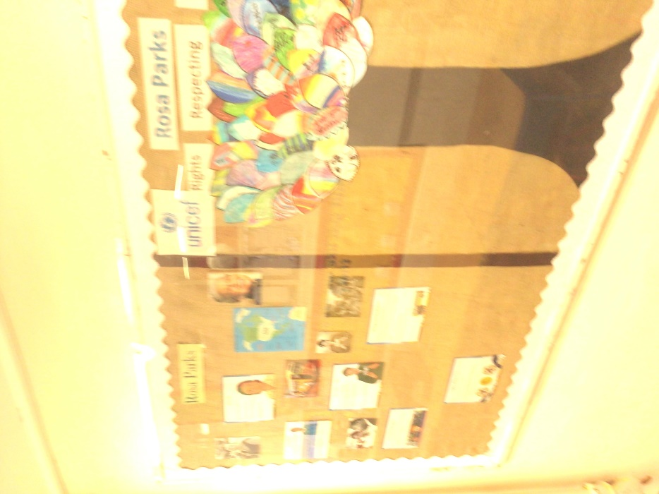
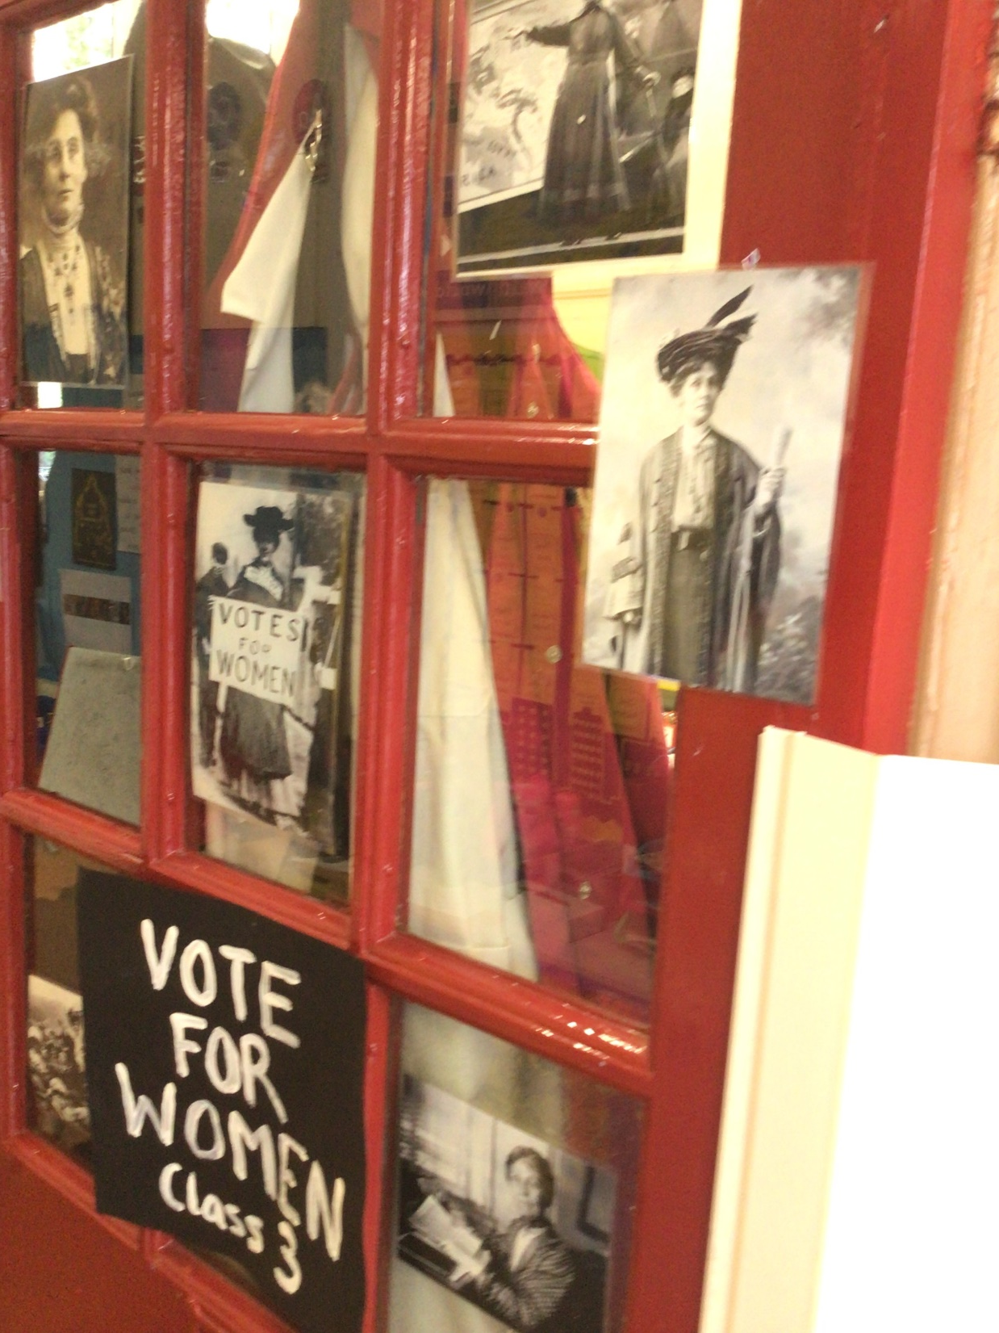




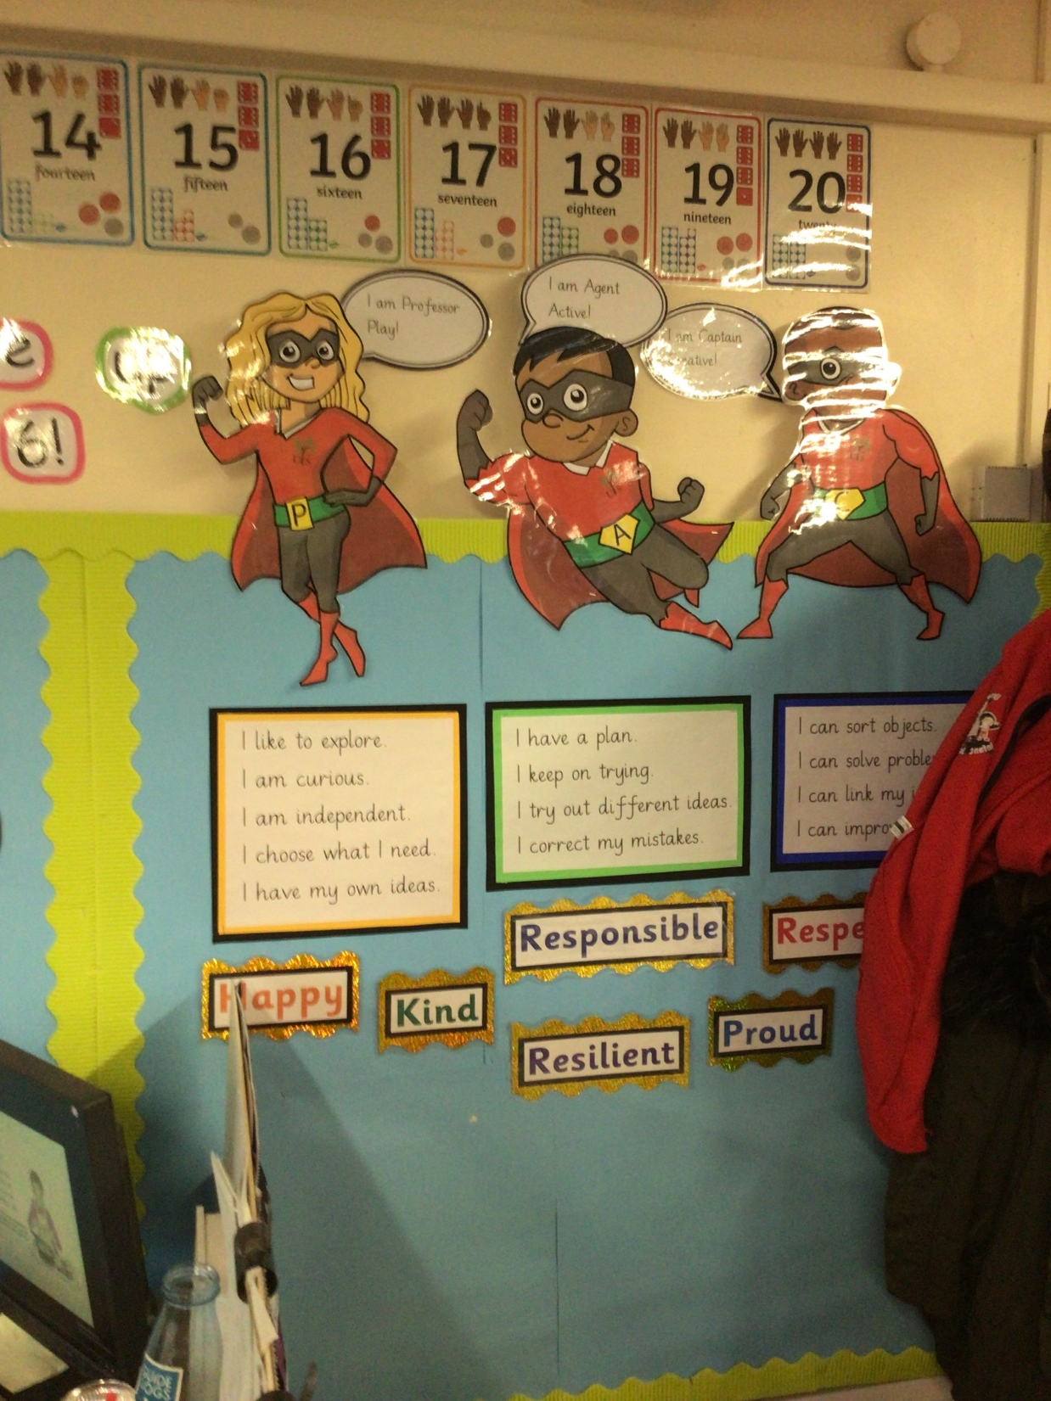
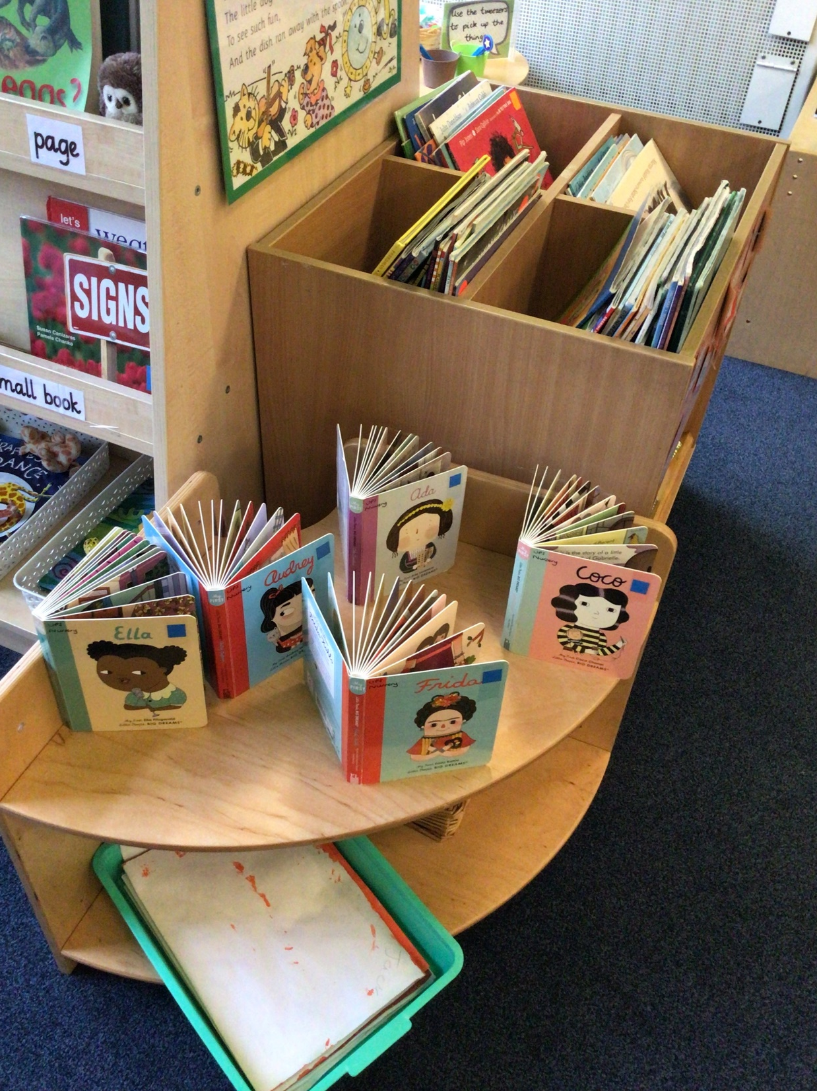
School Environment

Slide 5
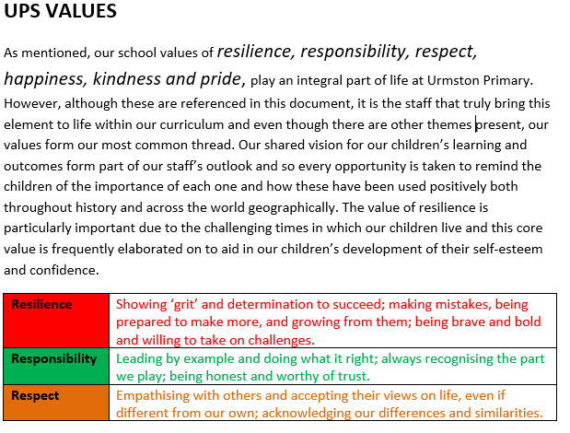

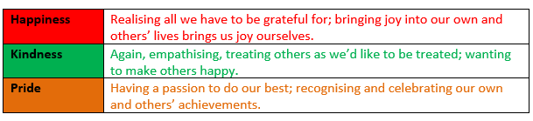
Curriculum

Slide 6
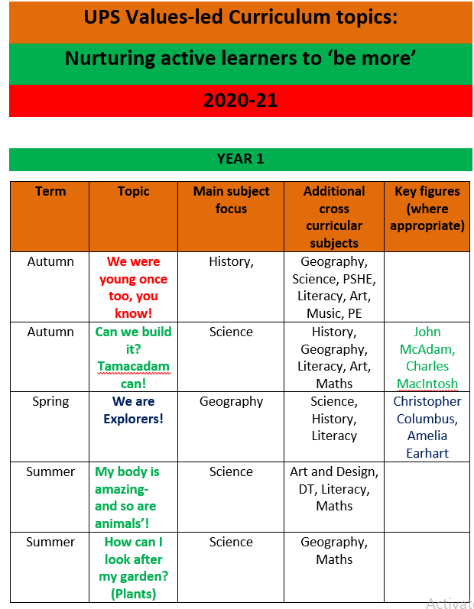
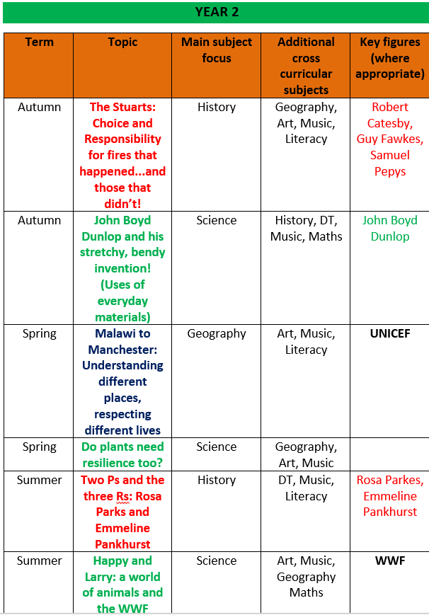
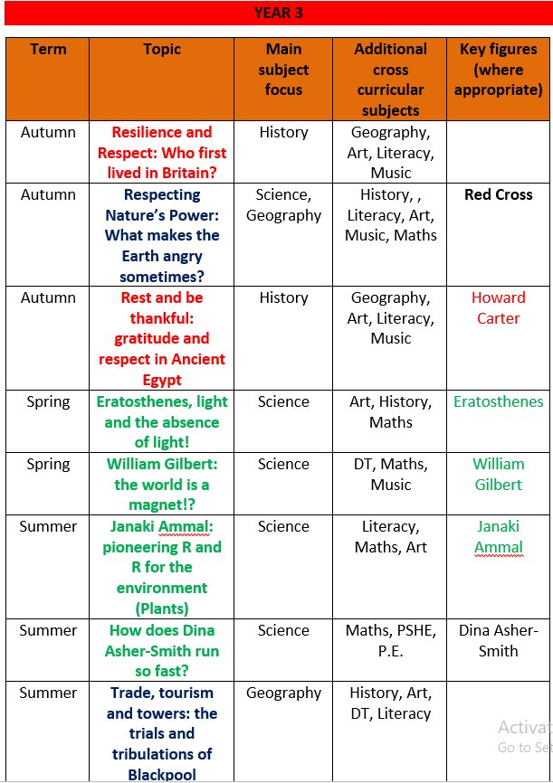

Slide 7
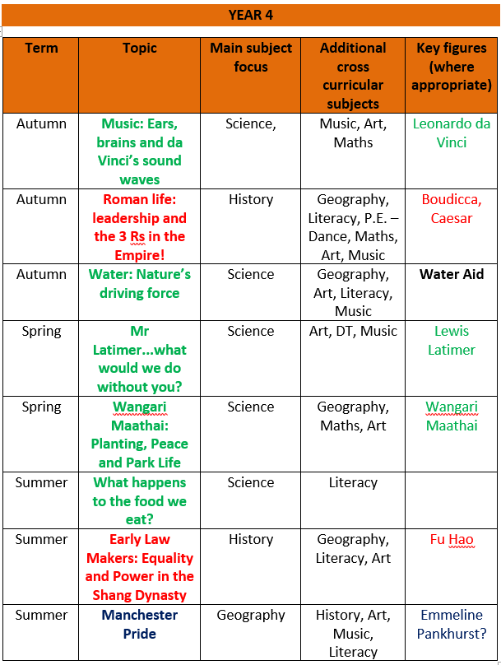
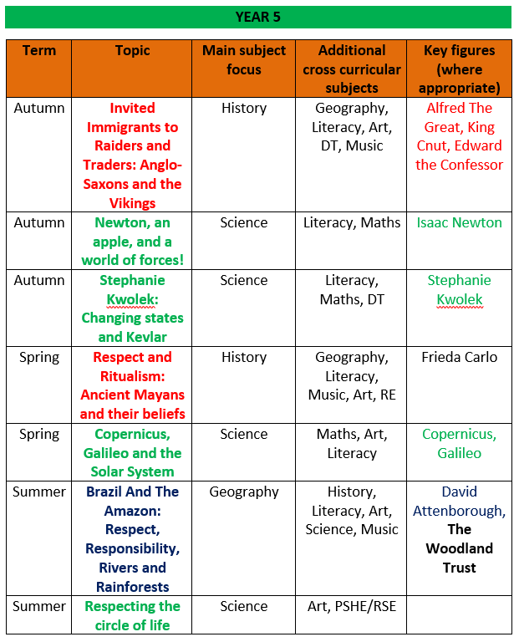
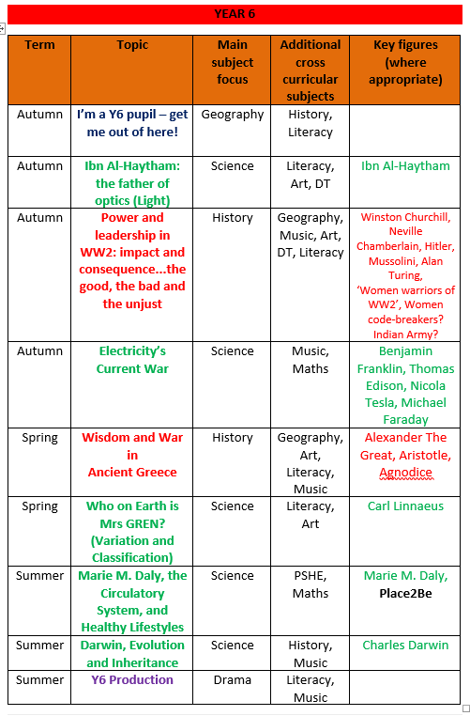

Slide 8
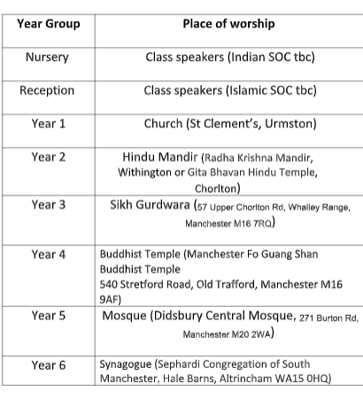
Community Partnerships

Slide 9
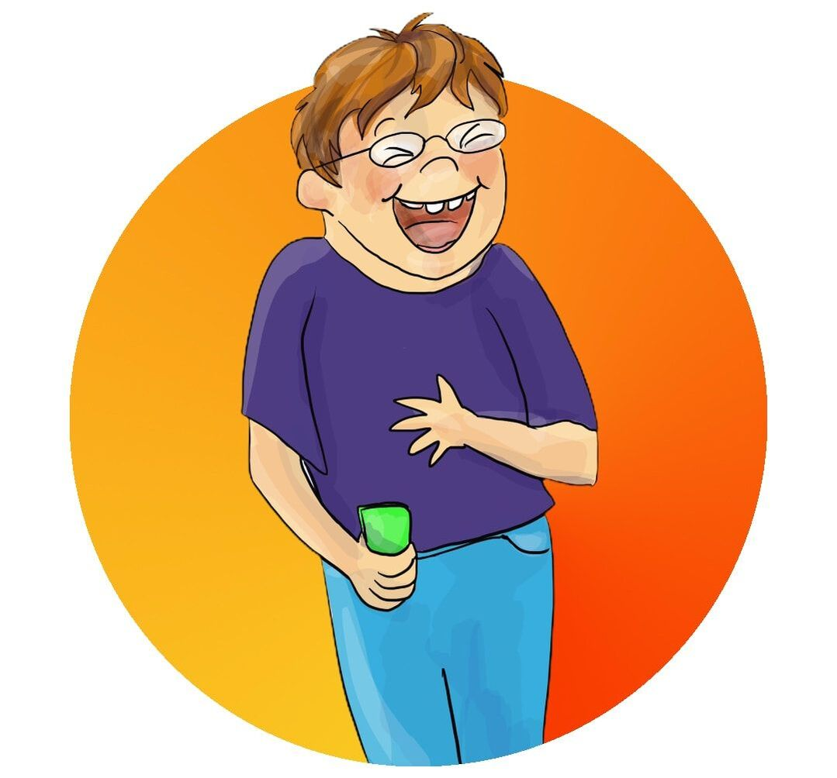
How do we now look to extend what it means to belong?
Different abilities
Sexuality
Gender
Transgender
Joe and Dusty

