Slide 1


Urmston Primary School
KS1 Phonics and Reading Workshop
With Mrs. Hall and Mrs. Cooper
Growing together. Empowered to be more.

Slide 2

Welcome
Housekeeping
Please mute your screens.
Add any questions to the chat and we will send a Q&A sheet out after
All supporting materials will be uploaded to our website by the end of the week.

Slide 3
Welcome
Why are we here today?
To take a look at how phonics works in KS1
To understand the importance of reading and how to support your child.
To look at the Phonics Screening Check in Year 1

Slide 4
Phonics at UPS
THERE ARE 44 PHONEMES (sounds) IN THE ENGLISH LANGUAGE AND WELL OVER 200 GRAPHEMES (how those sounds are written)...see the Alphabetic code!
Daily phonics sessions – linked to phonics phases from Bug Club phonics, where sounds are taught using synthetic phonics. This method looks at looks at how sounds (phonemes) are represented by written letters (graphemes) and how they are blended together to make words
Phase 1 – Nursery: Recognising sounds in the world around us and some initial sounds
Phase 2 – Reception: Initial sounds
Phase 3 – Reception – Year 1: CVC words and beginning to blend
Phase 4 – Reception – Year 1: Adjacent consonants – CVCC, CCVC, CCVCC, CCCVC, CCCVCC and consolidating segmenting and blending of Phase 3
Phase 5 – Year 1: Segmenting, blending, introducing new sounds and alternative sounds – making choices!
Phase 6 – Year 2: Spelling rules and patterns
Note: There are ‘tricky words’ in each phase and these will be focused on as well as high and common frequency words (See Spelling Logs)

Slide 5


Phonics at UPS
Daily phonics sessions – linked to phonics phases from ‘Bug Club’
  Y1 – predominantly Phase 5
  Y2 – predominantly Phase 6
    Spelling logs aid our focus and enable children to make informed spelling choices (these can be found on our website)
    Rapid Phonics – Used a an intervention for small groups who are struggling to retain the sounds at the different phases.

Slide 6
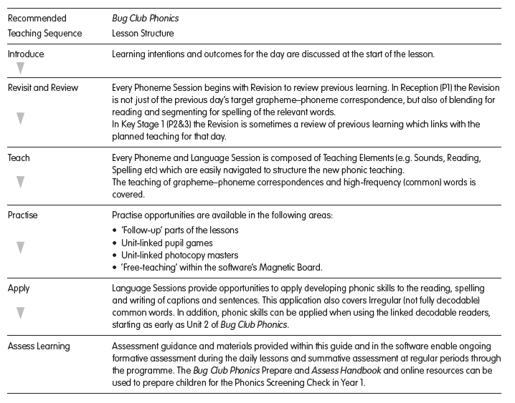
Phonics at UPS
What does a typical lesson look like?

Slide 7
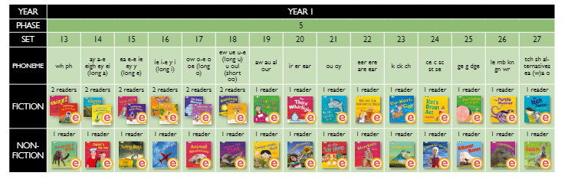
Phonics at UPS
Let’s take a closer look at Phase 5 phonics and the order sounds are taught:

Slide 8
Phonics at UPS
Type | Spelling Rule
Tricky words | Common Irregular verbs – to research and find
Suffixes | -ed for past tense verbs (inc. double consonants)
 | -ing for present continuous tense verbs (inc. double consonants, dropping the e)
 | -er added to adjectives (inc. double consonants, changing a y to an i)
 | -est added to adjectives (inc. double consonants, changing a y to an i)
 | -ful added to nouns to form adjectives (inc. changing a y to an i)
 | -ly added to adjectives to form adverbs (inc. changing a y to an i)
 | -ment added to verbs to form nouns
 | -ness added to adjectives to form nouns (inc. changing a y to an i)
 | -y added to nouns to form adjectives
 | -y (inc. changing a y to an i - plural -ies)
 | -en added to adjectives to form verbs (inc. double consonants)
 | -s added to base word
 | -es (inc. words ending in f and changing to -ves)
 | -es (inc. revisiting changing a y to an i - plural -ies)
Let’s take a closer look at Phase 6 phonics and the teaching sequence

Slide 9
Phonics at UPS
The ‘w special’ | The ‘or’ sound after w (using an a)
 | The ‘ur’ sound after w (using an o – were being an exception)
 | The ‘w’ sound after qu
 | The ‘r’ sound spelt wr
Ending in the ‘v’ sound (adding an e) | -ve
Common Prefixes | un-
 | mis-
 | dis-
 | To research and find others.
-ant or -ent and -ance or -ence | -ant
 | -ent
 | -ance
 | -ence
Let’s take a closer look at Phase 6 phonics and the teaching sequence

Slide 10
Phonics at UPS
The ‘dge’ sound | -dge
 | g
 | j
The ‘n’ sound at the start of some words | kn-
 | gn-
The ‘s’ sound spelt c | Before e, i and y
The ‘l’ sound at the end of words | -le
 | -el
 | -il
The ‘i’ sound as a y | At the end of a word
The ‘or’ sound | al
 | all
 | alk
The ‘ee’ sound as ey (plural -eys) | At the end of words.
Contractions (using apostrophes to shorten two words into one) | not as the second word
 | will as the second word
 | have as the second word
Possessive apostrophes | For singular nouns.
-tion word endings
Homophones | there (relating to here and where)
 | their (relating to they and them)
 | To research and find others.
Compound words | To research and find others.
Let’s take a closer look at Phase 6 phonics and the teaching sequence

Slide 11
How do UPS use Bug Club with phonics for reading?
Reading, writing and spellings are inextricably linked, especially in KS1!

Slide 12
Reading at UPS
Guided reading (small groups in class)
    – dual focus on phonetic reading/fluency and comprehension
Individual reading (one-to-one)
– dual focus on phonetic reading/fluency and comprehension
Home reading books linked to phonics phases...let’s take a look at these...
– dual focus on phonetic reading/fluency and comprehension

Slide 13
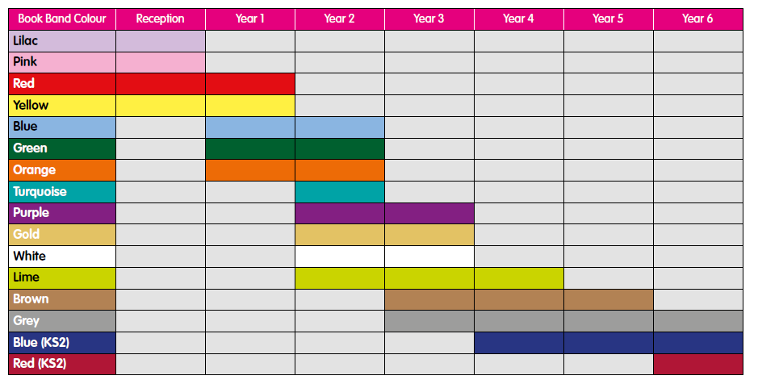
Book Bands

Slide 14
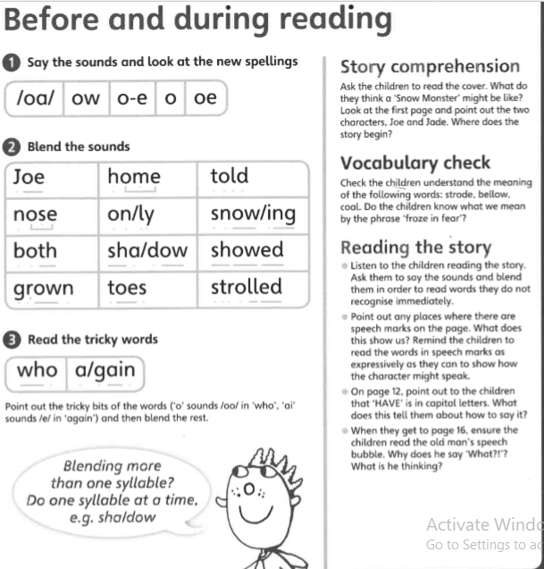
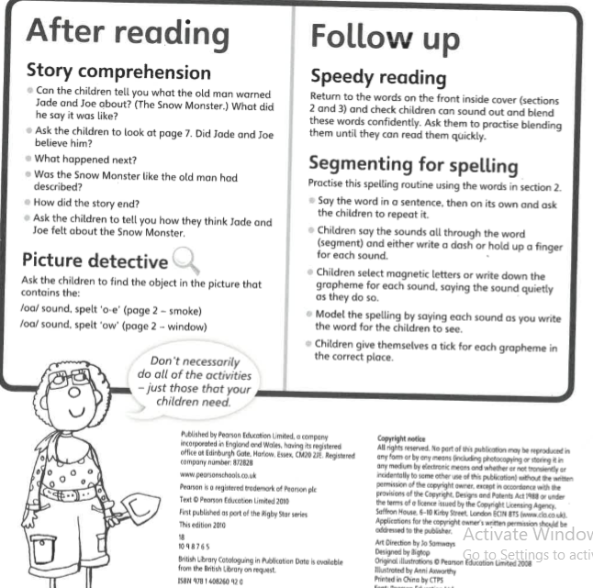
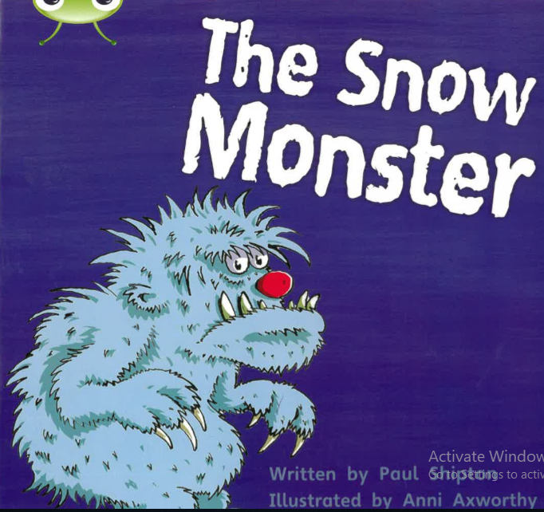
Helping at Home
  Home reading books with Bug Club are to support pupils consolidate the sounds that they have already learnt in school. We expect our pupils to read these books with a level of fluency and expression.

Slide 15
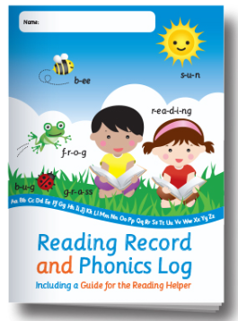
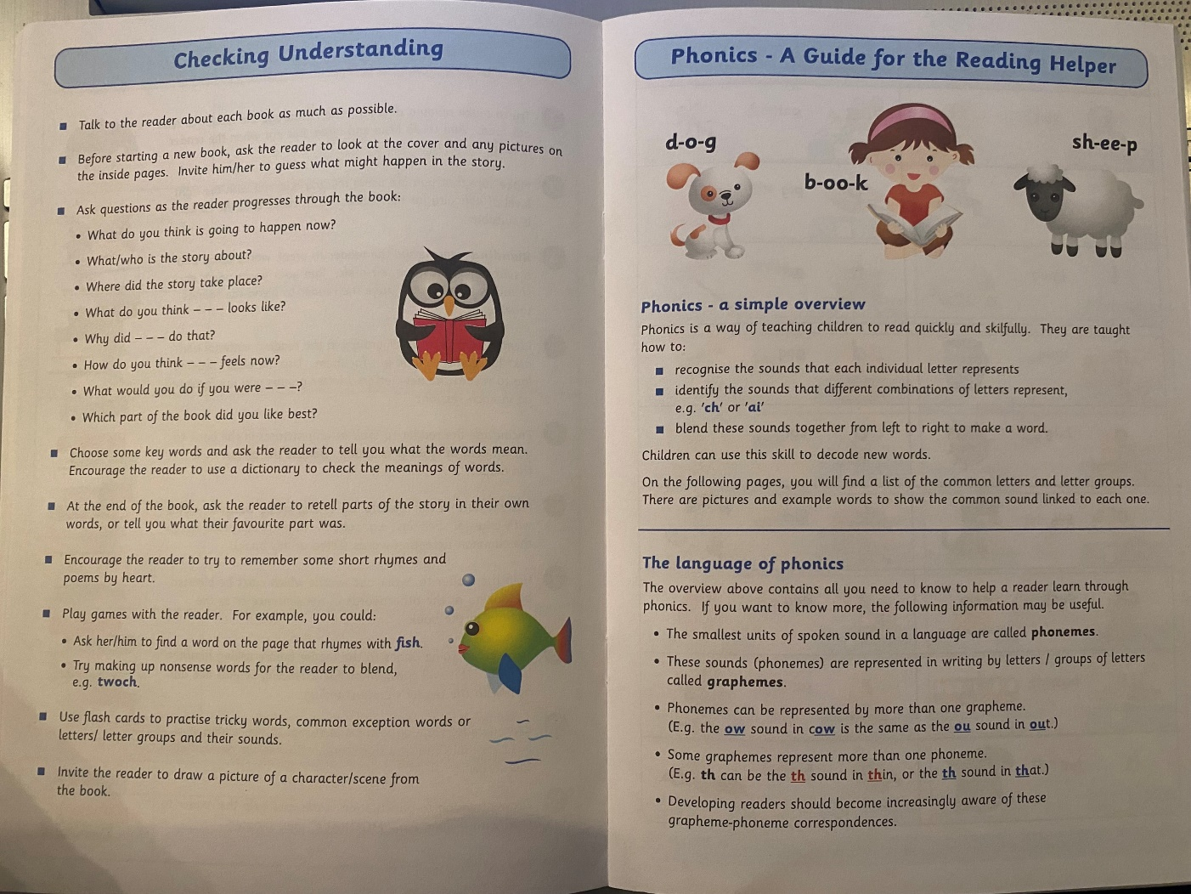
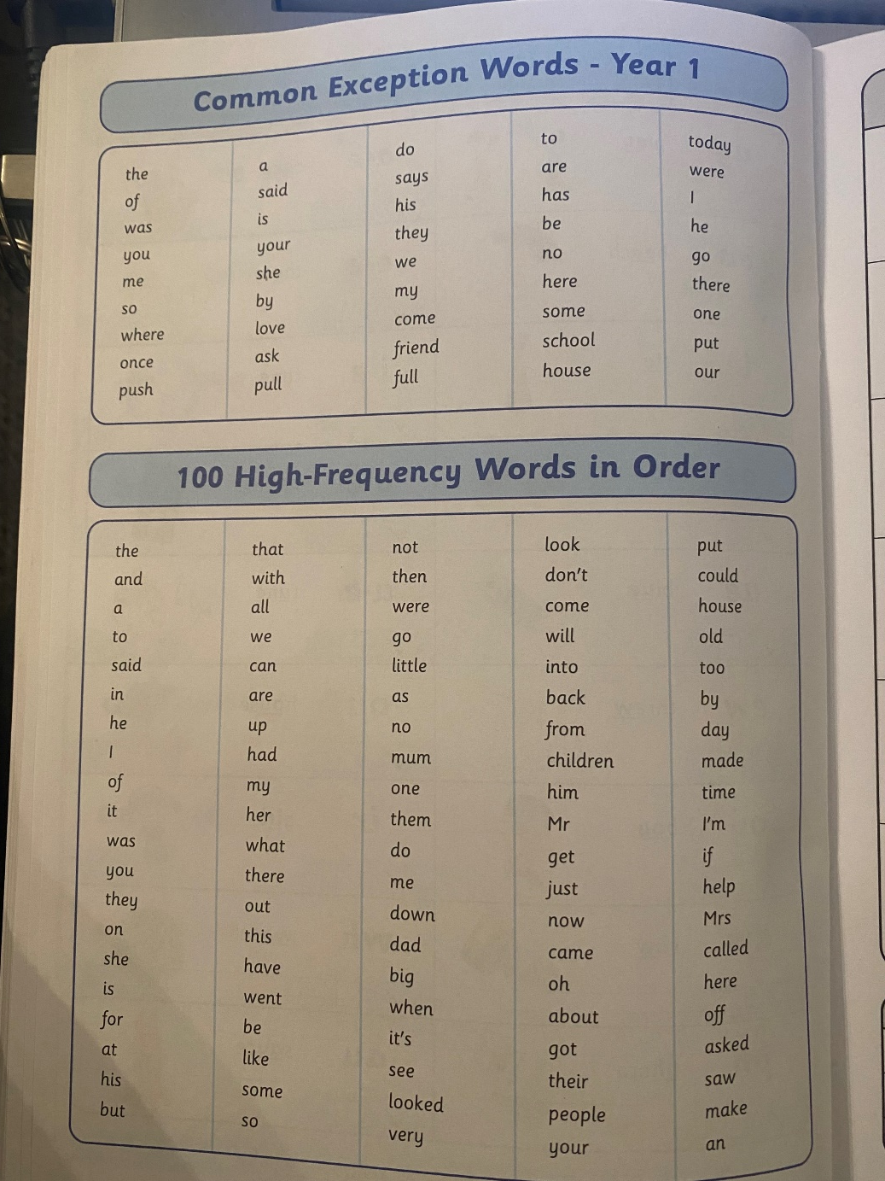
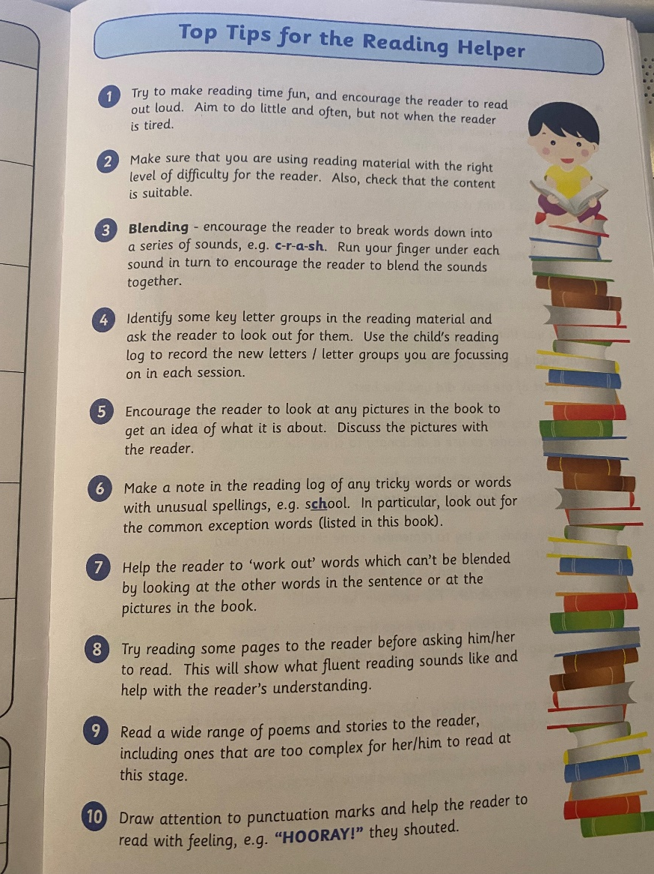
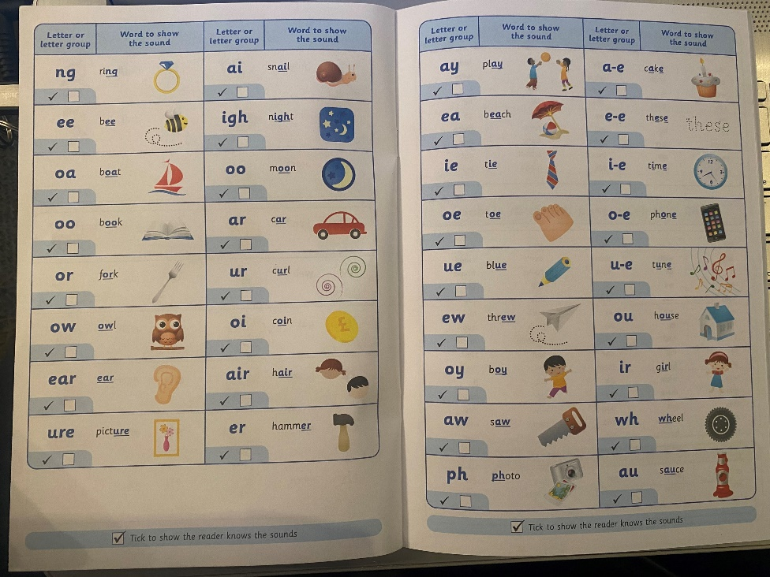
Helping at Home
  Reading Records Reception & Year 1
Please remember that your child should be reading to you at least 3 times a week at home and it should be recorded in their reading record.

Slide 16

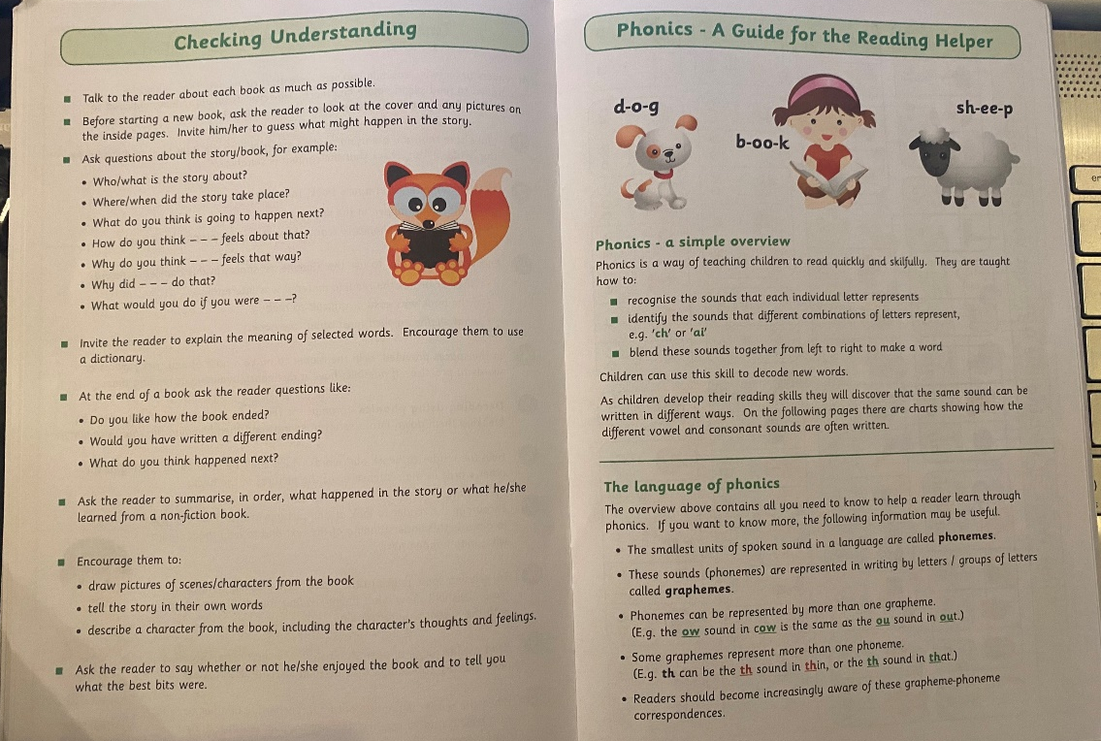
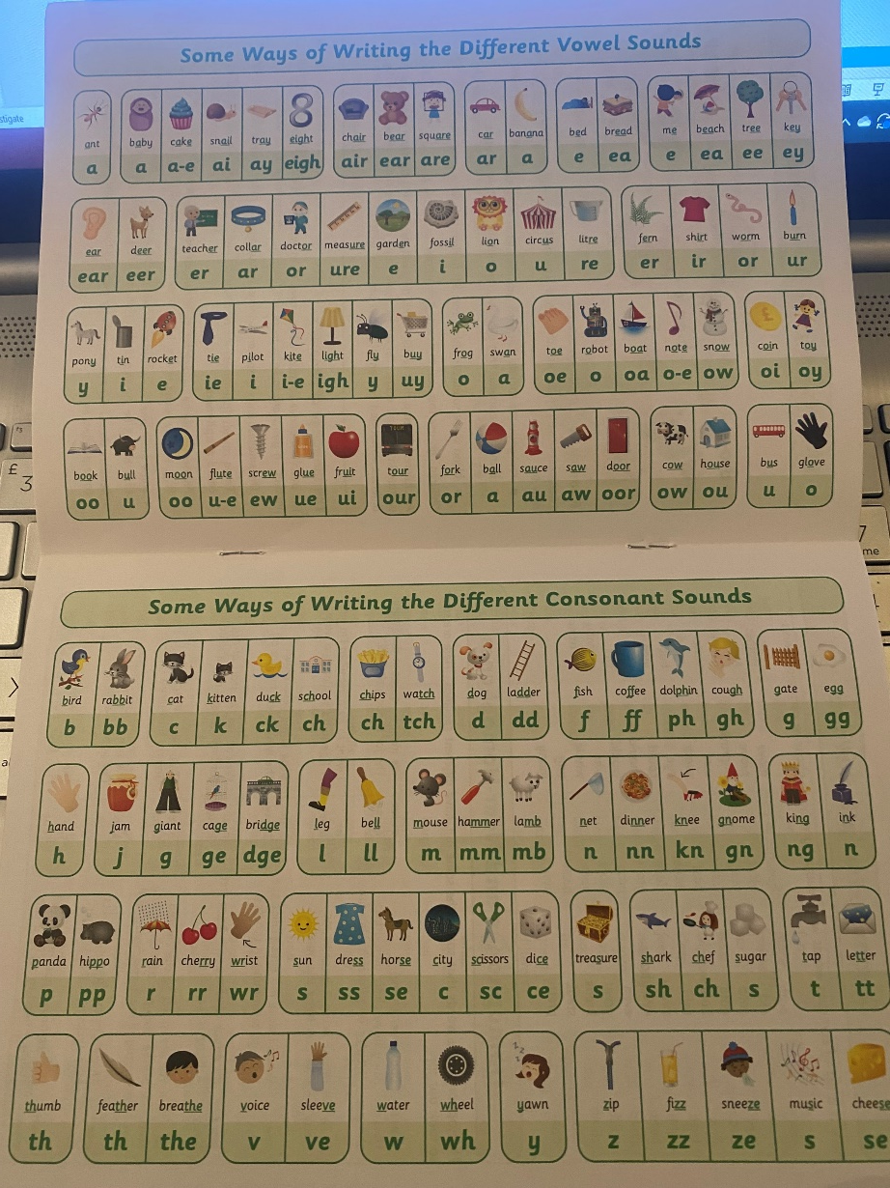
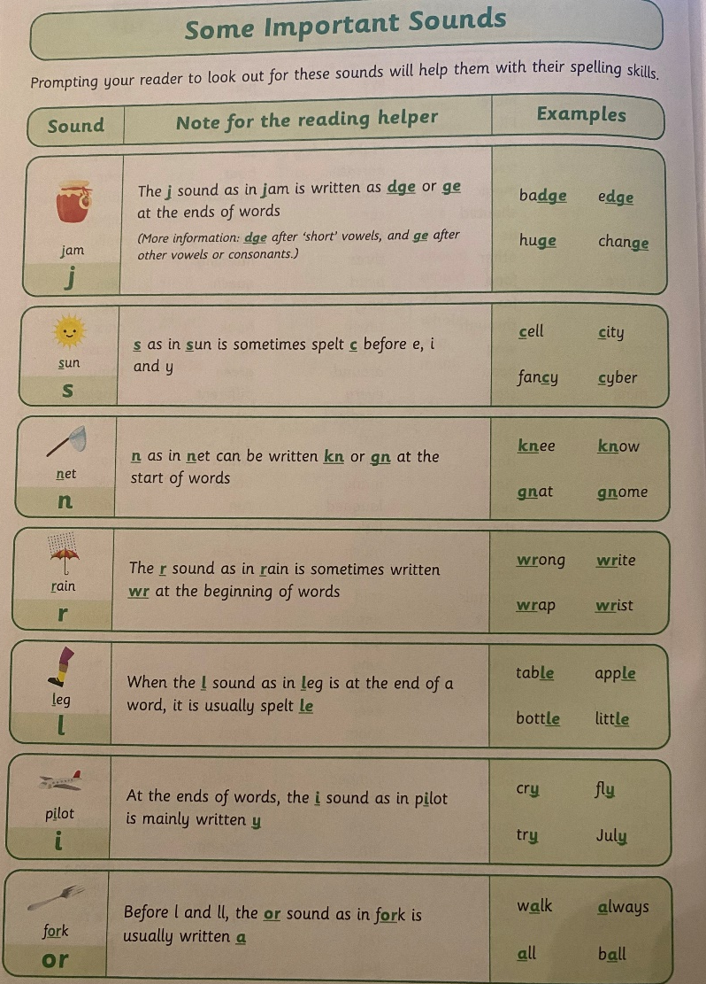
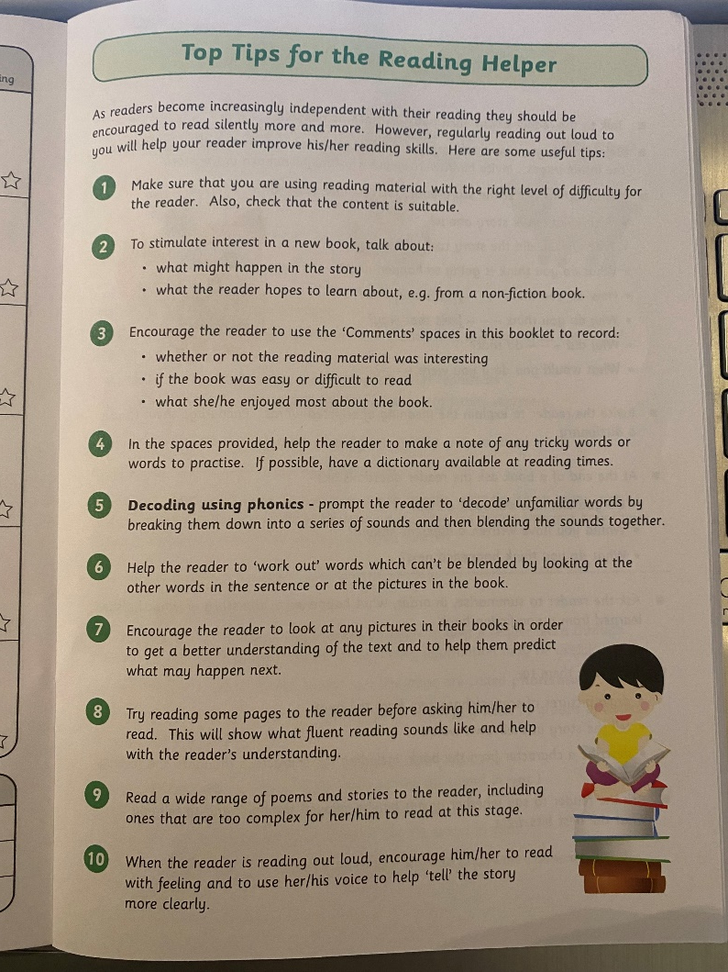
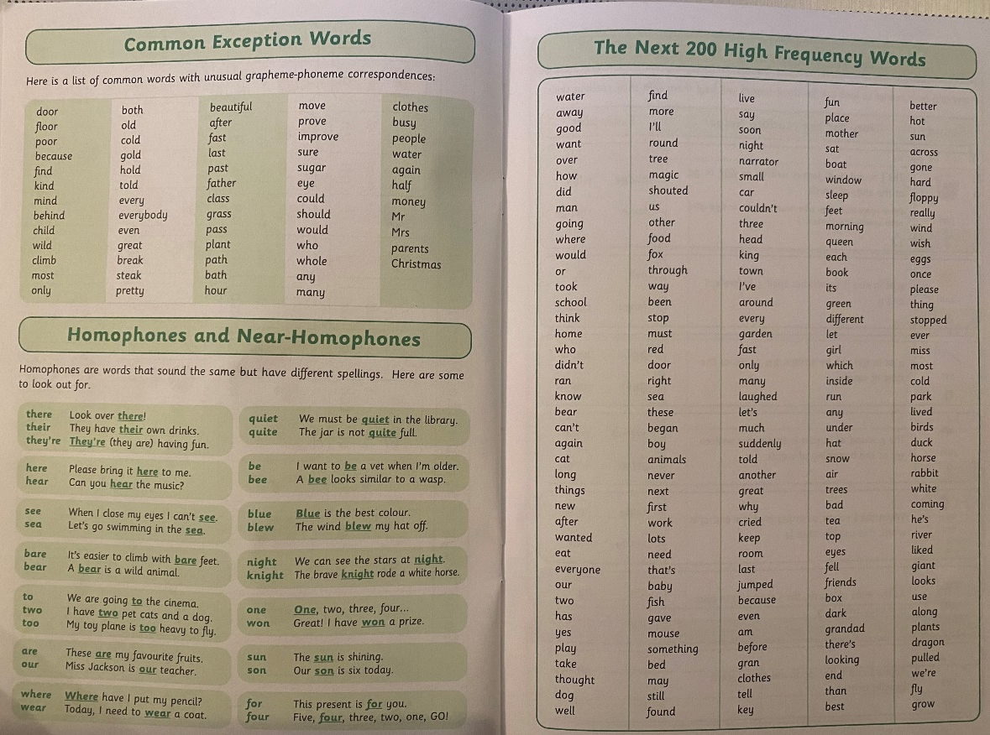
Helping at Home
  Reading Records Year 2

Slide 17
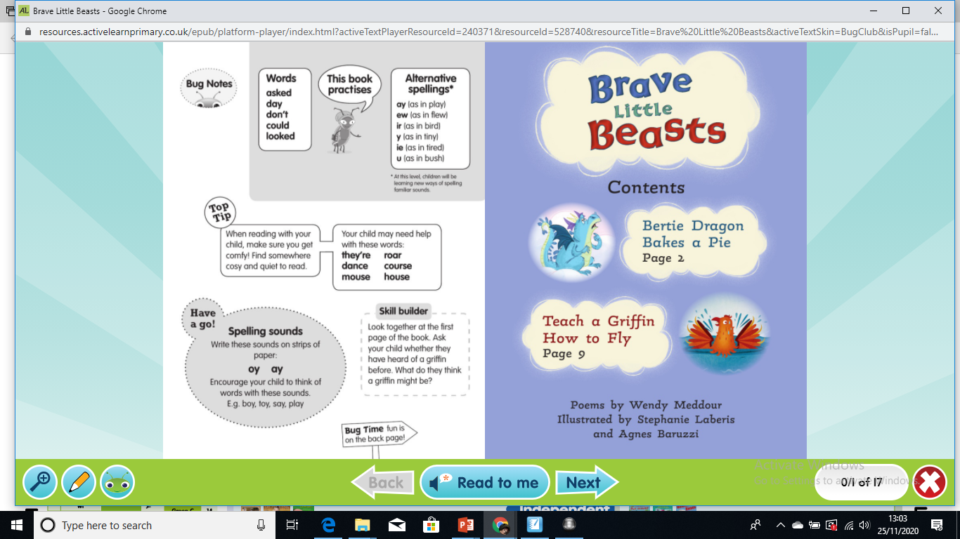
Helping at Home
  Online reading with Bug Club

Slide 18
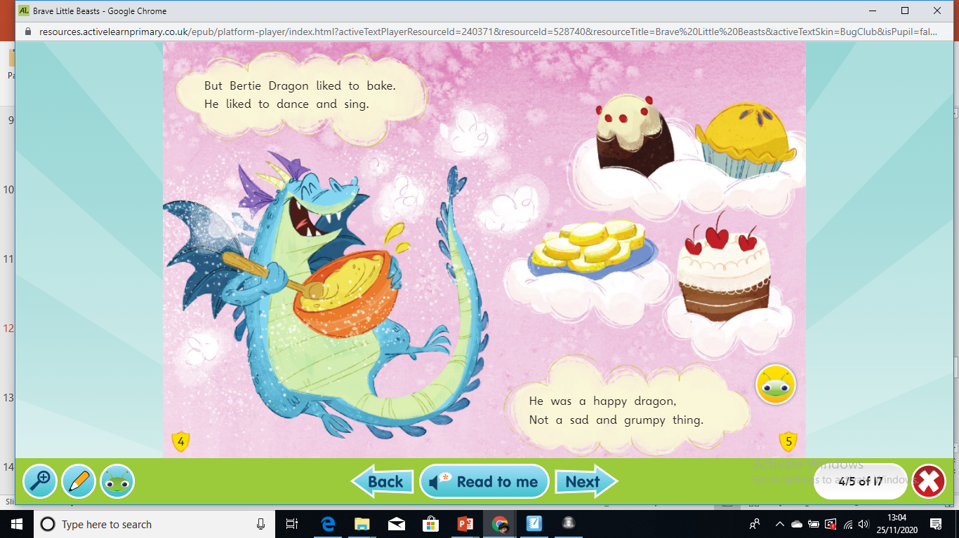
Helping at Home
  Online reading with Bug Club

Slide 19
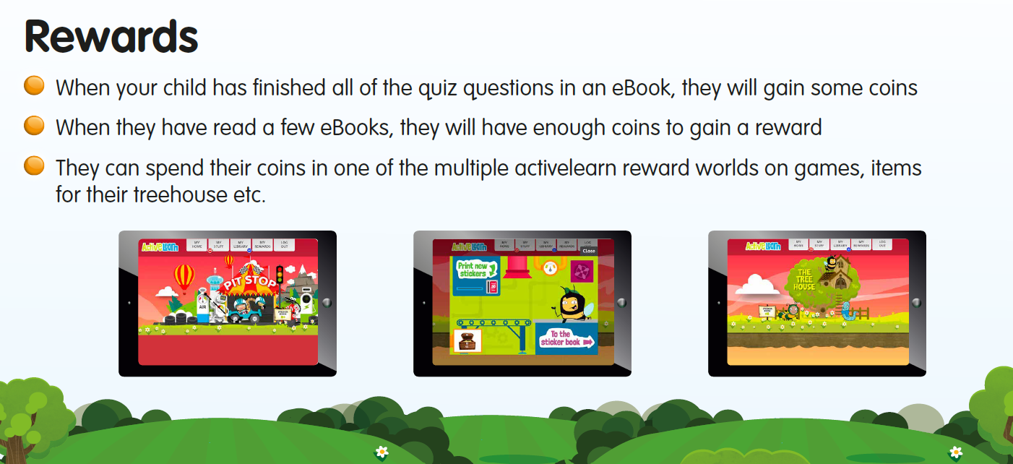
Helping at Home
  Online reading with Bug Club

Slide 20
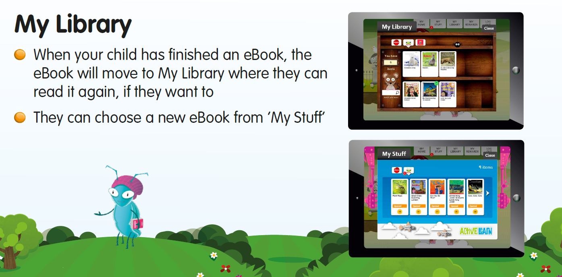
Helping at Home
  Online reading with Bug Club

Slide 21
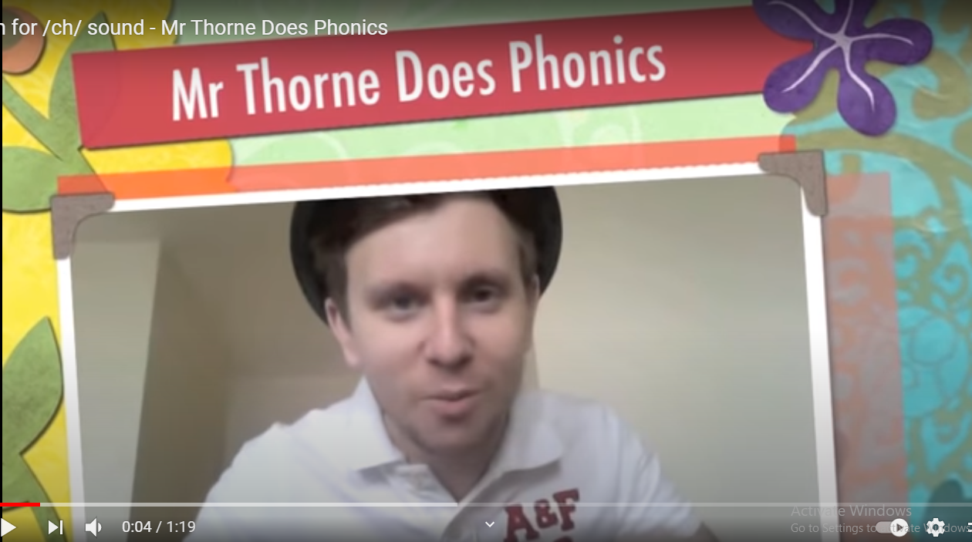

Helping at Home
RESOURCES TO HELP AT HOME...
  Phonics with Mr Thorne on YouTube
https://www.youtube.com/playlist?list=PLqh11DN6jmbBHVCDeYtWRgJcZLowiu9cv

Slide 22
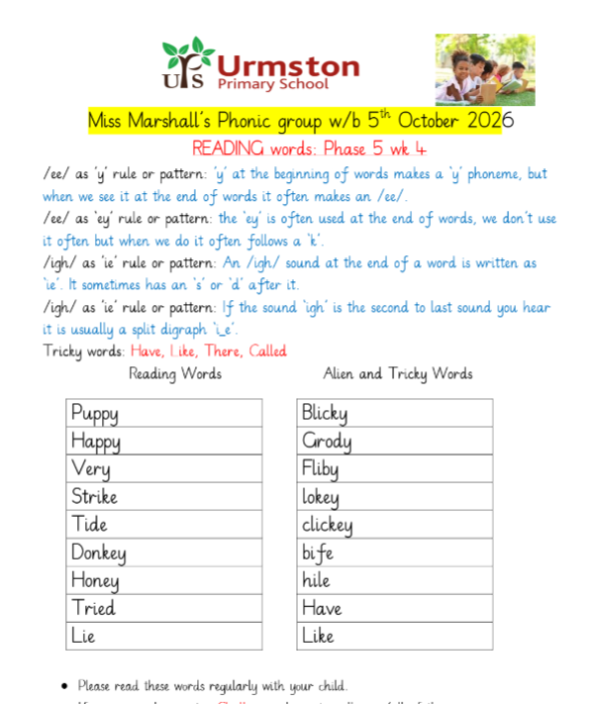
Helping at Home
  Spelling homework – based on high/common frequency words and ‘tricky words’, which will be tested half termly. It is good to visit these lists on a weekly basis at least.
  Children will have words to read each week that relate to the phonemes and digraphs that they have learnt in their phonics lessons. This should be a recap for them to allow them to consolidate their ability to recognise these phonemes more fluently within the words.
  Along with this, there will be some pseudo words (alien words) that contain the same phonemes / graphemes as the real words. This is in relation to the Phonics Screening Check in the summer term.
  You will know which phase and sounds to focus on because the books your children bring home (or have been allocated online) are linked to the words that they are practising to read.

Slide 23
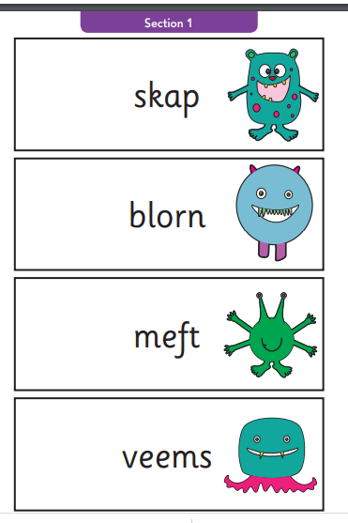
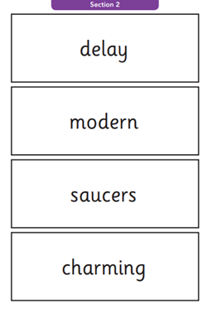
Phonics at UPS
What is the Phonics Screening Test
and when will it take place?
Week commencing 14 June 2027
There are two sections in this 40-word check and it assesses phonics skills and knowledge learned through Reception and Year 1. Your child will read up to four words per page for their teacher and they will probably do the check in one sitting of about 5–10 minutes.
https://www.youtube.com/watch?v=KKzSvB6wmGs
How can I help my child to prepare for this?
Please, please complete all the phonics activities that you will be receiving and read regularly with your child.
https://home.oxfordowl.co.uk/at-school/primary-school-assessment-tests/year-1-phonics-screening-check/

Slide 24
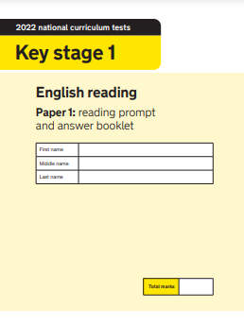
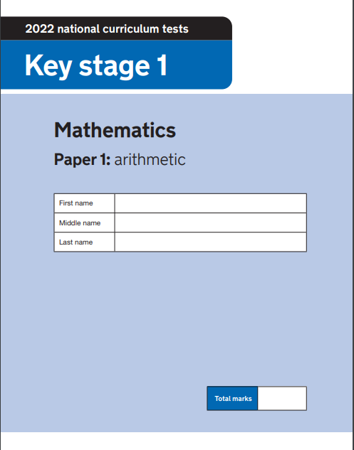
Assessment at UPS
SATs, simply stands for Standard Assessment Tests.
These end of KS1 tests used to be used as a benchmark for progression in primary educations, however, following the Government’s response to the 2017 consultation on primary assessment, on 20 July 2022, DfE announced that assessments at the end of KS1 would become non-statutory from the academic year 2023 to 2024.
The reception baseline assessment (RBA) has replaced the end of KS1 assessments as the baseline for cohort level primary progress measures. It became statutory in the academic year 2021 to 2022.
The papers are still made available to schools for teachers to use to inform their teacher judgement, and to support in the measurement of pupil achievement and to help identify where their pupils need additional support as they transition into key stage 2 (KS2).
We still use the papers in KS1 for Year 2, but have pushed the date back to June / July to allow more time to focus on embedding learning and actually finish the curriculum before the children are assessed. Year 1 children are assessed using Rising Stars, but these are mainly to support teacher judgement.

Slide 25
Assessment
What does this mean for your child?
The best thing that you can do is simply support your child with their reading and spelling / phonics homework each week. No extra preparation is needed.
As stated, these assessments are simply a tool for teachers to use to sit alongside judgements made by teachers regarding attainment in English and maths.
It is important to remember that at UPS, learning is about more than a score and at our very core of learning is our UPS Being More Curriculum, which is centred around our values, and ensuring that our pupils become good citizens is key to us here.

Slide 26
Any Questions?

