Slide 1
Growing up An introduction into supporting you and your child to lead a well-balanced, meaningful and connected life

Slide 2
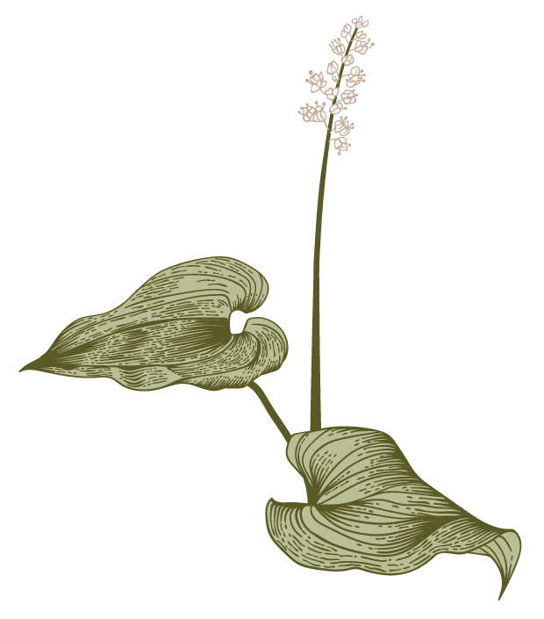
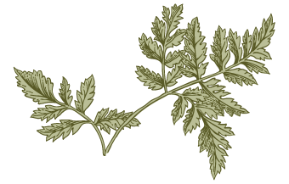
Agenda
A
Introduction
Your child’s brain
Self Reflection and Self compassion

Slide 3
Introduction
Megan Barber
Roots and Wings Play Therapy
Child and family therapist
Rootsandwingspt@gmail.com
‘Our ability to accept our children is directly linked to our ability to accept ourselves-both as we are presently, and for what we have the potential to become’
Dr Shefali

Slide 4
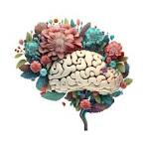
Parenting with the brain in mind

Slide 5
The importance of integration
We are often experts of our children’s bodies, but we often lack basic information into our child’s brain
Our brain has many different parts with different jobs
The key to thriving is to help these parts work together
Integration- coordinates and balances the separate regions of the brain
When our kids aren’t integrated, they become overwhelmed by emotions
We want them to be both horizontally integrated left-brain logic can work with right-brain emotion and Vertically integrated- physically higher parts of the brain which let them thoughtfully consider actions work well with lower parts which are more concerned with instinct gut reactions and survival
Our brain is plastic it physically changes through the course of our life not just childhood
What moulds our brain? EXPERIECNE ‘cells that fie together, wire together’
During the formative years lots of wiring and rewiring going on so the experience you provide will go a long way in determining the structure of your child’s brain

Slide 7
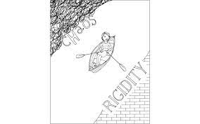
River of well being
‘It is not a child’s temperament that determines success but rather how parents and adults respond to that temperament’

Slide 8
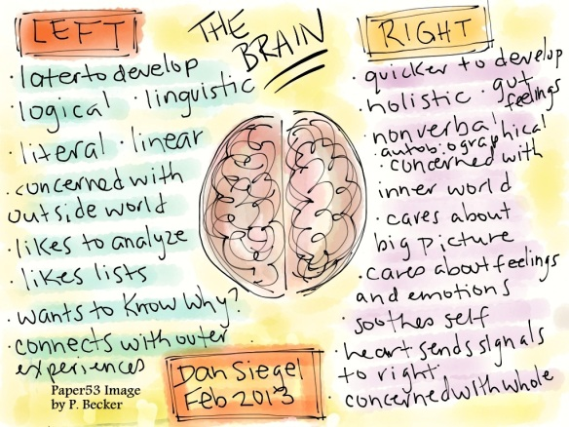
Helping your child work from both sides of the brain
Connect and Re-direct: Surfing emotional waves
Connect with the right, redirect with the left
Name it to tame it : Telling stories to calm big emotions
Resist the urge to dismiss and deny
Teach your child about the two sides of the brain
Autonomy and self awareness
Integrating Ourselves
Think about your own parenting styles, do you veer on the bank of rigidity or chaos?

Slide 9
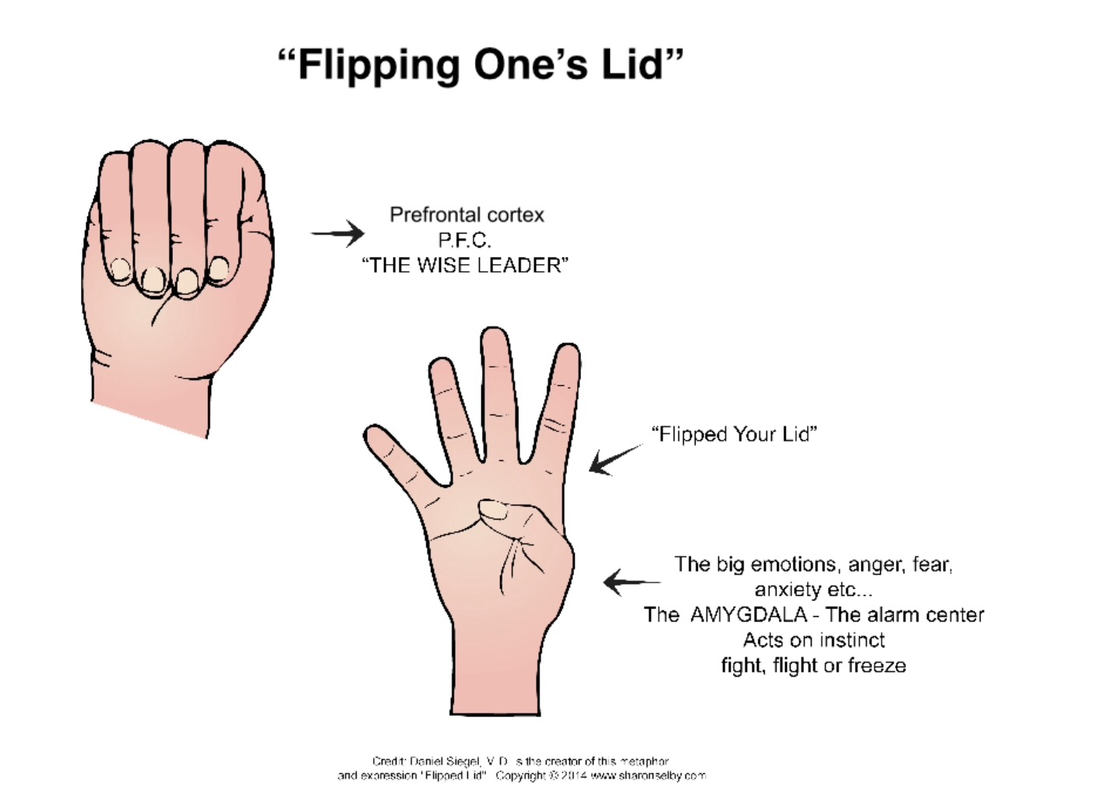

Slide 10
Building the Staircase of the mind The Unfinished Upstairs: Setting appropriate expectations Downstairs is well developed even at birth the upstairs isn’t fully mature until an individual reaches their mid-twenties Massive construction in the first few years of life and during the teenage years undergoes an extensive remodel
The Baby Gate of the mind: The Amygdala
The amygdala sits in the limbic system which resides in the downstairs area of the brain
The brains alarm system/watchdog when it senses danger it completely hijacks the brain
Tantrums:
Upstairs- A child decides to throw a fit- a conscious choice to act out, despite her dramatic and heartfelt pleas she can easily stop if you give in to her demands
Firm boundaries, clear limits and a natural consequence
Practice at seeing consequences for behaviour, learning to control impulses and teaching her that respectful communication, patience and delayed gratification pay off
As these tantrums are intentional children will stop turning to that strategy if they learn it is in ineffective
Downstairs-The child can no longer use his upstairs brain, he isn’t incapable of controlling his body or emotions
He has flipped his lid
We need to connect- loving touch, soothing voice, hold them close ‘you are safe, I am here’
Once the upstairs brain is accessible then respond using logic and reason

Slide 11
Helping develop and integrate your child’s upstairs and downstairs brain
Engage, don’t enrage: In high-stress situations, engage your child’s upstairs brain, rather than triggering the downstairs brain. Don’t immediately play the “Because I said so!” card. Instead, appeal to your child’s higher-order thinking skills. Ask questions, ask for alternatives, even negotiate.
Use it or lose it: Provide lots of opportunities to exercise the upstairs brain so it can be strong and integrated with the downstairs brain and the body. Play “What would you do?” games and present them with dilemmas. Avoid rescuing them from difficult decisions.
Move it or lose it: When a child has lost touch with his upstairs brain, a powerful way to help him regain balance is to have him move his body
Integrating ourself: Using our own mental staircase- Rupture and Repair

Slide 12
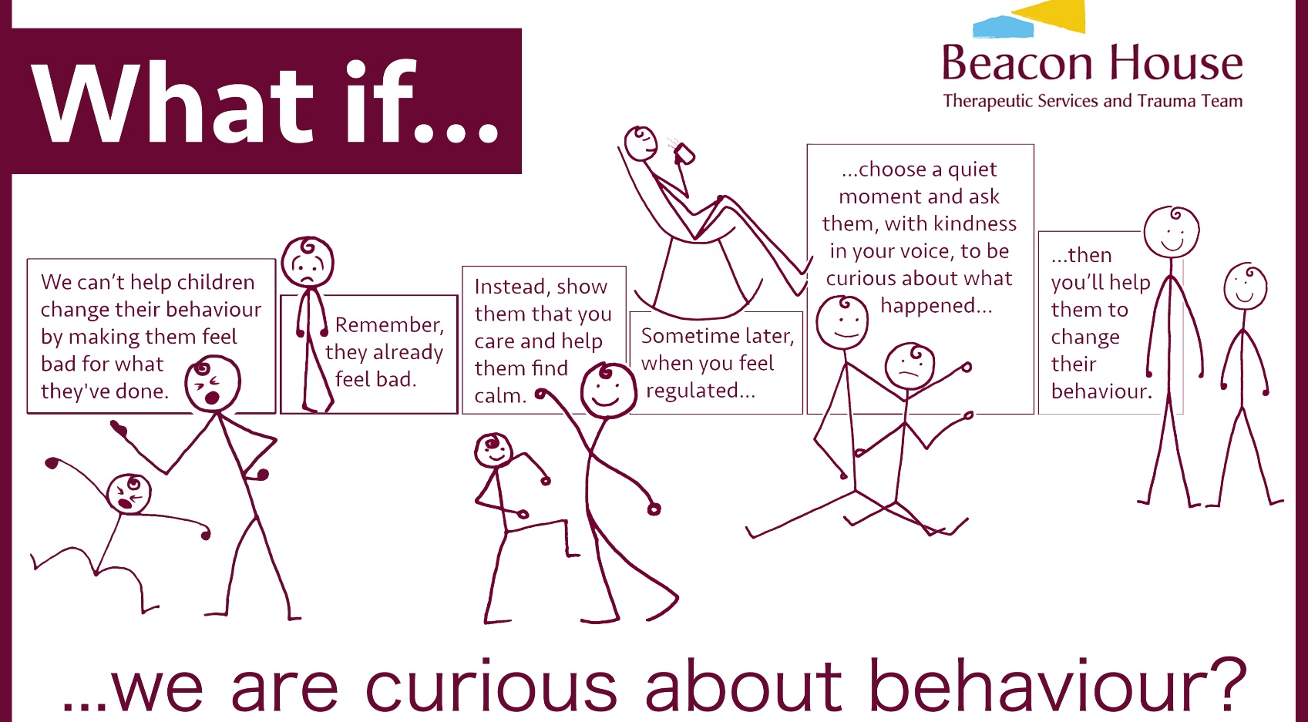

Slide 13
Mindsight
1) Insight: Let the clouds of emotion roll by: teaching that feelings come and go
It is important that kids learn and understand about their feelings, but it is also important that they are recognised for what they are: temporary changing conditions
These are states not traits
They won’t feel sad, hurt, lonely or angry forever
It takes ninety seconds for a feeling to come and go
The more they understand this the less they will get stuck in the feeling
SIFT- Paying attention to what’s going on inside: Sensations, Images, Feelings, Thoughts
Remember to come to the hub of your own mind - you can experience joy and gratitude about parenting our child by shifting your focus and attention

Slide 14
Mindsight
2) Empathy: The Me-We connection
The brain is a social organ made to be in relationship
The brain is set up for interpersonal integration- each individual brain is made to relate to the brain of each person we relate to.
Mirror Neurons:- we mirror the intentions of others but also their emotional states
and sponge in the internal states of others
Emotional contagion- The internal states of others from joy and playfulness to sadness and fear can directly our own state of mind
As parents are laying the groundwork for connection

Slide 15
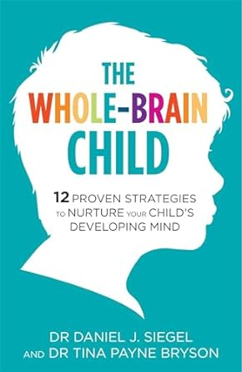
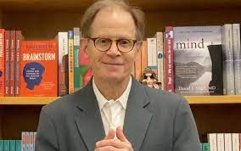
Worth checking out
https://www.youtube.com/watch?v=PGUEDtGSwW4

Slide 16
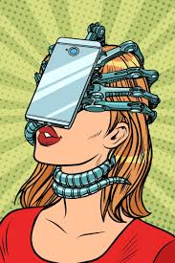
The world is no longer your oyster, it is your screen
During the stage of development when our kids have the LEAST amount of self-control, we give them the screens that require the MOST amount of self-control
There are benefits in letting your kids get bored if we always give in with screens, they might learn to connect technology with feeling better, no matter what the root cause is
Use it or lose it’-the child loses an opportunity to grow a key part of their brain used for emotional control (prefrontal cortex)
Instead of learning how to manage emotions they will learn to ignore emotions or distract themselves with screens

Slide 17
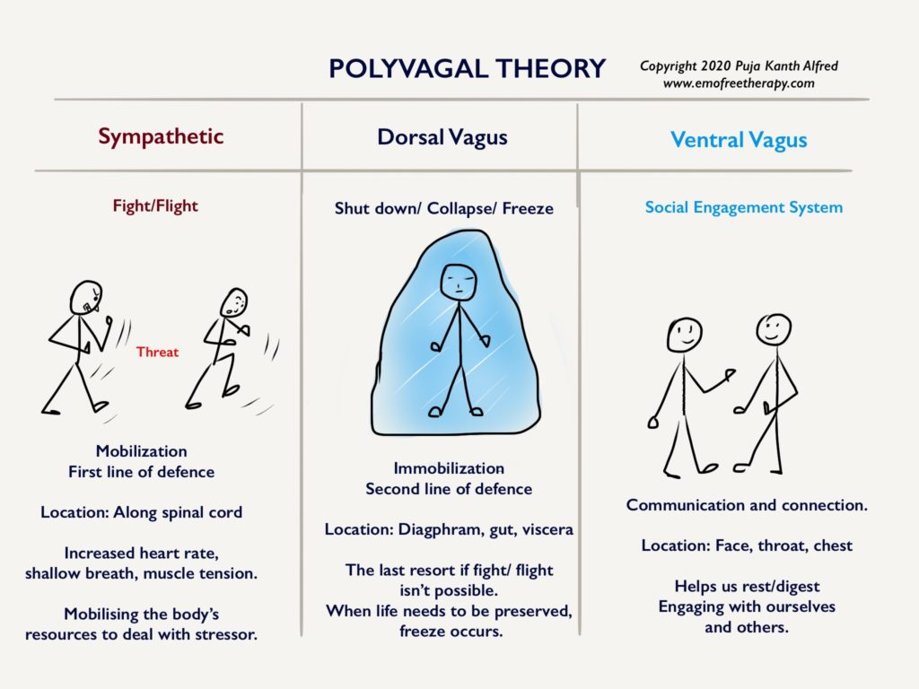
Polyvagal theory The social engagement system

Slide 18
Empowering our children while transforming ourselves

Slide 19
Frustration to clarity
As parents we often pretend that we know or should know how to raise these humans we call our children.
So great is this desire we will often pretend that we are perfect, and everything is going as planned.
Hide our sufferings from the world and suffer in silence and shame.
It is easy to blame our children for all the uncomfortable, sometimes heart-breaking feelings that’s can arise.
We are not supposed to intuitively know how to raise children
Let's change the focus of parenting from creating a kid to creating a new you
Let’s turn the spotlight inwards and work on becoming your best selves
Let’s stop being manager and tyrants, task masters and control freaks
Let’s work with connecting with them, learn from them, guide them and become their allies
Because it isn’t about what your kid does or doesn’t do its about what you do in response, what you feel in reaction and how you emotionally cope with it all
Our response to our kid's behaviour they come from our past- our disconnection from our kids come from our level of healing from the past
Our children show us the way we are broken
And the more we want our children to be great indicates how lesser than we feel <3

Slide 20
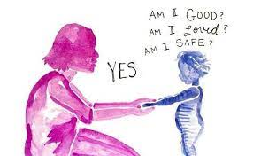
Discover your two I’s
Inner child
The term "inner child" is often used to describe the connection you have within yourself to your child self and your childhood memories. At times, you might find that certain behaviors or emotions mimic those you experienced as a child, causing you distress as you try to navigate an adult world.
Imposter ego
We wear our ego when we feel afraid or insecure
The ego developed to protect us
You might find you react to your children’s behaviours that ignite a trigger in us in s way that falls in these different categories
Fighter
Fixer
Feigners
Freezers
Fleers

Slide 21
Can we destroy the fantasy and lean into acceptance?
Can I accept my child and my reality as they are, without the movie?
What feelings come up for me as I release my expectation?
What about my reality is causing me pain and fear?
Can I find joy and abundance in my children, just the way they are?
Once we can do this, we can we can stop blaming our children for not acting out our fantasy movie and shift into finding ways to celebrate what is showing up for our children, without blame or shame.
Only then can our children feel anchored in their own authentic relationship with themselves
We give them to gift of self-worth and self-celebration
Let’s start attuning to who our kids truly are ☺
I became a parent because?

Slide 22
Babysitting It’s not a good idea to sit on your babies figuratively (or literally) Let them shout out their desires and despair For what is theirs, is yours, is theirs, was your Great Grans before Until it isn’t When you stop sitting on your babies Meg Adele

Slide 23
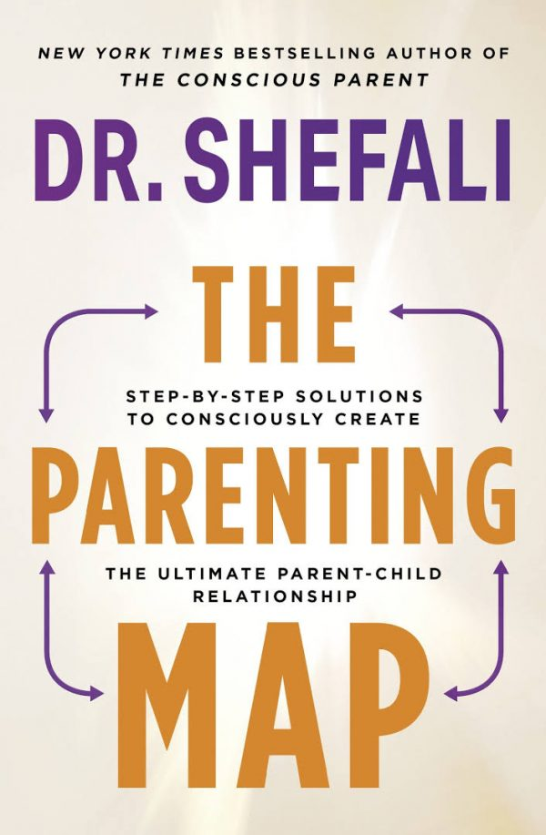
Worth checking out
https://www.youtube.com/shorts/DyFknvyemxA

Slide 24
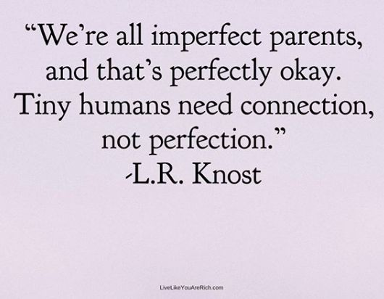
Thank you
https://www.youtube.com/watch?v=D9OOXCu5XMg

