Slide 1


Welcome to Reception at
Parent Meeting, Thursday 10th September, 8pm
Self-Awareness and Connection
Growing together. Empowered to be more.

Slide 2
First up…sorry, (but not sorry!), for pestering you all! Thank you for coming!

Slide 3

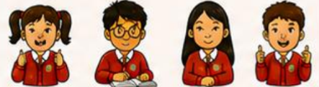
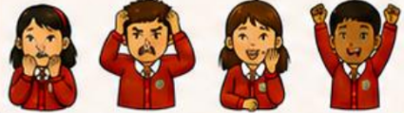
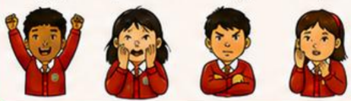
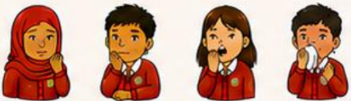
To note: UPS is a mainstream school. We are ‘judged’ on the academic ‘achievement’ of all of our children and to support and challenge all of them. Happiness and wellbeing must not be traded off for ‘standards’. Self-Awareness and Connection will aid readiness for learning and draw everything together.

Slide 4
What is it? Why are we doing it?
The UPS Self-Awareness Curriculum is a whole-school approach designed to help children understand and accept themselves, regulate their emotions, recognise and advocate for their needs, and develop the resilience, independence and empathy needed to thrive. It has been developed in response to the increasing social, emotional, mental health and behavioural needs experienced within the school community, while maintaining the principle that inclusive provision should benefit every child.
Rather than operating as a stand-alone subject, self-awareness is embedded within the wider culture and ethos of Urmston Primary. Through six interconnected modules, children develop understanding of the brain and nervous system, their individual strengths and needs, body awareness and interoception, energy and regulation, metacognition and learning, and ultimately their connection and interdependence with others.
Central to the approach is the ‘Me-Map’, enabling children to identify their strengths, preferences, triggers, sources of happiness, and strategies that help them feel safe and ready. This supports children to understand themselves while also developing greater empathy and awareness of the different needs and experiences of others.
Delivery is intentionally flexible, with teachers using their knowledge of individual children to integrate short, purposeful activities throughout the school day or week as appropriate, alongside assemblies, transitions and everyday relational practice. The curriculum therefore becomes a consistent way of thinking and behaving across the school, rather than a programme of lessons.
Ultimately, the curriculum seeks to fulfil the UPS vision of ‘Growing Together. Empowered to Be More’ by developing children who are more self-aware, resilient, confident, independent and brave, while being better able to communicate, connect, empathise and contribute to a culture of inclusion, belonging and togetherness.

Slide 5
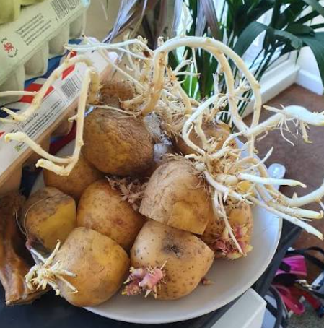
We are all just trying to grow in our own way…

Slide 6
Aims and Objectives
To support ALL of our children in developing their self-awareness, understanding their own ‘me maps’ and how to manage their emotions.
To nurture greater self-esteem, independence and resilience, in readiness for the next stage in their young lives and in preparation for a life that will be littered with struggles and mistakes being made, but also with opportunities to make them again and rise to challenges.
To help our children reflect on what brings them joy and happiness…and that this may be different to others, and that’s okay!
To enable our children to understand how importance it is to advocate for themselves, and to nurture the confidence to do so.
To enhance our children’s confidence in communicating and connecting with others – understanding that we all have different strengths in how we communicate and connect, and we should be aware of, respect and appreciate those different forms of connection.
To enhance our children’s mental health and wellbeing - to develop love for themselves and being their own best friend.
For our children, through increased self-awareness, to begin to make informed and responsible choices around tech, social media and AI, as they begin to think about secondary school and their place in the wider world.
To further develop children’s empathy and understanding of others’ needs, that everyone has their own story, their own ‘me map’, which shapes their view of the world.
To support families in our community with the above, sharing knowledge and experiences and further nurturing a culture and ethos of inclusion, togetherness and belonging.
To enhance the sense of ‘self’, ‘identity’ and ‘belonging’ of everybody within our school community and understanding that it may be that our ‘self’ changes and adapts to the people that we are with and in the different environments that we find ourselves in.
For everyone in our school community to become more aware of being part of something bigger than just our view of ‘self’ – to enhance our sense of ‘MWe’: togetherness, interdependence, and being connected to one another, whilst not losing sight of our own individuality and uniqueness.

Slide 7
Who has contributed?
Katy Beetham. ‘The Curiosity Project’ and the ‘Navigating Connection’ program
Megan Pitts. ‘Inner Worlds Therapy’
Trafford SENAS and EP service
The Zones of Regulation, Inc. founded by Leah Kuypers
Daniel J. Siegel
National Autistic Society
Thinking Matters
Daniel Hughes Ph.D. PACE approach to attachment theory
UPS Resilience Framework. Adapted from Boingboing – Resilience CIC
Mindflick – Spotlight Profiling tool - founded by performance psychologists Dr. Mark Bawden and Dr. Pete Lindsay, alongside former England Cricket Captain Sir Andrew Strauss

Slide 8
Module 1: How does my brain and nervous system work?
This module helps children to understand how the brain and nervous system work together. It works on the premise that if children have a greater understanding of how the brain works, about neuroplasticity, how memories and habits are formed and what the brain needs to feel safe, they will be more able to consider how their minds can work with the brain and nervous system to help form new, positive neural pathways. This could be a stepping stone to courage and increased resilience and independence.

Slide 9
Module 2: Knowing Myself: Being my own resilient best friend
This module is based on the view that we use our cortex (learnt in Module 1) to have ‘mindsight’. When we know our minds, we are able to converse with ourselves and talk to ourselves. This helps us to reflect on our mindset and behaviour preferences and to know what resilience truly is and how to develop and maintain it…knowing that we always have our own back and that we can lean into our biggest strengths when we need them the most. Maybe we can even think about when we might need to look at the inner strengths that we have that perhaps we don’t always use that much! Being your own best friend can be the grounding for self-awareness and help you to be a reliable friend for others too.

Slide 10
Module 3: How do I feel from the inside?
This module helps children to enhance their body awareness (the ‘phonics of self-regulation’ and interoception – our ‘sixth sense’). The more attuned they are to their bodies and what they feel, the more likely it is that they will be able to regulate their emotions, to be present and less distracted, and be ready and alert to learn and grow. Furthermore, when they are more aware of their emotions and how their bodies react, they will be more able to connect with others and others’ emotions, co-regulating with trusted adults and even with one another.

Slide 11
Module 4: How can I understand my energy?
When we are aware of our energy, whether high or low, due to anxiety, distress, excitement, fear, joy, we are more able to manage it to maintain positive mental health and wellbeing…in all manner of circumstances and environments. Being aware of our energy enables further growth of self-awareness, widens our window of tolerance and enables us to be resilient and take responsibility for our actions. It also helps us to empathise and be aware of the energy of those around us.

Slide 12
Module 5: Metacognition and being a ‘Meta-Learner’
Helping our children to be aware of how they learn, enables them to get into positive Habits of Mind, nurturing further independence in what works best for them on their journey of growth. Being aware of our own learning processes and how we plan, monitor and evaluate at each stage, enables our children to be more reflective, creative and critical thinkers.

Slide 13
Module 6:Me, You and ‘MWe’: ‘Intraconnection’
This module broadens our children’s understanding of what the ‘self’ really is and enhances awareness of the importance of connection and an ‘interdependence’ with others. Being aware of how we are all connected, not just with other humans but with all living things, enables us to understand that everyone has their own story, stories that we can empathise with and enabling us to support ourselves and support and love one another. We begin to understand that our ‘self’ can relate to the environment that we are in and those who we connect with. Helping children to relate to one another and feel valued by each other is key here and so promoting peer-to-peer emotion coaching will be a positive element of this module. Of course, grown-ups find keeping this in their awareness difficult enough…so let’s start early.

Slide 14
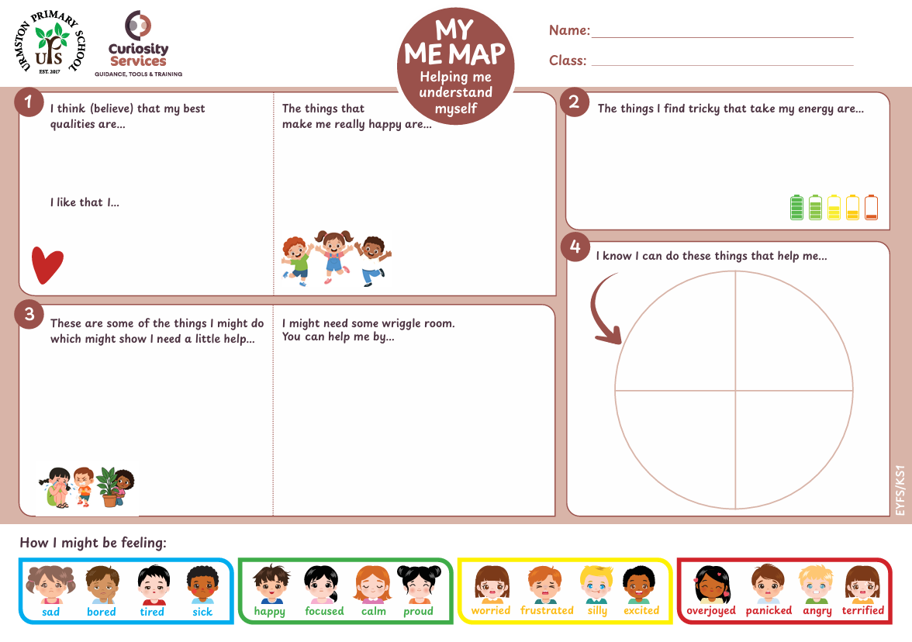
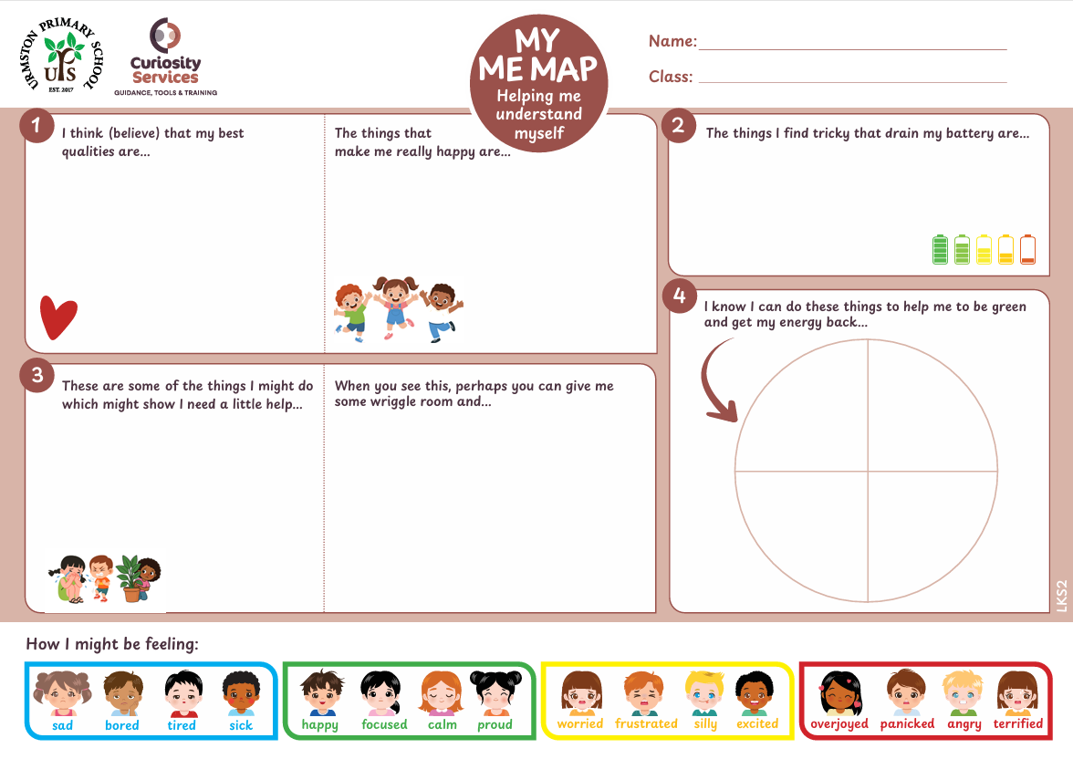
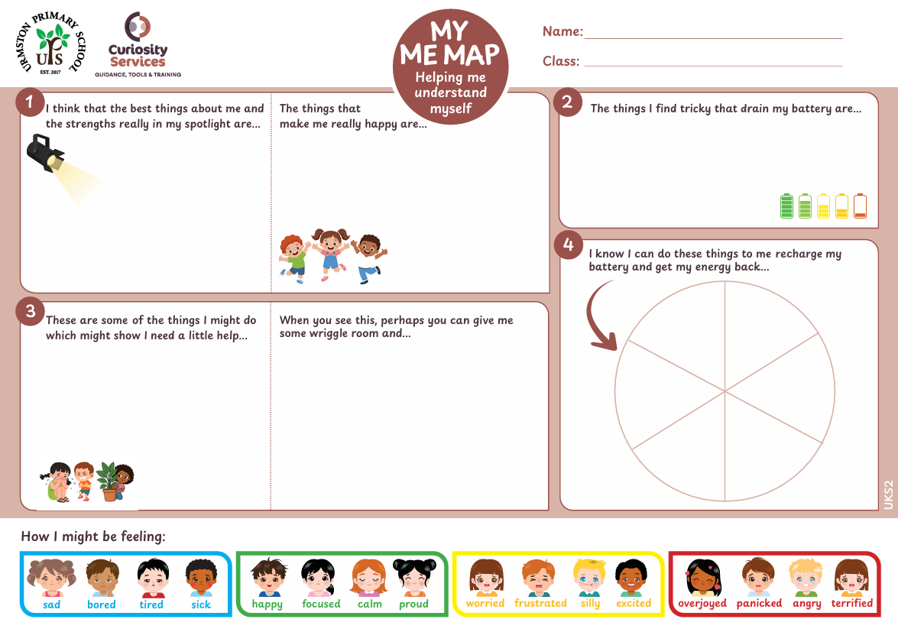
The really important bit…’Me-Maps’…EY/KS1 – LKS2 – UKS2
Let’s discuss…for you as adults and then for our children…

Slide 16
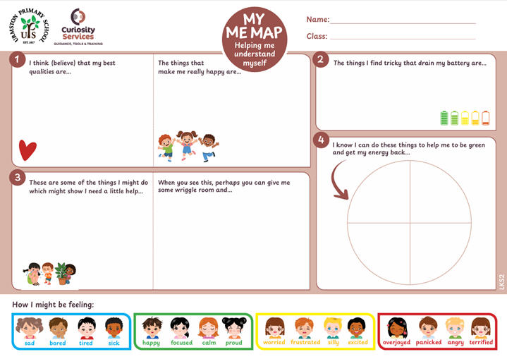

Slide 17


Slide 18
  Next steps…
  EY/KS1
  1) Talk with children and show them the me-map – what is it all about
  2) Send the me-maps home with the children
  3) Parents work with their children and return it to school
  4) Staff and children do together to get the ‘final, first’ version, adding and amending as necessary
  5) Put in class ring binder folder and make accessible to all
  6) Send agreed copy home to parents
  KS2
  1) Do as an activity with your children
  2) Send the me-maps home with the children
  3) Parents work with their children and jot on the me map and return it to school
  4) Staff and children do together to get the ‘final, first’ version
  5) Put in class ring binder folder and make accessible to all
  6) Send agreed copy home to parents in doc wallets
  These will then be referred to and used regularly and a dynamic document, providing consistency between home and school, helping every child to feel seen and valued, and to enhance their sense of self and belonging – celebrating uniqueness and difference whilst connecting, empathising and being part of something special.

Slide 19
Questions?
Follow up meeting and Q&A on Tuesday at 4.30pm…link below…
Topic: UPS Self awareness and me maps follow up discussions
Time: Sep 15, 2026 04:30 PM London
Join Zoom Meeting https://us06web.zoom.us/j/83928360460?pwd=S25HzaEwepJmORsMmassTiHoJiZmbf.1
Meeting ID: 839 2836 0460
Passcode: 625933

