Slide 1
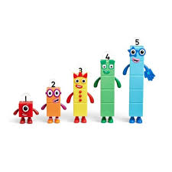
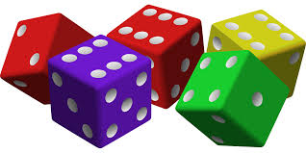
Maths in the Early Years Nursery and Reception

Slide 2
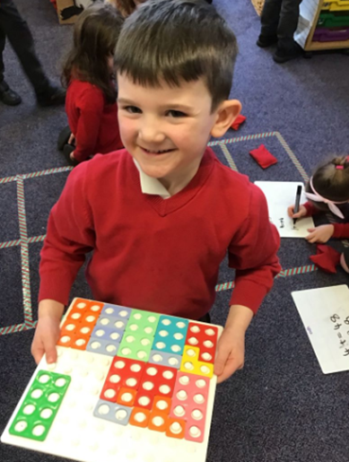
Research suggests that children’s confidence in Maths can be affected by the people around them.
It’s really important that if you lack confidence in Maths, you don’t pass this on.
Please never say “I’m rubbish at Maths” in front of your children.
Whatever your feelings are about Maths, our aim is to equip you with the right knowledge and advice so that you can feel confident in supporting your children on their mathematical journey through the EYFS.

Slide 3
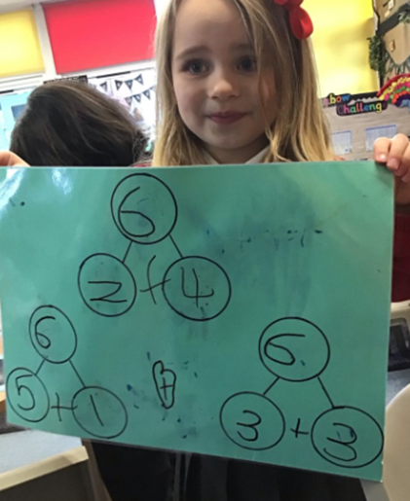
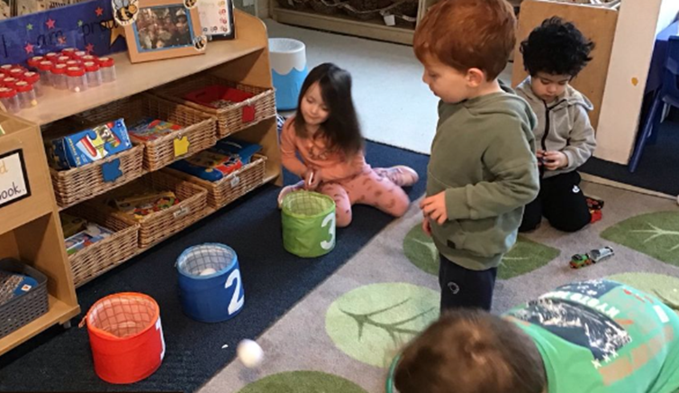
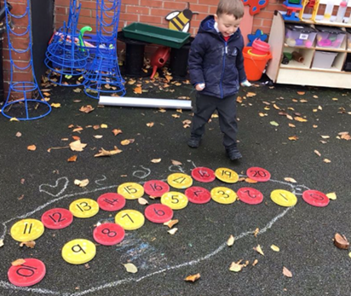

Slide 4
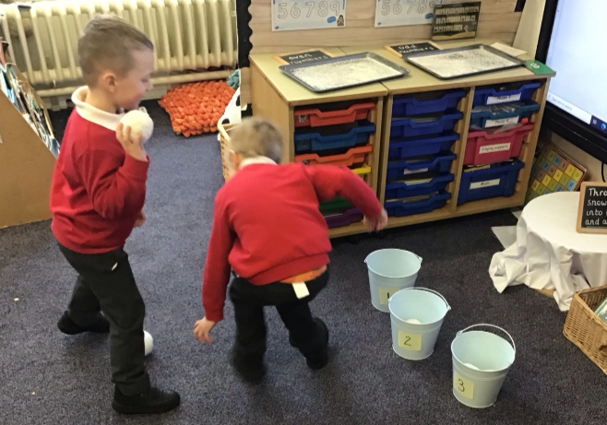
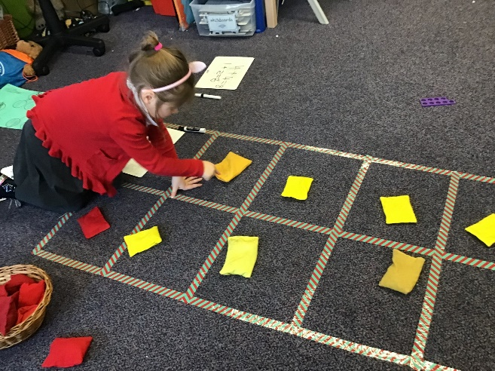
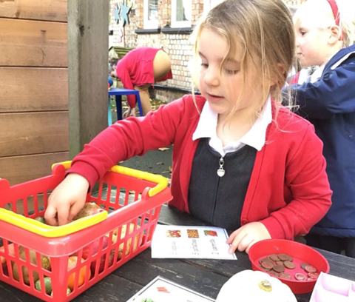
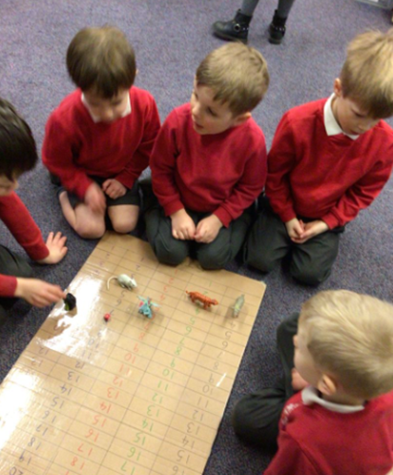
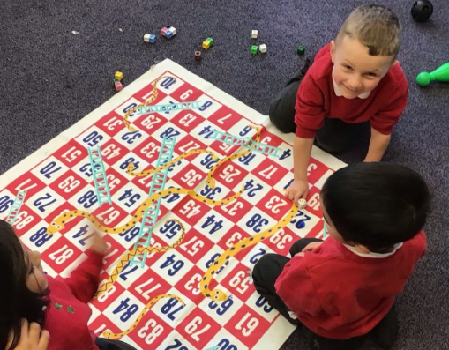
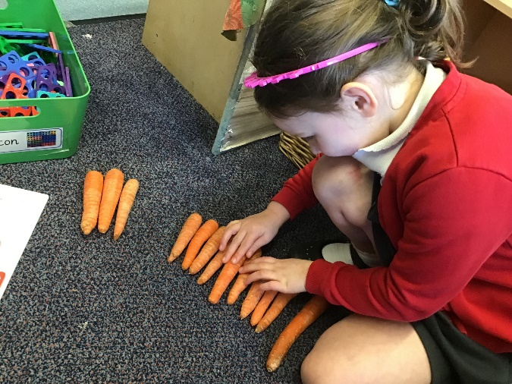

Slide 5
Early Learning Goals

Slide 6
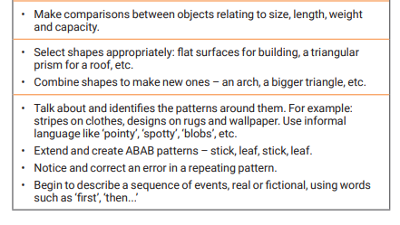
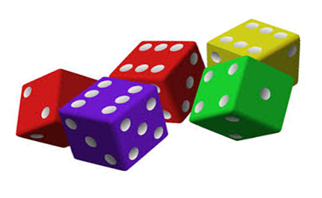

Slide 8
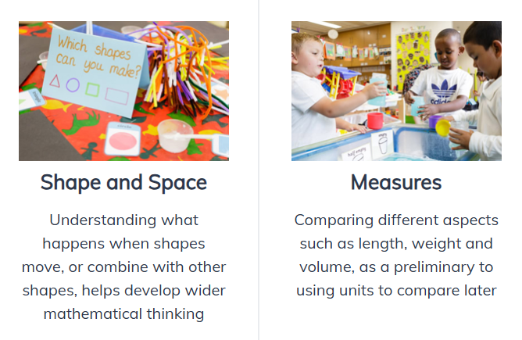

Slide 9
Counting and Cardinality
-Saying number names in sequence
-Tagging each object with a number word
-Numeral meanings
-Knowing the number counted gives the total so far
-Conservation of a number-knowing that the number does not change if things are rearranged (so long as none have been added or taken away)
Number sense

Slide 10
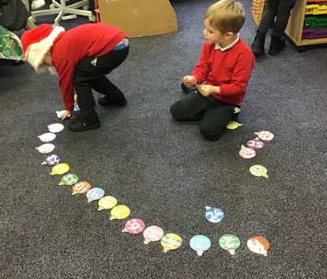
Common mistakes when counting
Missing out an object or counting an object twice.
When asked to collect a certain number of objects,
the child grabs a random amount or carries on counting past the given number.
When objects are rearranged the child unnecessarily recounts them to find out how many there are
Confusion over teen numbers
Missing numbers like 15 or 13 or confusing 13 with 30.

Slide 11
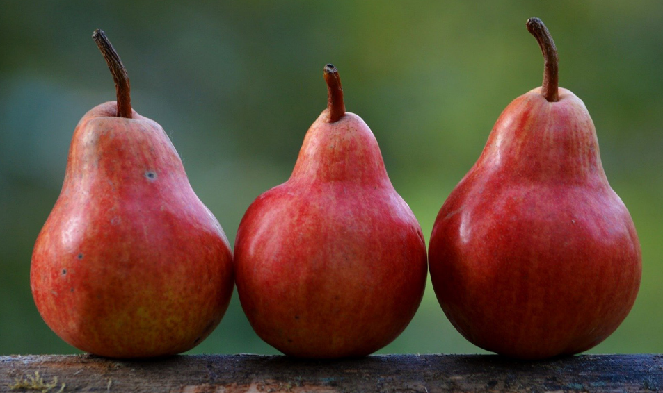
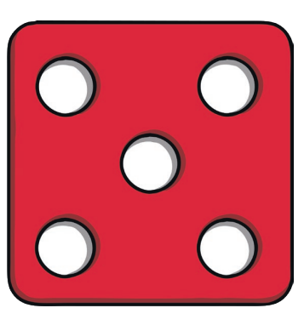
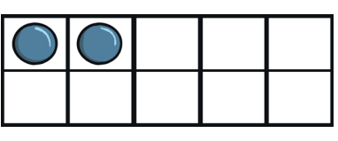
Subitising
Perceptual subitising

Slide 12
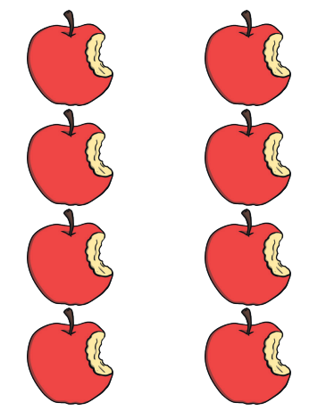
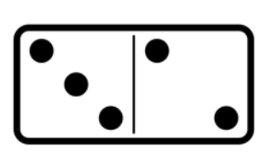
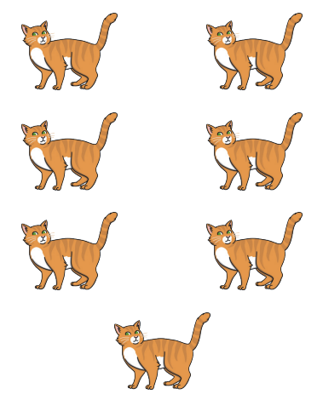
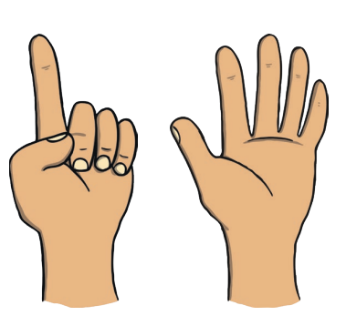
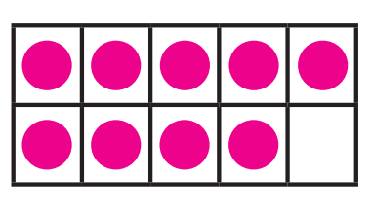
Subitising
Conceptual subitising

Slide 13
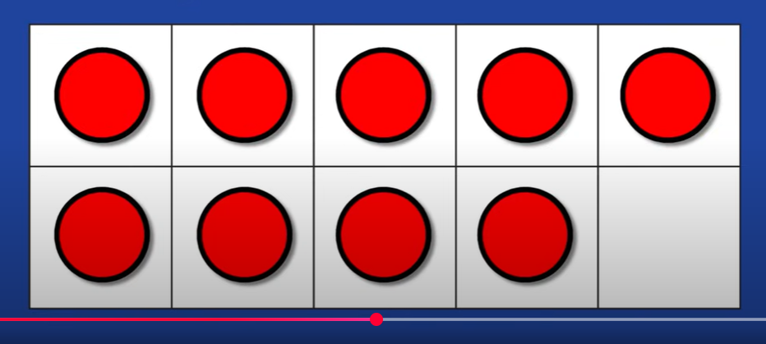
We love Jack Hartmann for subitising! Jack Hartmann subitising

Slide 14
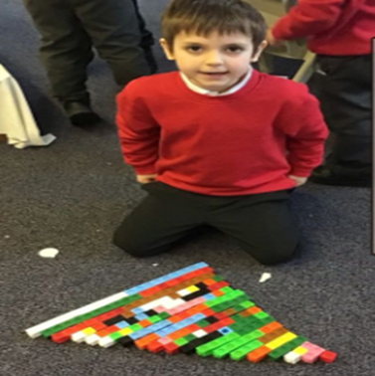
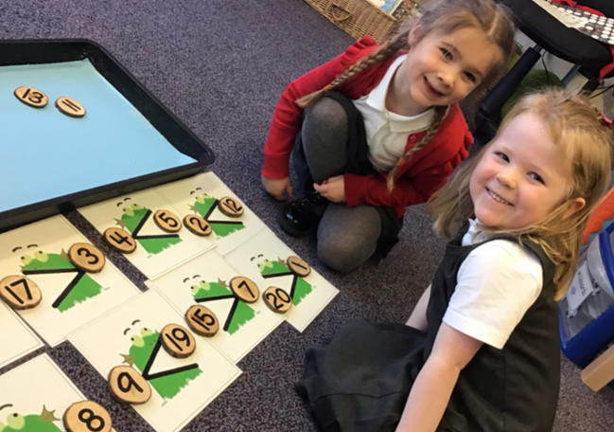
Comparison
-More/less than (greater/fewer)
-Identifying groups with the same number of things
-Comparing numbers and reasoning
-Knowing the ‘one more than/one less than’ relationship between counting numbers

Slide 15
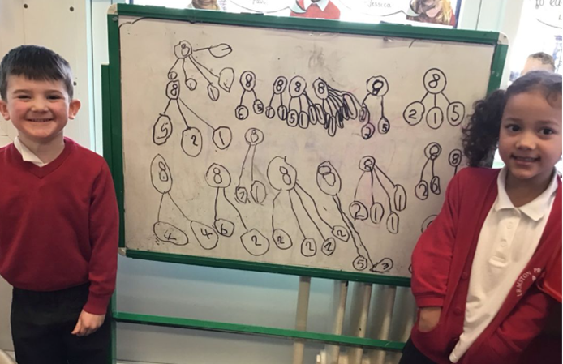
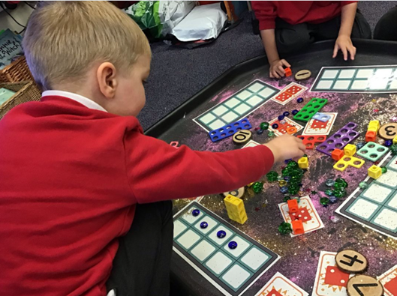
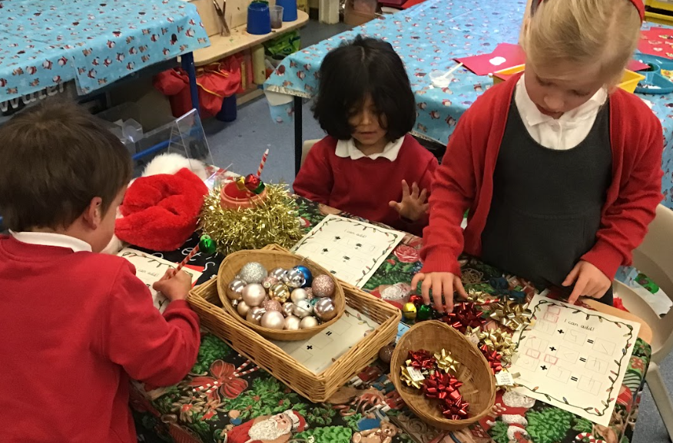
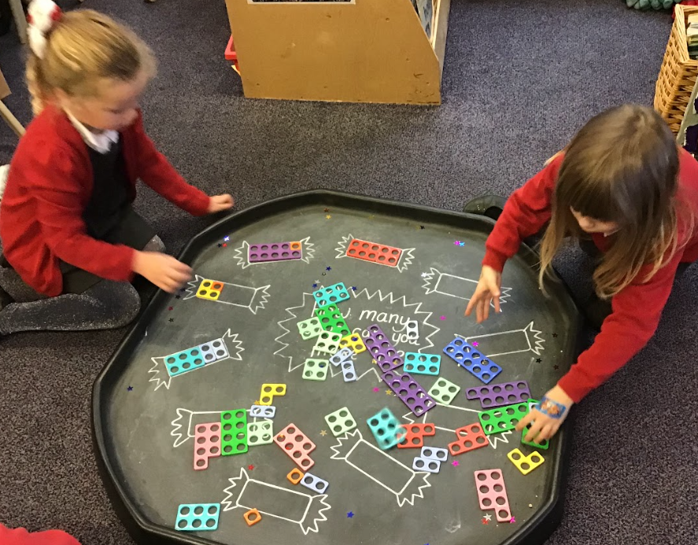
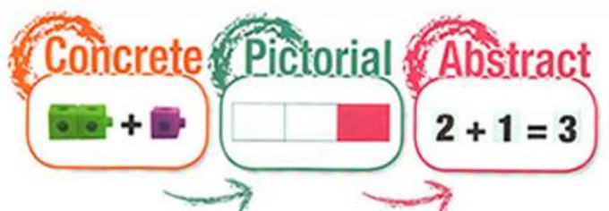
Composition
-Identifying smaller numbers within a number
-Inverse operations
-Numbers can be partitioned into pairs of numbers
-A number can be partitioned into more than 2 numbers
-Knowing number bonds- pairs of numbers that make a given number

Slide 16
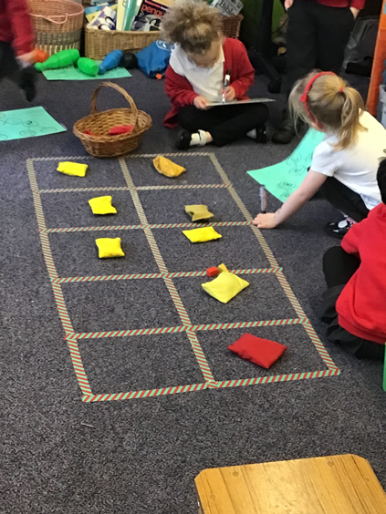

Slide 17
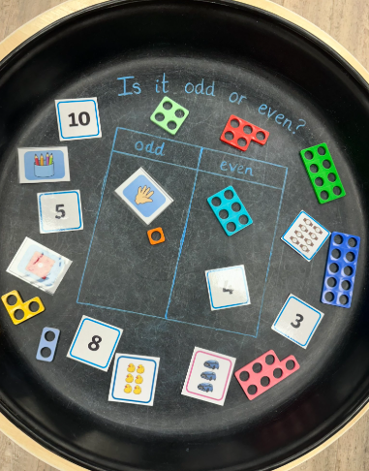
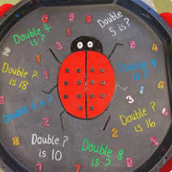
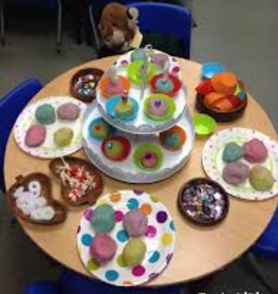
Number patterns
-Odds and evens- how do we know? What’s the pattern?
-Sharing- can we share equally?
-Doubling and halving- can we see the relationship?
-

Slide 18
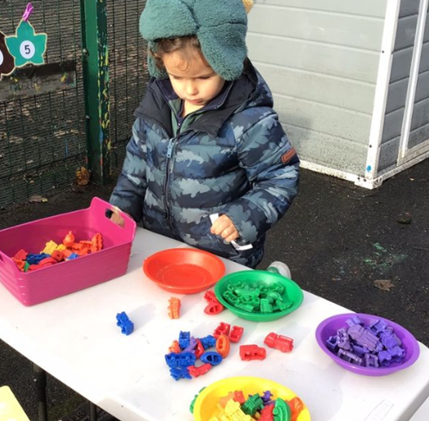
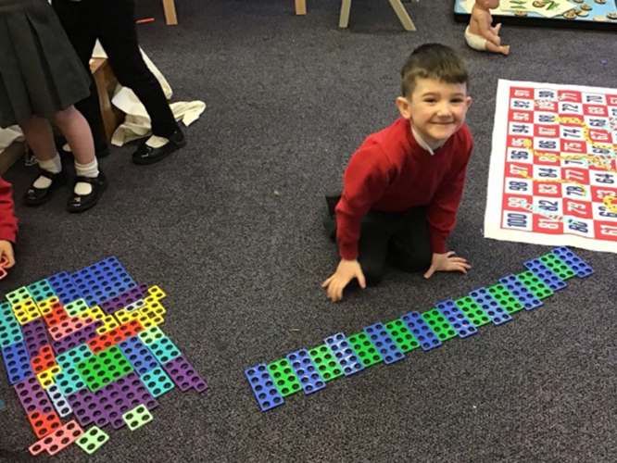
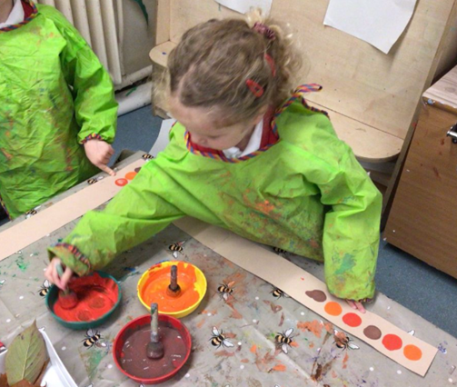
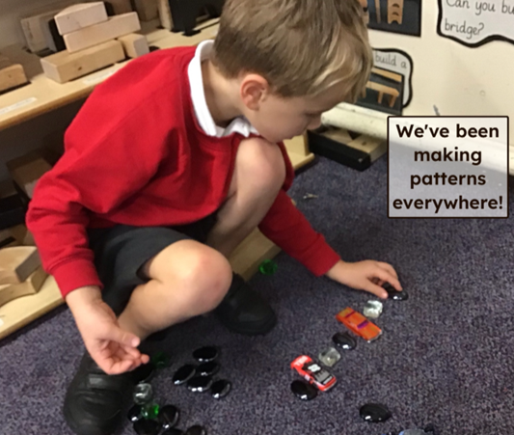
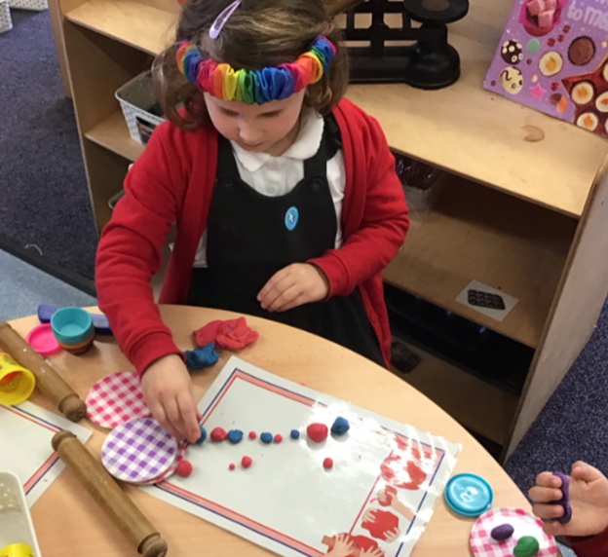
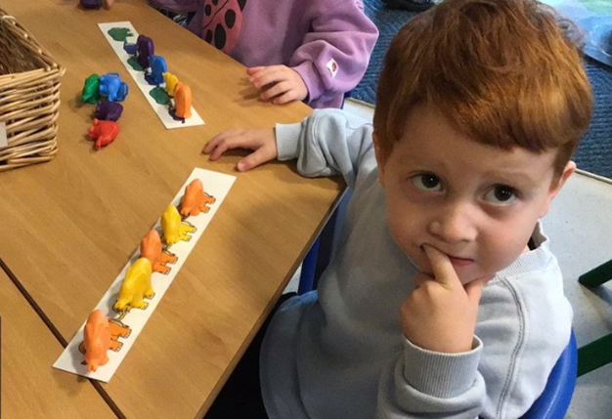
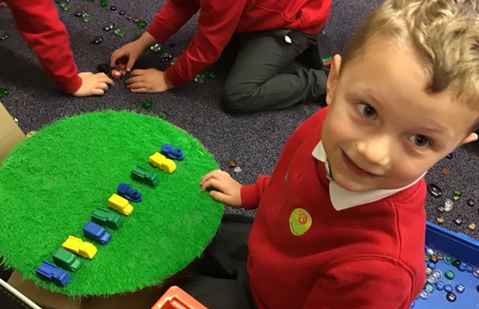
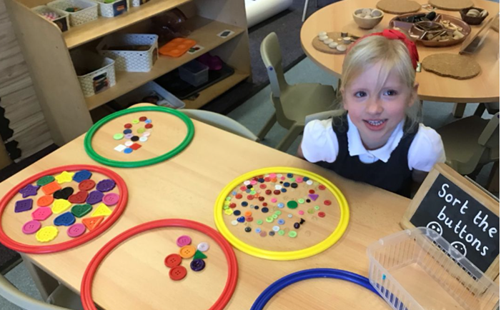
Pattern
-Noticing patterns- spots, stripes, repetitions, etc.
-Continuing/copying an AB pattern
-Making their own AB pattern
-Spotting an error in an AB pattern
-Spotting the unit of repeat in the pattern
-As above with ABC, ABB, ABBC patterns

Slide 19
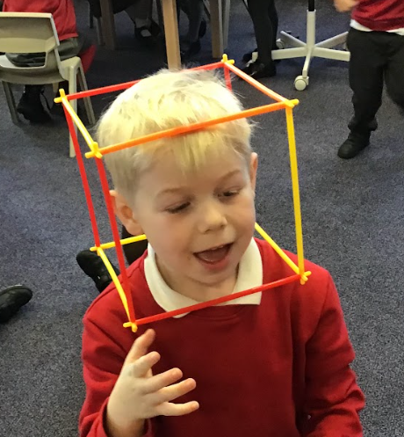
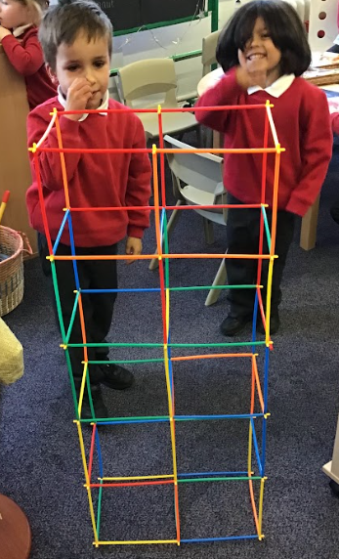
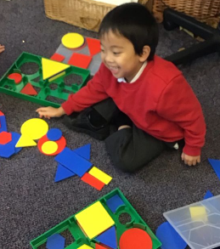
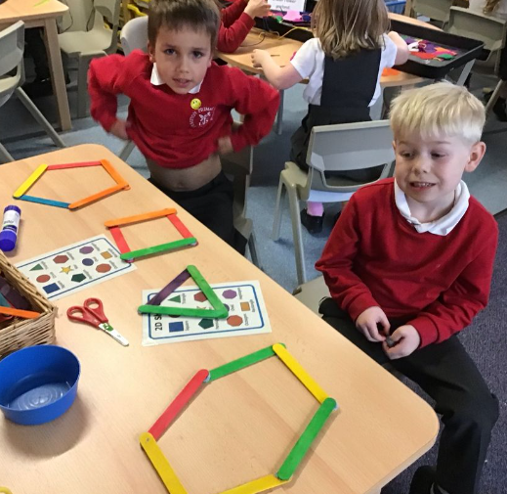
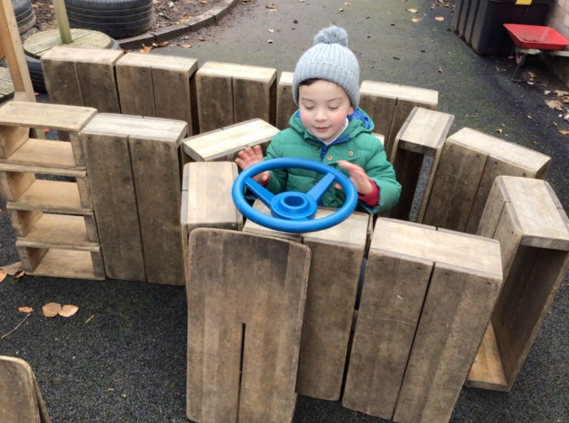
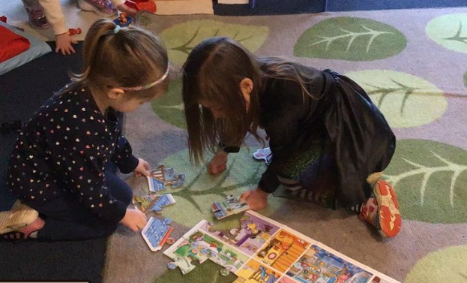
Shape
-Develop spatial awareness
-Positional Language
-Follow instructions including positional language
-Develop shape awareness through construction
-Identify similarities between shapes
-Talk about the properties of shapes
-Name 2d and 3d shapes

Slide 20
Measure
-Compare amounts and show an awareness of measure
-Begin to use the language of size, length, weight and capacity when comparing
-Estimate and predict
-Begin to use units to measure things
-Begin to sequence events (visual timetable)
-Begin to use the language of time
-Begin to experience specific time durations

Slide 21
Comparing
Estimating
Measuring
Rotating
Counting

Slide 22
Deepening understanding
Is your child able to explain how they found an answer?
Can they find different ways to give the same answer?
Can they apply their number knowledge to solve a word problem? E.g. 10 monkeys are jumping on the bed. 3 fall off. How many are left?
Can they solve real life problems? E.g. If my birthday is on the 8th and today is the 3rd, how many sleeps do I have? Today is Thursday so what day will my birthday be?
Can they explain the inverse? e.g. if 2+3=5, 5-3=2
Can they explain the patterns they see? E.g. 9+1=10 8+2=10 7+3=10
Are they showing awareness of place value and use their
knowledge of numbers to 10 to carry out larger calculations?

Slide 23
Numicon

Slide 25
Numberblocks…

Slide 26
Tidying up…

Slide 28
How you can help
Foam numbers in the bath
Hide number pebbles in the garden
Have a number hunt on the way to school
Spot the odd and even patterns on front doors
Encourage careful pointing and counting
Encourage your child to count out objects from a group
Share food, toys, cards, etc. equally
Ask your child to set the table
Count the stairs as you climb them
Sing counting songs together

Slide 29
Play games!
Board games
Orchard Games
Dominoes
Top Trumps
Skittles
Uno and other card games

Slide 30
Role Play!
Post Office
-Wrap parcels
-Weigh parcels
-Sell stamps
-Sort coins
Shops
Bank
-Price up the items
-Choose the correct coins
-Find the total of 2 items
-Have a half price sale
-Sort coins
-Find ways of making given amounts
Cinema/show
Tea party
-Sell tickets
-Make a poster with show times
-Sell snacks
-Share food equally
-Set the table
-Send invites with the time and date

Slide 31
Compare and order objects and people
Build models together
Go on a shape hunt
Talk about shapes in your home
Space, shape and measure
Fill different sized containers in the bath- which hold the most?
Encourage positional language- no pointing!
Bake together
Use mathematical language: shorter, taller, longer, wider, heavier, lighter, full, empty
Puzzles and jigsaws

Slide 32
Look at the calendar together
Talk about the date
Help your child to tell the time
Use language of time- today, yesterday, tomorrow, next week
Talk about upcoming events-count down the days/sleeps

Slide 33
Useful websites
https://www.bbc.co.uk/iplayer/episodes/b08bzfnh/numberblocks
https://www.topmarks.co.uk/
https://www.bbc.co.uk/programmes/b006mhcr/episodes/guide
https://www.bbc.co.uk/bitesize/subjects/zhtf3j6
https://www.bbc.co.uk/cbeebies/grownups/help-your-child-with-maths
https://ictgames.com/
https://home.oxfordowl.co.uk/kids-activities/fun-maths-games-and-activities/
https://uk.splashlearn.com/

Slide 35
Thank you for your time.
Any questions, please ask!

