Slide 1
Zones of Regulation

Slide 2
At school my teachers talk about the Zones of Regulation…
I hear them say “Wow! You must be in the green zone!” or “_______ you are in the red zone, you need to stop!”

Slide 3
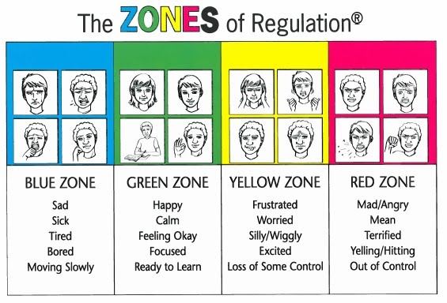
So what does this really mean?
There are 4 zones. Blue, Green, Yellow, and Red.
What color Zone I am in, is determined by how I am feeling.

Slide 4
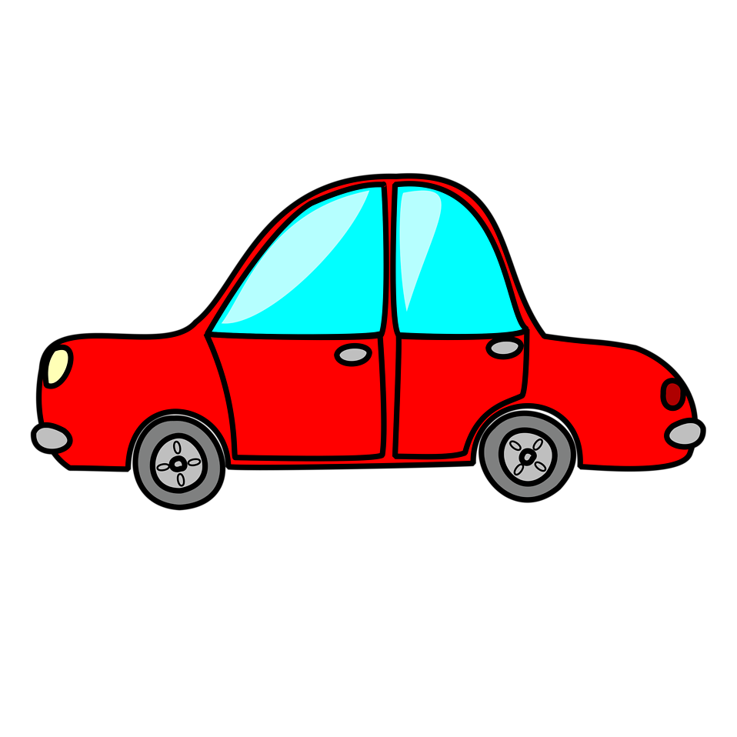
I can think about the Zones as if it were a car on the road. This helps me understand what it all means.

Slide 5
Blue Zone
When I think of Blue Zone, I can think my car needs some things to get moving.
I might need rest. This would be like charging my car battery.
I might need food. This would be like adding gas to my car.
I might have something bothering me. This might be like if my car needed an oil change.

Slide 6
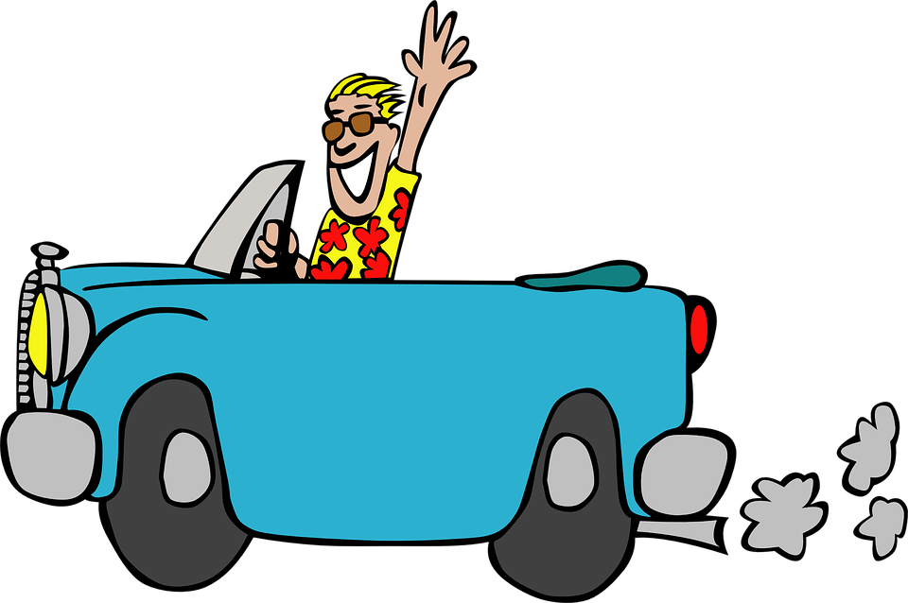
Green Zone
This is the place to be. I have my drivers license and I am ready to go.
When I am in the Green Zone, I am feeling happy and ready to do the things people ask me to do.
I can feel proud of myself for the things I do, while I’m in the green zone.
I am in the driver seat, and ready to drive the speed limit.

Slide 7
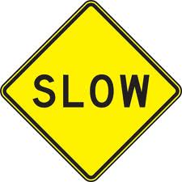
Yellow Zone
When people are driving cars, and they see yellow, they know that means SLOW DOWN!
It might mean a red light is coming soon.
It might mean I am moving too fast for the people and things around me.

Slide 8
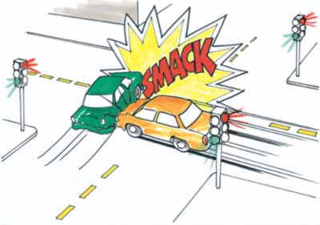
Red Zone
This means I need to STOP!
When I see a red light or sign driving, I need to stop right away or I will probably get into a crash.

Slide 9
It’s going to be okay!
It’s okay to be in any of the zones. It’s my emotions!
It’s okay to be in the red zone, yellow zone, blue zone, and of course green zone!
But I need to know what to do when I am in each zone, so that I make the right choice every time!

Slide 10
I can learn what to do in each zone so that I am successful at school, home, and in the community!

Slide 11
Blue Zone
When I am noticing that I am moving slowly, I can say “I must be in the blue zone”.
I can then ask myself Why am I am in the blue zone?? When I figure out WHY then I can be a problem solver!!!
Just like a car mechanic who inspects a car that isn’t moving quite right.

Slide 12
Blue Zone Solution Finder
Problem | Solution
I feel tired. | I can ask to take a nap.
I feel hungry. | I can ask for a snack.
I feel sad. | I can talk to an adult about it.

Slide 13
Green Zone
I am ready to go!
My teacher asks me to do something, and I feel ready to do it.
I might use Green Zone tools to help me stay in the Green Zone.

Slide 14
Green Zone Solution Finder
Problem | Solution
I don’t have a pencil to write with. | I can ask someone to use a pencil.
I don’t know how to do the math problem. | I can take a deep breath and know I can keep trying. I can ask an adult to help me.
I don’t know how to read a word in my book. | I can use different reading strategies to work it out.

Slide 15
Yellow Zone
When I am noticing that following directions feels hard, I am probably in the Yellow Zone.
When I am noticing that I am starting to feel mad or upset, I am in the Yellow Zone.
I need to take the Yellow Zone Road. This is going to help me avoid the red zone, and get back to the green zone. I can try to stay in class by doing strategies such as positive self talk, or deep breathing, but most of the time it is probably best to just try a break.

Slide 16
Yellow Zone Solution Finder
Problem | Solution
My math feels too hard. | I can take a break then come back and try it again with a fresh look. I can use positive self talk.
I don’t like what somebody said. | I can take a break and then talk with the person calmly when I am feeling calmer. I can ask a teacher to help me problem solve it. I can use positive self talk.
I am worried about something that happened at home. | I can take a break and then talk with an adult about how I feel. I can use positive self talk.

Slide 17
Red Zone
Usually when I am in the red zone. I am not able to think clearly. I do not really know what the problem is. My job is to get to my safe place.
When I’m in the safe place I need to do simple calming strategies so I can get myself to the yellow zone so I can identify the problem and make a solution plan.

Slide 18
Red Zone “Solution Finder”
Problem | Solution Finder
I can’t organize my thoughts. I feel confused about what’s going on. | Stick with my plan.
I think I want to do something unsafe. | Stick with my plan.

Slide 19
Red Zone Plan
I need to know what my Red Zone plan is.
My red zone plan is simple.
I need to:

Slide 20
Now I know all about the Zones of Regulation and know how I can use this to be safe, respectful, and responsible.

