Slide 1

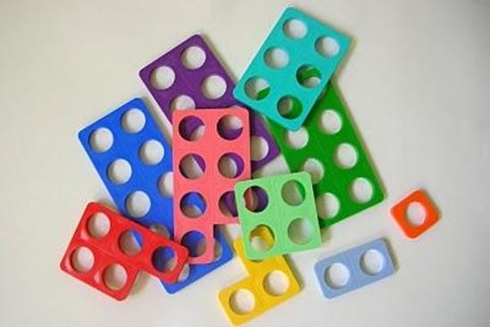
Supporting your child
with maths
Please fill in the first part of the feedback sheet.
Thank You

Slide 2
Why are we here……??
To find out why maths is sometimes tricky for our children.
What is Numicon and why we use it?
How you can help your children at home!

Slide 3
Curriculum
Early Learning Goal - Number
Children count reliably with numbers from one to 20, place them in order and say which number is one more or one less than a given number. Using quantities and objects, they add and subtract two single-digit numbers and count on or back to find the answer. They solve problems, including doubling, halving and sharing.
Early Learning Goal – Shape Space and Measure
Children use everyday language to talk about size, weight, capacity, position, distance, time and money to compare quantities and objects and to solve problems. They recognise, create and describe patterns. They explore characteristics of everyday objects and shapes and use mathematical language to describe them.

Slide 4
Maths
Number
Calculation
Shape
Measures
Data handling
Problem solving

Slide 5

What maths have you done today?

Slide 6





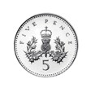
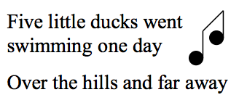
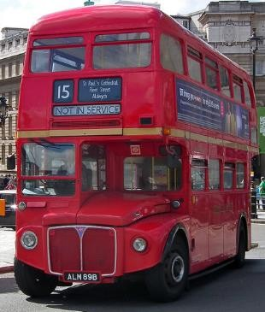


Why is it all so difficult? What is a number?
5

Slide 7


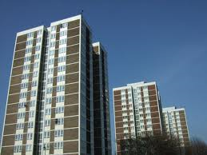

The language of mathematics
Nets
Properties
Flat
Face

Slide 8

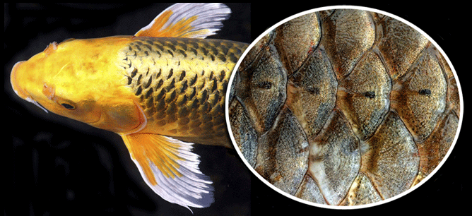
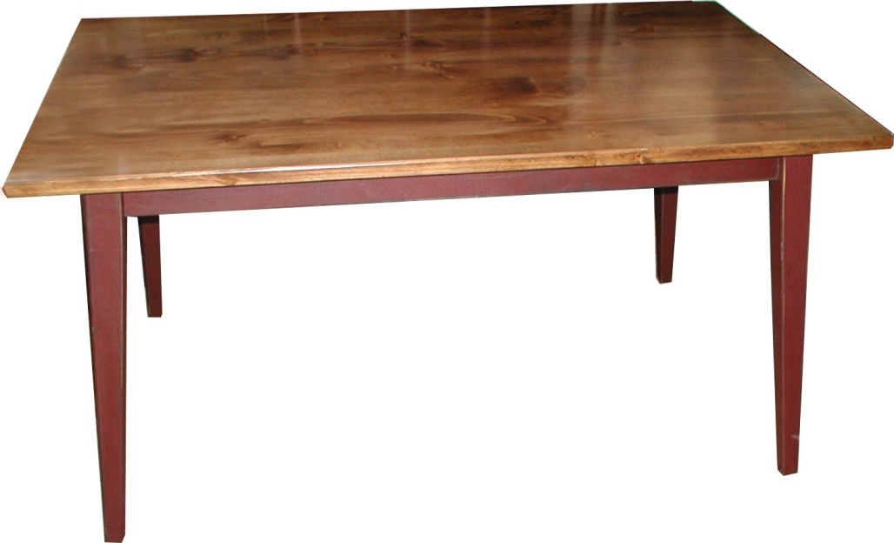
Language
Take away
Scales
Table

Slide 9
What is the biggest number?
1 2 3 4 5 6 7 8 9 10

Slide 10

Why is it so difficult?
Sing along with Doh, Ray, Me…..
Start at ‘Soh’ and continue the count.
Now start at ‘Me’.
Now……start at ‘Ti’ and go backwards.
How many steps are there from ‘Ray’ to ‘La’?
Count back from ‘Soh’ to ‘Doh’ – how many was that
Now try again, but without the number line!!!
Doh | Ray | Me | Fah | Soh | La | Ti | Doh

Slide 11
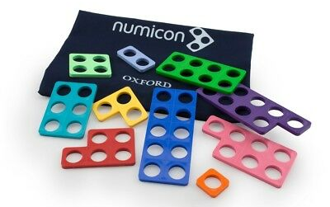
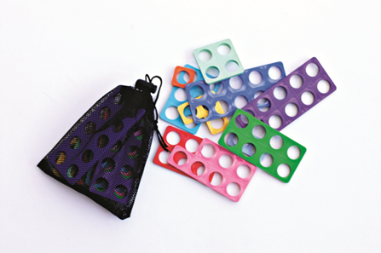
What is Numicon?
Numicon is a multi sensory approach using apparatus to focus on imagery, action and conversation.
• Numicon is designed to give children the understanding of number ideas and number relationships that are essential for success in maths.
Notes:
Please refer participants to Chapter 2 ‘What is Numicon?’ in the Implementation Guides.
Background information for consultants:
What is Numicon?
An evolving research-based approach to teaching maths grown out of the classroom: developed ‘for teachers by teachers’
Numicon is an adaptable and inclusive maths approach suitable for children of all abilities with quality first teaching, including intervention and SEN (one-to-one), ensuring every child can be successful in maths
Numicon has problem-solving and reasoning at its heart, using concrete objects and conversation to build a sound understanding of maths
Numicon embodies the aims of the new national curriculum by developing fluency, mathematical reasoning and using spoken language to explain, reason and justify
Numicon provides insights that encourage confidence, perseverance and achievement in children and gives teachers confidence and enthusiasm to teach maths successfully
Numicon equips teachers with a framework of resources and support that can be adapted to their classroom,
encouraging their creativity and empowering their teaching
Numicon is NOT shapes
Who is OUP?
Oxford University Press is a department of the University of Oxford. It furthers the University's objective of excellence in research, scholarship, and education by publishing worldwide. OUP is the world's largest university press with the widest global presence. It currently publishes thousands of new publications a year, has offices in around fifty countries, and employs some 6,000 people worldwide. It has become familiar to millions through a diverse publishing programme that includes scholarly works in all academic disciplines, bibles, music, school and college textbooks, children's books, materials for teaching English as a foreign language, business books, dictionaries and reference books, and academic journals.

Slide 12
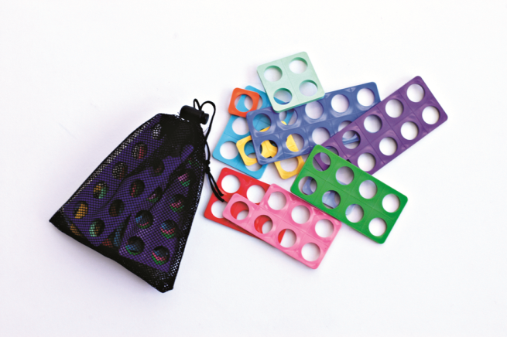
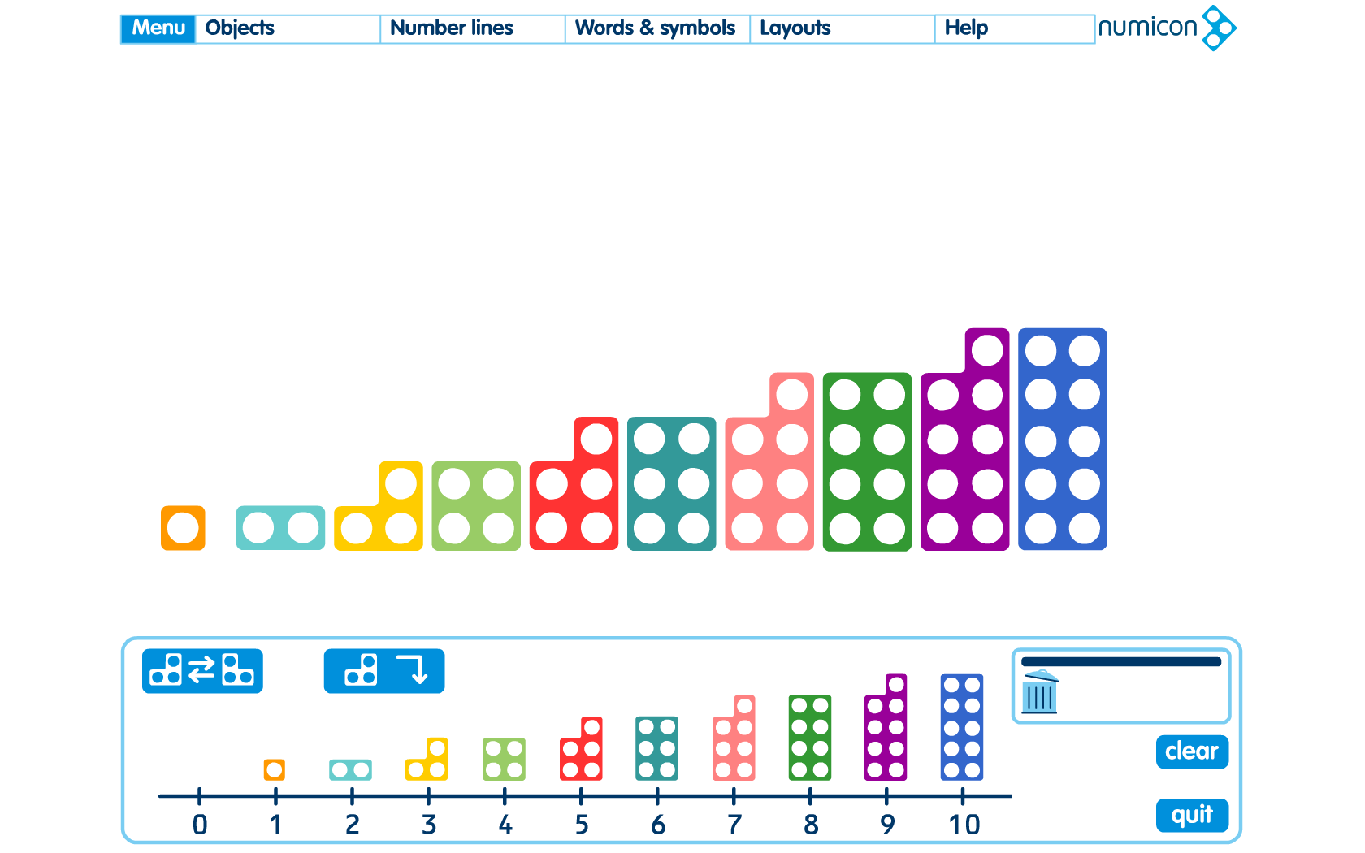
Numicon Shapes
What can you see?
What can you feel?
Can you sort them?

Slide 13
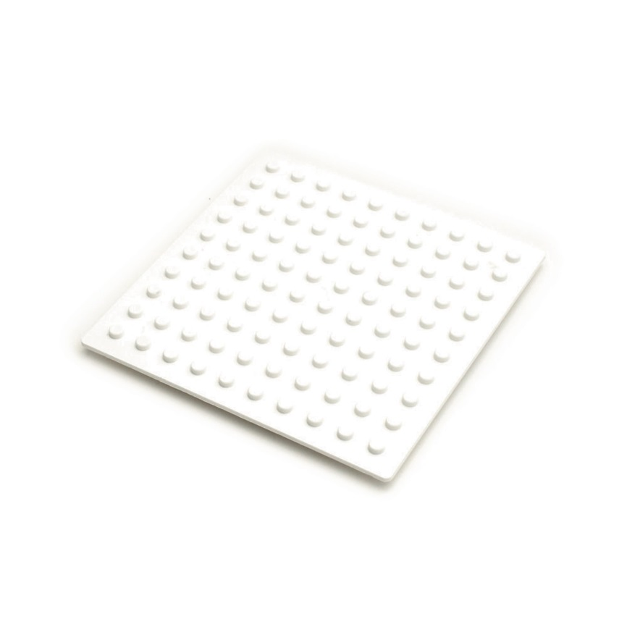
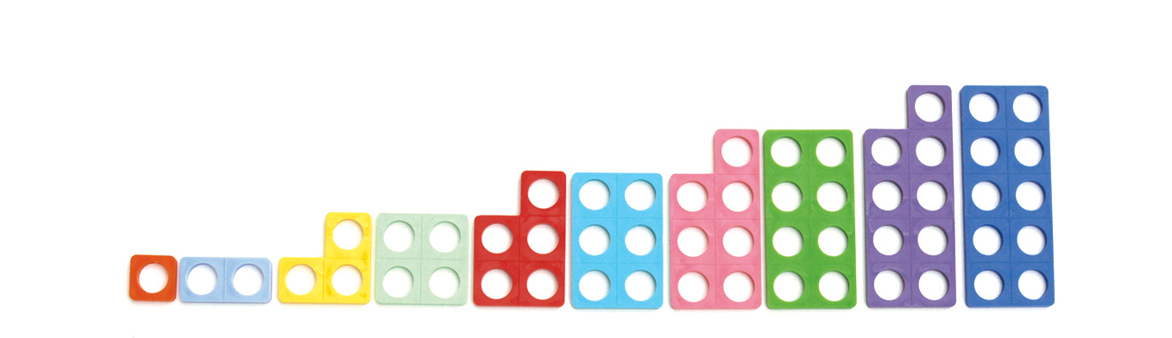


Constructing meaning:
Sequencing by order of size
Extend to…
With 2 of each shape. What is left over? Will this always be the case?
With only even shapes! Only odd!
Make a pattern with a horizontal line of symmetry or rotational symmetry of order
Notes:
Constructing meaning – noticing important regularity about numbers
Ordering key idea for understanding how numbers work and relate to one another
Difficult and important. Employs the temporal concepts i.e. first last next after before in between etc. (ref CtG) If children don’t know after in the context of their school day, how much harder for them to know that six is the number that comes after 5

Slide 14

How many?

Slide 15
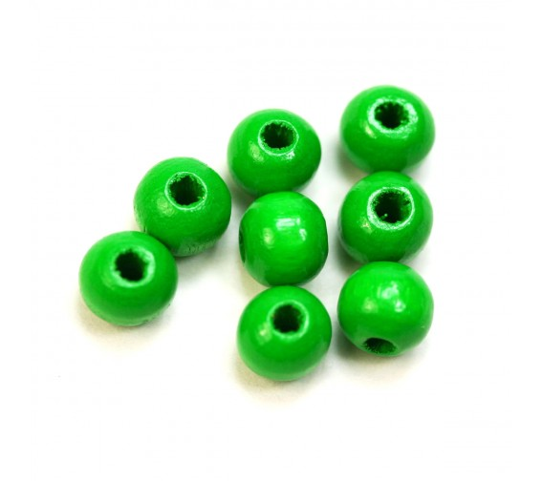
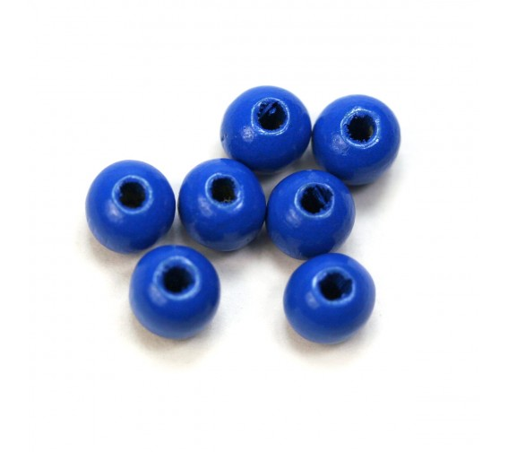
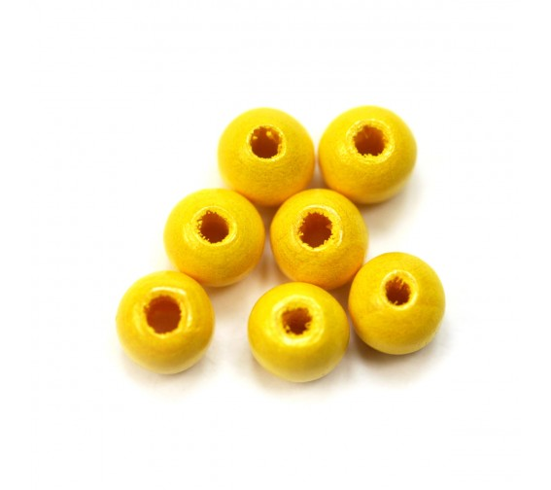

Calculating not counting

Slide 16
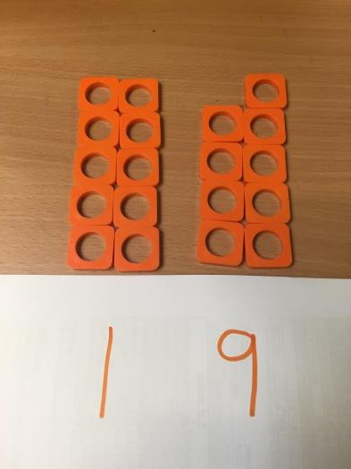
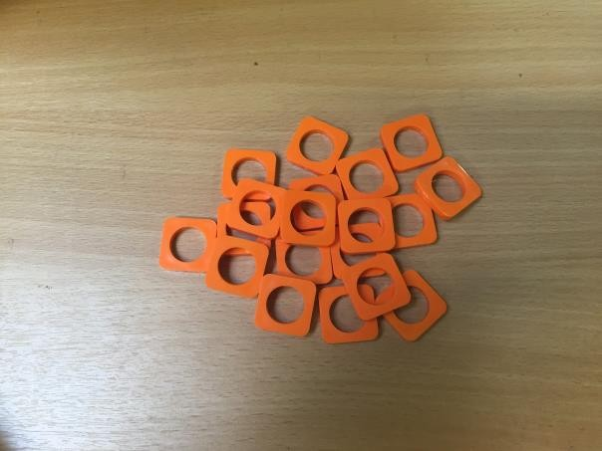

With Numicon chaos…….changes to structure……..
As soon as it is in a structure, children can instantaneously recognise the number of objects in a small group without the need to count them.

Slide 17
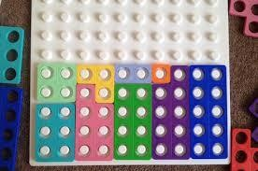
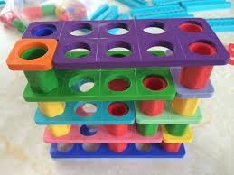
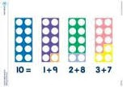
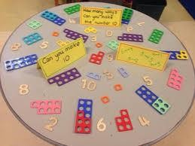
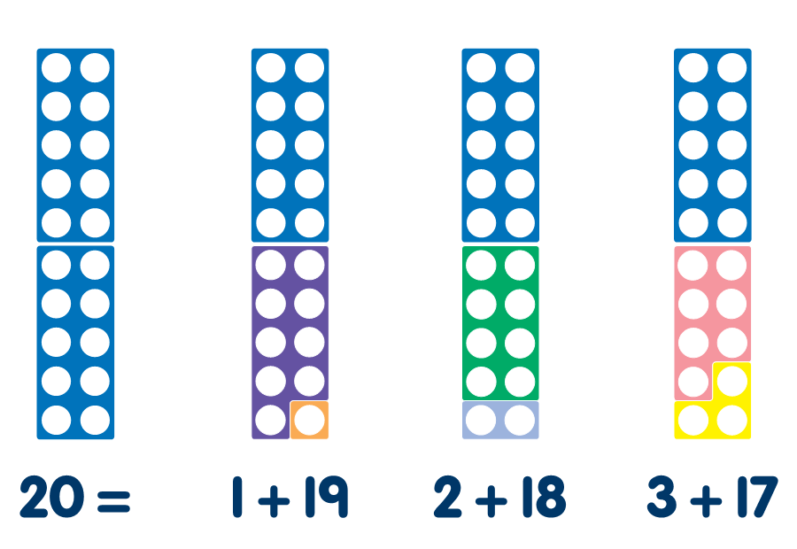
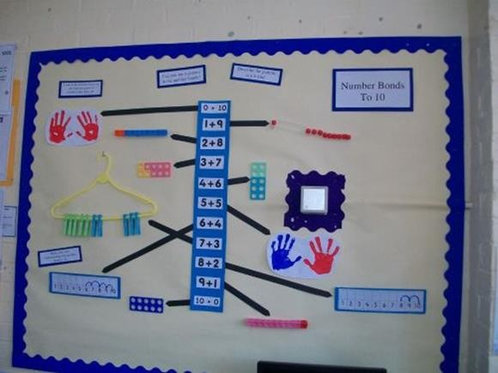
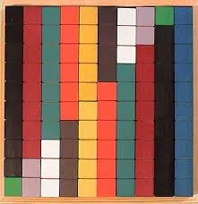
Bonds to 10!!

Slide 18
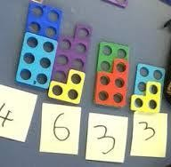
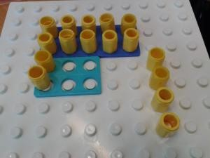
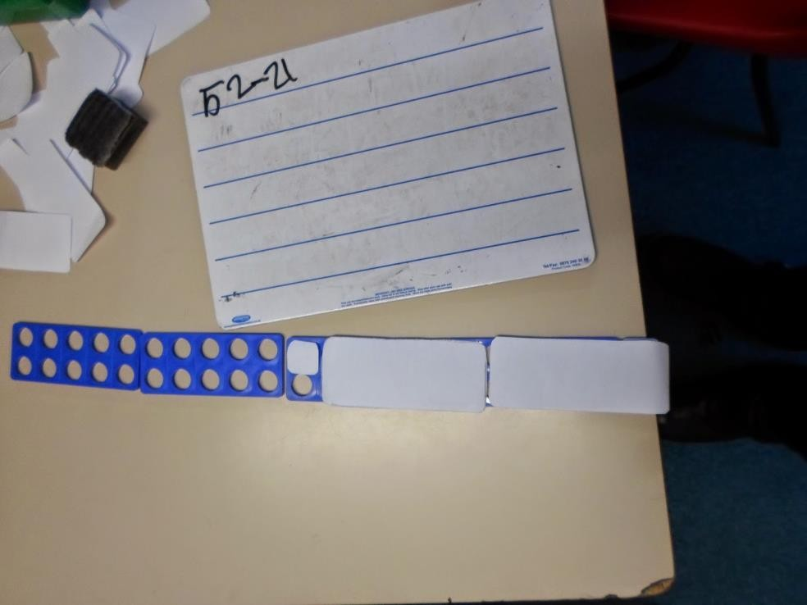
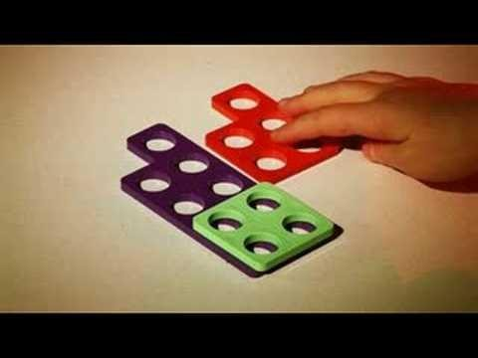
Subtraction

Slide 19
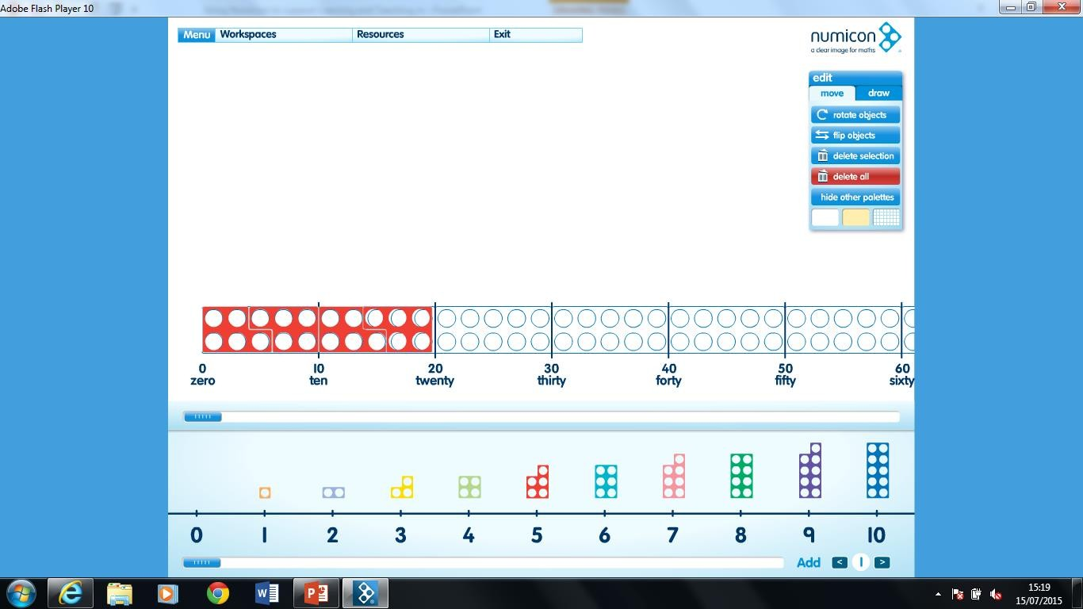
Division - How many in?
20 ÷ 5 =

Slide 20
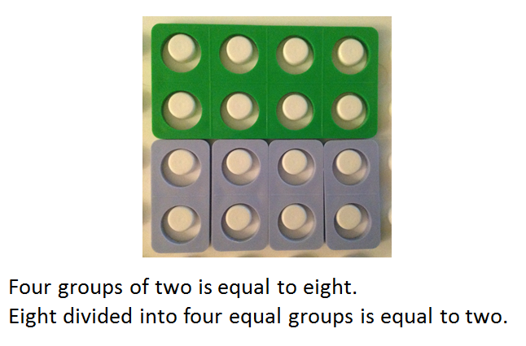
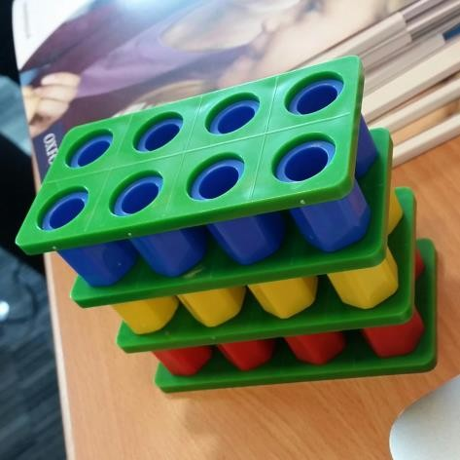
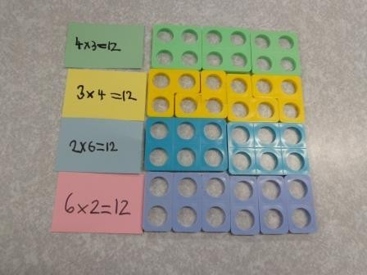
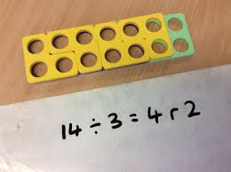
Multiplication
Division

Slide 21

How to help your child at home
Dice
Measuring
Playing cards
Board games
Car number plates
Door numbers
Money
Cooking
Dominoes
Countdown
Time
YOUR NEW NUMICON BAG!
400
30
2

