Slide 2
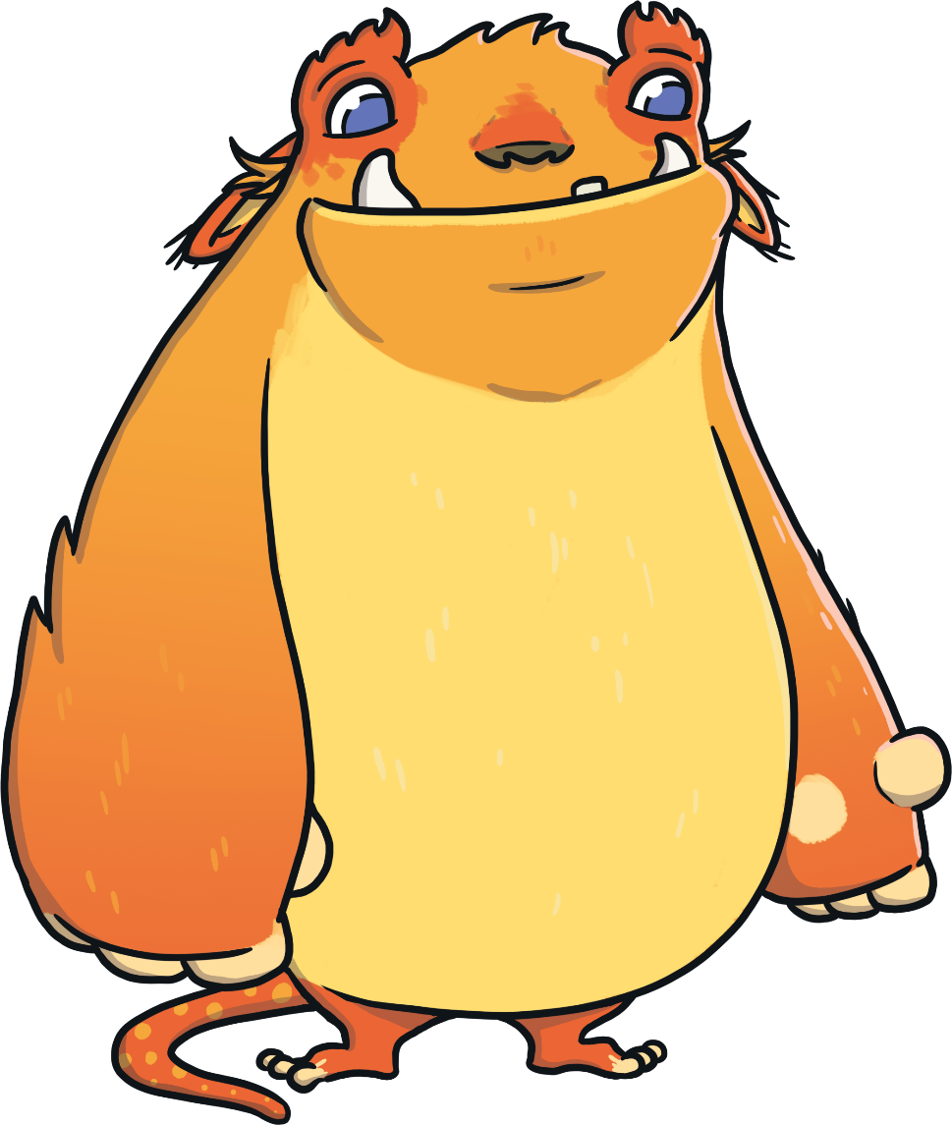
Find the Rhyme
Can you help the monster to spot the rhyming words?

Slide 3
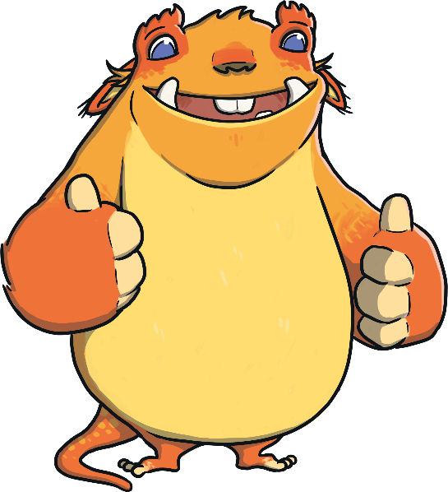
Click the correct rhyming word.
food
Next
rude
shoe
loop

Slide 4
Click the correct rhyming word.
ground
Next
group
found
out

Slide 5
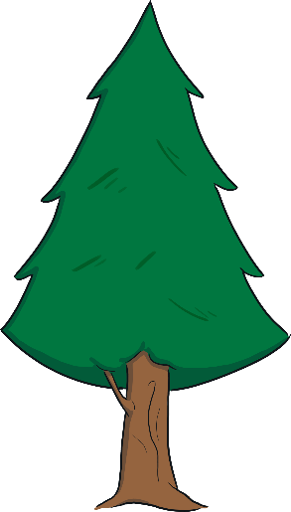
Click the correct rhyming word.
tree
Next
trip
feet
be

Slide 6
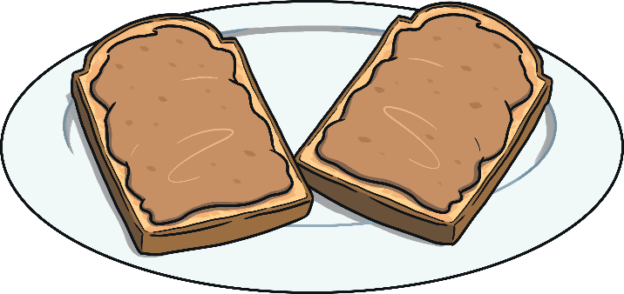
Click the correct rhyming word.
snack
Next
snake
back
snap

Slide 7
Find the Rhyme
Now, can you help the monster to find the rhyming words to tell the story?

Slide 8
Click the correct rhyming word to fill in the blank.
“My flowers have been stolen – almost every single bunch!” Rabbit panicked, feeling sure that there was not enough for .
Next
lunch
dinner
lunch
tea

Slide 9
Click the correct rhyming word to fill in the blank.
“My acorns have been stolen!” Squirrel shouted with a cry.
“And the villain left a bite mark in my tree as they went .”
Next
by
by
past
on

Slide 10
Click the correct rhyming word to fill in the blank.
“My branches have been stolen!” snuffled Beaver, full of grief.
“And I’m sure I saw a pointy tusk belonging to the .”
Next
thief
boar
sneak
thief

Slide 11
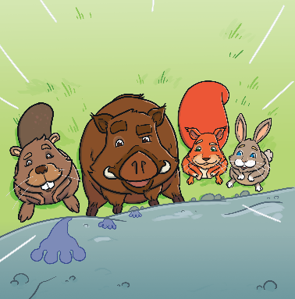
Click the correct rhyming word to fill in the blank.
“My berries have been stolen!” snorted Boar, wide-eyed with shock.
“And the robber left some footprints leading right across that .
Next
rock
rock
stone
wall

Slide 12
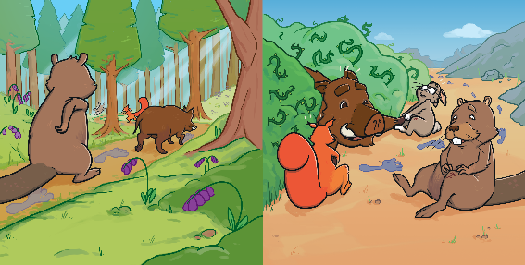
Click the correct rhyming word to fill in the blank.
They took a narrow path that formed a line between the trees…
And then crawled through thorny bushes that left scratches on their .
Next
knees
legs
knees
shins

Slide 13
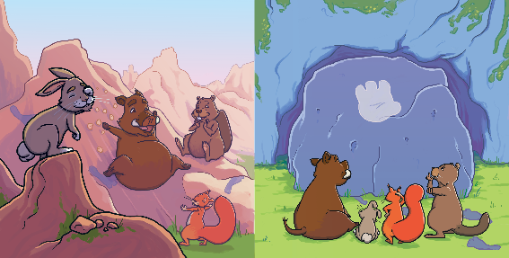
Click the correct rhyming word to fill in the blank.
They climbed some jagged rocks until their feet could take no more,
Then, they came across a cave that had a boulder for a .
Next
door
rock
door
stone

Slide 14
Click the correct rhyming word to fill in the blank.
“A monster!” Rabbit shouted as the friends all turned to flee. In the panic, Rabbit tripped, colliding head first with a .
Next
tree
bush
plant
tree

Slide 15
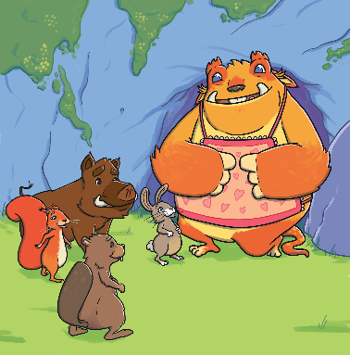
Click the correct rhyming word to fill in the blank.
The monster mumbled shyly as it bent down on one knee,
“I was hoping that you all would like to
join me for some .”
Next
tea
food
treats
tea

Slide 16
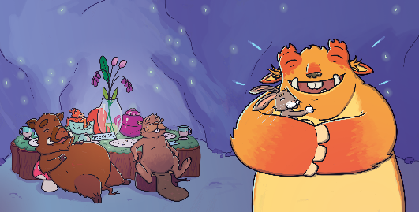
Click the correct rhyming word to fill in the blank.
When Boar was full of berries and
the stew was at an end,
They all thanked the gentle monster, who was now their brand new .
Next
friend
friend
mate
pal

Slide 17
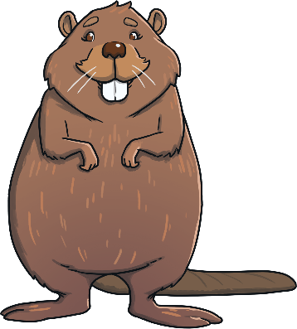
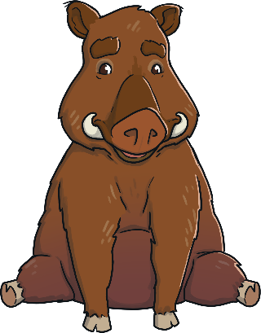
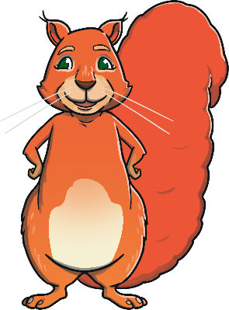
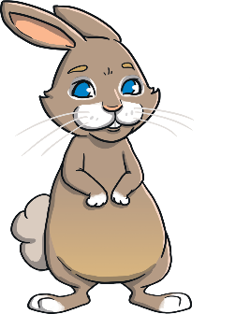
Well Done!
You found all the rhyming words to tell the story!

