Slide 1
How can you protect yourself from online identity theft?

Slide 2
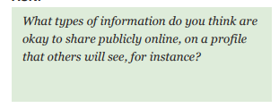

Slide 3
If you were to sign up to a website, what information would they require from you?
www.neopets.com
Birth day, gender, where you live, country, parents permission

Slide 4
SAFE – Personal information
Your favourite food
Your favourite colour
Your first name
Can you think of anymore?

Slide 5
UNSAFE – Private Information
Parents credit card information
Home address
Your date of birth
Can you think of anymore?

Slide 7
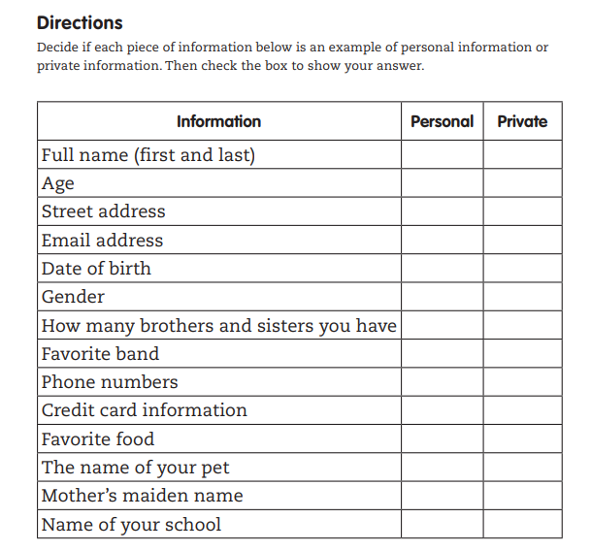

Slide 8
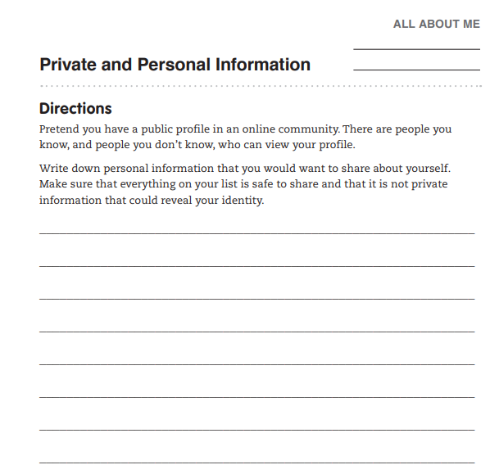
Task for today:
This is just a template
You can design your
own public profile

