Slide 1
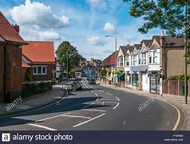
Our Community

Slide 2
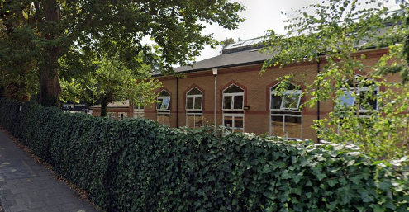
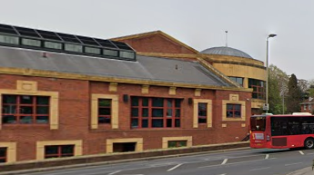
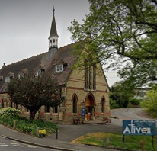
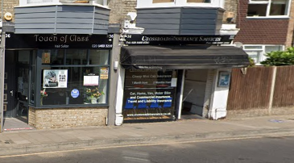
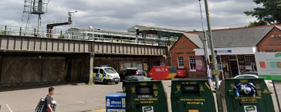
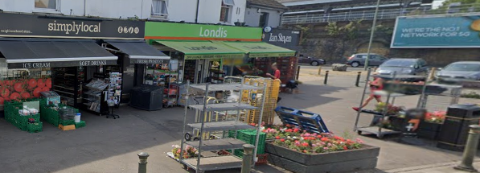
Look at your work from last lesson and see if any of the areas on the map can be grouped together.
Can you group them in these:
Shops
Services
Residential
Red brick building
New and old buildings

Slide 3
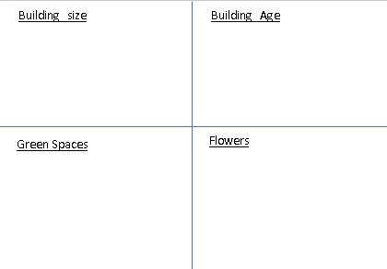
We're going to go and look at some of these different buildings in our area. We will have to use Google Earth again.
As you move about the area, make notes on these things:
The school is large
The shops opposite are small
The school has an old and a new part

Slide 4
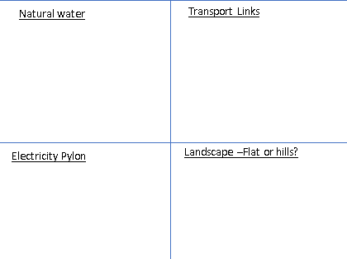

Slide 5
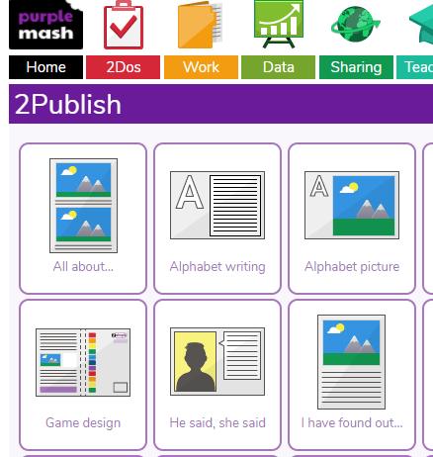
You are a community surveyor and now you have to go and publish your findings. In your ToDo list you will find 'I have found out...'

Slide 6
What could you write about Shortlands?
Could you share your findings as a community report?
A brief summary of Shortlands
In the area of shortlands, the buildings are quite new, apart from some of the school, which is over 100 years old.
There was a flow of natural water running through the community and this is the Ravensbourne River.
Fortunately, there are great transport links and you can ----

