Slide 1
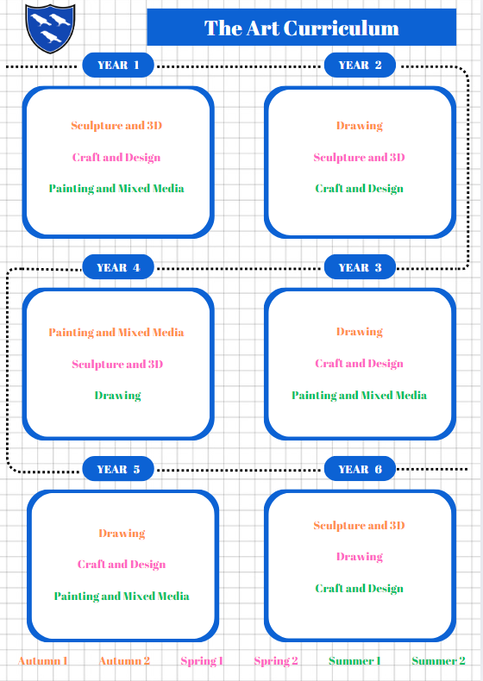
The DT Curriculum
Mechanisms – making a moving vehicle
Structures – constructing a windmill
Cooking and nutrition – smoothies
Structures – Baby Bear’s chair
Textiles – pouches
Mechanisms – making a moving monster
Textiles – Egyptian collars
Electrical systems - Torches
Cooking and nutrition – adapting a recipe
Mechanisms – Pneumatic toys
Cooking and nutrition– eating seasonally
Structures – constructing a castle
Electrical systems - Doodlers
Structures - bridges
Mechanisms – pop-up book
Electrical systems – steady hand game
Textiles – Waistcoats
Cooking and nutrition – come dine with me

