Slide 1
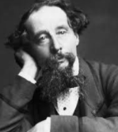
Can I identify how Dickins felt about Christmas through a setting description?
To understand how Dickens creates a gloomy and dark atmosphere through his use of language and structural features

Slide 2
The Life of Charles Dickins
Charles Dickens was born in Portsmouth on 7 February 1812, to John and Elizabeth Dickens. His schooling from the age of nine was limited due to his father being imprisoned for bad debt. Separated from his family, the young Dickens was sent to work in a blacking factory where he worked in appalling conditions. This must have been a traumatic experience for a young boy and Dickens would have endured great loneliness, pain and hardship. He eventually returned to school after three years of labour and his experiences became particularly immortalised in his novels David Copperfield and Great Expectations. Dickens eventually succeeded in becoming a journalist.

Slide 3
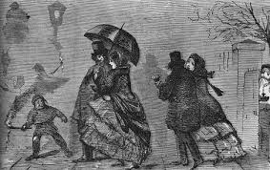
Victorian England

Slide 4
In 1836 Dickens married Catherine Hogarth and they went on to have ten children. In the same year of his marriage Pickwick Papers was published. His work was often serialised in the newspaper at this time and would have been the ‘soap opera’ of the day. Dickens wrote A Christmas Carol in 1843 in order to promote good will and charity at Christmas time. Dickens died in 1870 and is buried at Westminster Abbey.

Slide 5
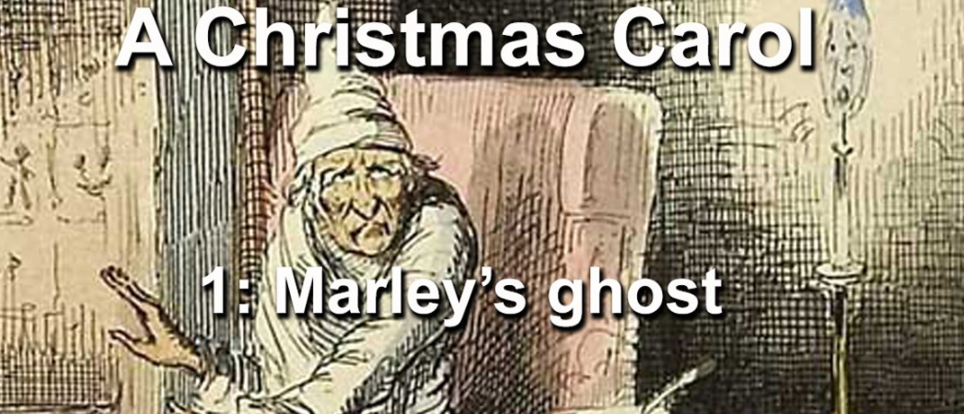
Marley’s Ghost
https://www.bbc.co.uk/teach/school-radio/english-ks2-a-christmas-carol-index/zbp9bdm

Slide 6
https://www.bbc.co.uk/teach/school-radio/english-ks2-a-christmas-carol-episode-2-meeting-with-marley/zhc6qp3

Slide 7
Highlight the most effective. The first one has been done for you.
adjectives
nouns
It was cold, bleak, biting weather: with fog: and he could hear the people in the court outside go wheezing up and down, beating their hands upon their breasts, and stamping their feet upon the pavement stones to warm them. The city clocks had only just gone three, but it was quite dark already -- it had not been light all day: and candles were flaring in the windows of the neighbouring offices, like smears upon the brown air. The fog came pouring in at every chink and keyhole, and was so dense without, that although the court was of the narrowest, the houses opposite were mere phantoms. To see the dingy cloud come drooping down, obscuring everything, one might have thought that Nature lived hard by, and was brewing on a large scale.
Notes:
Most effective in creating a sense of setting and atmosphere.
Allow class time to find the words and select the most effective.

Slide 8
It was cold, bleak, biting weather: with fog: and he could hear the people in the court outside go wheezing up and down, beating their hands upon their breasts, and stamping their feet upon the pavement stones to warm them.
The city clocks had only just gone three, but it was quite dark already -- it had not been light all day: and candles were flaring in the windows of the neighbouring offices, like smears upon the brown air.
The fog came pouring in at every chink and keyhole, and was so dense without, that although the court was of the narrowest, the houses opposite were mere phantoms.
To see the dingy cloud come drooping down, obscuring everything, one might have thought that Nature lived hard by, and was brewing on a large scale.
people wheezing, beating, stamping
candles flaring
fog pouring in
the dingy cloud drooping, obscuring
Nature brewing
cold
bleak
biting
foggy
dark
brown
dense
narrowest
dingy
smears
fog
phantoms
cloud

Slide 9
Think about…..Write down your thoughts
What atmosphere is created by the extended noun phrases?
How do the adjectives (describing) create one idea? Can you give an example?
How do these nouns keep the reader guessing about the happenings of the evening?
How might these nouns reflect the way that Scrooge’s viewpoint on Christmas?

Slide 10
Highlight the four most effective…
adjectives
nouns
Meanwhile the fog and darkness thickened so, that people ran about with flaring links, offering their services to go before horses in carriages, and conduct them on their way. The ancient tower of a church, whose gruff old bell was always peeping slyly down at Scrooge out of a Gothic window in the wall, became invisible, and struck the hours and quarters in the clouds, with shaky vibrations afterwards as if its teeth were chattering in its frozen head up there. The cold became intense. In the main street at the corner of the court, some labourers were repairing the gas-pipes, and had lighted a great fire in a brazier, round which a party of ragged men and boys were gathered: warming their hands and winking their eyes before the blaze in delight. The water-plug being left alone and reluctantly turned to ice.
Notes:
Most effective in creating a sense of setting and atmosphere.
Allow students time to find the words and select the most effective.

Slide 11
Meanwhile the fog and darkness thickened so, that people ran about with flaring links, offering their services to go before horses in carriages, and conduct them on their way.
The ancient tower of a church, whose gruff old bell was always peeping slyly down at Scrooge out of a Gothic window in the wall, became invisible, and struck the hours and quarters in the clouds, with tremulous vibrations afterwards as if its teeth were chattering in its frozen head up there.
The cold became intense.
In the main street at the corner of the court, some labourers were repairing the gas-pipes, and had lighted a great fire in a brazier, round which a party of ragged men and boys were gathered: warming their hands and winking their eyes before the blaze in rapture.
The water-plug being left alone and reluctantly turned to ice.
fog
darkness
clouds
cold
solitude
ancient
gruff
invisible
frozen
intense
congealed
misanthropic
repairing
warming
winking
lighted
gathered
fire
brazier
party
hands
eyes
blaze
rapture

Slide 12
Think about…….
How does this description build on the atmosphere of the setting established earlier?
Why do you think Dickens chose to write this statement in a short, simple sentence? How does that link to the adjective ‘intense’?

Slide 13
TASK 1
Can I plan to identify how Dickins felt about Christmas through a setting description? ( Use the planning sheets )
VERBS
wheezing
beating
stamping
flaring
pouring
drooping
obscuring
brewing
NOUNS
smears
fog
phantoms
cloud
fog
darkness
cold
solitude
ADJECTIVES
cold
bleak
biting
foggy
dark
brown
dense
narrowest
dingy
ancient
invisible
frozen

Slide 14
TASK 2
Can I identify how Dickins felt about Christmas through a setting description? (Refer to your planning sheets to write)
VERBS
wheezing
beating
stamping
flaring
pouring
drooping
obscuring
brewing
NOUNS
smears
fog
phantoms
cloud
fog
darkness
cold
solitude
ADJECTIVES
cold
bleak
biting
foggy
dark
brown
dense
narrowest
dingy
ancient
invisible
frozen

