Slide 2
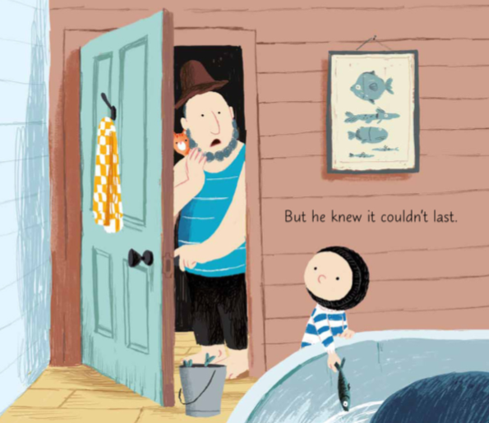

Slide 3
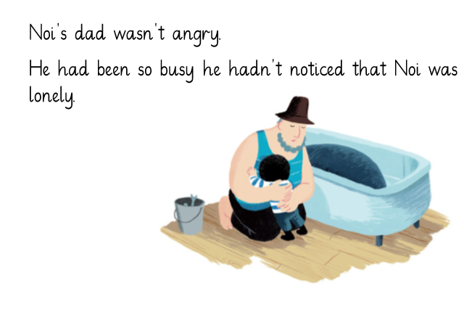

Slide 4
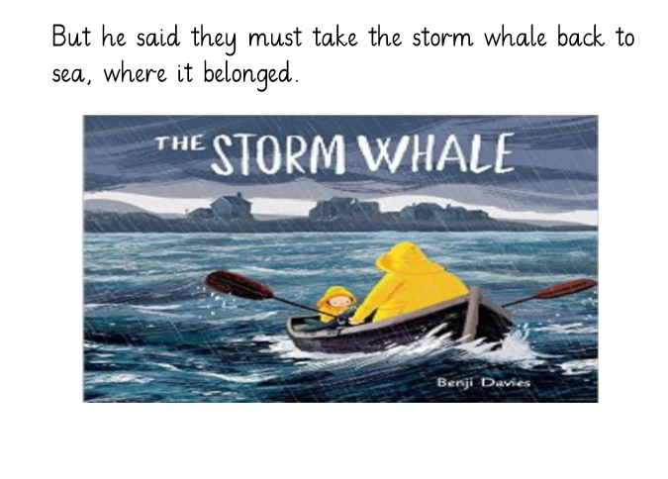

Slide 5
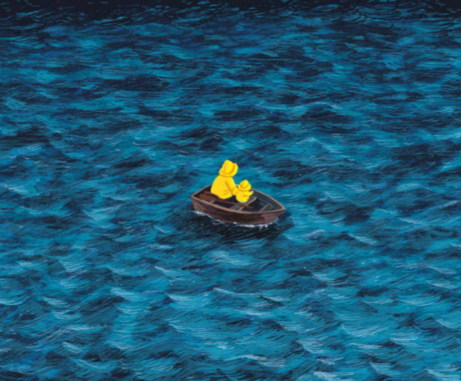

Slide 6
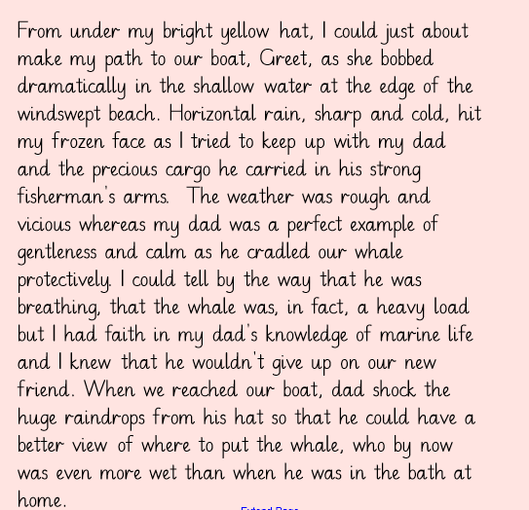

Slide 7
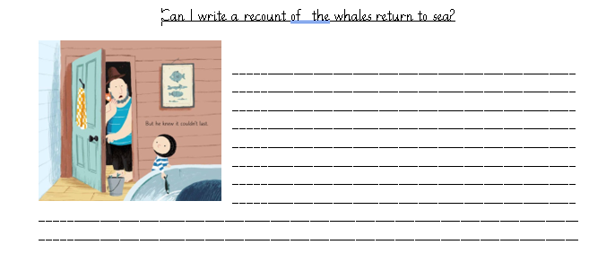
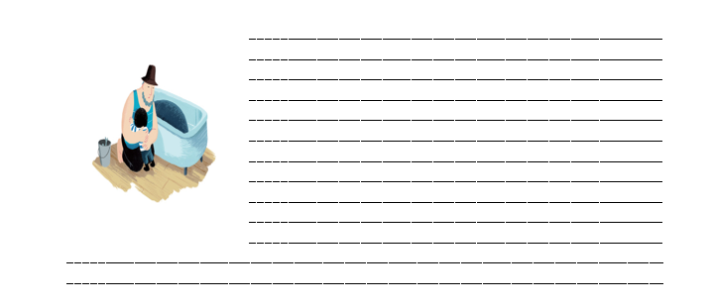
Think about what is happening in these pictures:
What is Noi thinking and feeling?
How does his dad react towards him and the whale?

Slide 8
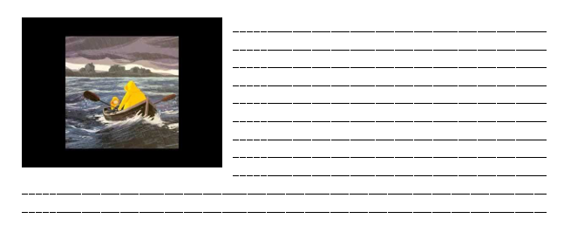
How would you describe the sea?
How are the waves moving? Are they getting wet?
How do they both feel? Is the Whale happy to be returned to the sea?

