Slide 1
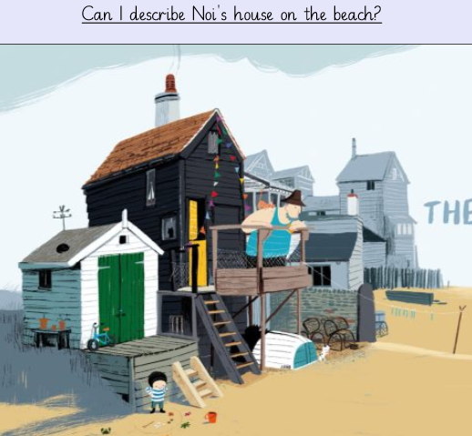

Slide 2
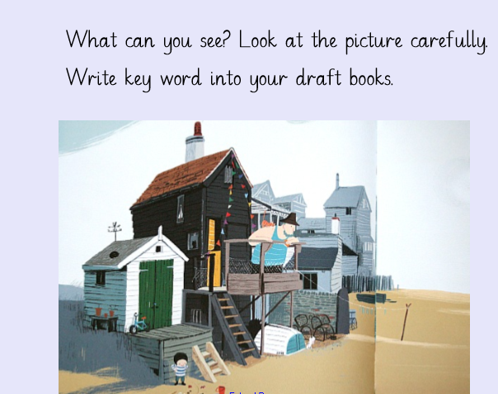

Slide 3
Nestled in the undulating sand dunes, Noi’s house appears like a collection of boxes on the sea shore. Sitting on the edge of a small group of houses, the white clapboard and green door stand out from afar. The different rooms of the house, haphazardly piled on top of each other, all have small windows that often have a cat peering out.
The larger part of the house, with black clapboard and a bright yellow stable door, has a small balcony and a long banner of coloured flags to welcome visitors. The door is kept ajar to let the sea breeze into the home. Under the balcony, Noi and his father store their small rowing boat, Greet, and empty lobster pots in preparation for the next fishing trip.
A sturdy, pebble wall separates the house from its neighbours who also look out onto the sand and the bay. Each house has steps down to the sand which stretches down towards the water like an expansive garden.
From the balcony, Noi and his father can see the whole crescent of the bay as it curves around the sea shore. The brave fisherman and his son, who prefers to construct sandcastles with his red bucket, often gaze out across the water to gauge the weather and check if conditions are right for fishing.

Slide 4
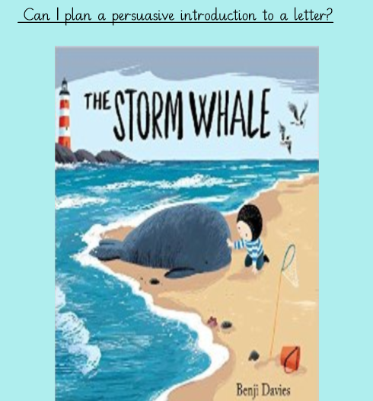

Slide 5
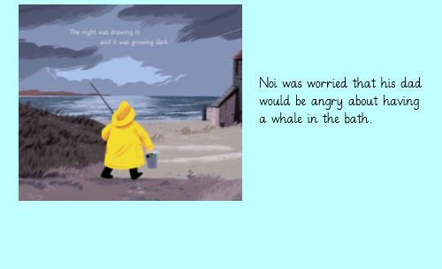
Please read up to page 13. This is where you should read up to.
What does Noi think his father might say? Is there anything in the book that makes you think this?

Slide 8
Please use the planning sheet to organise your persuasive arguments before you begin writing.

