Slide 2
Can I solve word problems using Multiplication and Division? In each of the following word problems, you must identify which operation you will need to use in order to solve the problem; There is no need to write out the question. Write your calculations down in full! The PPT will give you the answers so please pause after reading the question.

Slide 3
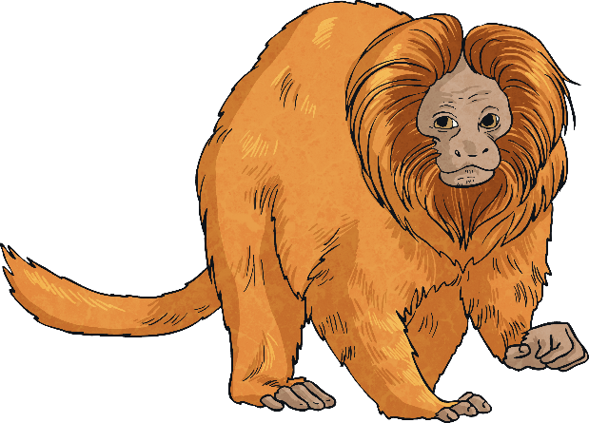
1) A troop of 12 monkeys at a zoo are each given 4 bananas every day. How many bananas are given out, in total, every day?
12 x 4 = 48
48 bananas are given out each day.

Slide 4
2) There are 4 tables in class 3P. 6 chairs can fit around each table. How many chairs are there in total in 3P?
4 x 6 = 24
There are 24 chairs.

Slide 5
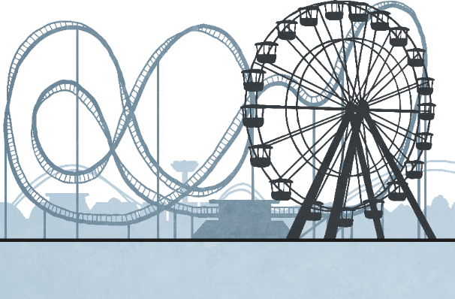
3) The waltzer ride at the local fairground can hold 5 people at one time. How many waltzers are needed so that 43 people can all go on the ride at once?
43 ÷ 5 = 8 r3
9 waltzers are needed.

Slide 6
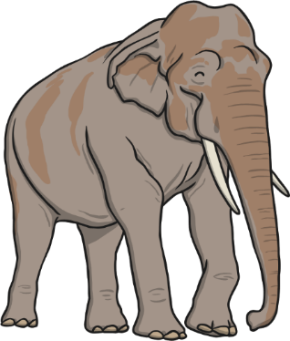
4) Cuddly toy elephants cost £8 at Torrington Zoo. Over the course of one day, 12 children buy an elephant. How much money does the zoo make from the sale of cuddly toy elephants?
8 x 12 = 96
The zoo makes £96.

Slide 7
5) Tennis balls are packed in tubs of 6. Sports ‘R’ Us already have 5 tubs in stock. A new delivery comes in with 18 more tennis balls that the shop need to pack in to tubs. How many tubs of balls will Sports ‘R’ Us have altogether?
18 ÷ 6 = 3; 3 + 5 = 8
They will have 8 tubs of balls.

Slide 8
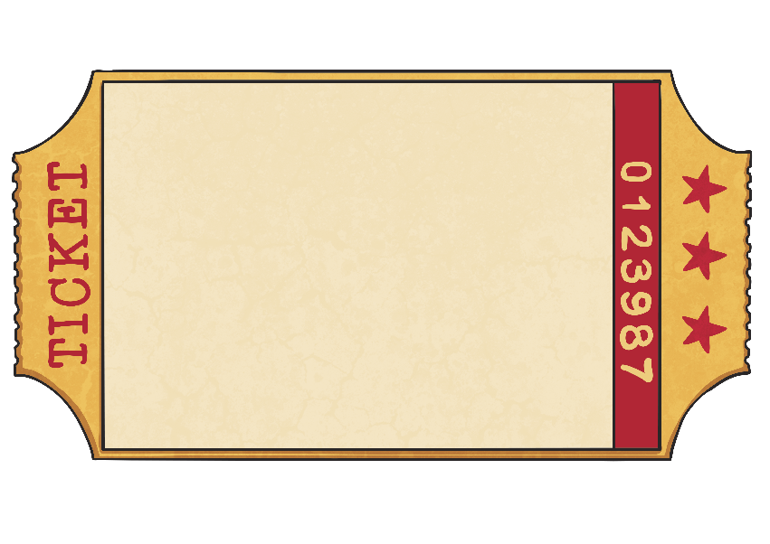
6) Tickets to the theatre cost £11 for adults and £8 for children. A family of 3 adults and 4 children buy tickets. How much will the tickets cost the family altogether?
Adult : £11
Children : £8
3 x 11 = 33; 4 x 8 = 32; 33 + 32 = 65
The tickets will cost £65 altogether.

Slide 9
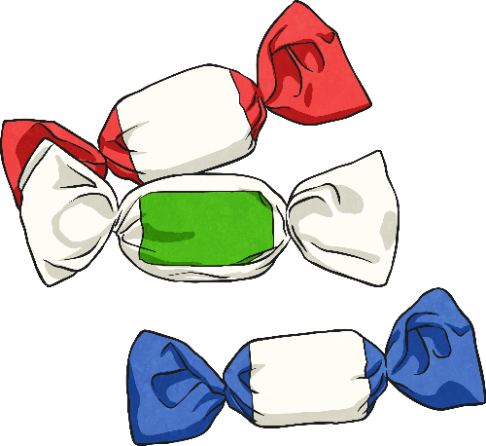
7) Helen’s Mum buys a box of 52 chewy sweets to put in party bags for her friends. There are 6 children coming to the party. Helen’s Mum has said that Helen can have any sweets left over after they have been shared equally between her friends. How many sweets will Helen get to eat?
52 ÷ 6 = 8 r4
Helen will get 4 sweets.

Slide 10
Well done for completing the word problems Year 5!

