Slide 1
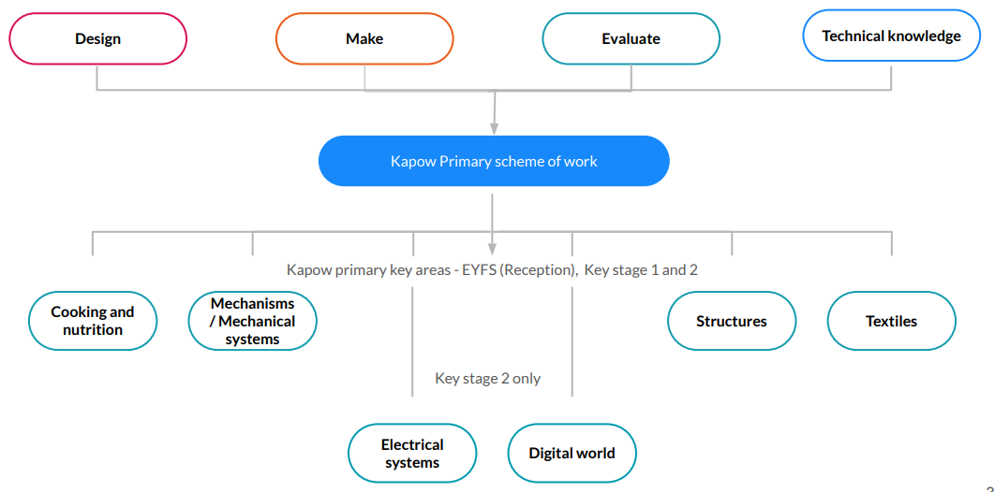

Slide 2
Mechanisms
Cooking and nutrition
Structures
Textiles
Electrical systems (KS2 only)
Year 1
Making a moving vehicle
Learning about the main components of a wheeled vehicle. Developing understanding of how wheels, axles and axle holders work and problem-solving why wheels won't rotate. Pupils then design and build their own vehicles and evaluate them against a set design criteria.
Year 1
Smoothies
Handling and exploring fruits and vegetables and learning how to identify a fruit. Undertaking taste tests to identify ingredients for a smoothie they make, and designing and creating packaging for their smoothie.
Year 1
Constructing a windmill
Designing, decorating and building a windmill, developing an understanding of different types of windmill, how they work and their key features. Looking at examples of windmills and exploring the functions that they carry out.
Year 2
Pouches
An introduction to sewing, pupils learn to sew a basic running stitch and then use and create templates to then make their own pouches, designing, cutting, sewing and decorating them.
Year 4
Torches
Applying their scientific understanding of electrical circuits, pupils design and create a torch made from recycled and reclaimed materials and objects. They then evaluate their products against a set design criteria.
Year 3
Eating seasonally
Discovering when and where fruits and vegetables are grown and learning about seasonality in the UK. Pupils respond to a brief to design a seasonal food tart using ingredients harvested in the UK in May and June.
Year 4
Egyptian collars
Pupils learn two new sewing skills: cross stitch and appliqué and then apply these to the design, decoration and assembly of their own Egyptian collars.
Year 2
Making a moving monster
Learning the terms: pivot, lever and linkage, pupils then design a monster that will move using a linkage mechanism. Pupils practise making linkages and experiment with various materials to bring their monsters to life
Year 2
Baby bear’s chair/throne
Using the tale of Goldilocks and the Three Bears as inspiration, pupils help Baby Bear by making him a brand new chair, exploring different shapes and materials. When designing the chair, they consider his needs and what he likes.
Year 5
Doodlers
Further exploring series circuits and and introducing motors. Pupils investigate existing products and use their problem-solving skills to establish how they think the products have been constructed, before then creating their own doodler.
Year 6
Waistcoats
Selecting fabrics, using templates, pinning, decorating and stitching materials together to create a waistcoat.
Year 3
Pneumatic toys
Designing and creating a toy with a pneumatic system, learning how trapped air can be used to create a product with moving parts. Pupils are introduced to thumbnail sketches and exploded diagrams.
Year 4
Adapting a recipe
Evaluating existing biscuits recipes, children then work in groups to adapt a simple biscuit recipe to create a biscuit suited to a chosen target audience. They ensure that their creation comes within a given budget of overheads and ingredients
Year 3
Constructing a castle
Learning about the features of a castle, pupils design and make one of their own. Using configurations of handmade nets and recycled materials to make towers and turrets and constructing a stable base.
Year 6
Steady hand game
Designing and creating a steady hand game, using nets to make the bases and applying knowledge of electrical circuits to build an operational circuit with a buzzer.
Year 5
Pop up-books
Creating a four-page pop-up story book design, incorporating a range of functional mechanisms that use levers, sliders, layers and spacers to give the illusion of movement through interaction.
Year 5
Bridges
Learning about different types of bridges and exploring how the strength of structures can be affected by the shapes used within them. Pupils then create their own bridge and test its durability - using woodworking tools and techniques.
Year 6
Come dine with me
Researching and preparing a three-course meal and taste-testing and scoring their outcomes. Researching the journey of their main ingredient from ‘farm to fork’ and writing a favourite recipe.

