Slide 1
Valley Primary School PE Curriculum
• Healthy Lifestyle
• Acquire, Apply and Evaluate Skills and Techniques.
• Sports Leadership

Slide 2
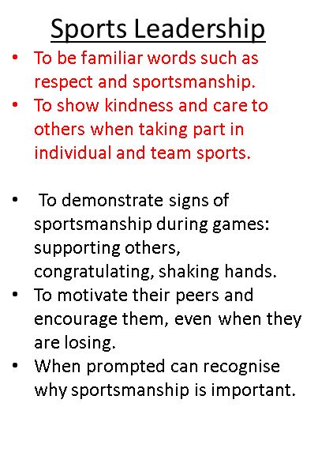
Physical Education
Curriculum Drivers
End of KS1 expectations
Key Vocabulary:
Ambition & Aspiration
Know how to try their best when taking part in physical activity.
Know and learn about some different local sports personalities.
Know and understand how to persevere and show resilience in times of difficulty.
Our Place in History
Name dates and events in History where Britain has hosted different sporting tournaments; Women’s 2022 European Championships and London 2012 Olympics,
Learn about some of the sports men and women from Britain over the last 50 years.
Community
Have access to and be familiar with some of our local sports clubs, team’s other small business’ through our extracurricular timetable.
Know and understand that people’s actions can have both positive and negative results through PE and competitive fixtures.
Ambition | A strong desire to achieve something.
Aspiration | The hope of wanting to be someone or do something.
Resilience | The ability to be able to bounce back or overcome difficulties.
Healthy Lifestyle | Knowing how to stay healthy both physically and mentally by exercising and eating a balanced diet.
Teamwork | Working together in a pair or a group in order to achieve something.
Community | A group of people that share, or have in common, one particular interest.
Role models | Someone that can be looked to and who sets the example of how to behave and interact with others.
Healthy Lifestyle
Describe how they body is feeling before, during and after an activity.
Begin to discuss different vocabulary: heart, sweaty, healthy, fitness, strong.
Show how to exercise safely in different environments.
Describe how their body is feeling during different activities. Begin to compare different sports.
Begin to explain what their body needs, to stay healthy.
STEP Assessment;
Space – adapt the space that you are using.
Time or Task – change the task or limit/extend time.
Equipment – think about the equipment that you are giving. Can you change it?
People – How are you splitting your class? Can you pair children up OR challenge the more able and support those that need it.

Slide 3
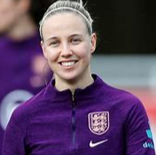
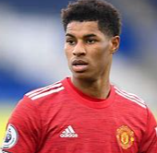
Physical Education
Unit: KS1 Multi Skills
Links to Invasion games in KS2
Key Vocabulary:
Children will be taught to:
Introduce and develop ABC (Agility, Balance and Coordination).
Explore different ways of moving and speeds, showing control.
Be able to coordinate moving in different directions (side to side, backwards etc).
Understand the difference between A, B and C.
Show clear control when changing direction and between different movements.
Apply these skills into different games.
Make simple decisions about when /where to move in game
Perform some dribbling skills with hands, feet and a stick using space.
Balance | To stay still and steady in a position or shape.
Control | To perform movements and skills without loosing your balance, change the speed and direction you move.
Attack | Movement made towards the oppositions goal within a game to score points.
Defend | Movements made to protect the home teams goal, preventing the opposition from scoring.
Defence | The positions, whose job it is to stop the opposition from scoring.
Dribble | An act of taking the ball forward with repeated and controlled touches or bounces.
Coordination | The ability to move two or more body parts under control, smoothly and efficiently.
Agility | The ability to change the direction of the body in an efficient and effective manner.
Speed | The rate at which someone or something is able to move.
Game | .A contest carried on following set rules amusement, exercise or reward.
Tactic | Planning something to achieve a goal
Move | To change place or position.
Healthy Lifestyle:
How does their body feel at the start and end?
What body parts might they feel or be using?
Think about using key vocabulary.
How can we exercise safely?
What does our body need? E.g. warm up / water etc.
Sports to consider…
Hockey
Tag-rugby
Football
Netball
Basketball
Sports Leadership:
Begin to talk about playing fairly. What is that?
How can we help people in our team?
How should we act when we are losing?
Why do we want to show sportsmanship?
Ambition & Aspiration
Think…
Sports Leadership
Healthy Lifestyle
Acquire, apply and evaluate skills
Beth Mead
Marcus Rashford

Slide 4
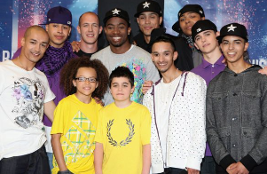
Physical Education
Unit: KS1 Dance
Key Vocabulary:
Children will be taught to:
Express and communicate ideas and feelings.
Learn and understand the term ‘beat’.
Begin to practise performing different movements in time with the beat.
Explore a range of different ways in which you can move and change direction.
Link moves together and perform up sequences up to 10 beats.
Explore and change different levels and speeds of movement.
Use movement imaginatively, responding to stimuli, including music and performing basic skills.
Begin to work cooperatively with others when creating a dance.
Create a complete dance that is controlled and in time.
Speed | The rate at which someone moves.
Routine | When lots of shapes and movements join together to make a dance.
Balance | To stay still and steady in a position or shape.
Control | To dance without loosing your balance, change the speed and direction you move.
Direction | The way you move: Forwards, backwards, sideways, up and down.
Mood | How a character or person feels.
Facial expression | Using your face to show how you feel: Happy, sad, upset, angry.
Interpretation | When somebody explains and demonstrates their understanding of an image, piece of writing or music.
Fluency | To be able to move with ease and gracefulness.
Co-ordination | The working together of different muscles to carry out different movements.
Timing | Moving to the beat or rhythm within a piece of music.
Theme | The topic of the dance or story such as: adventure, horror, cultural, futuristic.
Sequence | A pattern in which one thing follows another.
Rhythm | Moving to the regular repetition of sounds.
Level | The different physical aspects a dancer reaches when performing. These are high middle and low.
Healthy Lifestyle:
Sports Leadership:
How can we help others who are not as confident in dance?
How can we still show sportsmanship in a lesson when we aren’t racing or against someone?
How does our body feel when dancing?
Do we use different body parts?
How does it feel when we are balancing?
Do we still get sweaty and does our heart beat as fast?
What does our body need to stay healthy?
Ambition & Aspiration
Think…
Sports Leadership
Healthy Lifestyle
Acquire, apply and evaluate skills
Ashley Banjo
Diversity

Slide 5
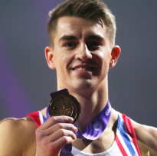
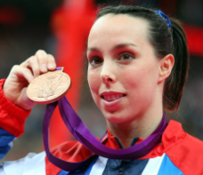
Physical Education
Unit: KS1 Gymnastics
Key Vocabulary:
Children will be taught to:
Introduce and develop the term level and explore how to change this in gymnastics.
Explore different shapes that can be made and ways in which you can travel.
Introduce vocab such as along, next to, on to.
Begin to link shapes and movements into a sequence.
Build upon shape and travel learnt in Yr 1 and introduce balance to a sequence.
Perform a variety of balances (recognising the different body parts used) with control.
Explore movement and travel involving apparatus.
Create a sequence of balances and shapes that are linked with travel in pairs or groups.
Show contrasts on use of body and shape (such as small, tall, straight, curved).
Sequence | The order of movements within a routine. .
Balance | To stay still and steady in a position or shape.
Control | To dance without loosing your balance, change the speed and direction you move.
Direction | The way you move: Forwards, backwards, sideways, up and down.
Body Shape | Shapes created through the position of the body.
Technique | The safe method performers have been taught to perform a skill such as a forward roll.
Travelling | How the performer decides to move within a routine on hands and feet.
Fluency | To be able to move with ease and gracefulness.
Element | A gymnastic skills such as a forward roll or balance.
Point balances | When a balance is performed on a number of points of the body.
Canon | Performing the same movements and physical actions at the same time.
Body tension | Tensing muscles to create a stable shape.
Safety | Making sure the environment around and techniques are performed properly.
Contrast | To compare in order to make differences clear.
Healthy Lifestyle:
How can we use this space safely?
What body parts can we use to travel?
Why might we need to show strength in gym?
How does our body feel doing different balances and techniques?
Sports Leadership:
Begin to talk about playing fairly. What is that?
How can we help people in our team?
How should we act when we are losing?
Why do we want to show sportsmanship?
Ambition & Aspiration
Think…
Sports Leadership
Healthy Lifestyle
Acquire, apply and evaluate skills
Max Whitlock
Beth Tweddle

Slide 6
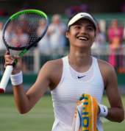
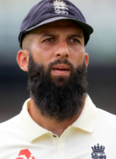
Physical Education
Unit: KS1 Multi Sports
Link to basic throwing and catching
Key Vocabulary:
Children will be taught to:
Introduce bounce, underarm and overarm throwing techniques.
Explore throwing and catching and dribbling with different objects (beanbags, small balls, uneven balls, foam balls).
Be aware of when to use the different techniques or balls (discuss sports).
Master receiving skills ( stop, trap and catch).
Develop accuracy of the different throws learnt in Year 1 and begin to apply them into different situations (overarm for distance etc).
Introduce movement to throwing and catching (not to always be standing still).
Introduce striking techniques (with larger balls to begin with) and body positioning.
Apply skills into a game (handball/cricket).
Overarm throw | An object throw from the should and then forced forward. This throw is great for longer distances.
Underarm throw | Using an object to throw over a short distance accurately. It involves the transference of weight forwards as the straight-throwing arm swings through from the back to the front to release the object at hip height.
Field | Attempting to return the ball or object before the striking team complete a run between 2 markers.
Strike | Hitting a ball or object into an open space in the playing area.
Receive | When the ball is passed to a player. They are able to stop it and move on with it.
Accuracy | Being able to make passes and shots making sure they get to the location the player is aiming for.
Passing | Sending the ball to another member of your team.
Control | To perform movements and skills without loosing your balance, change the speed and direction you move.
Healthy Lifestyle:
What body parts do we use when throwing and catching?
Are we always feeling sweaty or tired?
How can we stay safe when exercising?
Does our body feel differently compared to gymnastics or multi-sports?
Sports to consider..
Handball
Cricket
Rounders
Tennis (striking)
Sports Leadership:
How can we demonstrate being good sports and leaders? E.g. hand shaking.
What do we do if someone drops a throw or cannot throw under arm?
Ambition & Aspiration
Think…
Sports Leadership
Healthy Lifestyle
Acquire, apply and evaluate skills
Emma Radacanu
Moeen Ali

Slide 7
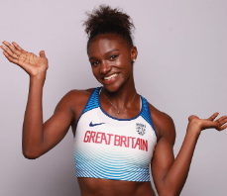
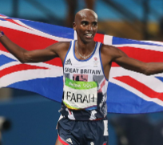
Physical Education
Unit: KS1 Athletics
Key Vocabulary:
Children will be taught to:
Learn the difference between running, jogging and sprint. Discuss terms like slower faster.
Begin to practise the different ways of jumping (hop, long jump, two-footed and leap).
Apply balance and coordination to sports day events (egg and spoon).
Throw different objects in a variety of ways
Know when to run, jog or sprint and link this to shorter distances, relays, cross country etc.
Develop different ways of jumping but using arms and bent knees to improve accuracy and distance.
Apply agility, balance and coordination to sports day events (egg and spoon).
Balance | To stay still and steady in a position or shape.
Throw | Propel (something) with force through the air by a movement of the arm and hand.
Run | To move at a speed faster than a walk, never having both or all the feet on the ground at the same time.
Jump | Push oneself off a surface and into the air by using the muscles in one's legs and feet.
Sprint | Run at full speed over a short distance.
Target | An aim.
Jogging | Running at a steady, gentle pace as a form of physical exercise.
Hop | To move by jumping on one foot.
Leap | Jump or spring a long way, to a great height.
Balance | The ability to hold your body upright and steady without falling down
Co-ordination | The ability to move two or more body parts under control, smoothly and efficiently.
Stamina | Ability to take part in prolonged physical activity.
Healthy Lifestyle:
How does our body change and feel in different events that we are trying?
Does your body feel the same way in a sprint as it does in the bean bag toss?
Do you think our body uses different body parts in different events?
What body parts are you using?
Sports Leadership:
How can you show sportsmanship?
How should you react if someone is upset when they lose?
Is it ok to be happy when you win?
How can you show kindness and care in sport?
Ambition & Aspiration
Events to consider…
Sprinting
Run the risk
Egg and spoon
Long jump
Think…
Sports Leadership
Healthy Lifestyle
Acquire, apply and evaluate skills
Dina Asher-Smith
Mo Farah

