Slide 1
Valley Primary School PE Curriculum
• Healthy Lifestyle
• Acquire, Apply and Evaluate Skills and Techniques.
• Sports Leadership

Slide 2
Physical Education
Curriculum Drivers
End of Year 4 expectation
Key Vocabulary:
Ambition & Aspiration
Be aware of the different careers and learn about national and global sports personalities.
Know the importance of applying and evaluating skills that you have learnt to help you improve and aim high.
Our Place in History
Understand when the 2012 London Olympics was within a timeline and its legacy.
Know and name some of the rule changes that made sport more inclusive to all.
Learn about Sporting Heroes who changed History.
Community
Know and understand how positive change can be brought about within a team environment.
See that a team and community can be made up from people of all different backgrounds, ethnicities and beliefs.
Ambition | A strong desire to achieve something.
Aspiration | The hope of wanting to be someone or do something.
Resilience | The ability to be able to bounce back or overcome difficulties.
Healthy Lifestyle | Knowing how to stay healthy both physically and mentally by exercising and eating a balanced diet.
Teamwork | Working together in a pair or a group in order to achieve something.
Community | A group of people that share, or have in common, one particular interest.
Role models | Someone that can be looked to and who sets the example of how to behave and interact with others.
Healthy Lifestyle
Begin to discuss the importance on warming-up and cooling down when exercising.
Identify different body parts used in different activities; compare how different sports use different muscles etc.
Explain the importance of warming up and why staying fit is important for their health.
Begin to explore how different body parts feel before, during and after exercising in different sports.
STEP Assessment;
Space – adapt the space that you are using.
Time or Task – change the task or limit/extend time.
Equipment – think about the equipment that you are giving. Can you change it?
People – How are you splitting your class? Can you pair children up OR challenge the more able and support those that need it.
Sports Leadership
To show respect to all during team sports.
Begin to discuss leaders in sport (present examples) and to discuss qualities such as good communicators (listening and talking), motivating and helping others.
To begin to lead warm-ups in small groups.
Begin to demonstrate the typical qualities that a leader has.
Begin to evaluate and assess their own and others performances.

Slide 3
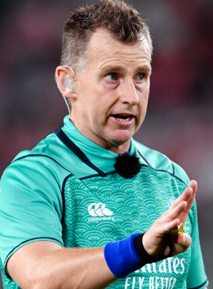
Physical Education
Unit: LKS2 Invasion Games
* Please see the inspiring athletes attached with sport specific knowledge organisers.
Key Vocabulary:
Children will be taught to:
Apply tactics to a variety of different invasion games and the terms attack and defence.
Apply hand-eye coordination into game situations.
Continue to apply Agility, Balance and Coordination but advancing this into a competitive situation.
Be able to work as a team (showing motivation, sportsmanship).
Apply teamwork when attacking and defending in games.
Understand rules of different games and begin to understand the positions in relevant sports.
Choose suitable tactics to defend, attack, pass and receive the ball when playing a game.
Be able to evaluate their own and peers performances, identifying how to improve using good communication skills.
Begin to understand the concept of space in invasion games and the importance of creating it.
Balance | To stay still and steady in a position or shape.
Control | To perform movements and skills without loosing your balance, change the speed and direction you move.
Attack | Movement made towards the oppositions goal within a game to score points.
Defend | Movements made to protect the home teams goal, preventing the opposition from scoring.
Bounce Pass | To pass the ball to a team mate using one bounce.
Weave | When dribbling be able to move in a side to side motion.
Coordination | The ability to move two or more body parts under control, smoothly and efficiently.
Agility | The ability to change the direction of the body in an efficient and effective manner.
Obstruction | When a player stands to close and prevents the opposition from passing and shooting.
Receive | When the ball is passed to a player. They are able to catch, trap or control it.
Tactic | Planning something to achieve a goal
Accuracy | Being able to make a pass directly to another team mate.
Healthy Lifestyle:
Why do we do a warm up and a cool down?
How do they help our bodies?
Can you begin to name some muscles in your body?
What are examples of exercise?
Sports Leadership:
What does respect mean?
What does a ‘leader’ need?
Can you lead a small warm up or cool down in groups?
Tell your partner/team something that they did well today.
Ambition & Aspiration
Alternative roles in sport…
There is more to sport than just playing:
Coach
Manager
Referee
Emma Hayes
Nigel Owens

Slide 4
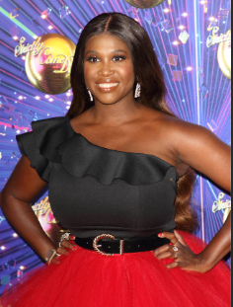
Physical Education
Unit: LKS2 Dance
Key Vocabulary:
Children will be taught to:
Explore and perform actions creatively in response to music stimulus.
Understand the terms unison, tempo and rhythm.
Show expression and use gestures to help tell a story while dancing.
Create a short sequence of movements showing imagination and creativity, linking phrases smoothly.
Demonstrate the ability to move fluently with variation in speed, height and direction.
Show precision of movement during performances.
Maintain a consistent tempo throughout a dance using beats to maintain timing.
Be able to create their own dance using a variety of different movements, balances and patterns.
Begin to perform and evaluate their own and others work.
Be able to learn, perform and adapt complex movements (Charleston, strut, chasse).
Tempo | The rate or speed of motion or activity.
Routine | When lots of shapes and movements join together to make a dance.
Balance | To stay still and steady in a position or shape.
Control | To dance without loosing your balance, change the speed and direction you move.
Direction | The way you move: Forwards, backwards, sideways, up and down.
Mood | How a character or person feels.
Facial expression | Using your face to show how you feel: Happy, sad, upset, angry.
Interpretation | When somebody explains and demonstrates their understanding of an image, piece of writing or music.
Fluency | To be able to move with ease and gracefulness.
Phase | A section of a dance routine.
Healthy Lifestyle:
What exercises can we do to warm up our bodies?
Do we use the same muscles in dance that we did last term?
Which muscles may we be using?
How does your body feel during dance?
Sports Leadership:
How can we motivate one another in dance?
How can you communicate to someone to help them improve?
Which leadership qualities can / have you shown today?
Timing | Moving to the beat or rhythm within a piece of music.
Theme | The topic of the dance or story such as: adventure, horror, cultural, futuristic.
Motif | A short phrase of movements.
Gesture | Movements of the body to show how you feel.
Stamina | The ability to take part in physical activity over a period of time.
Unison | The simultaneous performance of speech or action. Something done at the same time.
Think…
Sports Leadership
Healthy Lifestyle
Acquire, apply and evaluate skills
Motsi Mabuse

Slide 5
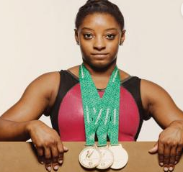
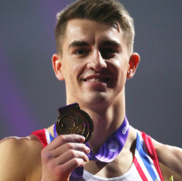
Physical Education
Unit: LKS2 Gymnastics
Key Vocabulary:
Children will be taught to:
Explore jumping techniques and link them with other gymnastic actions.
Improve the ability to choose appropriate actions when creating a sequence of gymnastic movements to music.
Be able to jump with a stable and safe landing in a variety of ways (pencil jump etc).
Begin to develop different ways in travelling to help link movements (rolls, skipping etc).
Identify and practice more complex shapes and balances such as pike, straddle and tuck.
Begin to practise symmetrical and asymmetrical body shapes.
Include counterparts and incorporate them into a sequence of movements.
Perform a sequence using equipment.
Perform and evaluate your own and others sequences.
Sequence | The order of movements within a routine.
Routine | When lots of shapes and movements join together to make a dance.
Balance | To stay still and steady in a position or shape.
Control | To dance without loosing your balance, change the speed and direction you move.
Direction | The way you move: Forwards, backwards, sideways, up and down.
Body Shape | Shapes created through the position of the body.
Technique | The safe method performers have been taught to perform a skill such as a forward roll.
Travelling | How the performer decides to move within a routine on hands and feet.
Fluency | To be able to move with ease and gracefulness.
Element | A gymnastic skills such as a forward roll or balance.
Healthy Lifestyle:
Do we need to warm up the same muscles as we would for football or netball?
How does your body feel when holding a balance?
How does your body feel at the end of a routine? Is it different at different times?
Sports Leadership:
Can anybody support their groups?
How must a leader communicate?
How can you be respectful during gymnastics?
What do we need to think about when reflecting on our routines?
Point balances | When a balance is performed on a number of points of the body.
Canon | Performing the same movements and physical actions at different time.
Body tension | Tensing muscles to create a stable shape.
Safety | Making sure the environment around and techniques are performed properly.
Counter Balance | A balance where two performers take each others weight by pushing against each other.
Symmetrical | A shape that has two completely identical sides that are around an axis.
Asymmetrical | One half is not a mirror reflection of the other.
Ambition & Aspiration
Simone Biles
Max Whitlock

Slide 6
Physical Education
LKS2: OOA/Orienteering
Key Vocabulary:
Children will be taught to:
Follow a map in a familiar context (school playground).
Move from one point to another following a map.
Use clues to help them follow a route on a map.
Begin to show good communications skills when working with others.
Be familiar with and understand key vocabulary: key, route, tactics etc.
Follow a route on a map safely.
Apply direction when navigating a map (left, right, forward, backwards).
Follow a map in a more familiar demanding context.
Move from one location to another using a map.
Follow a route accurately, safely and within a time limit.
Begin to apply tactics to plan the best way to navigate a map within a certain time.
Control Card | This is the card carried by each team to identify what they find at each marker.
Control marker | The stations scattered throughout a course that each team should visit.
Orientating the map. | This is setting the map so it is held the right way round. You can find your location on the map using features.
Stamina | The ability to perform physical activity for a sustained period of time.
Grid reference/ Coordinates | Using the markers and grids on the map to identify locations of control markers.
Teamwork | Communicating and working with others to establish a goal.
Key | A set of symbols that marks human and physical features on a map.
Route | The direction they aim to go in order the visit each control marker.
Tactics | The plan and approach taken to try to win the competition.
Navigate | Plan or direct something/someone through a course or route using a map.
Healthy Lifestyle:
Is this a form of exercise?
What makes exercise actually exercise?
How does our body feel in comparison to other activities?
Sports Leadership:
What does teamwork look like?
Why is communication important for this task?
Curriculum links:
Maths – Scales / coordinates / direction / position
Geography – Map reading / keys /scales
PSHCE – Teamwork / resilience / Cooperation

Slide 7
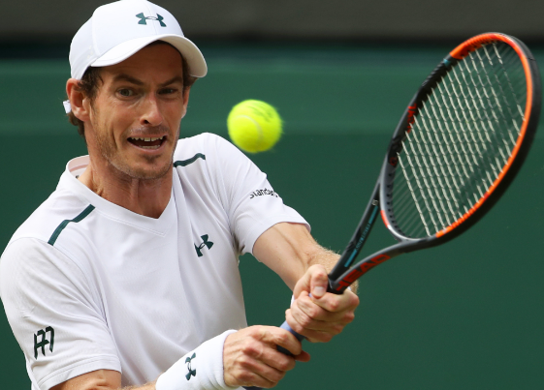
Physical Education
Unit: LKS2 Striking & Fielding
* Please see the inspiring athletes attached with sport specific knowledge organisers.
Key Vocabulary:
Children will be taught to:
Begin to apply simple tactics and skills to small sided games.
Identify and follow rules in a variety of games.
Continue to develop the basic throwing techniques (underarm, overarm, bounce and chest).
Throw and hit a ball in different ways (high, low, fast, slow).
Move and follow their passes in order to create space, ensuring accuracy and control is still evident.
Understand the importance of both striking and fielding.
Apply agility, coordination and balance when fielding.
Know when to use the correct throwing technique (distance and overarm).
Continue to practise striking techniques.
Develop receiving skills using the long leg barrier.
Overarm throw | An object throw from the should and then forced forward. This throw is great for longer distances.
Underarm throw | Using an object to throw over a short distance accurately. It involves the transference of weight forwards as the straight-throwing arm swings through from the back to the front to release the object at hip height.
Fielder | A person who is on the team which are bowling. Their job is to catch the ball and return it to the bowler quickly.
Strike | Hitting a ball or object into an open space in the playing area.
Receive | When the ball is passed to a player. They are able to stop, catch or trap it and move on with it.
Accuracy | Being able to make passes and shots making sure they get to the location the player is aiming for.
Passing | Sending the ball to another member of your team.
Control | To perform movements and skills without loosing your balance, change the speed and direction you move.
Bowler | The person who bowls the ball.
Technique | The safe method performers have been taught to perform a skill such as serving and forehand.
Healthy Lifestyle:
Give me so examples of what a warm up and cool down should look like.
Which muscles are we using to strike and field?
Why should we keep exercising?
At what point is your body using more energy?
Sports Leadership:
Think about what went well in today’s lesson and what could be improved?
What qualities of leadership have you shown in todays lesson?
What are some examples of good leadership?
Ambition & Aspiration
Andy Murray
Heather Knight

Slide 8
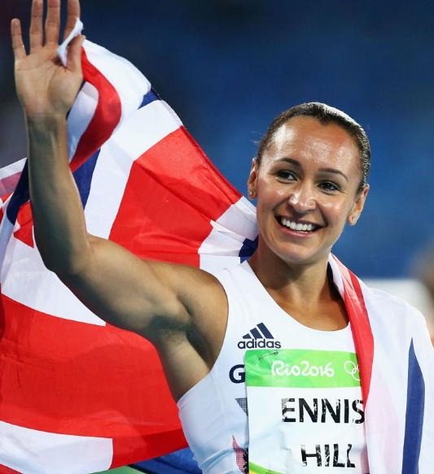
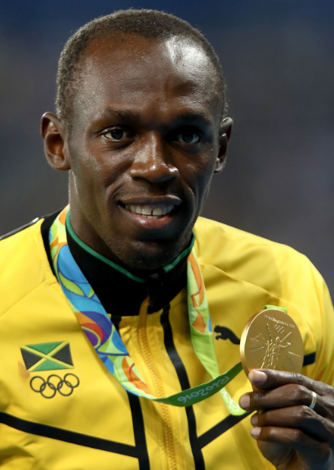
Physical Education
Unit: LKS2 Athletics
Key Vocabulary:
Children will be taught to:
Run in different distances and at different speeds using good techniques.
Apply throwing techniques to individual events such as howler, javelin, and discus.
Show that they can use their legs as well as their arms when throwing.
Learn and apply passing the baton techniques – being able to do this at pace.
Understand the rules required to complete the standing long jump.
Show control and precision when performing different jumps.
Select and maintain a running pace for different distances.
Begin to discuss different techniques when running (striding, arm action and knee lift). Show a video of sprinting and marathon runners as an example of different techniques.
Learn the pull technique for throwing – developing on from Year 3’s learning.
Balance | To keep steady on their feet while moving and performing skills.
Control | Changing the speed and direction you move and keeping balanced whilst doing it.
Technique | The safe method performers have been taught to perform a skill such as javelin and standing long jump.
Fluency | To be able to move and perform skills with ease.
Accuracy | Being able to make passes and tags making sure they get to the location the player is aiming for.
Stamina | The ability to perform physical activity for a sustained period of time.
Baton | A short tube passed between runner in a relay.
Relay | A race where teams of runners pass a baton to each member of their team.
Pace/Speed | The speed at which someone moves.
Healthy Lifestyle:
Do we still need to warm up when it is warm?
Are we using different muscles for different events? E.g. sprint / howler.
How does this topic keep us healthy?
What activities could we do for a warm up?
Sports Leadership:
What techniques could we improve?
Which techniques did we perform well today?
How can we help others during this topic?
Can you lead or teach a small group a technique?
Ambition & Aspiration
Sprint | Usually your top speed to run as fast as you can to get from A to B.
Throw | Picking something up and giving it force to travel through the air and land in a different location.
Jessica Ennis-Hill
Usain Bolt

Slide 9
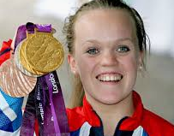
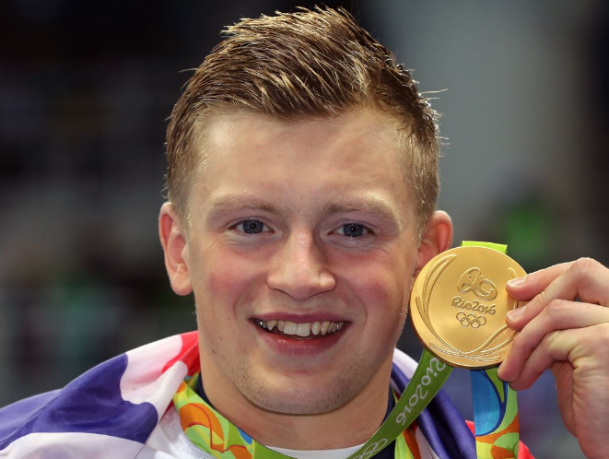
Physical Education
Unit: Swimming
Key Vocabulary:
Children will be taught to:
Perform safe self-rescue in different water based situations
Swim competently, confidently and proficiently over a distance of at least 25 metres
Use a range of strokes effectively, for example, front crawl, backstroke and breaststroke
Water Safety | Children learn how to swim and be taught how to stay safe in and around water.
Breaststroke | Swim with your chest facing down and push your arms ahead under the water and then pull yourself forwards while doing the frog kick.
Front Crawl | A swimming stroke; arms are moved alternately overhead accompanied by a flutter kick.
Backstroke | Arms rotating backwards instead of forwards and feet kicking.
Noodle | Useful when learning to swim, for floating, for rescue reaching, in various forms of water play, and for aquatic exercise.
Freestyle | In this style you swim face-down and circle your arms forwards through the air and backwards through the water while doing the flutter kick.
Butterfly | Rotate both arms forward just above the water and then use them to pull your body through the water while lifting your chest and head into the air. At the same time you propel your body forward with a rhythmic leg movement called the dolphin kick.
Inspiring Athlete
Ellie Simmonds and Adam Peaty
Inspiring Athlete
Dina-Asher Smith
Safety
Remove all jewelry including earrings.
Long hair must be tied back.
Wear suitable footwear.
Wear goggle if it is needed.
Use correct techniques.
Health and Leadership
Are we using different body parts than if we were doing a sport on land?
Is our breathing technique just important in the pool?
Showing respect to one another.
Motivating and encouraging our peers.
Things to think about:
Arm technique
Leg technique.
Using correct breathing techniques.
Are we ensuring that we are swimming safely?
Think…
Sports Leadership
Healthy Lifestyle
Acquire, apply and evaluate skills
* Remember to keep a log of those children taking part in swimming lessons and the distances they can swim.

