Slide 1
Valley Primary School PE Curriculum
• Healthy Lifestyle
• Acquire, Apply and Evaluate Skills and Techniques.
• Sports Leadership

Slide 2
Physical Education
Curriculum Drivers
End of Year 6 expectation
Key Vocabulary:
Ambition & Aspiration
Be aware of the different careers and learn about national and global sports personalities.
Know the importance of applying and evaluating skills that you have learnt to help you improve and aim high.
Our Place in History
Understand when the 2012 London Olympics was within a timeline and its legacy.
Know and name some of the rule changes that made sport more inclusive to all.
Learn about Sporting Heroes who changed History.
Community
Know and understand how positive change can be brought about within a team environment.
See that a team and community can be made up from people of all different backgrounds, ethnicities and beliefs.
Ambition | A strong desire to achieve something.
Aspiration | The hope of wanting to be someone or do something.
Resilience | The ability to be able to bounce back or overcome difficulties.
Healthy Lifestyle | Knowing how to stay healthy both physically and mentally by exercising and eating a balanced diet.
Teamwork | Working together in a pair or a group in order to achieve something.
Community | A group of people that share, or have in common, one particular interest.
Role models | Someone that can be looked to and who sets the example of how to behave and interact with others.
Healthy Lifestyle
Begin to talk about the impact of exercising on mental health and physical health.
Explain what impact exercise has on their body using previous learning/vocabulary to help.
Explain how the body reacts to different exercises.
Understand the different between fitness and exercise and why we should be doing regular exercise.
Able to talk about foods, mental and physical health when staying healthy.
Sports Leadership
Can lead or referee small groups confidently on their own or with a partner.
Begin to understand the term ‘fair play’ and apply their understanding of sportsmanship and respect to showing fair play.
Able to evaluate and assess their own and others performances by giving constructive feedback.
Can discuss and demonstrate fair play and sportsmanship.
Critique their own and others performances in order to help improve the team.
STEP Assessment;
Space – adapt the space that you are using.
Time or Task – change the task or limit/extend time.
Equipment – think about the equipment that you are giving. Can you change it?
People – How are you splitting your class? Can you pair children up OR challenge the more able and support those that need it.

Slide 3
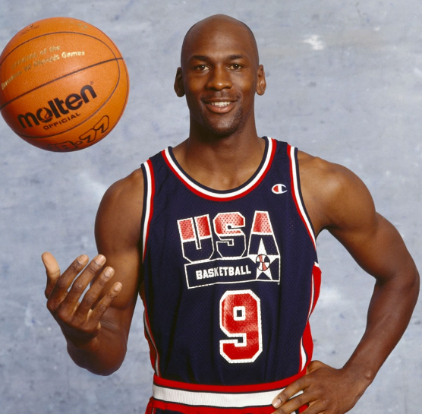
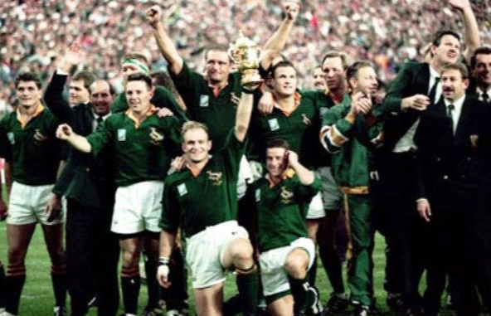
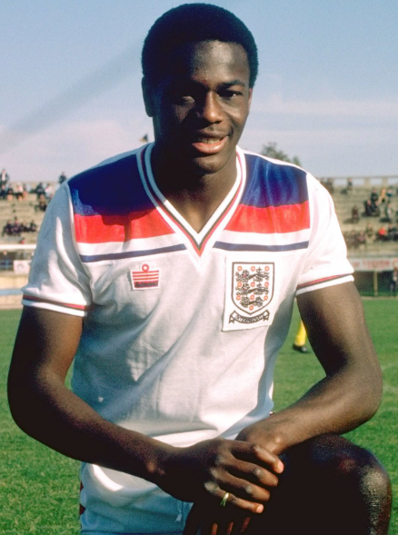
Physical Education
Unit: UKS2 Invasion Games
* Please see the inspiring athletes attached with sport specific knowledge organisers.
Key Vocabulary:
Children will be taught to:
Understand the different positions in a team.
Demonstrate the importance of moving to make space to receive a pass.
Continue develop accuracy when passing and applying this to shooting at a target.
Show good communication by calling for the ball, motivating and talking to their team mates.
Show good hand-eye coordination when passing and receiving a ball.
Understand and apply the rules and skills of different games.
Show good spatial awareness to get free from opponents.
Understand and practise the purpose of intercepting.
Show teamwork when attacking and defending.
Recognise the different roles that different positions have when attacking and defending.
Reinforce passing and receiving skills, showing accuracy and variation in technique. .
Balance | To stay still and steady in a position or shape.
Control | To perform movements and skills without loosing your balance, change the speed and direction you move.
Attack | Movement made towards the oppositions goal within a game to score points.
Defend | Movements made to protect the home teams goal, preventing the opposition from scoring.
Bounce Pass | To pass the ball to a team mate using one bounce.
Weave | When dribbling be able to move in a side to side motion.
Hand-eye Coordination | The way that one's hands and sight work together to be able to do things that require speed and accuracy
Agility | The ability to change the direction of the body in an efficient and effective manner.
Obstruction | When a player stands to close and prevents the opposition from passing and shooting.
Receive | When the ball is passed to a player. They are able to catch, trap or control it.
Tactic | Planning something to achieve a goal
Interception | The act of stopping or catching a pass from an opposing player.
Spatial Awareness | Being aware of other players on the pitch. Moving without causing collision.
Healthy Lifestyle:
How does exercise help us mentally?
How can exercise keep us fit?
How has our body reacted to the different movements we have done today?
How does this compare?
Sports Leadership:
Can anybody lead a small game?
What characteristics must a role model show?
How can we show fair play during our matches?
Springboks 1990 Rugby Team
Michael Jordan
Justin Fashanu

Slide 4
Physical Education
Unit: UKS2 Dance
Key Vocabulary:
Children will be taught to:
Identify the key skills needed to provide accurate and constructive feedback to their peers.
Continue to acquire, develop and practise new dance patterns.
Show awareness of musical rhythm for timings and when improvising.
To develop and link expressions, gestures and movements when creating routines.
Confidently perform a variety of different movements, patterns and sequences in front of peers.
Show precision in movement and consistently keep to the beat and timings.
Using skills that have been acquired, they are to be able to constructively evaluate and adapt their own and their peers performances.
Ensure that emotion and expression are visible when performing.
Tempo | The rate or speed of motion or activity.
Routine | When lots of shapes and movements join together to make a dance.
Balance | To stay still and steady in a position or shape.
Control | To dance without loosing your balance, change the speed and direction you move.
Canon | When a group of dancers perform the same sequence of movements but they are spaced out in time.
Compose | To create.
Precision | Something that is exact and accurate.
Interpretation | When somebody explains and demonstrates their understanding of an image, piece of writing or music.
Fluency | To be able to move with ease and gracefulness.
Phase | A section of a dance routine.
Healthy Lifestyle:
Is dance a form of fitness or physical activity?
What muscles and parts of our body are we using?
How does this change throughout our routine?
How do the foods and things we put in our body help keep us healthy?
Sports Leadership:
Give feedback to our group or another group based on their performance.
How can we be constructive when giving feedback?
How can we be a role model by showing respect during our lessons?
Timing | Moving to the beat or rhythm within a piece of music.
Theme | The topic of the dance or story such as: adventure, horror, cultural, futuristic.
Motif | A short phrase of movements.
Gesture | Movements of the body to show how you feel.
Accompaniment | A part of a piece of music that supports or provides background for another, more important part.
Unison | The simultaneous performance of speech or action. Something done at the same time.
Len Goodman

Slide 5
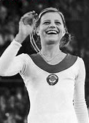
Physical Education
Unit: UKS2 Gymnastics
Key Vocabulary:
Children will be taught to:
Consolidate previously taught shapes with control and accuracy. Introduce arch, dish and star.
Work cooperatively with others and link movements together with timing, fluency and good body tension.
Identify and perform symmetrical and asymmetrical body shapes.
Develop different movements within a sequence – bridge, rolling etc.
Develop the skills of critiquing, recognising strengths and areas of improvement in their own and others performances.
Critique their own and others performances using appropriate feedback.
Perform a wide range of balances, shapes and movements using their own body weight to balance with control.
Create a long sequence in response to a stimuli that includes a wide range of skills taught including canon
and unison.
Show consistently accuracy, understanding of timing, precision in movement and cooperation when performing.
Sequence | The order of movements within a routine.
Routine | When lots of shapes and movements join together to make a dance.
Balance | To stay still and steady in a position or shape.
Control | To dance without loosing your balance, change the speed and direction you move.
Direction | The way you move: Forwards, backwards, sideways, up and down.
Body Shape | Shapes created through the position of the body.
Technique | The safe method performers have been taught to perform a skill such as a forward roll.
Accurate | Free of mistakes or error.
Fluency | To be able to move with ease and gracefulness.
Element | A gymnastic skills such as a forward roll or balance.
Healthy Lifestyle:
How does the movement and our body work differently in gymnastics to dance?
What is the difference between fitness and exercise?
How does exercise help us mentally?
Sports Leadership:
Give feedback to our group or another group based on their performance to help them.
How can we be constructive when giving feedback?
How can we be a role model by showing respect during our lessons?
Point balances | When a balance is performed on a number of points of the body.
Canon | Performing the same movements and physical actions at different times.
Body tension | Tensing muscles to create a stable shape.
Safety | Making sure the environment around and techniques are performed properly.
Counter Balance | A balance where two performers take each others weight by pushing against each other.
Symmetrical | A shape that has two completely identical sides that are around an axis.
Asymmetrical | One half is not a mirror reflection of the other.
Olga
Korbut

Slide 6
Physical Education
UKS2: OOA/Orienteering
Key Vocabulary:
Children will be taught to:
Begin to show problem solving skills when having to adapt their plan when following a route (e.g. say they cannot pass through a certain area).
Communicate opinions on a plan or a problem within a team.
Begin to follow a map in an unknown location.
Continue to use direction when following a route but begin introduces a compass to assist this.
Work cooperatively in order solve clues and when following a route.
Follow a route using a compass.
Work collaboratively as part of team when adapting to a new route or having to change a plan.
Plan a route for someone else using clues.
Plan a route for someone else taking into account safety and hazards.
Control Card | This is the card carried by each team to identify what they find at each marker.
Control marker | The stations scattered throughout a course that each team should visit.
Orientating the map. | This is setting the map so it is held the right way round. You can find your location on the map using features.
Stamina | The ability to perform physical activity for a sustained period of time.
Grid reference/ Coordinates | Using the markers and grids on the map to identify locations of control markers.
Teamwork | Communicating and working with others to establish a goal.
Key | A set of symbols that marks human and physical features on a map.
Route | The direction they aim to go in order the visit each control marker.
Tactics | The plan and approach taken to try to win the competition.
Navigate | Plan or direct something/someone through a course or route using a map.
Compass | An instrument used for navigation which shows direction.
Cooperation | Process of working together for the same outcome.
Healthy Lifestyle:
Is this a form of exercise or fitness?
What makes exercise actually exercise?
How might this help you in other areas of your school life?
Sports Leadership:
How can you evaluate your performance when orienteering?
What characteristics can you show when problem solving or facing difficulty?
Curriculum links:
Maths – Scales / coordinates / direction / position
Geography – Map reading / keys /scales
PSHCE – Teamwork / resilience / Cooperation

Slide 7
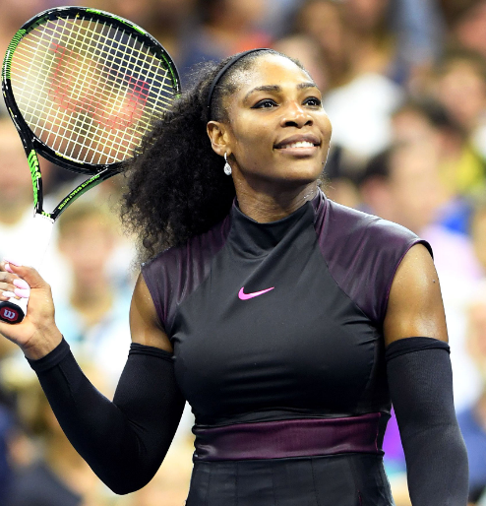
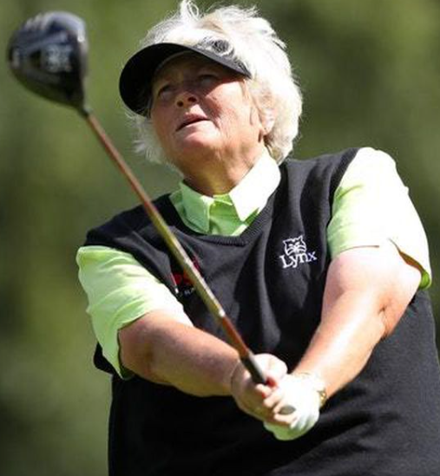
Physical Education
Unit: UKS2 Striking & Fielding
Key Vocabulary:
Children will be taught to:
Be able to hold a bat/racket correctly depending on the sport and begin to show accuracy when returning.
Show an understanding and be able to abide by the different rules and scoring in sports.
Recognise the different roles in fielding; wicket keeper/back stop and show team work when fielding.
Develop accuracy in throwing when using the appropriate technique.
Be able to throw and catch accurately when under pressure.
Consolidate fielding skills in order to stop a ball (trap, stop, long leg barrier).
Be able to show control and direction when hitting a ball with a bat/ racket.
Understand the different roles and begin to identify different tactics to best win a game.
Show teamwork in both fielding and batting.
Be able to assess and analyse one another’s performances within a game and give constructive feedback.
Overarm throw | An object throw from the should and then forced forward. This throw is great for longer distances.
Underarm throw | Using an object to throw over a short distance accurately. It involves the transference of weight forwards as the straight-throwing arm swings through from the back to the front to release the object at hip height.
Fielder | A person who is on the team which are bowling. Their job is to catch the ball and return it to the bowler quickly.
Strike | Hitting a ball or object into an open space in the playing area.
Receive | When the ball is passed to a player. They are able to stop, catch or trap it and move on with it.
Accuracy | Being able to make passes and shots making sure they get to the location the player is aiming for.
Passing | Sending the ball to another member of your team.
Control | To perform movements and skills without loosing your balance, change the speed and direction you move.
Bowler | The person who bowls the ball.
Technique | The safe method performers have been taught to perform a skill such as serving and forehand.
Tactic | Planning something to achieve a goal
Healthy Lifestyle:
What else does our body need to stay healthy?
What foods can help our body be healthy?
How does what we eat and how much we exercise keep us mentally and physically healthy?
Sports Leadership:
Can anybody lead a group working on a key skill?
How can we improve our own performance?
What does improvement look like?
What does a Valley Sports Role Model look like?
How can I support my peers and team mates?
Serena Williams
Dame Laura Davies

Slide 8
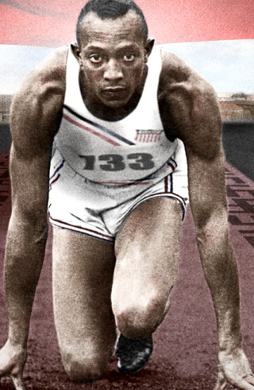
Physical Education
Unit: UKS2 Athletics
Key Vocabulary:
Children will be taught to:
Develop fitness and technique in order to run for distance.
Develop throwing techniques – demonstrating the push technique.
Learn and apply the techniques of relay running, especially the handing over of the baton.
Begin to apply skills learnt into a competitive setting.
Be able to perform a controlled standing long jump.
Explore the footwork required when attempted the triple jump.
Demonstrate good arm and leg technique when running.
Be able to sustain, change and adapt the speed of which they are running to different distances and situations (e.g. last 30m in a race).
Be able to perform, discuss and evaluate the different throwing techniques.
Perform a variety of different jumps with control in a competitive situation.
Balance | To keep steady on their feet while moving and performing skills.
Control | Changing the speed and direction you move and keeping balanced whilst doing it.
Technique | The safe method performers have been taught to perform a skill such as javelin and standing long jump.
Fluency | To be able to move and perform skills with ease.
Accuracy | Being able to make passes and tags making sure they get to the location the player is aiming for.
Stamina | The ability to perform physical activity for a sustained period of time.
Baton | A short tube passed between runner in a relay.
Relay | A race where teams of runners pass a baton to each member of their team.
Pace/Speed | The speed at which someone moves.
Healthy Lifestyle:
How does our body change when taking part in different events and activities?
What will happen to our body if we do not warm up and cool down?
Why does our body change depending on intensity of the exercise?
Sports Leadership:
Can anybody lead a group working on a key skill?
How can we improve our own performance?
What does improvement look like?
What does a Valley Sports Role Model look like?
How can I support my peers and team mates?
Sprint | Usually your top speed to run as fast as you can to get from A to B.
Throw | Picking something up and giving it force to travel through the air and land in a different location.
Competitive | Relating to a competition where losing or winning is involved.
Jesse Owens
Tanni Grey-Thompson

Slide 9
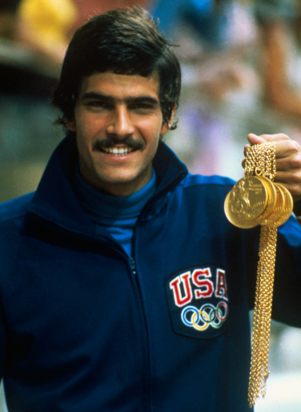
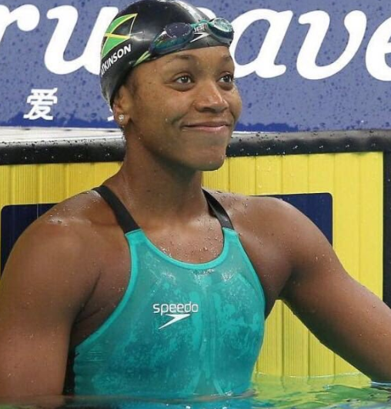
Physical Education
Unit: Swimming
Key Vocabulary:
Children will be taught to:
Perform safe self-rescue in different water based situations
Swim competently, confidently and proficiently over a distance of at least 25 metres
Use a range of strokes effectively, for example, front crawl, backstroke and breaststroke
Water Safety | Children learn how to swim and be taught how to stay safe in and around water.
Breaststroke | Swim with your chest facing down and push your arms ahead under the water and then pull yourself forwards while doing the frog kick.
Front Crawl | A swimming stroke; arms are moved alternately overhead accompanied by a flutter kick.
Backstroke | Arms rotating backwards instead of forwards and feet kicking.
Noodle | Useful when learning to swim, for floating, for rescue reaching, in various forms of water play, and for aquatic exercise.
Freestyle | In this style you swim face-down and circle your arms forwards through the air and backwards through the water while doing the flutter kick.
Butterfly | Rotate both arms forward just above the water and then use them to pull your body through the water while lifting your chest and head into the air. At the same time you propel your body forward with a rhythmic leg movement called the dolphin kick.
Safety
Remove all jewelry including earrings.
Long hair must be tied back.
Wear suitable footwear.
Wear goggle if it is needed.
Use correct techniques.
Health and Leadership
Are we using different body parts than if we were doing a sport on land?
Is our breathing technique just important in the pool?
Showing respect to one another.
Motivating and encouraging our peers.
Things to think about:
Arm technique
Leg technique.
Using correct breathing techniques.
Are we ensuring that we are swimming safely?
Think…
Sports Leadership
Healthy Lifestyle
Acquire, apply and evaluate skills
Mark Splitz
Alia Atkinson

