Slide 1
Art and D&T Update 2021-2022 Wallace Fields Junior School
Subject Leader: Holly Birch

Slide 2
Overview of presentation
Introduction to leadership in Art and D&T
Actions implemented this year (2021/2022)
Progression Maps
Book Looks
Whole school competitions
Assessment in Art
Next Steps
Pupil voice and learning walks
Diverse and modern artists
Real people and jobs linked to D&T
Challenge and Support

Slide 3
Leadership in Art and D&T
Became Art and D&T lead in September 2021.
First time leading a subject - first few months spent understanding what it means to be a subject leader and understanding how the progression map worked.
Have had CPD for both Art and D&T development which helped contribute to my understanding of the subjects and what I wanted to do with them.
If you want to know more about the intent, implementation and the impact for for both Art and D&T at Wallace Fields Junior School then you can find these on the website links below.
Art: https://www.wallacefields-jun.surrey.sch.uk/learning/art
D&T: https://www.wallacefields-jun.surrey.sch.uk/learning/design-technology

Slide 4
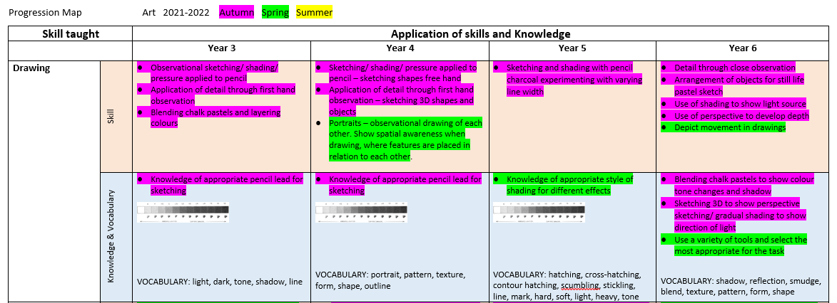
2021 – 2022 Actions: Art Progression
Colour key helps both subject leader and teaching staff with lesson sequences to ensure curriculum coverage and progression.

Slide 5
2021 – 2022 Actions: D&T Progression
New this year
Colour key helps both subject leader and teaching staff with lesson sequences to ensure curriculum coverage and progression.

Slide 6
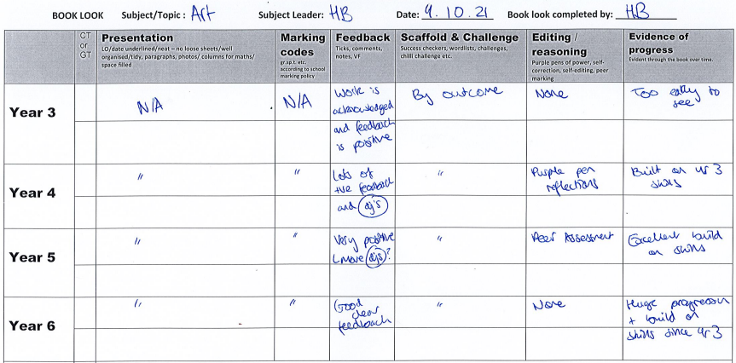
2021 – 2022 Actions: Book Looks
Created a new book look template that ensures Art and D&T book looks are effective and a valuable use of time. No need for sections such as ‘presentation of LQ and date’ or ‘marking codes’, etc.

Slide 7
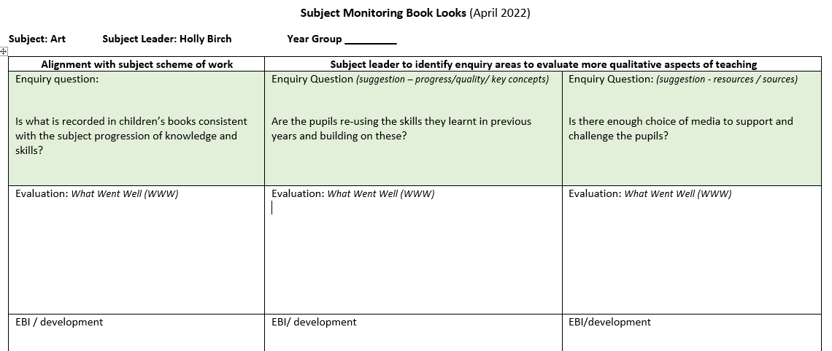
2021 – 2022 Actions: Book Looks
Created a new book look template that ensures Art and D&T book looks are effective and a valuable use of time. No need for sections such as ‘presentation of LQ and date’ or ‘marking codes’, etc.

Slide 8
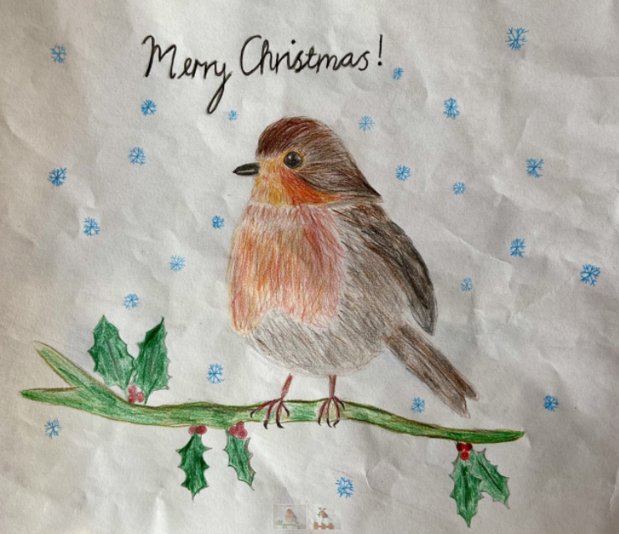
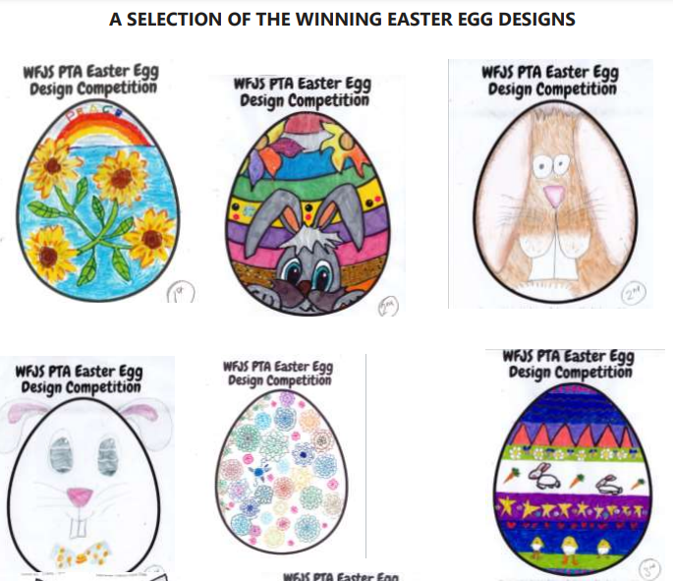
2021 – 2022 Actions: Competitions
Chris Grayling MP Christmas Card Competition
Babushka Artwork for Christmas Show
Jubilee Picnic Boxes (coming soon!)
Easter Egg Design Competition

Slide 9
2021 – 2022 Actions: Assessment
Assessment in foundation subjects is one of the four Whole School Key Priorities areas this academic year.
I also noticed there was a lack of assessment in Art due to its subjective nature. I therefore made it a focus to understand how we can assess whether our pupils are achieving the skills and knowledge intended in each topic or lesson.

Slide 10
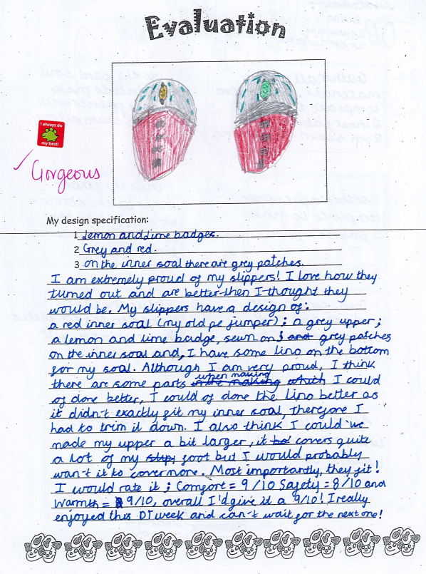
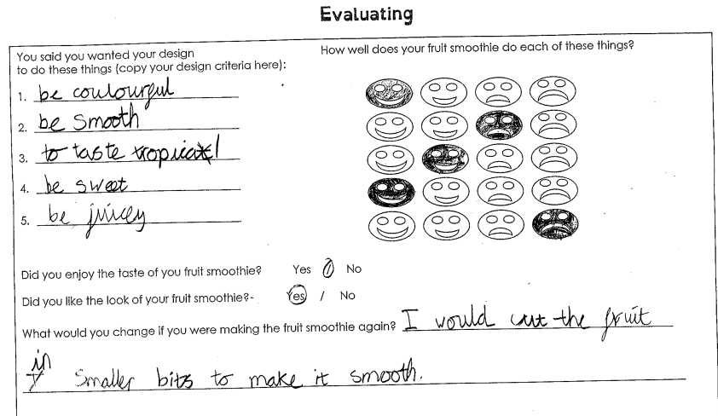
2021 – 2022 Actions: Assessment
The D&T booklets already have a self evaluation page at the end of the booklet which I feel works really well.
It allows both pupil and teacher to assess whether they have understood and achieved the key skills.
It also allows pupils to reflect on what they would do differently next time.

Slide 11
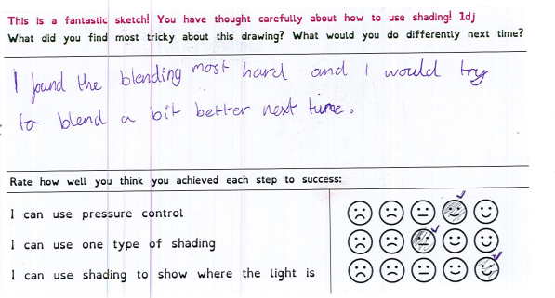
2021 – 2022 Actions: Assessment
However Art didn’t have as much structure to it’s assessment. I asked all the teachers to give the children an opportunity to self-assess their work at the end of each topic.

Slide 12
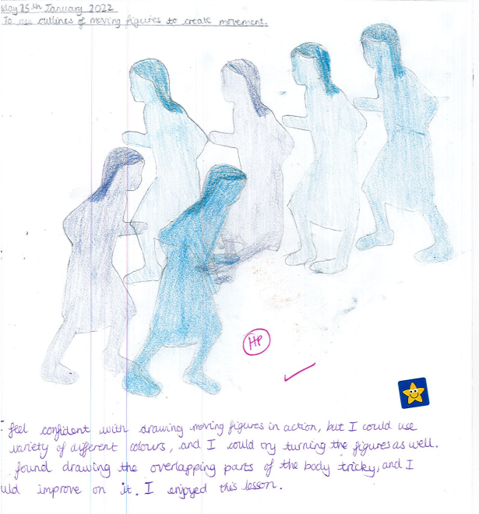
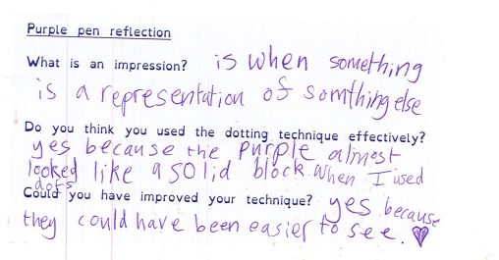
2021 – 2022 Actions: Assessment
I also encouraged the teachers to give the pupils opportunity to purple pen (reflect) on each piece of work, to demonstrate whether they have understood the aim of the lesson.

Slide 13
2021 – 2022 Actions: Assessment
Impact of Assessment:
Skills and knowledge is more explicit for pupils and they have the opportunity to reflect on what they would do differently next time.
Class teachers are able to make an assessment of pupils levels in Art and D&T by looking at the pupils reflections and self-assessment.
As a subject leader, I can reflect on whether the children have understood and applied the skills and knowledge, allowing me to adjust the progression map accordingly.

Slide 14
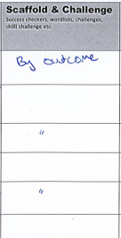
Next Steps for Art and D&T
Gather more pupil voice and conduct learning walks to gather more evidence for what pupils think about art and D&T. (Summer Term 2022)
Research more diverse and modern artists (Summer Term 2022)
Link D&T projects to real people/jobs/projects as inspiration. (Summer Term 2022)
Consider what other materials/media to order for the school to ensure lessons are differentiated. (Next academic year)

