Slide 1

Welcome to Year 6

Slide 2
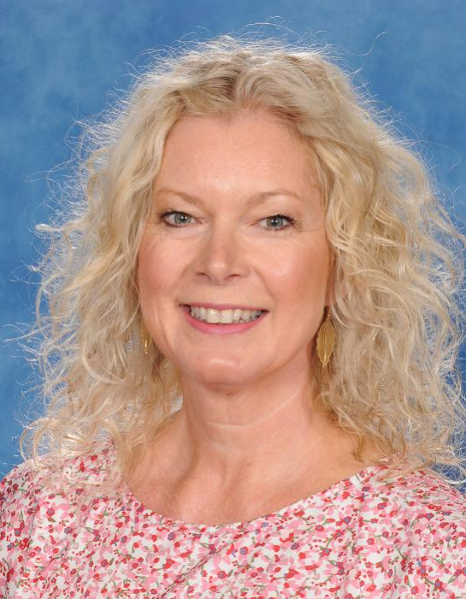
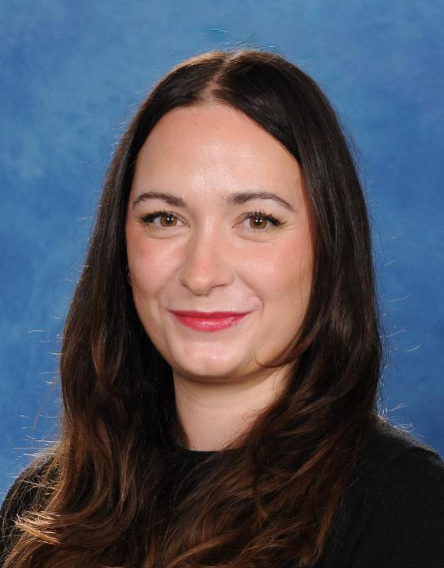
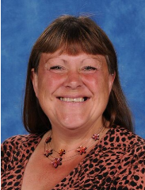
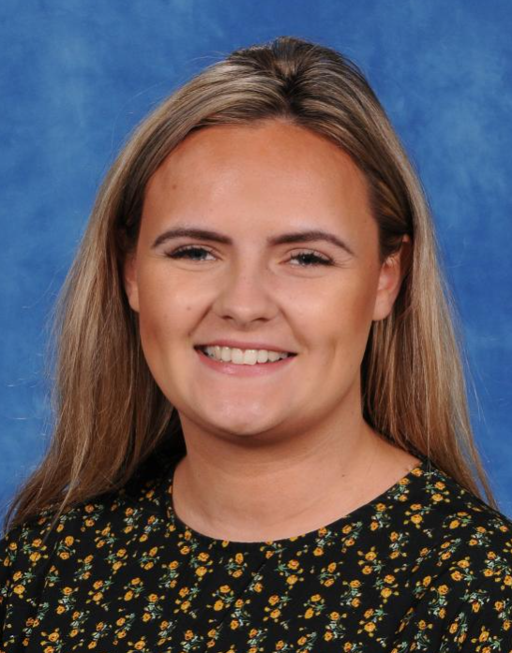
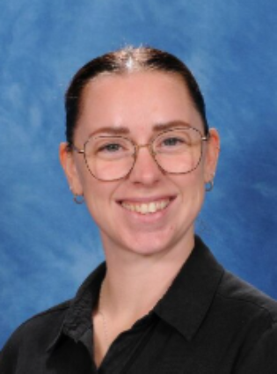
Class teachers: Ms. Gough & Miss Sarjeant
Support staff: Mrs. Langner & Mrs Murtagh
Group and intervention teacher: Mrs. Day

Slide 3
Resources needed for this year…
A pencil case with the following items: pencils, ruler, rubber, whiteboard pen, glue stick, sharpener, blue handwriting pen, purple pen and colouring pencils.
Chrome book compatible head phones (Usb port or line in)
A reading book for pleasure

Slide 4
Autumn Dates
School photos (15.9.26) – school uniform
Jam jars coming up (17.9.26)
Year 6 Tea Party (14.10.26)
Parents Evening (9.11.26 & 10.11.26)
Wellbeing Day (13.11.26)

Slide 5
ART AND D&T projects and resources
Slippers (14.12.26) – lino, fabric
Hot Cross Buns (15.3.27) – equipment
Fairground Rides (12.7.27) – shoe box

Slide 6
Year 6 Dates
SATS Week – 10th May 2027
Bikeability – 1 group 17th May 2027
1 group 24th May 2027
France – Week beginning 14th June 2027
Production – 14th and 15th July 2027
Year 6 Decade Day – 23rd July 2027
Year 6 Disco – 26th July 2027

Slide 7
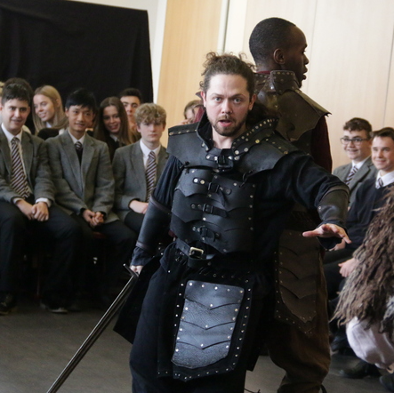


Trips and visitors
Young Shakespeare Company to perform Macbeth (2.11.26)
Bikeability
Junior Citizens
France residential (DHT usually leads the trip)

Slide 8
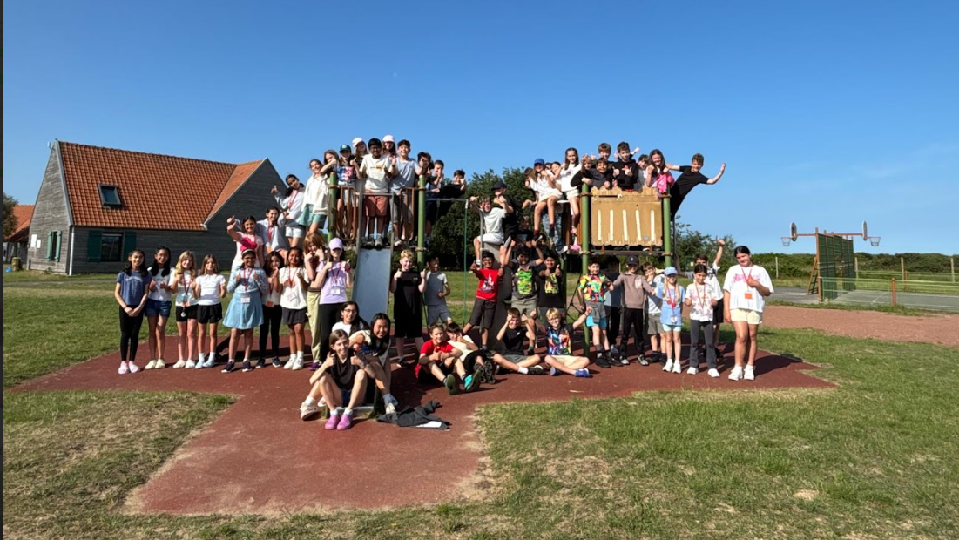
France
Boulogne-sur-Mer

Slide 9
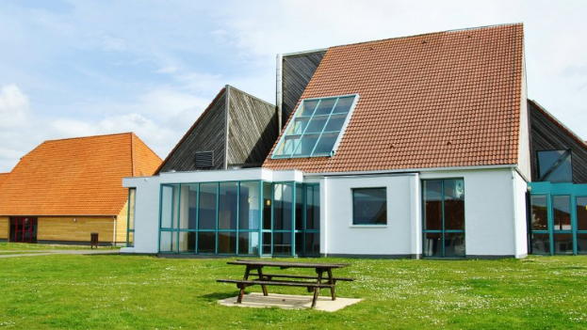
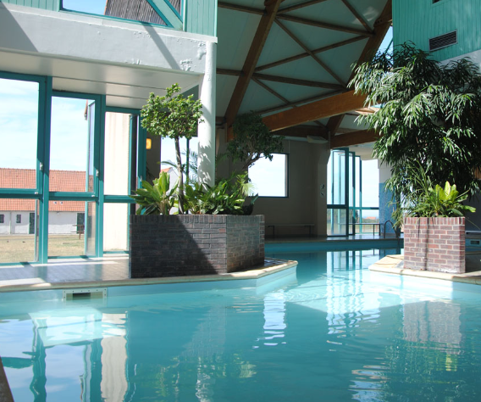
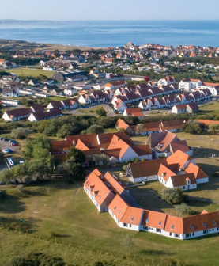
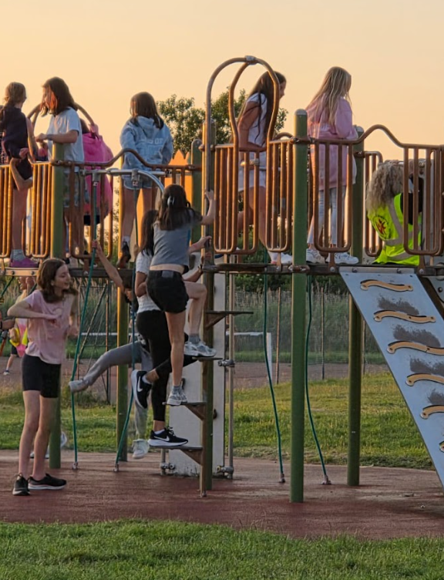
France
Accommodation

Slide 10
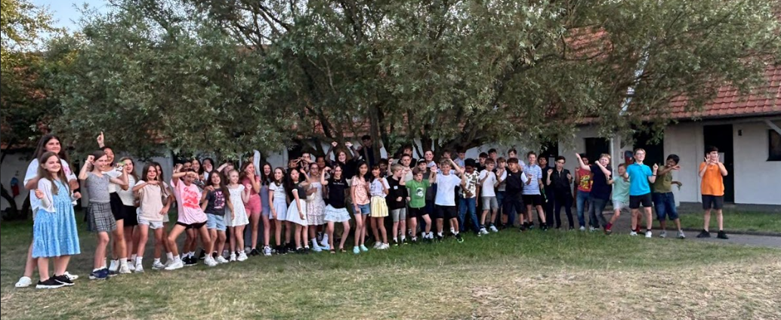
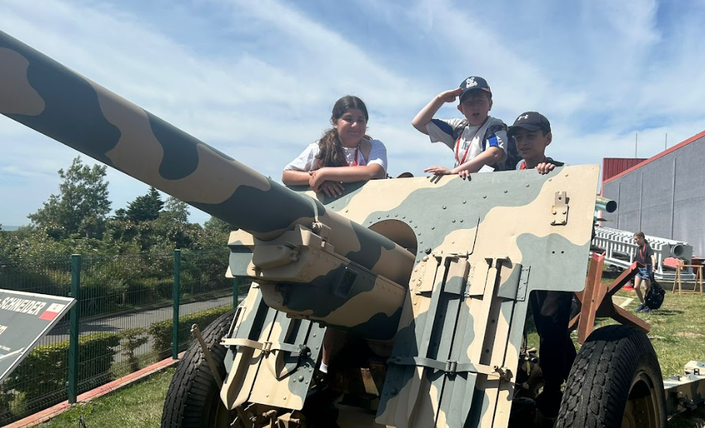
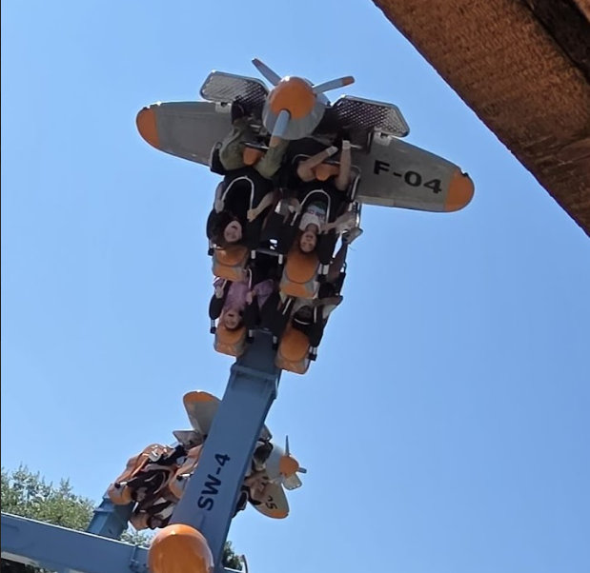
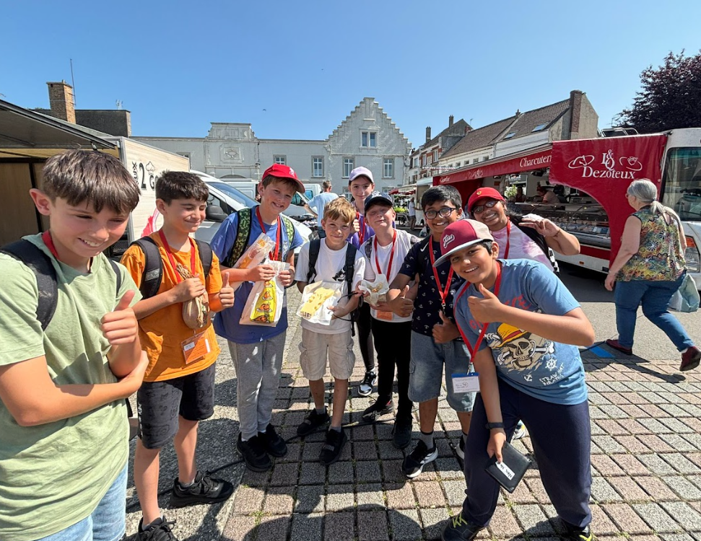
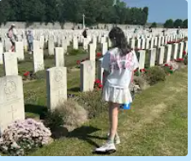

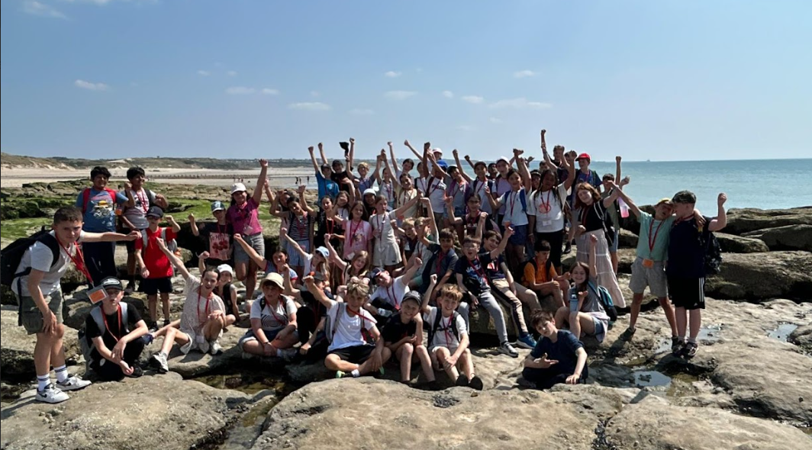
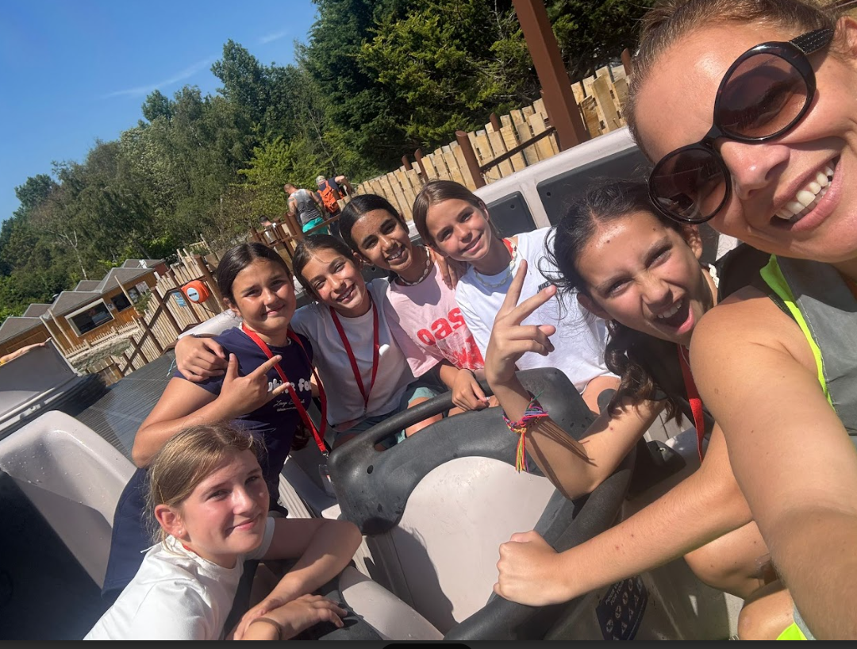
France
Days out…

Slide 11
Trackers/Air Tags
Tags fine in class but not on trips/residentials.
Suitcases will need to be brought in the Friday before the trip so that they can be scanned.

Slide 12
Year Books
Photos
PTA Rep
Reps needed
Year Group Rep

Slide 13
Homework
Monday: English homework – every week
Wednesday: Maths homework – every week
Friday: Topic/Foundation homework – 2 times per half term

Slide 14
SATS – in brief!
WB 10th May 2027
Written test for Reading Comprehension
Spelling, Punctuation and Grammar test
Maths Arithmetic and 2 Reasoning tests
Writing is Teacher Assessed through the year
Additional support: children will be assessed in the Mock SATs in autumn and spring for access arrangements
During the Spring term and early summer, children will be given the opportunity to practise past papers in school. It would greatly help us if they did not practise these at home or use them for revision. The papers do not cover the whole curriculum – they are a snapshot and therefore the revision we do in lessons is far more valuable than previous papers.

