Slide 1
Meet the Teacher
Year 1

Slide 2
Year 1
Mrs Cahill and Mrs Holt
Music: Mr Martin
Mrs Smith PPA(cover)

Slide 3
The School Day
08:45/ 08:55 Registration
Morning activity is important. Reading groups/ interventions
10:30 am: break time- healthy snack/school fruit
12:10pm: Lunch
Afternoon break
15:30 Home time
Please let us know in advance if somebody different is collecting your child.

Slide 4
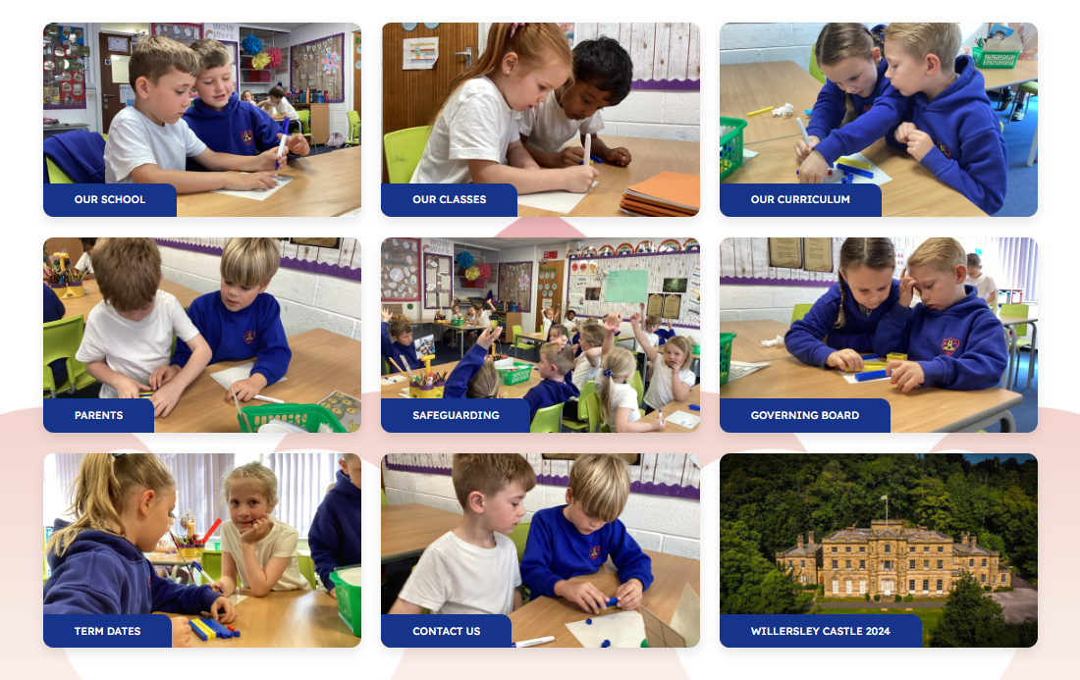
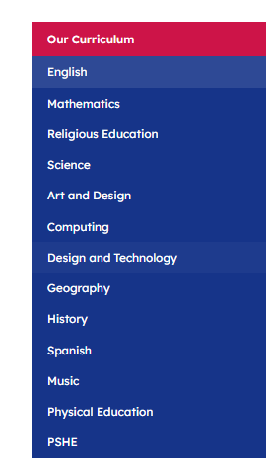
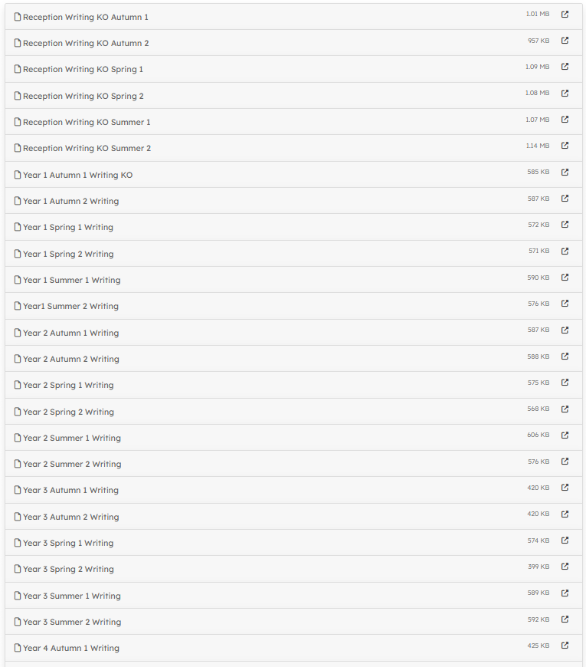
English Curriculum
Lost and Found – Oliver Jeffers | Nibbles: The Book Monster – Emma Yarlett | The Lion Inside – Rachel Bright | The Curious Case of the Missing Mammoth – Ellie Hattie A Great Big Cuddle – Michael Rosen | Somebody Swallowed Stanley – Sarah Roberts | Goldilocks and Just the One Bear – Leigh Hodgkinson

Slide 5
How can you help?
Read as much as you can.
Talk about what you are reading.
Practise spelling.
Encourage them to write.
Expose them to different text types.
Homework and diaries
Let them be creative!

Slide 6
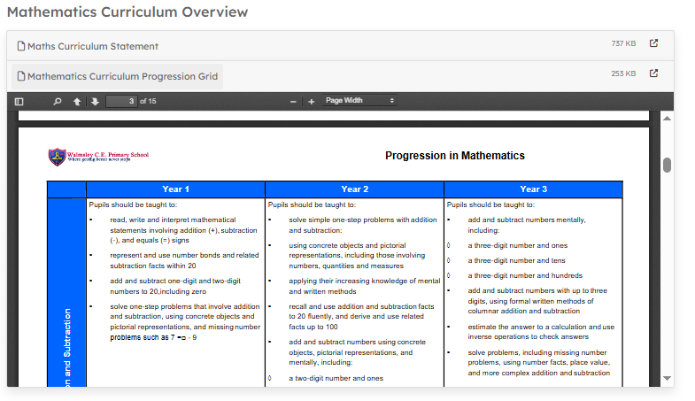
Maths Curriculum
Progression grid and knowledge organisers.

Slide 7
How can you help?
Number bonds to 10 and 20 and in-between.
Counting backwards and forward from any given number (Y1 50)
Understand inverse relationships.
Use the language on the knowledge organisers (Tens and Ones)
Make maths fun at home- baking, games, counting in nature.

Slide 8
Wider Curriculum
Science
RE
ART
Computing
DT

Slide 9
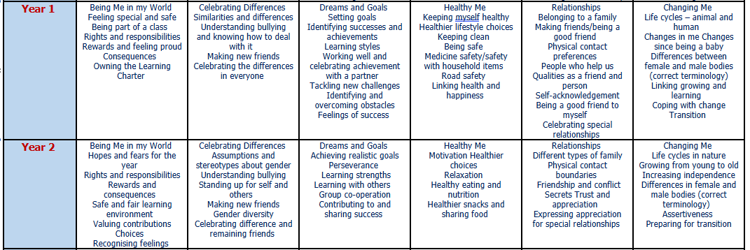
PSHE
History
Geography
PE

Slide 10
Phonics Y1
5 x weekly – Little Wandle
Phonics test in June
Whole class
Intervention groups.
Reading books will only include sounds they have been taught.
By the end of Y1, they should be able to sight read most words containing phase 5 sounds.

Slide 11
How you can help…
Encourage the children to blend in their heads and they should not be sounding out tricky words.

Slide 12
Homework
Homework will be given on a Friday each week and is expected in by the following Wednesday. It will be checked and noted which areas need more work.
It will consist of maths recall (number bonds), maths and grammar.
Reading should be done every night for 15 minutes to help develop fluency.

Slide 13
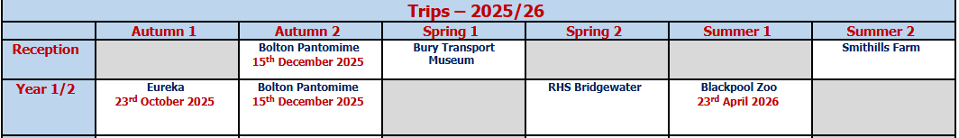
Trips
Plants- Science Topic Animal –Science topic
Gross Lab Science Show

Slide 14
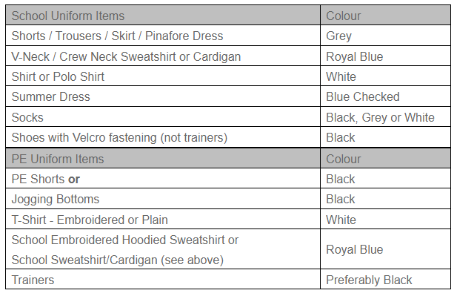
Uniform

Slide 15
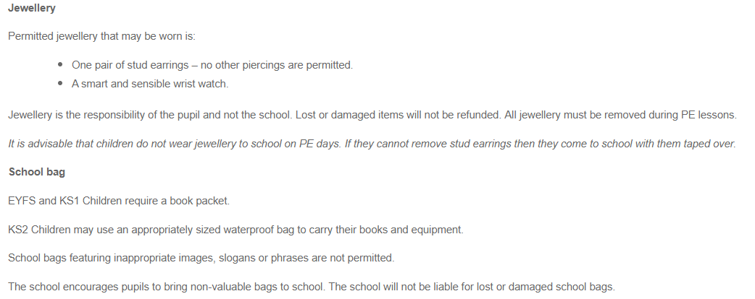
Uniform

Slide 16
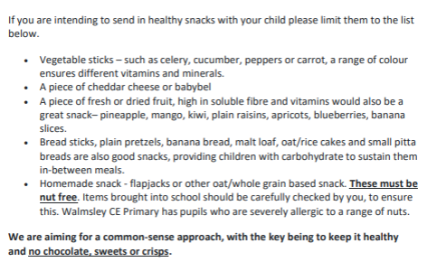

Slide 17
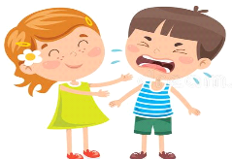



Golden Rules/Always Children
Dojo Awards
Our Golden Rules
We are gentle
We are kind and helpful
We listen
We are honest
We work hard
We look
after property

Slide 18
E-safety
This is taught and practised throughout school.
We have E-safety lessons and assemblies to emphasise its importance.
Please try to reinforce this at home.
Be aware of what your children are viewing.

