Slide 1
Meet the Teacher
Lower KS2

Slide 2
Staff
Year 3 – Miss Plumb with Miss Stanworth
Year 3/4 - Miss Liston with Mr Ellison
Year 4 – Miss Hawkins with Miss Yates
Mrs Morris will provide support with Year 3 & 4 Maths and across the phase in other lessons

Slide 3
Routines
This year our school day timings have gone back to how they originally were
8.45am – 8:55am - Children are to come into school through the Junior door. (Maths/Corrections/ Intervention)
9am – 9.30am – Collective Worship
9.30am – 10:30 am - Morning Lessons (1)
10.30am – 10:45am – Break
10:45am – 12:20 pm – Further Morning Lessons (2)
12:20pm – 1:15 pm – Lunch
1:15pm – 3:30pm - Afternoon lessons (2 or 3)

Slide 4
Routines
Each day your child will need to bring to school
Reading diary and reading book
Water bottle – filled with water only – no juice or cordial please
One snack – one for morning, NO afternoon snack. A letter was sent out last week, please refer to this for suitable snacks
Outer wear suitable for all weather playtimes - Children will be taken outside for playtimes where possible depending on the weather. Please ensure your child has a coat with a hood.

Slide 5
Routines
Packed lunch – for children who are not on school dinners. Please let the office know ASAP about any packed lunch / school dinner changes . NO NUTS
Please make sure ALL of your child’s belongings are labelled, including water bottles and snack pots.
Anything your child brings into school is their responsibility. If your child chooses to bring in any notepads, fidgets or similar, they are only to be used at breaktime and lunchtime. We are not responsible for any of these items.
If your child wishes to bring something into school that is linked to our learning, please let us know so it can be acknowledge and stored away safely.

Slide 6
English
The children will have English every day.
4 writing lessons
1 grammar lesson
2 spelling lessons
2 guided reading sessions
We also practise handwriting.
Over the year we will cover a variety of different themes of fiction and non-fiction to engage the children in their learning.
Throughout the year the children will learn how to compose 6 text types; recount, instructions, report, explanation, discussion and persuasion.

Slide 7
Spellings
Every Friday all children will be given a ‘Spelling Shed’ list to learn from
Spellings are inline with the National Curriculum and must be covered in Year 3 and Year 4.
Although some of the words will seem unusual they are included to develop the children’s vocabulary and understanding. The 2019 Year 6 SATs Reading paper required the children to read 140 words per minute and contained complex vocabulary.

Slide 8
Maths
This year, we are following the White Rose Maths scheme.
The children will be working very practically, sometimes in pairs and small groups to investigate, explore and evidence in all areas of Maths. This style of learning enables the children to take ownership of their learning resulting in more secure knowledge and understanding.

Slide 9
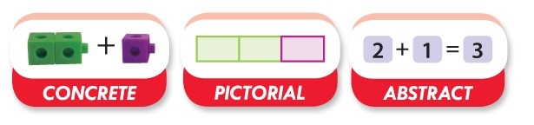
Maths
Concrete, Pictorial, Abstract (CPA) is a highly effective approach to teaching that develops a deep and sustainable understanding of maths in pupils.
Many people assume using concrete and pictorial methods shows a lower level of ability.
These methods also allow the children to build a picture in their head and equip them with techniques that can be applied to a variety of challenges and situations as well a test environment.
Ways to help at home –
Encourage your child to use equipment to support their continued learning at home. Using pasta shapes or dried kidney beans for counting, grouping, addition, subtraction.
They may benefit from using a small whiteboard or paper for working / drawing out models and pictures.

Slide 10
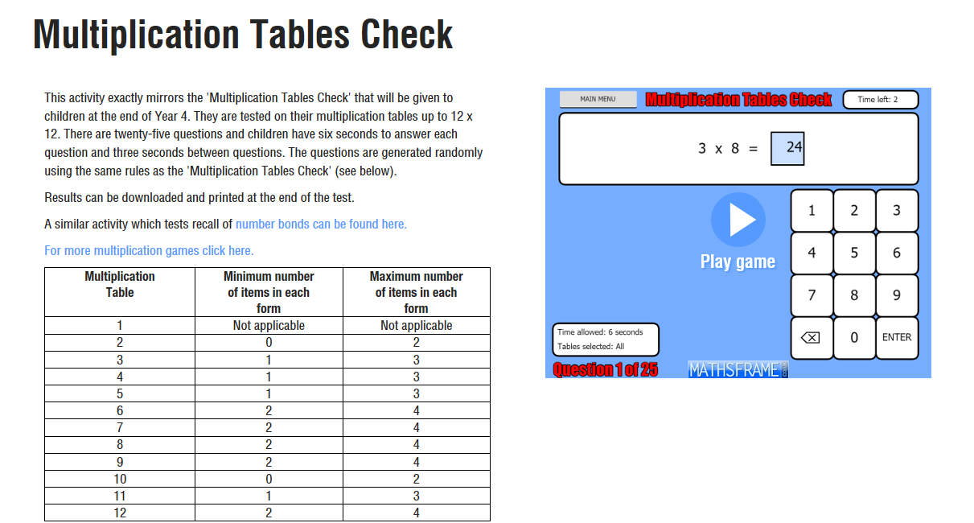
Times Tables
We will have a weekly times tables test within lessons.
This will help to build up fluency in our daily maths lessons
In Year 3 and Year 4, we will be preparing the children for the National Year 4 Times Tables Test – children will complete this on a computer and will be given only 6 seconds to answer each question.
In Year 3, we will start by revising the times tables learnt in Year 2 before introducing 3s, 4s and 8s.
In Year 4, we will start by revising the times tables learnt in Year 3 before introducing the remaining times tables.
Mathsframe.co.uk has a Multiplication Tables Check which replicates the test that the children will be sitting at the end of year 4

Slide 11
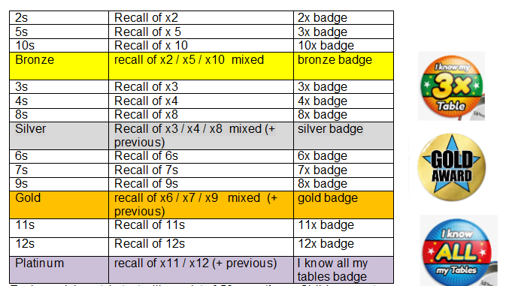
Times Tables
This year the lower juniors will continue with their times tables challenge.
The challenge has 50 questions and you need to score 45 or above, three times in a row to complete a level and move on to the next stage.
Badges will be awarded on completion of the set time tables as well as bronze, silver and gold.
We encourage the children to wear their badges with pride to school, to motivate them to learn.
Year 3 starting point
Year 4 starting point

Slide 12
Year 3 Reading
All Year 3 children will read in school at least once a week. Some will read more depending on their comprehension and inference skills, as well as their word recognition and fluency when reading.
This is subject to change throughout the year.
The focus of this session is a quality read with appropriate questioning to further develop the children’s comprehension skills.

Slide 13
Year 4 Reading
Most Year 4 children will not read with an adult in school but some may. Again, this is depending on their comprehension and inference skills, as well as their word recognition and fluency when reading.
This is also subject to change throughout the year.
Most Year 4 children will be classed as independent readers. They will be expected to read at home from either a book of their choice or a school scheme book.
All children are expected to record any reading that they do in their diaries and record books in their School Reading Challenge record in their diaries. For every 10 books that are read they receive a book from Mrs Atherton.
If children are not reading at home, we will include them in our reading sessions with an adult using school scheme books.

Slide 14
In School Readers
Pages will be set for your child to read at home with a grown up, please try to keep up with the reading pages given and let us know if there are any issues.
Please initial the diary when your child has read otherwise we will assume they haven’t.
When your child is reading aloud to you please encourage them to…
Read with a clear voice, showing an understanding of the punctuation used
Revisit words they have pronounced incorrectly
And attempt unfamiliar words
With expression
You can support your child by…
Asking questions on the text they have read
Discuss the meaning of new vocabulary
Ask them to identify the different types of punctuation and grammar and how this changes the use of intonation.

Slide 15
Homework
Please use pencil only, so mistakes can be erased.
Homework will be set every Friday to be completed and handed in by the following Wednesday.
Maths – White Rose Maths Journal pages.
Grammar & Punctuation - CGP book tasks will be mostly linked to what we have covered that week.
Spelling Shed - Matching the list we will send home each week
TT Rock Stars

Slide 16
Standards and Behaviour
In the lower juniors, we are preparing the children to become more independent and responsible. It is their job to remember to hand in notes, homework and bring homework diaries into the classroom.
At the end of the day, although we do remind them, the children are responsible for ensuring they take home their homework, diaries and letters.
At Walmsley, children are expected to behave in a respectful and appropriate manner. This applies to all members of our school family; staff, visitors and other children.
Since September, Year 3 have been using a pencil for all written work. As we move through the year all children will be given a pen. This will be decided by the standard of their presentation and handwriting.
All Year 4 have been given a handwriting pen.

Slide 17
Rewards
Value Award – Given out weekly
Visits to Mrs Atherton for brilliant work and other achievements
DOJO points – these can be exchanged for other rewards as they are collected.

Slide 18
Always
We have restarted our Always Children Award
Children who achieve this will receive a badge and have their name displayed in the hall.
To be awarded this the children need to demonstrate the they can follow the school rules
We are always gentle
We are always kind and helpful
We always listen
We are always honest
We always work hard
We always look after property

Slide 19
Communication is Key
Please let us know of any change in circumstance as it may have an affect on your child's behaviour, focus and general wellbeing.
We kindly ask that if you wish to speak to us please contact the office to see if we are available or to make an appointment.
Please be aware that if you write a note in your child’s diary we may not see it as they do not read every day.
If you or the person collecting your child is going to be late please let the office know asap.
If your child is going home with someone different you MUST tell the office prior to this. Without this notification, the children will need to stay with us.
We can not remember every single child’s pattern of collection, so if we question this please see it as a positive rather than a negative.

Slide 20
Social Media
As the children are getting older they will be starting to be exposed to different types of technology. As much as we try to protect them through the teaching of e-safety, we also need your support at home.
Please monitor what your children are watching on TV and on YouTube. Also, many games can be inappropriate for children of this age. Games such as Call of Duty and Grand Theft Auto are not suitable for children of primary school age. We are especially concerned about games that allow online interaction with other people and potentially strangers, this makes children very vulnerable.
Please be aware that conversations between parents involving school and staff members are counterproductive and will not resolve any issues. If you have any concerns or queries you must come and speak to us directly so they can be addressed suitably.

