Slide 1

Reading in EYFS and KS1
Rachael Cahill & Laura Frodhsam
November 2024

Slide 2
Early Reading – Reception and Year 1
Phonics lesson daily
Carefully matched decodable books
Catch up daily for those that need it
Teachers read a story to the class for 20 minutes a day, four times a week
Recommended Reads
Book from the class library

Slide 3
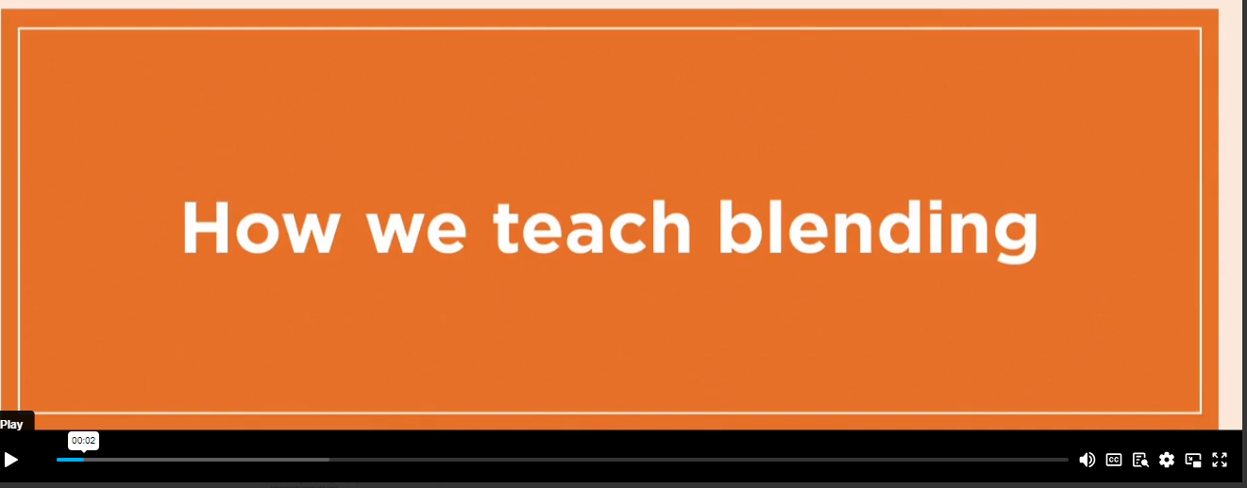
How we Teach Blending

Slide 4
Supporting Your child with Reading
Although your child will be taught to read at school, you can have a huge impact on their reading journey by continuing their practice at home.
There are two types of reading book that your child may bring home:
A reading practice book. This will be at the correct phonic stage for your child. They should be able to read this fluently and independently.
A sharing book. Your child will not be able to read this on their own. This book is for you both to read and enjoy together.

Slide 5
Reading practice book
This book has been carefully matched to your child’s current reading level. If your child is reading it with little help, please don’t worry that it’s too easy – your child needs to develop fluency and confidence in reading.
Listen to them read the book. Remember to give them lots of praise – celebrate their success! If they can’t read a word, read it to them. After they have finished, talk about the book together.

Slide 6
Sharing book
In order to encourage your child to become a lifelong reader, it is important that they learn to read for pleasure. The sharing book is a book they have chosen for you to enjoy together.
Please remember that you shouldn’t expect your child to read this alone. Read it to or with them. Discuss the pictures, enjoy the story, predict what might happen next, use different voices for the characters, explore the facts in a non-fiction book. The main thing is that you have fun!

Slide 7
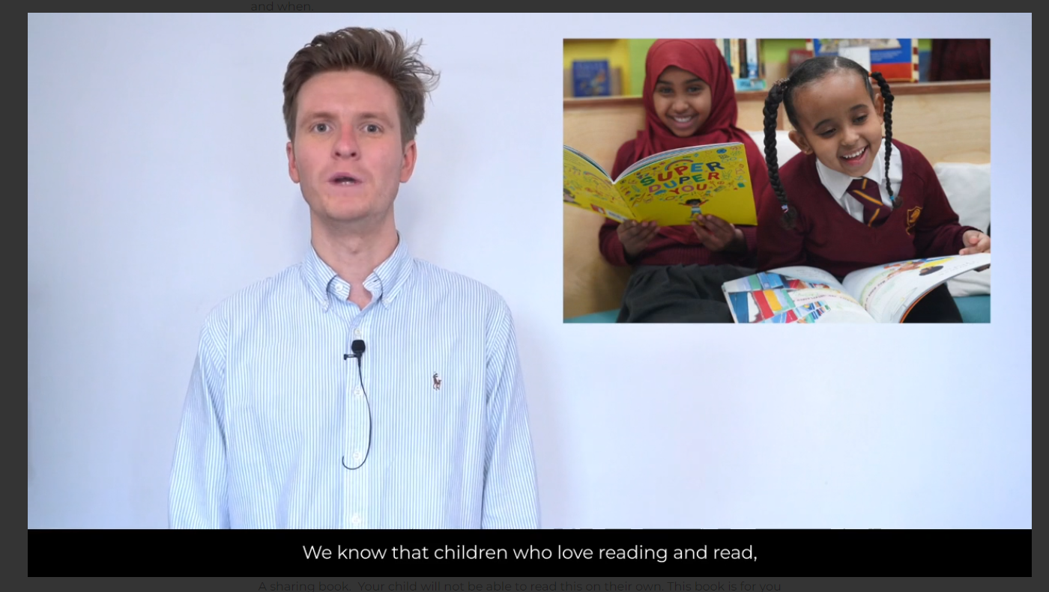
Supporting your child read at home

Slide 8
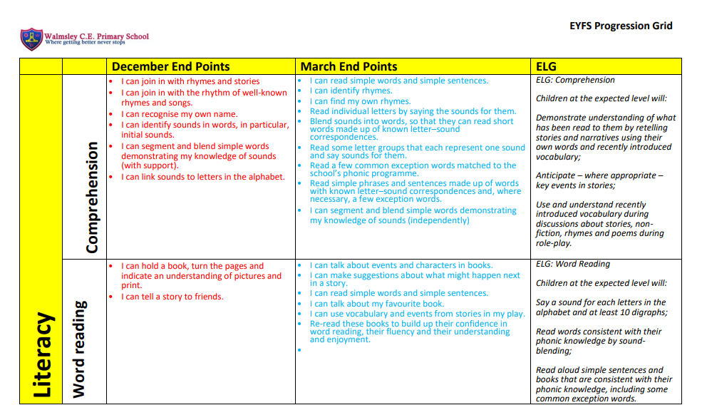

Slide 9
Teaching Reading in school Year 2
Reading lessons to create readers, not just pupils who can read
Key elements for teaching reading in English lessons are: teacher reading aloud: pupils reading: Teacher modelling and explanations and questioning
Using ‘paired talk’ during discussions
Story time 4x a week
Phonic interventions for those that need it

Slide 10
Reading Pathways Lessons and Planning
Year 1
One Whole Class Reading lesson per week starts in Spring term.
Year 2 – Year 6
Three 30mins lessons per week
Lesson 1 – Whole Class Reading
Lesson 2/3 – Guided read with 2 groups , 2 groups follow on task

Slide 11
Whole Class Reading
Reading whole texts without stopping for discussion
Understanding the difference between questioning in the reading English lessons to drive thinking and discussion or to assess
Emphasis on promoting discussion rather than teaching limited objectives
The teaching of reading should not be organised around the eight content domains for reading
Focus on fluency and developing vocabulary to prepare pupils for reading assessments of unseen texts.

Slide 12
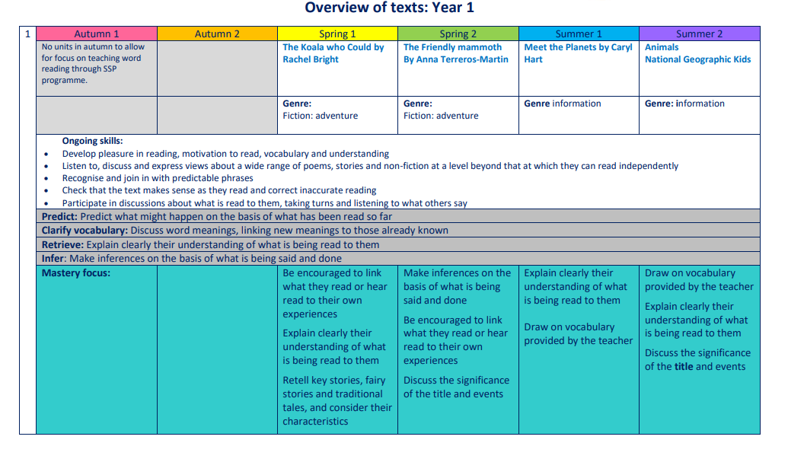

Slide 13
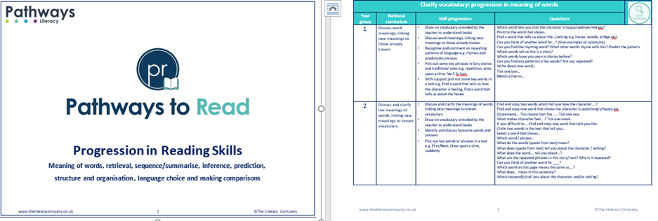
Progression Grid

Slide 14
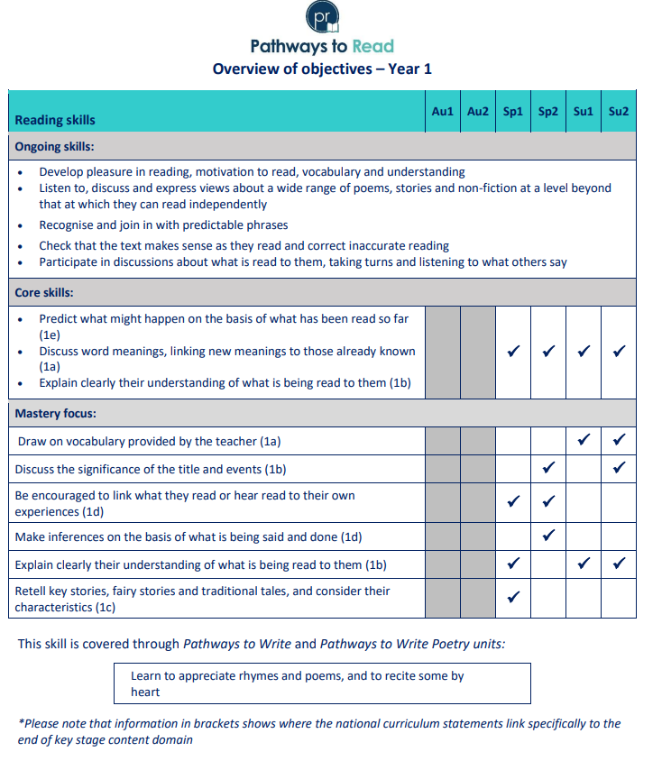
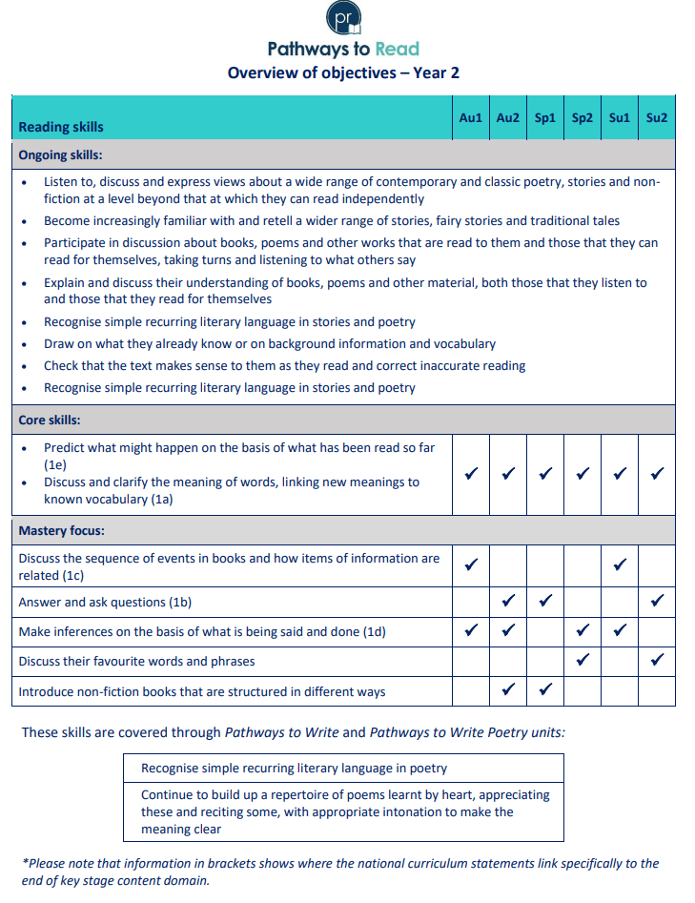

Slide 15
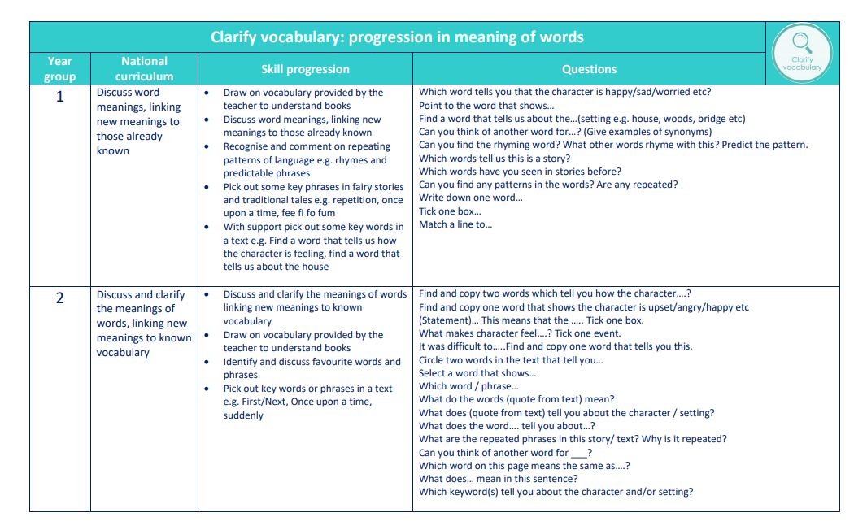

Slide 16
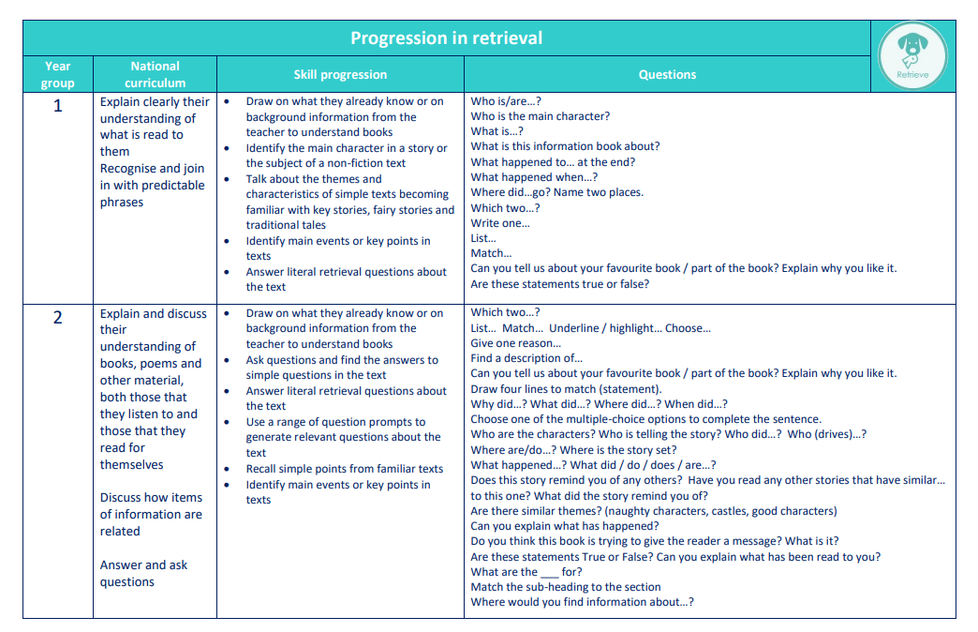

Slide 17
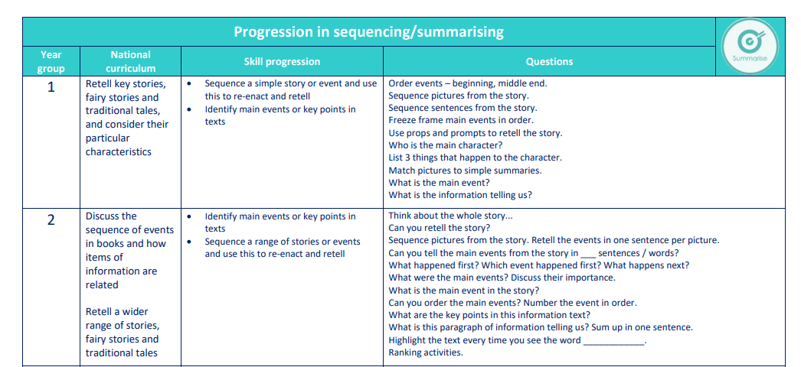

Slide 18
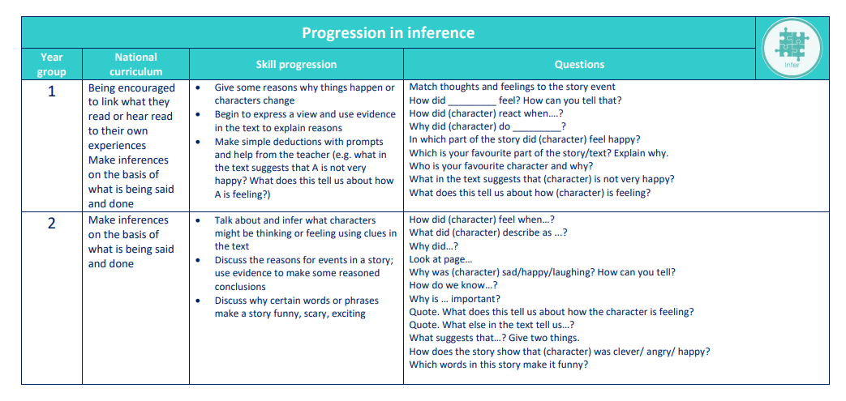

Slide 19
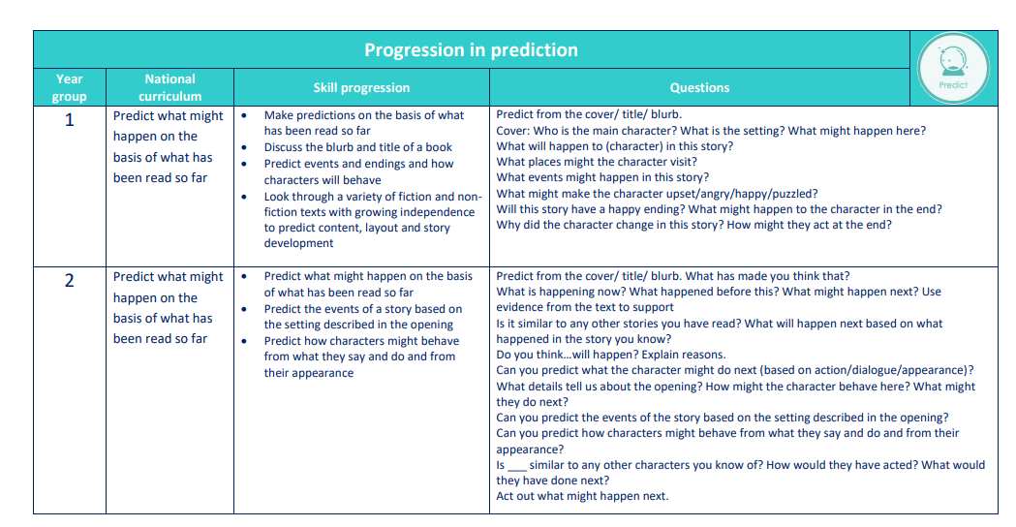

Slide 20
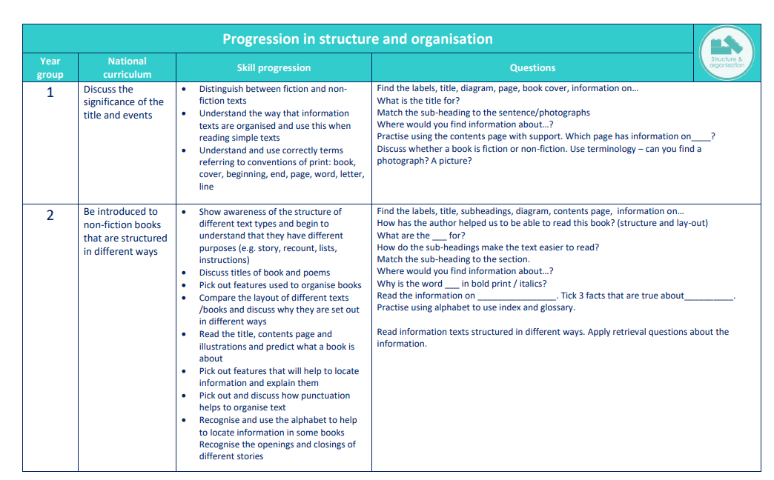

Slide 21
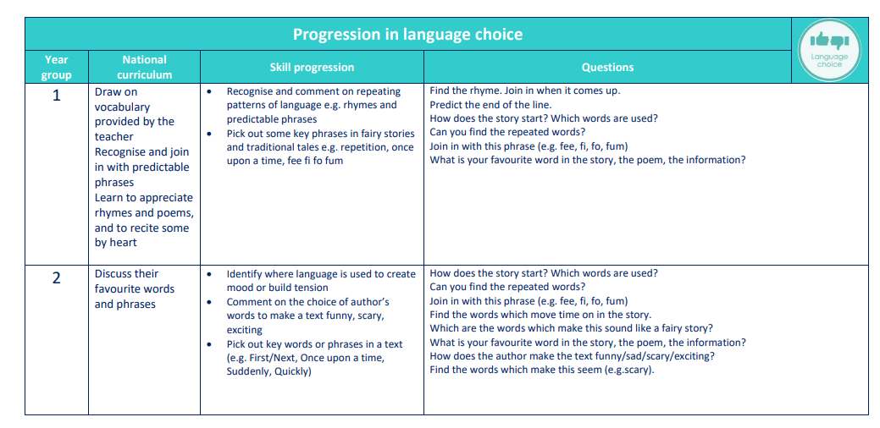

Slide 22
Reading for Pleasure
We aim to develop a reading for pleasure culture
Adults should read aloud regularly in class. This is done daily in EYFS and KS1
Children are given opportunities to have informal book talks
The school/class library should be used regularly
Provide time to read in sociable reading environments
Pupils should have opportunities to choose books that appeal to them – Free Choice!

Slide 23
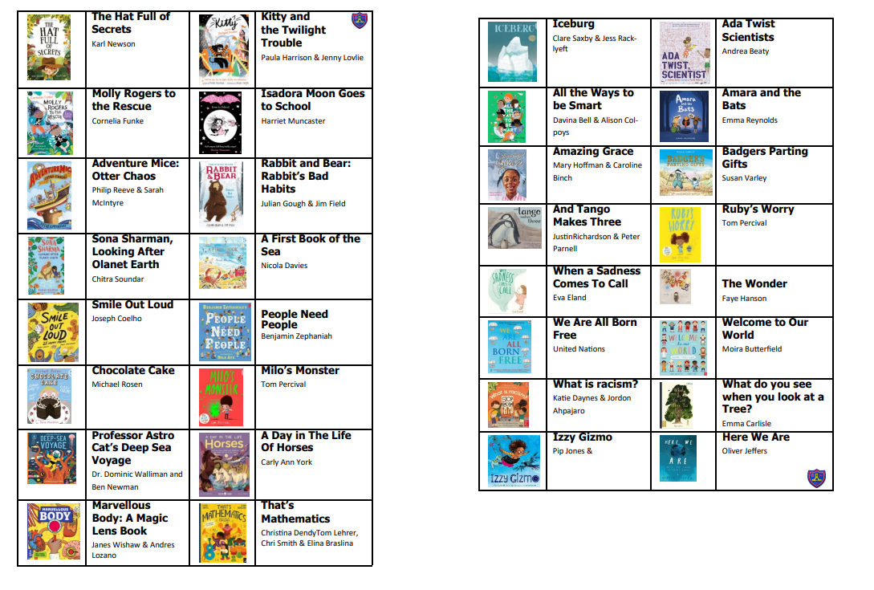
100 Recommended Reads for ……

Slide 24
How can I Support my child’s reading at home
Practice phonic sounds and tricky words
Discuss front cover/title/author/illustrator/blurb
Make predictions
Strategies to decode – sounds/then blend. Re-read in sentence to check it makes sense. Move towards blending in head
Words in blue – I can tell you.
Questions

