Slide 1
Year 6 SATs 2024 Information for Y6 Parents

Slide 2
Things to remember about SATs
SATs focus on what children know about Maths and English on one day.
They will not reflect how talented they are at science, geography, history, art, PE…, and they certainly won’t highlight all of their amazing personal characteristics.
A child’s progress is key.
Children learn, develop and take leaps forward at different times.
Positive attitudes and strong work ethic will take children far in life.

Slide 3
What are the SATs?
SATs are the Standardised Assessment Tests that are given to children at the end of Key Stage 2.
The SATs take place over four days, starting on Monday 13th May ending on Thursday 16th May.
The SATs papers consist of:
Grammar, punctuation and spelling (paper 1: GPS) – Monday 13th May
Grammar, punctuation and spelling (paper 2: Spelling) – Monday 13th May
Reading – Tuesday 14th May
Maths (paper 1: Arithmetic) – Wednesday 15th May
Maths (paper 2: Reasoning) – Wednesday 15th May
Maths (paper 3: Reasoning) – Thursday 16th May
Writing is assessed using evidence collected throughout Year 6. There is no Year 6 SATs writing test.
Notes:
Note that this government guidance (https://www.gov.uk/government/news/changes-to-key-stage-2-assessment-dates-in-2023) outlines changes in dates for 2023. This includes guidance on KS2 timetable variations if schools have pre-planned activities on Friday 12th May.
The key stage 2 tests will be taken on set dates unless your child is absent, in which case they may be able to take them up to 5 school days afterwards.

Slide 4
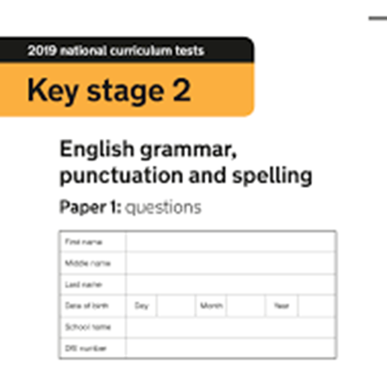
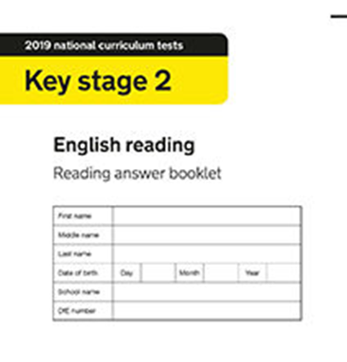
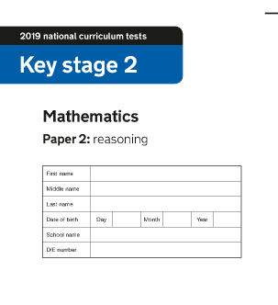
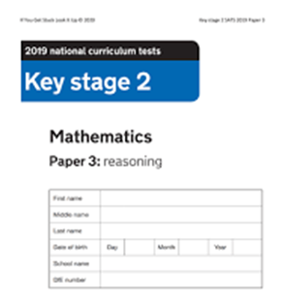
When and how the SATs are completed
The tests take place during normal school hours, under exam conditions.
After the tests are completed, the papers are sent away to be marked externally.
The results are then sent to the school in July.
Each test lasts no longer than 60 minutes
The majority of children will sit the test in the hall, some in a classroom.
45 minutes
60 minutes
30 minutes
40 minutes
40 minutes
Spelling paper = approx. 15 minutes
Notes:
Unless special arrangements made.

Slide 5
The results
Tests are marked externally. Once marked, the tests will be given the following scores:
A raw score (total number of marks achieved for each paper);
A scaled score (see below);
A judgement on if the National Standard has been met.
After marking each test, the external marker will convert the raw score to a scaled score. Even though the tests are made to the same standard each year, the questions must be different. This means the difficulty of the tests may vary. Scaled scores ensures an accurate comparison of performance over time.
Scaled scores range from 80 to 120.
A scaled score of 100 or more shows the pupil is meeting the National Standard.
Notes:
This year, the test results will be available on the PAG on Tuesday 4th July (https://assets.publishing.service.gov.uk/government/uploads/system/uploads/attachment_data/file/1110107/2023_key_stage_2_assessment_and_reporting_arrangements.pdf section 9.1)
There is no separate test that would indicate a pupil is working above the national standard.
A scaled score of less than 99 would indicate a pupil is working below the national standard.
To have a scaled score, pupils must have a minimum raw score (determined each year). If the pupil does not achieve the minimum raw score, they have not demonstrated sufficient understanding of the KS2 curriculum in the subject.

Slide 6
Grammar, Punctuation and Spelling: Monday 13th May
Grammar, punctuation and spelling consists of two papers.
Paper 1 focuses on all three elements (grammar, punctuation and spelling or GPS). The paper lasts for 45 minutes.
Paper 2 consists of a spelling test only. It should take approximately 15 minutes, although this is not a set amount of time (pupils should be given as much time as they need to complete the test).

Slide 7
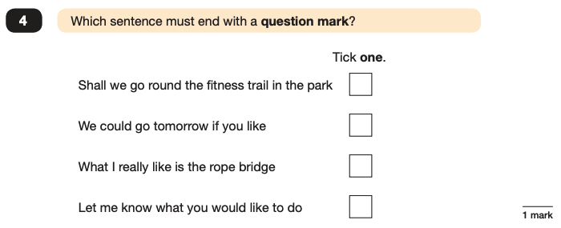
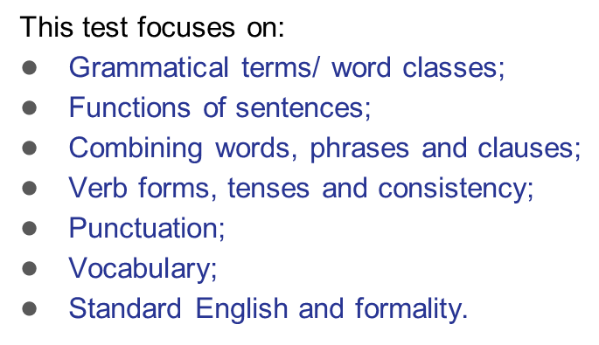
Grammar, Punctuation and Spelling: Paper 1 (GPS)
Accurate punctuation e.g. capital letters/ full stops needed.
Example questions:
✓
e.g. Although, While
e.g. Switch off the lights! Please turn off the lights
Notes:
For questions 32 and 37, there are various correct answers.

Slide 8
Grammar, Punctuation and Spelling: Paper 2 (spelling)
Paper 2 is a shorter paper that focuses solely on spellings.
Example questions:
Notes:
There is a spelling script that accompanies this. Example:
The word is creature. The dragon is an imaginary creature. The word is creature.

Slide 9
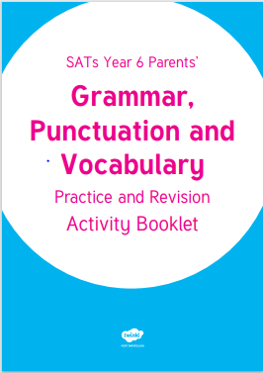
How to help
Question your child about their grammar homework
Revise old spellings
Encourage regular spelling practice on Ed Shed
All spellings are on the knowledge organisers online
Grammar revision books KS2 SATs

Slide 10
Reading: Tuesday 14th May
There is one reading test that lasts for 60 minutes.
The test is designed to measure if the children’s comprehension of age-appropriate reading material meets the national standard.
There are three different set texts for children to read. These could be any combination of non-fiction, fiction and/ or poetry.
Notes:
The test covers the following areas (known as Content Domains):
Give/ explain the meaning of words in context;
Retrieve and record information/ identify key details from fiction and non-fiction;
Summarise main ideas from more than one paragraph;
Make inferences from the text/ explain and justify inferences with evidence from the text;
Predict what might happen from details stated and implied;
Identify/ explain how information/ narrative content is related and contributes to meaning as a whole;
Identify/ explain how meaning is enhanced through choice of words and phrases;
Make comparisons within the text.

Slide 11
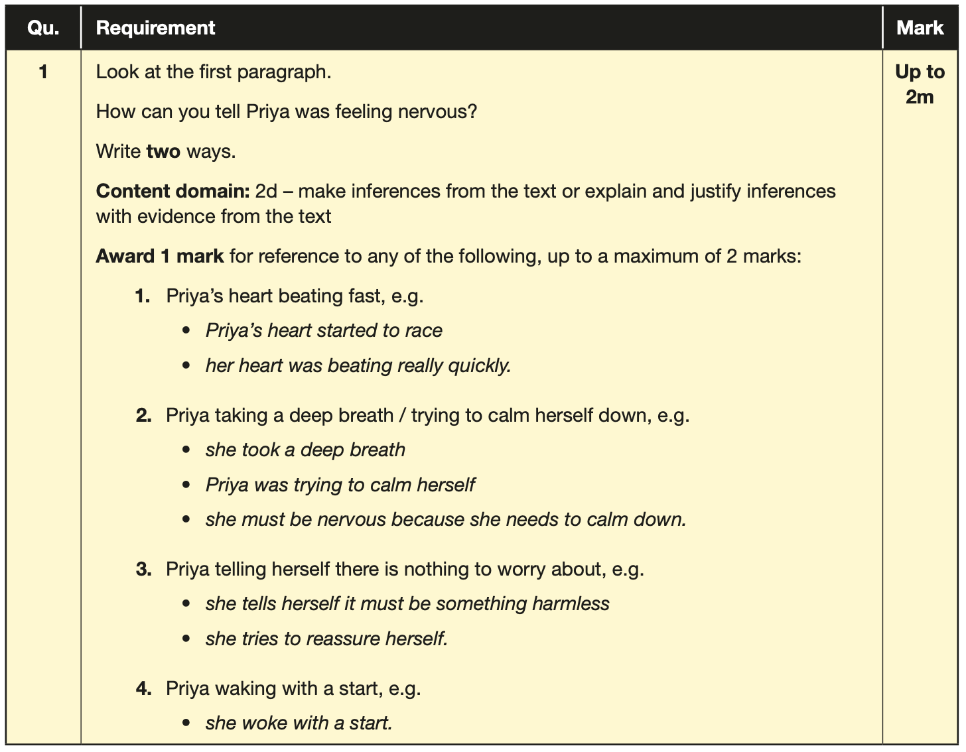
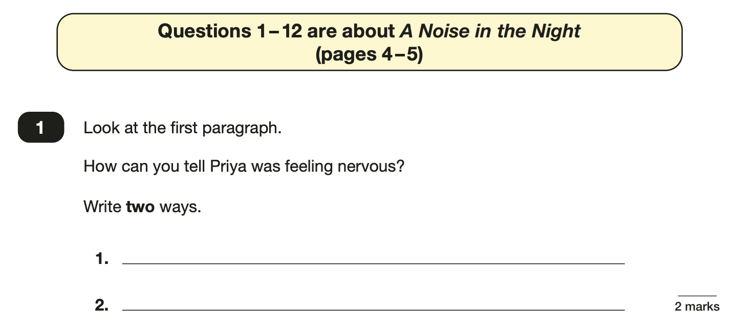
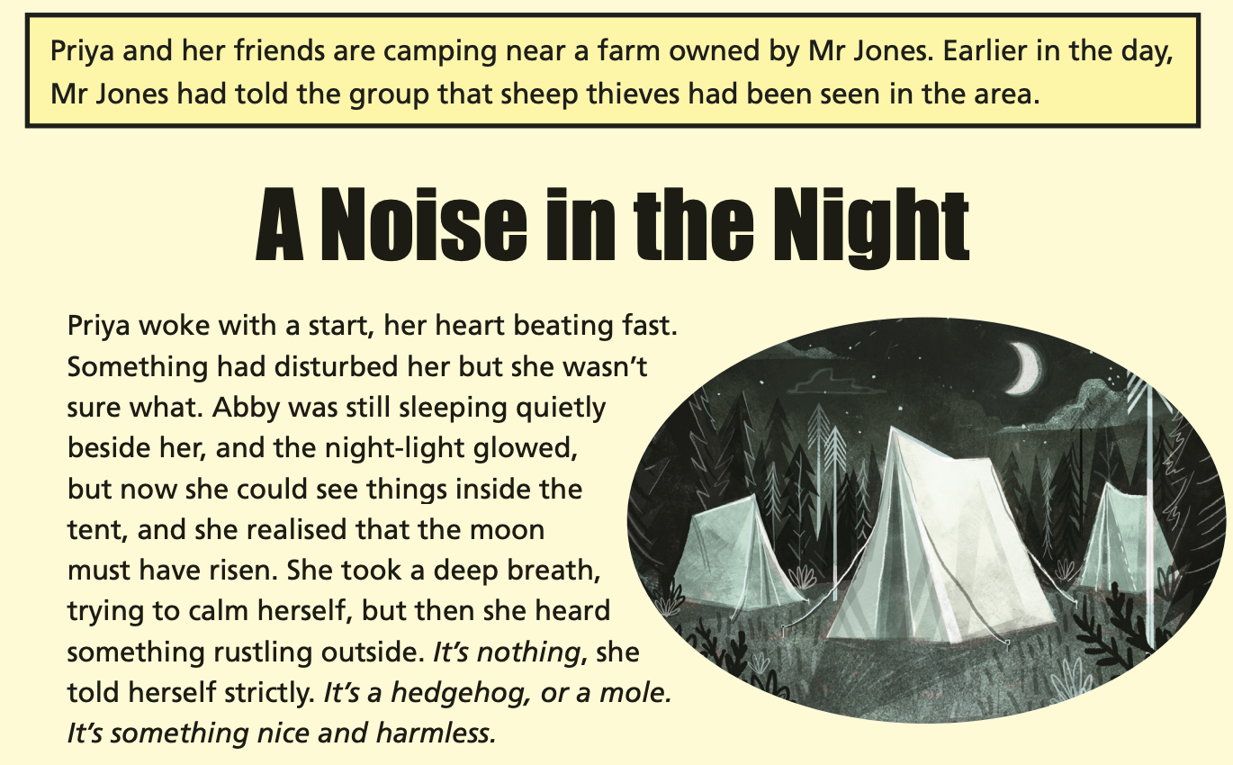
Reading
The reading SATs paper requires a range of answer styles.
Question styles include:
Multiple choice questions
One-word answers
Short answer questions
Multiple mark (long answer) questions
Point Prove it

Slide 12
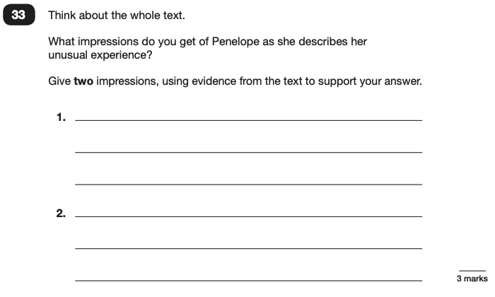
Reading
Example questions:
Based on the whole text
Point, prove it
Point, prove it

Slide 13
Reading
Notes:
Questions are from the 2023 Reading SATs paper.
Question styles include:
Multiple choice questions
One-word answers
Short answer questions
Multiple mark (long answer) questions

Slide 14
How to help?
Encourage your child to read daily at home
Get them to talk to you about their book
Listen to your child read/ read to them
Encourage them to have times when they read a page/paragraph quickly – scanning the text. What information can they pick up in a minute? How quickly can they find a key word?
Question them on what they have read.
Example questions to ask at home:
What does this word mean?
Which word in this paragraph is the closest in meaning to…?
What is [character] doing when [event] happened?
True or false questions about a paragraph/ text.
How is the character feeling? How do you know? (point , prove it).
What impression do you get of the character? (point, prove it)

Slide 15
Maths: Wednesday 15th and Thursday 16th May
The maths assessments consist of three tests.
Paper 1: Arithmetic (30 minutes) – Wednesday 15th May
Paper 2: Reasoning (40 minutes) – Wednesday 15th May
Paper 3: Reasoning (40 minutes) – Thursday 16th May

Slide 16
Y3 , Y4 and Y5 content is also tested as well as concepts learnt in Y6

Slide 17
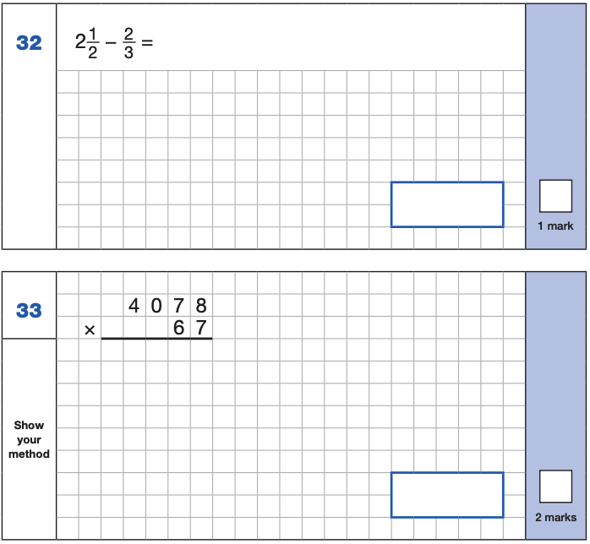
Maths Paper 1 (Arithmetic)
The maths arithmetic paper has a total of 40 marks and lasts for 30 minutes.
The test covers the four operations (addition, subtraction, multiplication, division, including order of operations requiring BIDMAS), percentages of amounts and calculating with decimals and fractions.
Example questions:
Notes:
Identify that there are some questions that have 2 marks and some that have 1.

Slide 18
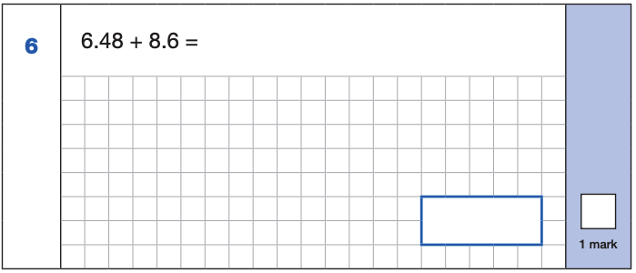
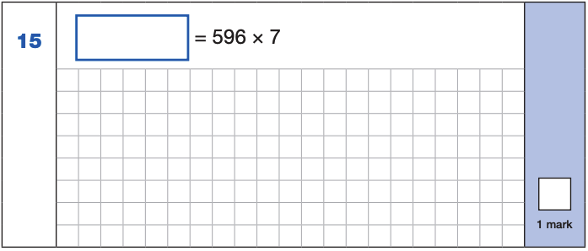
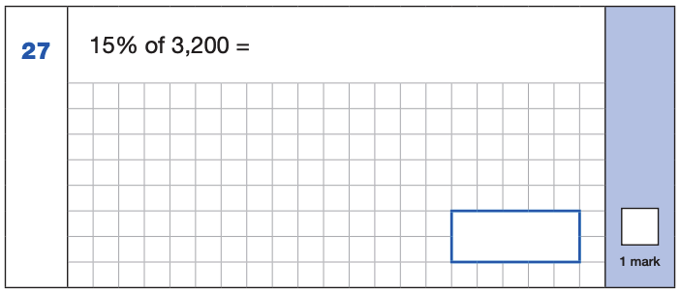
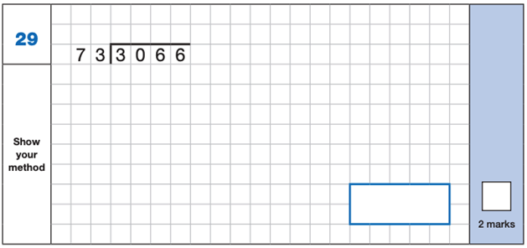
Maths Paper 1 (Arithmetic)
Example 1 mark questions:
4,172
6.48
+ 8.6 .
15.08
¹
596
x 7
4172
⁶ ⁴
15.08
Example 2 mark questions:
10% of 3,200 = 320
5% of 3,200 = 160
15% of 3,200 = 480
480
Notes:
These are examples of how children could solve the calculations. There are some that could/ should be solved mentally as it is far quicker that way (40 marks in 30 minutes does not allow for 1 minute + per mark).
Answers should always be given in their simplest form unless stated otherwise.

Slide 19
Maths Papers 2 and 3 (Reasoning)
Paper 2 will take place on Wednesday 15th May and paper 3 will take place on Thursday 16th May. These tests have a total of 35 marks each and lasts for 40 minutes each.
These papers require children to demonstrate their mathematical knowledge and skills, as well as their ability to solve problems and their mathematical reasoning. They cover a wide range of mathematical topics from key stage 2 including,
Number and place value (including Roman numerals);
The four operations;
Geometry (properties of shape, position and direction);
Statistics;
Measurement (length, perimeter, mass, volume, time, money);
Algebra;
Ratio and proportion;
Fractions, decimals and percentages.
Notes:
In general, the questions get progressively harder throughout the paper. As this is the case, it is not unusual for children to be unable to complete the entire paper in the given time.

Slide 20
Number & place value, calculations and fractions/decimals and percentages are the 3 big focus areas.

Slide 21
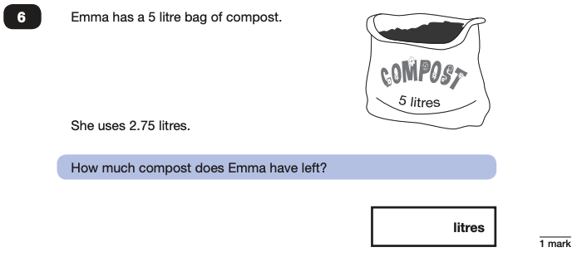
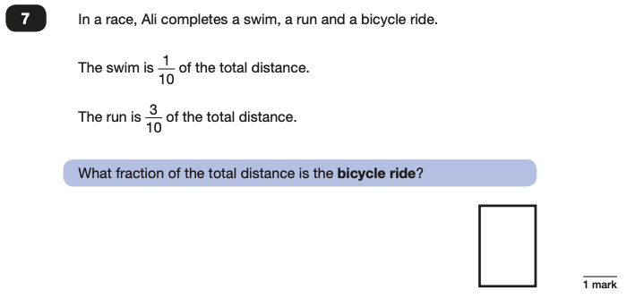
Maths Papers (Reasoning)
Example questions:
2.25
$$\frac{\text{6}}{\text{10}}$$

Slide 22
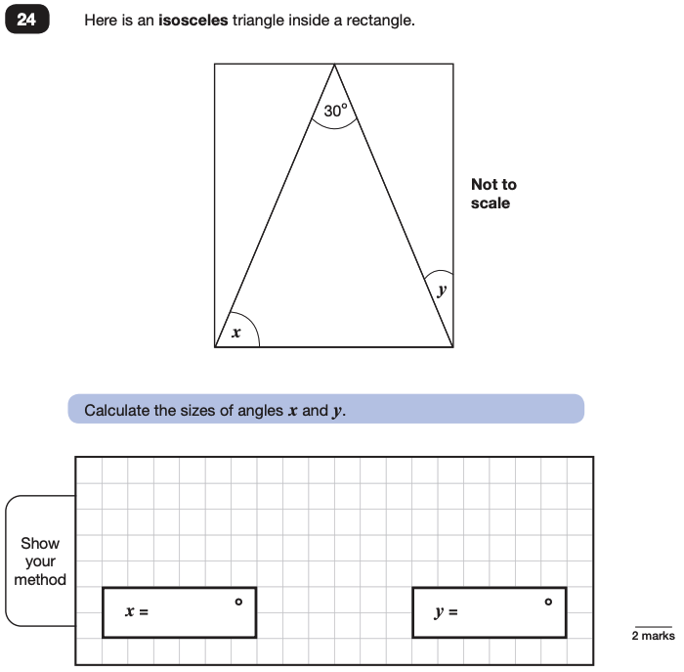
Maths Papers (Reasoning)
Example questions:

Slide 23
How to help?
For children still wobbly with times tables keep practising – online games (hit the button), chanting, TT Rockstars, question them
https://mathsbot.com/primary/ks2 KS2 arithmetic practice
https://www.mathswithamouse.co.uk/
https://corbettmathsprimary.com/content/
https://www.maths4everyone.com/pages/ks2-sats-practice.php
https://www.mathsgenie.co.uk/primary.html
Help your child learn the mathematical facts on
the key facts knowledge organiser.
Maths knowledge
organisers are on our
website.

Slide 24
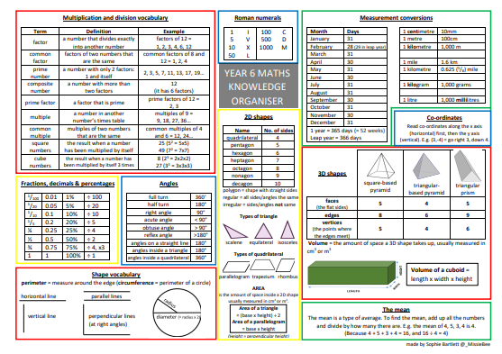

Slide 25
Maths Breakfast Club
All welcome
Work through reasoning questions with their friends
Croissants/brioche/pan au chocolate available
4 Tuesday mornings 8am
EASTER holidays
Tuesday 16th April
Tuesday 23rd April
Tuesday 30th April
Tuesday 7th May

Slide 26
Supporting your child in preparing for the SATs
Give them as much encouragement as you can.
Talk to us if you have any concerns rather than worry your child.
Encourage your child to talk to us about their anxieties.
Give your child a quiet, distraction free space to complete homework.
Fresh air and exercise will support their well being in the run up to SATs
Ensure your child is eating and drinking well and getting a good amount of sleep.

Slide 27
The week of the SATs
Positive and encouraging
Early bed times
Some anxiety will be normal
If it is getting too much, speak to us.
Eat well and plenty – healthy breakfast
Water bottle in school
Arrive at school on time (or a few mins early)

Slide 28
Advice for Year 6 children
The adults you work with all want you to do your best.
Everyone in Year 6 has made brilliant progress.
Show off what you can do.
Get plenty of sleep and eat well: this will help your brain.
Read all the questions carefully. This can help you to avoid silly mistakes.
Don’t panic. There may be questions you think you can’t answer. Take a deep breath. Read it again. You can always move on and go back to it later. It’s often better to write something rather than nothing.
Remember that the Year 6 SATs last for 4 days out of your whole life! They aren’t any different to what we have practised in class. You have worked so hard and you are ready for them.

Slide 29
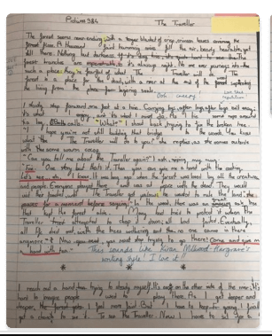
Writing Moderation
Writing is teacher assessed from work done throughout the year
Our judgements are moderated internally by SLT, other local Y6 teachers and often externally by the local authority
Judgements:
Working towards the expected standard
Working at the expected standard
Working at the greater depth standard
GDS writing is incredibly strong
Technically accurate, precise vocabulary and a creative flair

Slide 30
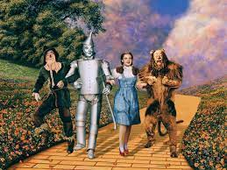
After SATs
Y6 residential 17th - 20th May
Writing
Reading
Geography, history, science, DT, computing, PE, music, Spanish, RE, PSHE
Maths projects / revision for secondary school
Transition work for secondary school
Business Enterprise and trip (Alton Towers??)
Y6 Water fight / sports / games
Y6 leavers service at Manchester Cathedral (children only)
Y6 Performance – Wizard of OZ (11th and 12th July)
Y6 leavers church service Thurs 18th July AM (parents welcome)
Last day – parents invited in before the children leave at the end of the day. (details TBC)

Slide 31
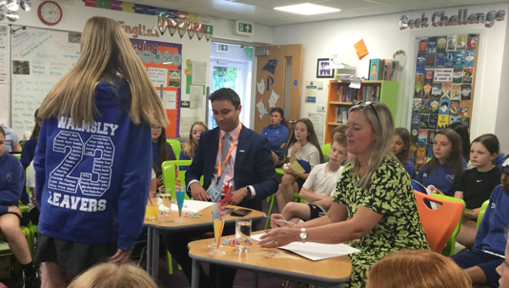
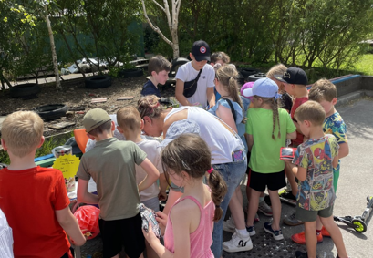
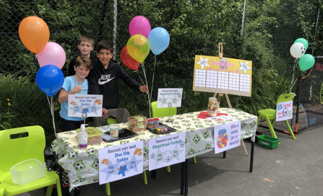
Business Enterprise
Teams
Develop an idea to sell and make a profit
Team work, problem solving, communication, initiative, leadership skills, concepts such profit, handling money and how a business is run.
Dragon’s Den
Parents shouldn’t be out of pocket
Selling day in school
Profits to be split between charity (children’s choice), towards a trip (possibly Alton Towers) and some money comes into school for resources which benefit children across school.

