Slide 1
Respect@WLD
Respect Learning
Respect Students
Respect Staff
Respect the Community
Respect your Environment
Respect Yourself

Slide 2
BASICS@WLD
On time for lessons, respect for learning.
Perfect uniform in every lesson.
Come in quietly. Sit down in your correct seat.
Equipment out – pen, pencil, ruler, planner and homework.
Starter activity – no wasted time.
Silent learning, listening to instructions.
Quiet signal - quiet if the teacher raises their hand
Put your hand up if you have a question.
Uniform correct before leaving the lesson.
End of the lesson, stand behind your chair and wait to be dismissed for an orderly exit.

Slide 3
Form Time Programme
Forget this – talk about stopping bullying and BEING KIND
 | Monday | Tuesday | Wednesday | Thursday | Friday
Blue | Equipment & Word of the Week | Thought for the Week – PSHE | Planner and Classcharts | Learn it Challenge | Assembly
Indigo | Equipment & Word of the Week | Thought for the Week – PSHE | Planner and Classcharts | Assembly | Learn it Challenge
Red | Equipment & Word of the Week | Thought for the Week – PSHE | Assembly | Planner and Classcharts | Learn it Challenge
Yellow | Planner and Classcharts | Assembly | Equipment & Word of the Week | Thought for the Week – PSHE | Learn it Challenge
7 | Assembly | Equipment & Word of the Week | Thought for the Week – PSHE | Planner and Classcharts | Learn it Challenge

Slide 4
Anti-Bullying Week 2019: Change Starts With Us

Slide 5
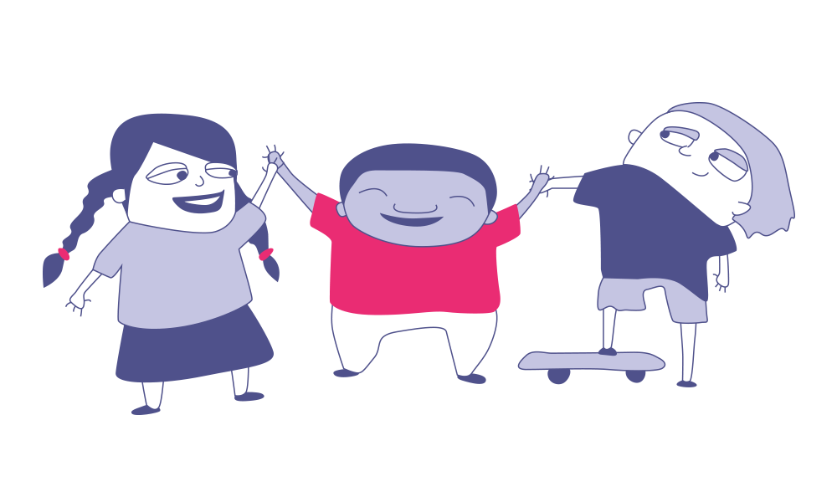
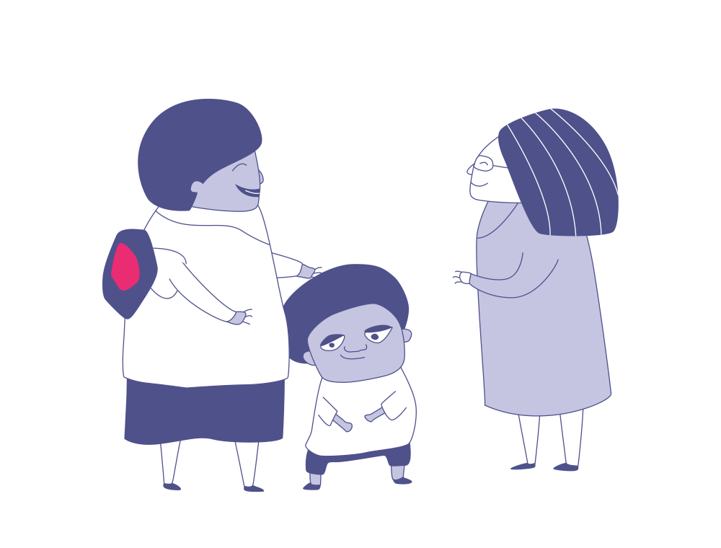
Change starts with …?
Who is most responsible for tackling bullying?
1
3
Students?
Your
teachers?
Who currently does the most to tackle bullying?
2
The school?
Who could do more to tackle bullying?
4
Parents and carers?
Hold up the number of fingers (1-4) to show your answers to each question!

Slide 6
This is our community. What are your
ideas to reduce bullying in our school?
We want to hear from you!
Tell your form tutors to share your ideas NOW

Slide 7
Change starts with … having a voice
Bullying is still a big problem in the world today. It affects us both in our schools and online; many of us will be affected by it in some way. Something needs to change. But what?
As a school, can we work together to make the world better for the people around us?
What do you do if you see someone bullying someone else?
Do you challenge bullies or stay silent?

Slide 8
Change Starts With Us!
VIDEO LINK: https://youtu.be/oAmVkVEmOP4

Slide 9
I put this slide on Week 1 in September
Be the person that stands up to bullies Be the person that lets someone know Be the person who is kind
Have you been that person?

Slide 10
I put this slide on Week 1 in September
Be the person that stands up to bullies Be the person that lets someone know Be the person who is kind
Have you been that person?

Slide 11
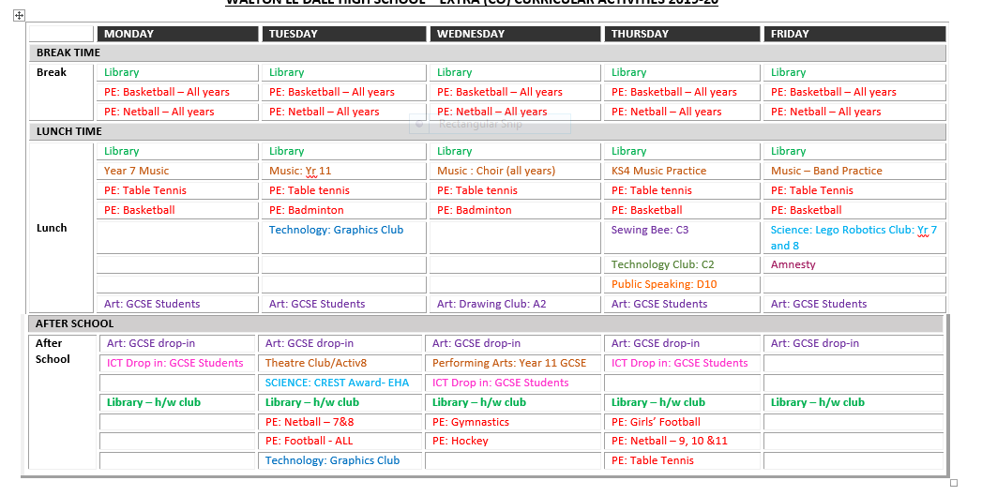
Wow! Look how committed your teachers are to you. They provide approximately 47 hours of extra-curricular activities per week. Show your commitment to them – get involved!

