Slide 1
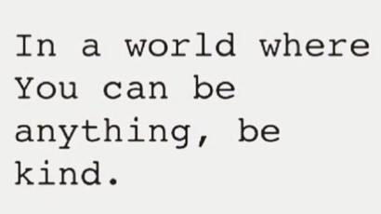

Slide 3
Respect@WLD
Respect Learning
Respect Students
Respect Staff
Respect the Community
Respect your Environment
Respect Yourself

Slide 4
Year 11 Revision Plan
Monday
Maths & Option A
Tuesday
English & Option B
Wednesday
Science & Option C
Thursday
Maths & Review
Friday
English & Option B
11 weeks to go!

Slide 5
BASICS@WLD
On time for lessons, respect for learning.
Perfect uniform in every lesson.
Come in quietly. Sit down in your correct seat.
Equipment out – pen, pencil, ruler, planner and homework.
Starter activity – no wasted time.
Silent learning, listening to instructions.
Quiet signal - quiet if the teacher raises their hand
Put your hand up if you have a question.
Uniform correct before leaving the lesson.
End of the lesson, stand behind your chair and wait to be dismissed for an orderly exit.

Slide 6
Form Time Programme
 | Monday | Tuesday | Wednesday | Thursday | Friday
Blue | Equipment & Word of the Week | Thought for the Week – PSHE | Planner and Classcharts | Learn it Challenge | Assembly
Indigo | Equipment & Word of the Week | Thought for the Week – PSHE | Planner and Classcharts | Assembly | Learn it Challenge
Red | Equipment & Word of the Week | Thought for the Week – PSHE | Assembly | Planner and Classcharts | Learn it Challenge
Yellow | Planner and Classcharts | Assembly | Equipment & Word of the Week | Thought for the Week – PSHE | Learn it Challenge
7 | Assembly | Equipment & Word of the Week | Thought for the Week – PSHE | Planner and Classcharts | Learn it Challenge

Slide 7
Spring-Week 7: 24th February 2020
Definition:
supplementary
Completing or enhancing something
adjective
Etymology:
Latin: supplementum
(that which fills up or is made whole)
Latin –supplere:
To fill up
1620s
Current meaning
Examples
The programme offers supplementary information about the news.
Synonyms:
Additional
Extra
Increased
Further
Notes:
Frayer Model – the main WoW slide will all be in this format. There will also be a TV screen version of this around school – all week – every week.
Explain how important the 39 WoWs are / reasons (SHOULD I DO A ONE PAGE ‘WHY ARE WE DOING THIS?’ for pupils? Ideally in an assembly – Caroline? Maybe the academic words slide??
Say the word
Give definition – link to pupil planner and word on board
Model reading aloud and ask pupils to read aloud
Try examples - Q&A

Slide 8
PSHE – Thought for the week – Thank you to Mrs Sweeney
Empathy Week 24th – 28th February 2020
EMPATHY
Core Theme – Relationships
SMSC – Social&Cultural Development
FBV – Tolerance (Acceptance) & Mutual Respect

Slide 9
Empathy – what is it?
There are many different definitions for empathy, but it’s often mistaken for meaning just ‘being kind.’
This week is about exploring the true meaning of empathy, which we believe is the ability to connect authentically with another person’s perspective, feel their emotions and lead us into a positive action.
Empathy Week’s mission is to build the #empathygeneration - a generation able to understand other people’s perspectives and create positive change in society.
EMPATHY
Core Theme – Relationships
SMSC – Social&Cultural Development
FBV – Tolerance (Acceptance) & Mutual Respect

Slide 10
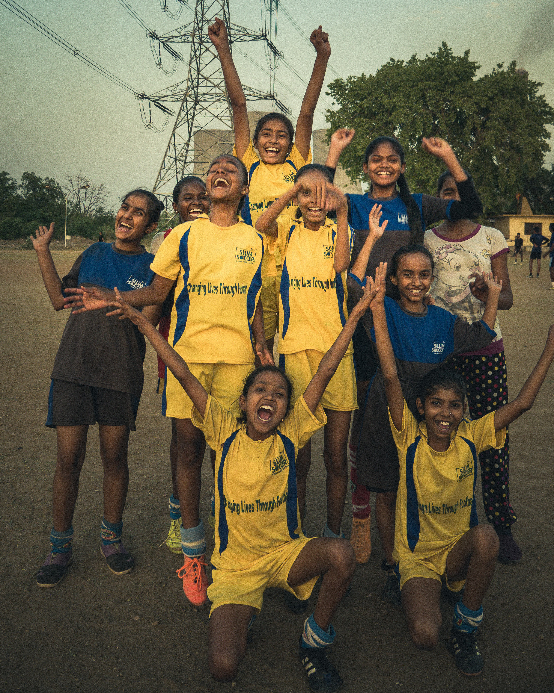
VIDEO | 10 MINUTES Slum Soccer’s Story
Core Theme – Relationships
SMSC – Social&Cultural Development
FBV – Tolerance (Acceptance) & Mutual Respect

Slide 11
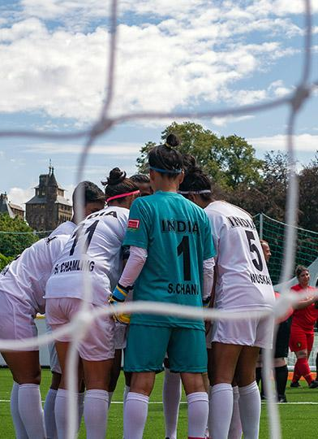
…we're going to watch a story about the impact football has had on the lives of children and young people living in slum areas in India.
WATCH VIDEO | 10 MINUTES
Introducing Slum Soccer
Core Theme – Relationships
SMSC – Social&Cultural Development
FBV – Tolerance (Acceptance) & Mutual Respect

Slide 12
Together…
Working in pairs, we will focus on one of these questions and discuss them together afterwards.
What is the role of football in this community?
Are there parts in the film that feel familiar to your own life?
What was the action that started Slum Soccer?
Core Theme – Relationships
SMSC – Social&Cultural Development
FBV – Tolerance (Acceptance) & Mutual Respect

Slide 13
Discuss…
Abhijeet Barse and Vijay Barse tell the story of how and why "Slum Soccer" began and the role that empathy played in that story, having an impact on the lives of young girls.
Take a look at this comment from the video and, as a form, discuss what this makes you think and feel.
Core Theme – Relationships
SMSC – Social&Cultural Development
FBV – Tolerance (Acceptance) & Mutual Respect

Slide 14
"We’re becoming so self-obsessed all the time…we are magnifying just ourselves… so we need to look at others also. You don’t really need to do a lot or do a lot of costly stuff to support others.”
“
ABHIJEET BARSE
”

Slide 15
empathy-week.com

Slide 16
Young Business Enterprise Every Tuesday after school.
Young Business Enterprise | Walton-le-Dale High School Please support our Year 10 Young Business Enterprise teams and have a shop through the following Christmas gifts from our five companies; Enterprise Sky Squad, Lazer Cutter Industries, Fro, Fin and Gift Company. www.waltonledale.lancs.sch.uk
Please support our Young Business Enterprise pupils by checking out their latest Christmas products https://www.waltonledale.lancs.sch.uk/parents/businessenterprise
Payments can be made over Parent Pay and will be delivered to you in school.

Slide 17
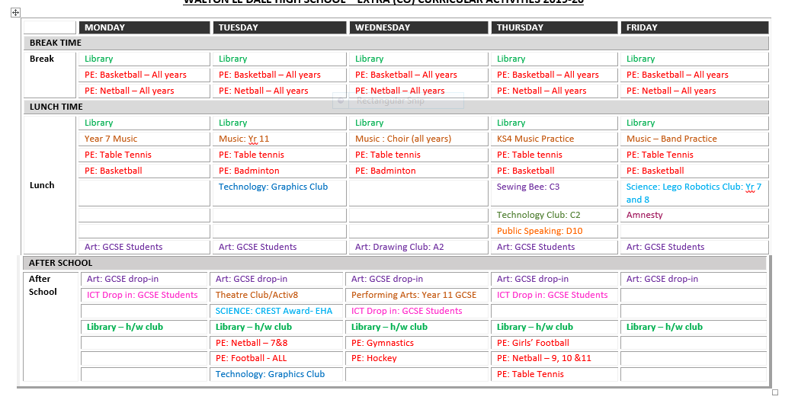
Wow! Look how committed your teachers are to you. They provide approximately 47 hours of extra-curricular activities per week. Show your commitment to them – get involved!

