Slide 1
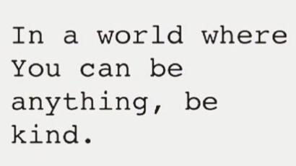

Slide 2
Respect@WLD
Respect Learning
Respect Students
Respect Staff
Respect the Community
Respect your Environment
Respect Yourself

Slide 3
Form Time Programme
 | Monday | Tuesday | Wednesday | Thursday | Friday
Blue | Equipment & Word of the Week | Thought for the Week – PSHE | Planner and Classcharts | Attendance | Assembly
Indigo | Equipment & Word of the Week | Thought for the Week – PSHE | Planner and Classcharts | Assembly | Attendance
Red | Equipment & Word of the Week | Thought for the Week – PSHE | Assembly | Planner and Classcharts | Attendance
Yellow | Planner and Classcharts | Assembly | Equipment & Word of the Week | Thought for the Week – PSHE | Attendance
7 | Assembly | Equipment & Word of the Week | Thought for the Week – PSHE | Planner and Classcharts | Attendance

Slide 4
Year 11 Revision Plan
Monday
Maths & Option A
Tuesday
English & Option B
Wednesday
Science & Option C
Thursday
Maths & Topic Review
Friday
English & Option A
Saturday
Science & Option B
Wednesday
Option C & Topic Review
9
Weeks to go!

Slide 5
BASICS@WLD
On time for lessons, respect for learning.
Perfect uniform in every lesson.
Come in quietly. Sit down in your correct seat.
Equipment out – pen, pencil, ruler, planner and homework.
Starter activity – no wasted time.
Silent learning, listening to instructions.
Quiet signal - quiet if the teacher raises their hand
Put your hand up if you have a question.
Uniform correct before leaving the lesson.
End of the lesson, stand behind your chair and wait to be dismissed for an orderly exit.

Slide 6
Spring-Week 9: 9th March 2020
Definition:
conformity
compliance with standards, rules, or laws.
noun
Etymology:
Examples
Conformity to regulations
She showed no conformity to the school rules.
Synonyms:
Adherence to
Compliance with
Observance of
Notes:
Frayer Model – the main WoW slide will all be in this format. There will also be a TV screen version of this around school – all week – every week.
Explain how important the 39 WoWs are / reasons (SHOULD I DO A ONE PAGE ‘WHY ARE WE DOING THIS?’ for pupils? Ideally in an assembly – Caroline? Maybe the academic words slide??
Say the word
Give definition – link to pupil planner and word on board
Model reading aloud and ask pupils to read aloud
Try examples - Q&A

Slide 7
PSHE Thought for the week – by Mrs Sweeney
Staying healthy
Coronavirus – COVID-19
Core Theme – Health and Wellbeing
SMSC – Social & Cultural Development
FBV – Tolerance (Acceptance) & Mutual Respect

Slide 8
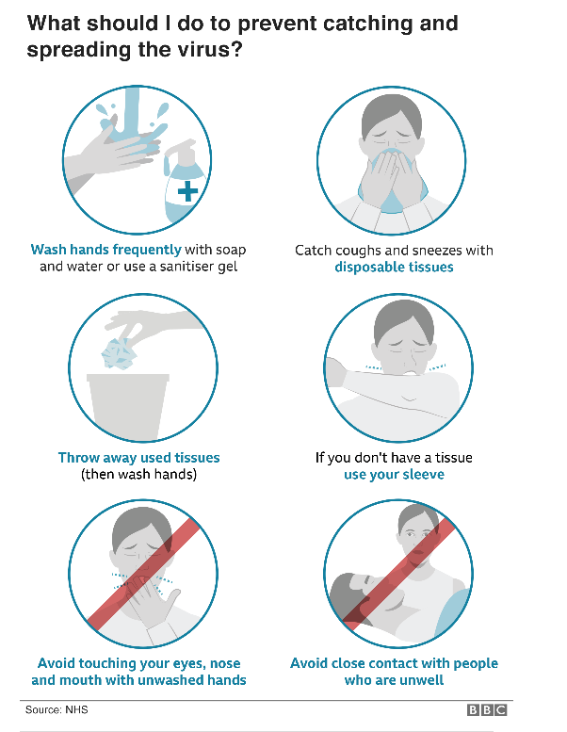
Prevention

Slide 15
Young Business Enterprise Every Tuesday after school.
Young Business Enterprise | Walton-le-Dale High School Please support our Year 10 Young Business Enterprise teams and have a shop through the following Christmas gifts from our five companies; Enterprise Sky Squad, Lazer Cutter Industries, Fro, Fin and Gift Company. www.waltonledale.lancs.sch.uk
Please support our Young Business Enterprise pupils by checking out their latest Christmas products https://www.waltonledale.lancs.sch.uk/parents/businessenterprise
Payments can be made over Parent Pay and will be delivered to you in school.

Slide 16
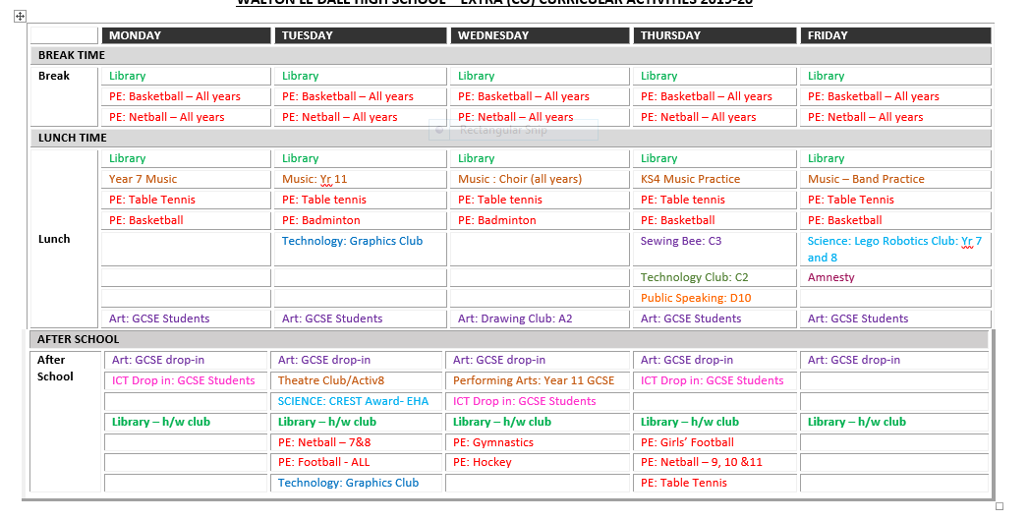
Wow! Look how committed your teachers are to you. They provide approximately 47 hours of extra-curricular activities per week. Show your commitment to them – get involved!

