Slide 1
Respect@WLD
Respect Learning
Respect Students
Respect Staff
Respect the Community
Respect your Environment
Respect Yourself

Slide 2
BASICS@WLD
On time for lessons, respect for learning.
Perfect uniform in every lesson.
Come in quietly. Sit down in your correct seat.
Equipment out – pen, pencil, ruler, planner and homework.
Starter activity – no wasted time.
Silent learning, listening to instructions.
Quiet signal - quiet if the teacher raises their hand
Put your hand up if you have a question.
Uniform correct before leaving the lesson.
End of the lesson, stand behind your chair and wait to be dismissed for an orderly exit.

Slide 3
Open Evening TODAY
All prefects will need to be present from 5pm in school to be brilliant tour guides to the parents
If you are helping out in Departments, you need to be in school by 5pm and report to the Department
Thank you, you make it a great evening

Slide 4
Kindness
PSHE – Thought for the week
The world is full of kind people,
if you can’t find one, be one.
(Unknown)

Slide 5
How can you Show Kindness?
Think about it on your own, Pair up and discuss with the person sat next to you and Share it with your form and form tutor
Here’s some things to think about
In school
On the corridor
In lesson
At home
In the community

Slide 6
What is Kindness?
Think about it on your own, Pair up and discuss with the person sat next to you and Share it with your form and form tutor
Watch this clip
What have you done to show kindness? How have people been kind to you?
https://www.youtube.com/watch?v=9rpsjdo1pee

Slide 7
Kindness
Can you discuss as a group the following, nominate one person to feedback your thoughts to your form tutor
What motivates him to be kind? Why should he bother?
Now consider the following
What lessons can we learn?
What motivates you to be kind?

Slide 8
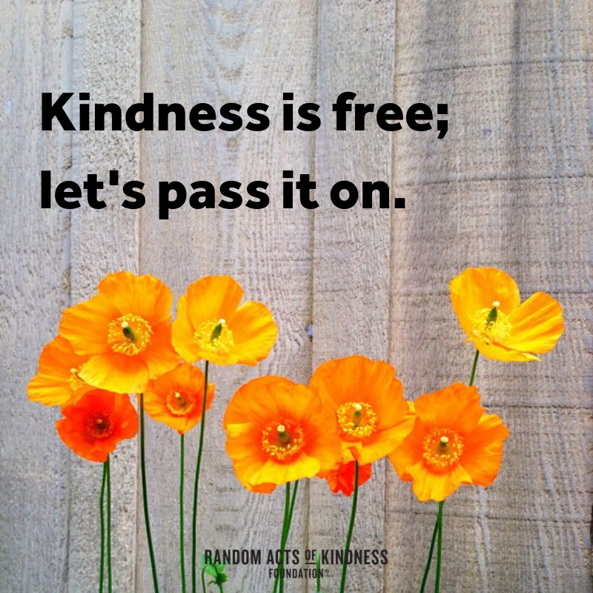
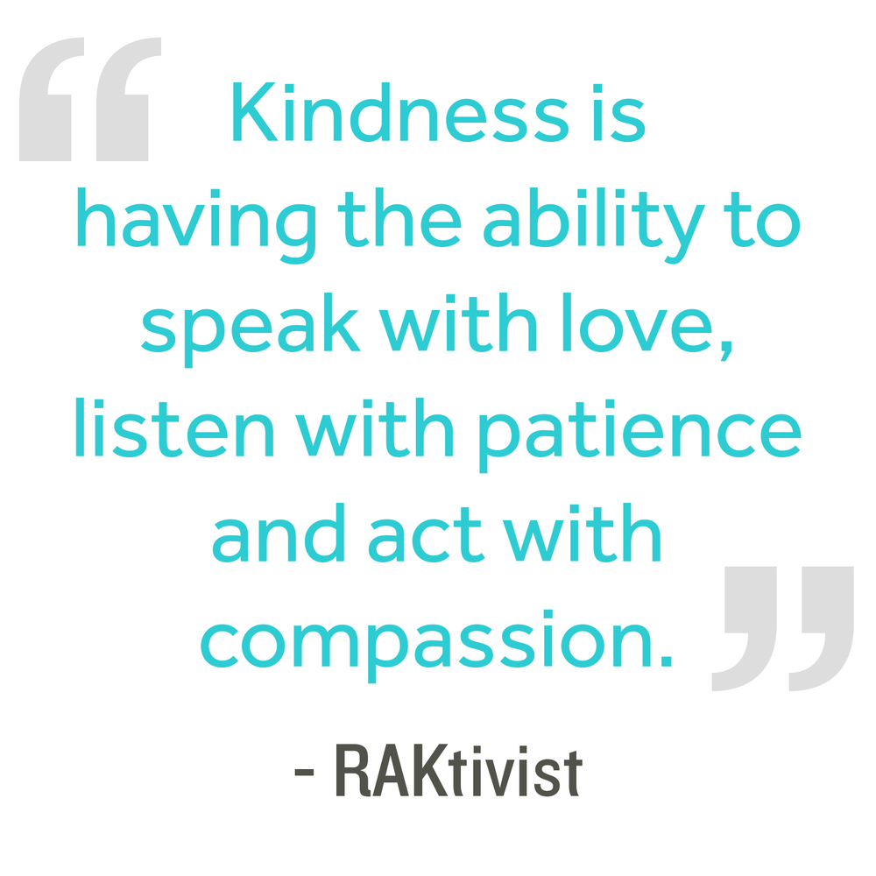
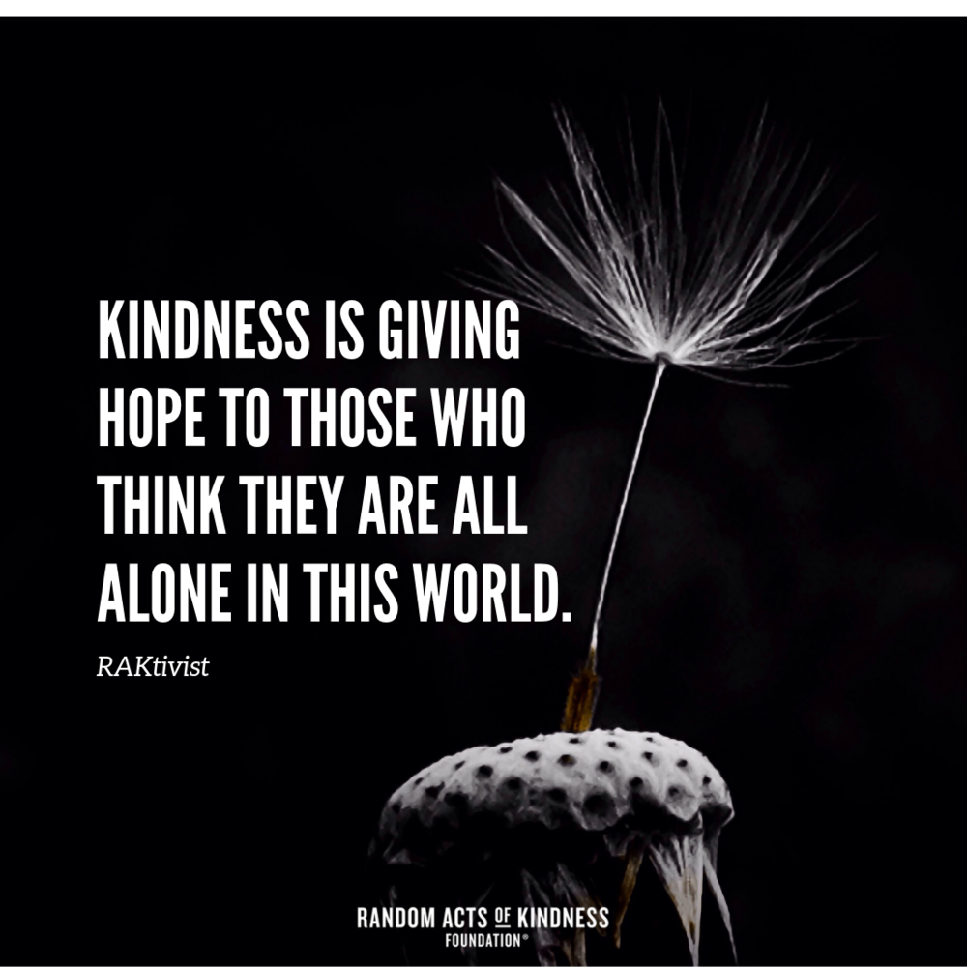
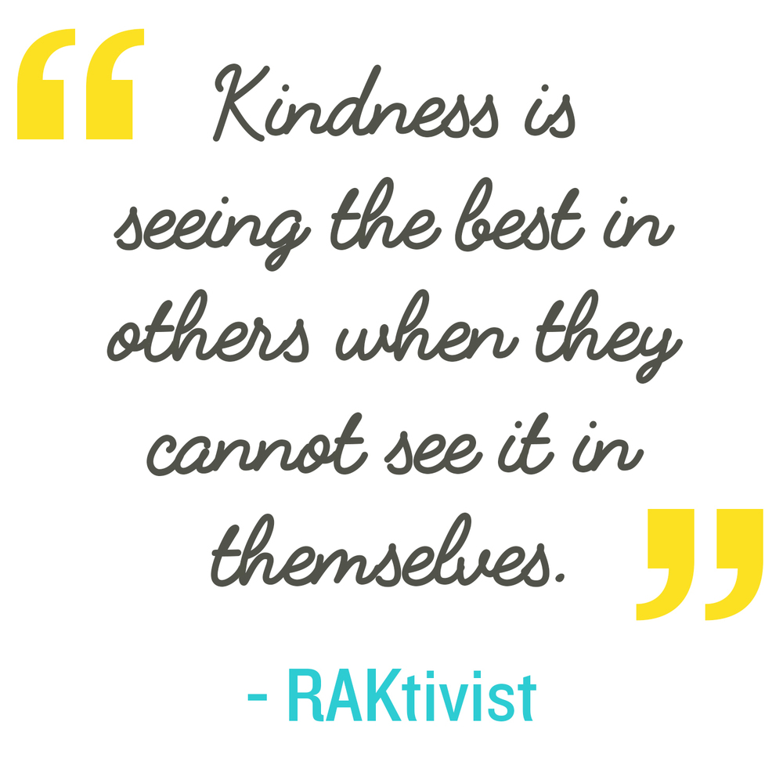
kindness

Slide 9
Week Two: 16th September 2019
Definition:
Positive
Consisting in or characterised by the presence rather than the absence of distinguishing features.
Constructive, optimistic, or confident.
With no possibility of doubt; definite.
adjective
Characteristics:
From Old French positif (13c.) and directly from Latin positivus, ‘settled by agreement, positive’.
Examples:
Examples:
The student received a positive report from his teachers.
He was positive he had seen the missing key.
Synonyms:
Clear
Conclusive
Real
specific
Antonyms:
Flawed
Indefinite
Uncertain
Vague
Notes:
Frayer Model – the main WoW slide will all be in this format. There will also be a TV screen version of this around school – all week – every week.
Explain how important the 39 WoWs are / reasons (SHOULD I DO A ONE PAGE ‘WHY ARE WE DOING THIS?’ for pupils? Ideally in an assembly – Caroline? Maybe the academic words slide??
Say the word
Give definition – link to pupil planner and word on board
Model reading aloud and ask pupils to read aloud
Try examples - Q&A

Slide 10
Discuss and give an example.
Think of a situation that may be described as positive.
Positive
Talk it through:
……………. felt positive about …
The positive effects of recycling are evident.
Consisting in or characterised by the presence rather than the absence of distinguishing features.
Constructive, optimistic, or confident.
With no possibility of doubt; definite.

Slide 11
Learn it!
Learn It!
Add the word to the back of your planners.
Practise spelling it – verbally with a partner.
Tell your partner a sentence using the word.
Remind yourselves of our examples from earlier in the week.
Try and use this word in at least one lesson this week!

