Slide 1
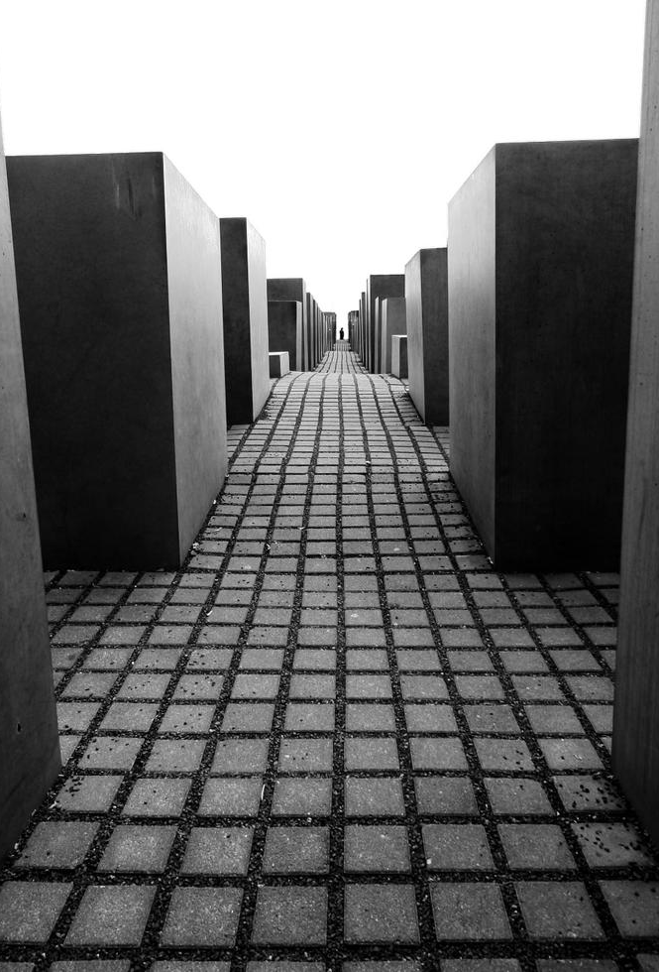
Holocaust Memorial Day assembly 2018: The Power of Words
Holocaust: the persecution of a group of people just because of one part of who
they are: Jewish, black, gay, travellers…

Slide 2
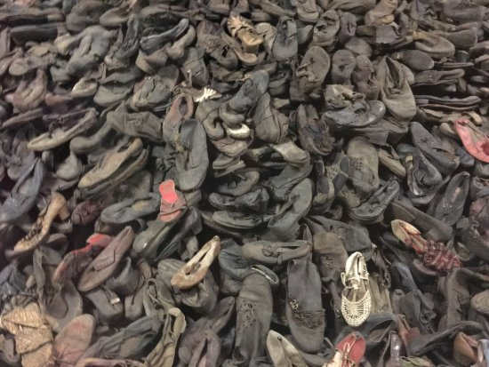

Slide 3
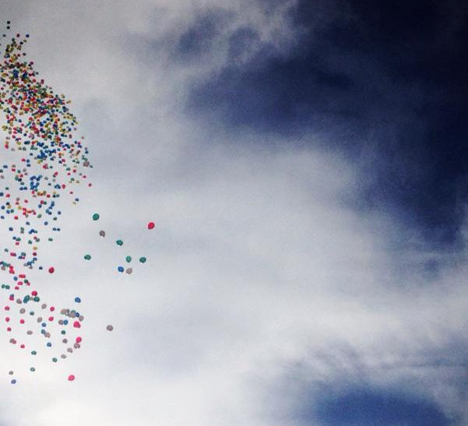
Why 27th January?
On this day in 1945, the Auschwitz death camp in Poland was liberated. Whilst many who were at the camp at the time had been sent west on a death march, those that remained were finally freed.

Slide 4
Holocaust Memorial Day What it hopes to achieve…
‘honour the survivors of these regimes and challenge ourselves to use the lessons of their experience to inform our lives today’

Slide 5
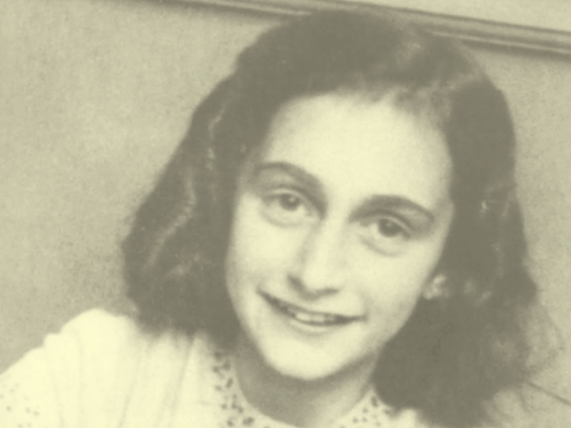
Anne Frank
© AFS Amsterdam /AFF Basel
Reproduced by permission from the Anne Frank Trust UK

Slide 6
Miep Gies
© AFS Amsterdam /AFF Basel
Reproduced by permission from the Anne Frank Trust UK

Slide 8
How we can make a difference going forward?
Remember the words of Meip Gies and draw on the lessons of the past to inform our lives today and ensure that everyone works together to create a safer, better future.
1
Be careful with your words, they are powerful and can cause harm, use them to make a positive difference instead.
2
Report acts of unkind words to a teacher
3
TAKE RESPONSIBILITY

Slide 9
Are you ok?
Why don’t you sit with us?
What can you do?
That was really good
Do you want some help?

Slide 10
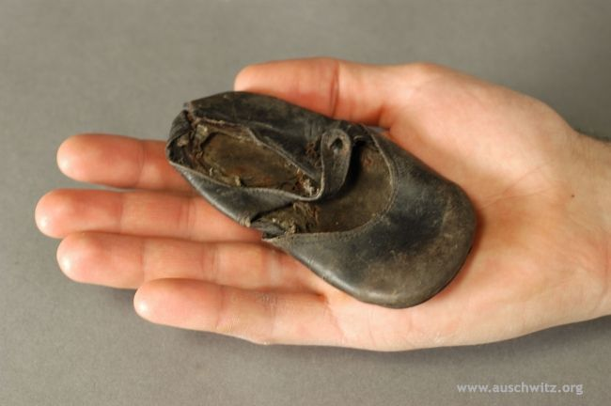

Slide 11
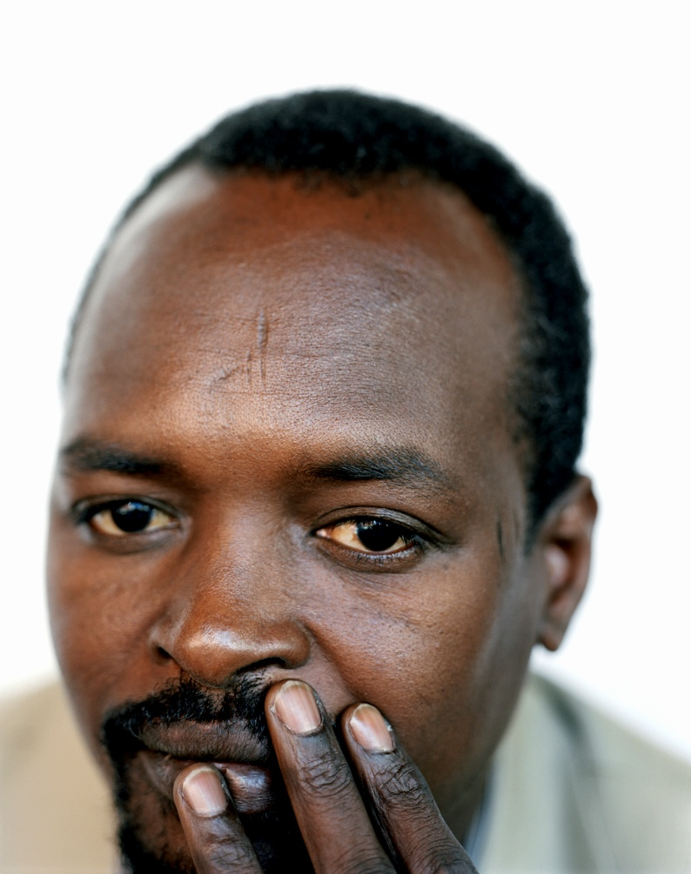
‘What can one person do? You make friends, of course, and do what you can.’
DaoudHari
Darfuri refugee
© Jens Umbach

