Slide 1
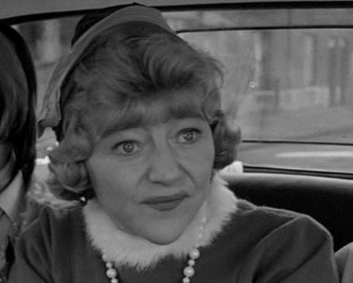
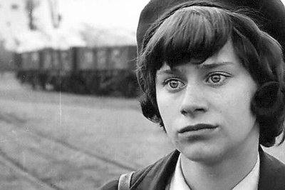
“Have I ever laid claim to being a proper mother?”
Helen to Jo

Slide 2
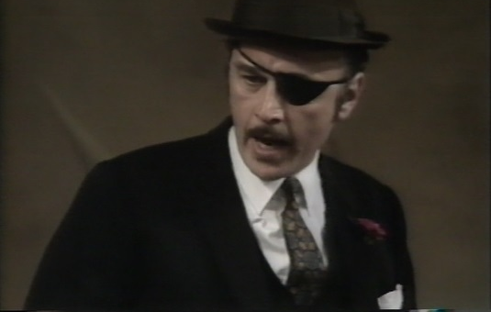
‘He’s got a wallet full of reasons’
Helen on her reasons for marrying Peter

Slide 3
‘Look you’re only young. Enjoy your life. Don’t get trapped.’
Helen on finding out about Jo’s engagement

Slide 4
‘I never thought about you! It’s a funny thing, I never have done when I’ve been happy.
Helen to Jo

Slide 5
‘Put it on the stage and call it blackbird’
Helen on finding out Jo’s baby will be black:

Slide 6
‘‘I’m sick of you. You make my life a misery”
Jo on Helen as a mother

Slide 7
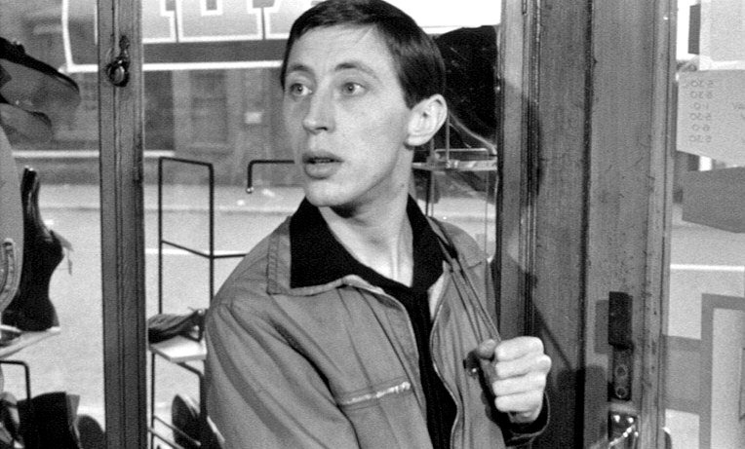
‘I think I’ve had enough. I’m sick of love. That’s why I’m letting you stay here. You won’t start anything.’
Jo to Geof

Slide 8
‘I’ll bash its brains out. I’ll kill it. I don’t want this baby Geof. I don’t want to be a mother. I don’t want to be a woman.’
Jo on the prospect of being a mother:

Slide 9
‘A bit of love, a bit of lust and there you are. We don’t ask for life, we have it thrust upon us.’
Jo reflecting on the meaning of life

Slide 10
‘You’re just like a big sister to me’
Jo on her relationship with Geof:

Slide 11
‘You hurt people’s feelings and you don’t even notice’
Jo on Helen:

Slide 12
‘You do need me Jo, don’t you?’
Geof to Jo

Slide 13
‘ Oh well, you need someone to love you while you’re looking for
someone to love’
Geof to Jo

Slide 14
‘I can’t stand people who laugh at other people’
Geof on Jo’s questions about his sexuality

Slide 15
‘If you don’t watch it, you’ll turn out exactly like her.’
Geof on Jo’s similarity to Helen

Slide 16
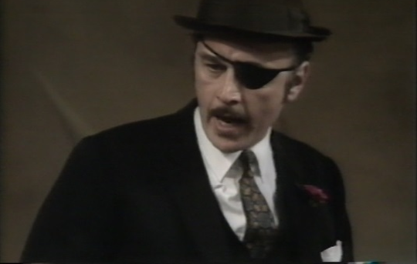
‘Who’s the lily?’
Peter on Geof

Slide 17
‘Shut your mouth bubble belly! Before I shut it for you.’
Peter to Jo:

Slide 18
‘I dragged you out of the gutter once.’
Peter to Helen:

Slide 19
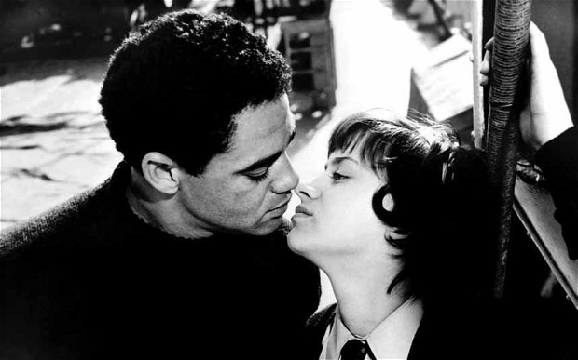
‘Doesn’t she care who her daughter marries?’
Boy (Jimmie) on Helen’s reaction to his relationship with Jo:

Slide 20
‘We’re saving up to get married’
Boy to Jo:

Slide 21
‘I hate dirt and this is the dirtiest place I’ve ever seen’
Boy on Jo and Helen’s flat

Slide 22
‘ I adore you’
Boy’s response to Jo saying ‘I Love you’:

Slide 23
‘ I adore you’
Boy’s response to Jo saying ‘I Love you’:

