Slide 1
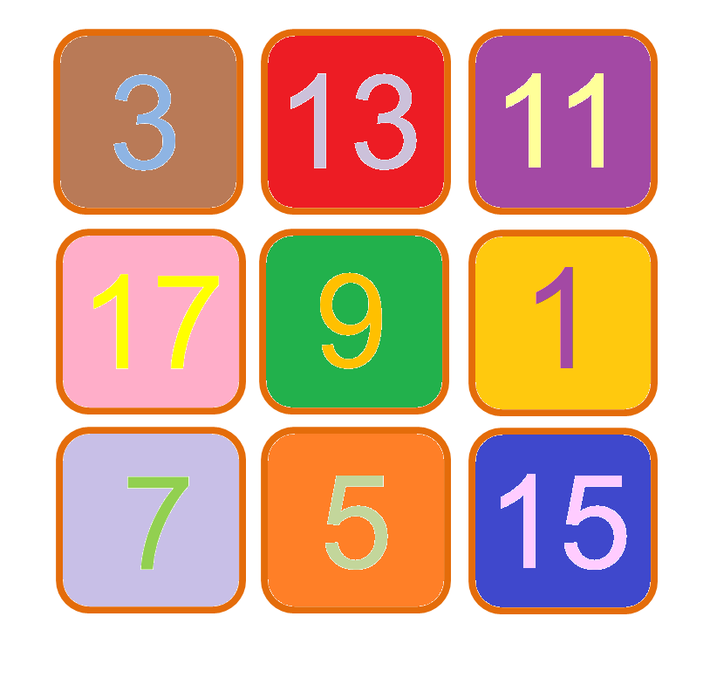
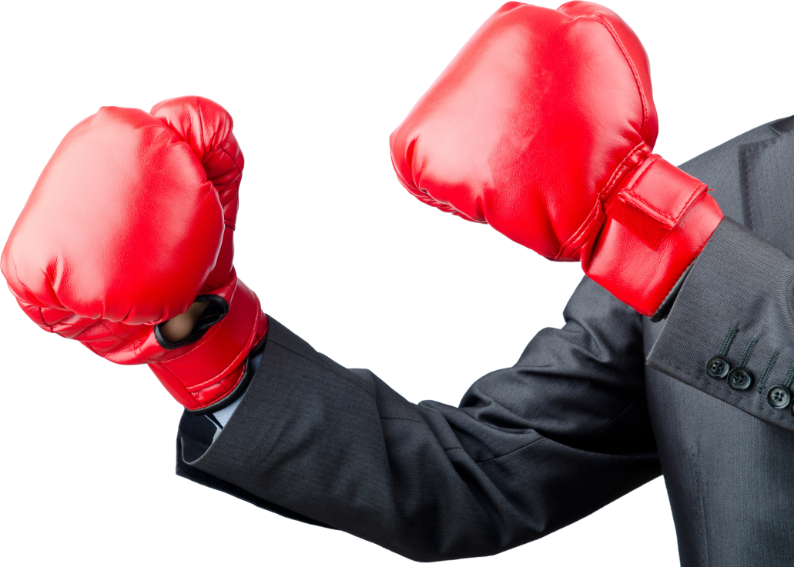
Say what you see…

Slide 2
BEATING THE ODDS
How is this song linked to ‘beating the odds’?

Slide 3
Key spellings and vocabulary
Celebrate
Success
Achievement
Culmination
5. Cumbersome
Can you spell these words?
Do you know what they mean?
Can you work out the meaning from the article?

