Slide 1
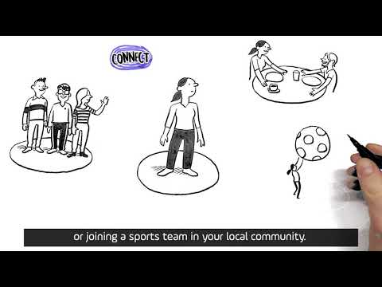
Staying connected has been so important in recent months but also more challenging with lockdown and social distancing in place. With this in mind today’s activities will help you connect with others whilst staying safe.

Slide 2
Which tasks will you do today?
CLICK ON THE BOXES TO FIND OUT MORE
Organise a virtual quiz with friends or family
Make someone’s day and send them a surprise in the post
Spend time with family or friends in a virtual escape room
Record a bedtime story for someone
Make a video for our new Year 7 students
Surprise someone with an album full of happy memories
Spread messages of happiness from your window
Organise a virtual sleepover with friends or a night at the cinema
Plan a social media campaign to promote social distancing to 12-17 year olds
Make a lunch or dinner for everyone in your household and connect over food
Create an epic sporting moment in your kitchen
Go to Google Form

Slide 3
Organise a virtual quiz for friends or family
Everybody loves a quiz or game show and many of us have spent time doing this with friends and family on zoom etc in the past weeks. Now is your chance to put together a quiz or game show, invite your friends or family and host and event.
Putting your quiz together
4 rounds with 10 questions in each is a good start. Popular rounds would be: general knowledge, sports, food and drink, TV and film. Music rounds work well too like, guess the intro or guess the theme tune. You will find some good questions on the internet too.
Once you have written your questions and DOUBLE checked your answers you are ready to meet your guests. Good luck
Back to Menu

Slide 4
Make someone’s day and send them a surprise in the post
We all love receiving mail!
A handmade thank you card!
A picture you’ve drawn with
A message for a grandparent
When did you last post a card or letter to someone?
Whatever it is just pop it in an envelope,
add the address, don’t forget the stamp
and pop it in a postbox
Who do you know that would really appreciate receiving a surprise through the post?
Back to Menu

Slide 5
Spend time with family or friends in a virtual escape room
Escape rooms are the new thing and during lockdown there are many online. So, why not connect with those around you and enjoy the challenge together
If you like Harry Potter why not try this one
Hogwarts Escape Room
or a treasure hunt at
www.www.escapedurham.co.uk/mr-x
Back to Menu

Slide 6
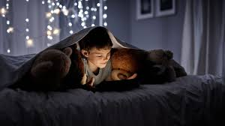
Record a bedtime story
for someone
Is there a younger member of your family or friends who you haven’t been able to see and connect with during lockdown?
Why not surprise them! Record yourself reading a bedtime story for them and send it to their parents so they can play it to them at bedtime. It will be a real treat to have someone else read them a story. They would love it!
Back to Menu

Slide 7
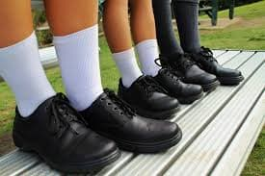
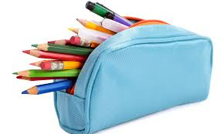
Make a video for our new Year 7 students
We Need Your Help To Connect with Year 6
We are doing all we can to prepare the Year 6 students for joining school in September but, as you can imagine, this is tricky as we can’t do our normal transition activities.
So, we would like to challenge you to make a short video (max 30 secs) giving our new students some little ‘gems’ of information.
What did you need help with? Could you show them how to do a tie? Could you give them tips for organisation? What would you recommend they have in their pencil case. I know they would absolutely LOVE to hear from you.
Back to Menu

Slide 8
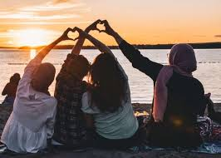
Surprise someone with an album full of happy memories
Whilst we are unable to be together with our friends and family at the moment why don’t you spend some time putting together an album of happiness from someone.
Find photos of times you have had with them, memories you’ve made. You will have this again but in the meantime send them a collection to connect with them remotely and let them know you are thinking of them.
Back to Menu

Slide 9
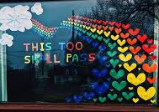
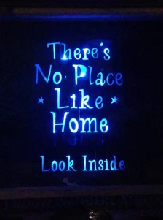
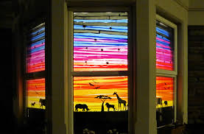
Spread messages of happiness from your window
Use your window or door to connect with others and spread positivity. You could chose a quote or create a picture. There are some great examples in this blog: Window Wanderland
Back to Menu

Slide 10
Organise a virtual sleepover or a trip to the cinema
Just because we can’t get together shouldn’t mean everything is on hold.
Why not organise a virtual sleepover. Get in the snacks, set up the sleepover, plan some fun activities, connect through your phones and imagine you’re all together.
OR
Organise to watch the same film at the same time. You might even be able to have a Netflix party. Get in the popcorn agree a time, connect and enjoy the film.
Back to Menu

Slide 11
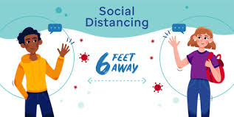
Plan a social media campaign to promote social distancing to 12-17 year olds
We know social distancing is a challenge, particularly for young people.
What could you do to promote ‘safely’ connecting with others?
Your challenge today is to plan a social media campaign around this. Could you get creative with photography to show safe socialising at a distance? Could you make a film to promote it? How would you reach this age group?
Back to Menu

Slide 12
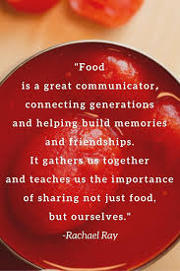
Make lunch or dinner for everyone in your household and connect over food
This quote says it all. Treat the other people in your house to a meal prepared by you. Sit down together and enjoy the food and company in equal measure.
You might find some inspiration here:
BBC Goodfood Lockdown Recipes
Back to Menu

Slide 13
Create an epic sporting moment in your kitchen
A Hometasking challenge.
Work with others.
Turn your kitchen into a sporting arena and create the most epic moment of sporting glory - in your kitchen
Watch this clip from the online Hometasking Challenge for some inspiration.
Hometasking Video
Back to Menu

