Slide 1
Chinese New Year

Slide 2
5th Feb 2019 - Year of the pig
Recent years of the Pig are: 1935, 1947, 1959, 1971, 1983, 1995, 2007, 2019
Why should we know that it is Chinese New Year?

Slide 3
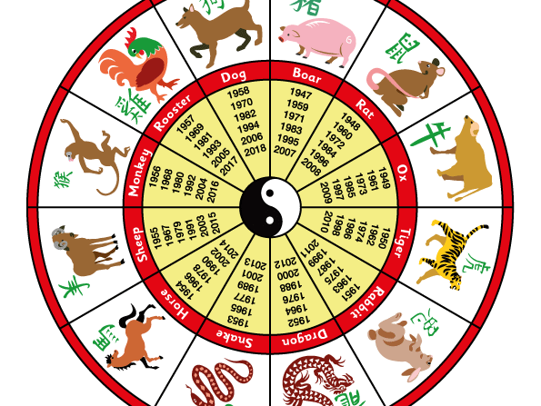
Challenge…what was the Chinese zodiac sign in the year of your birth?

