Slide 1
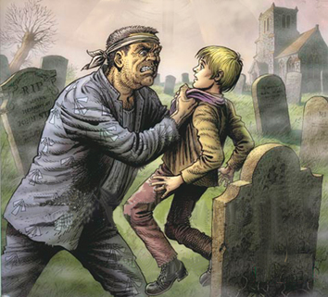
‘Keep still you little devil, or I’ll cut your throat.’
Magwitch threatens young Pip at the beginning.

Slide 2
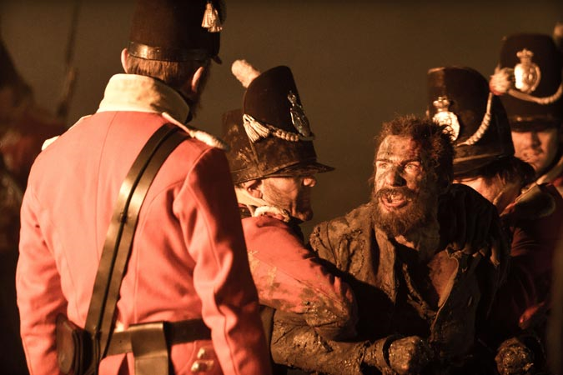
‘I’m sorry to say I eat your pie.’
Magwitch protects young Pip at the beginning:

Slide 3
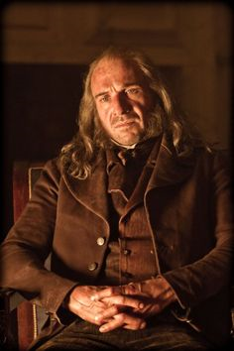
‘My dear boy!’
Magwitch sees Pip as like a son to him:

Slide 4
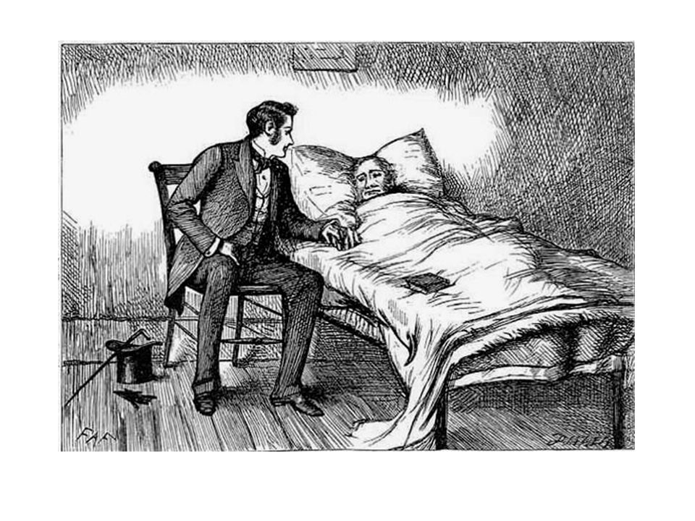
‘my repugnance to him had all melted away, and in the hunted, wounded, shackled creature who held my hand in his, I only saw a man who had meant to be my benefactor, and who had felt affectionately, gratefully, and generously towards me.’
Pip on Magwitch before his death:‘

Slide 5
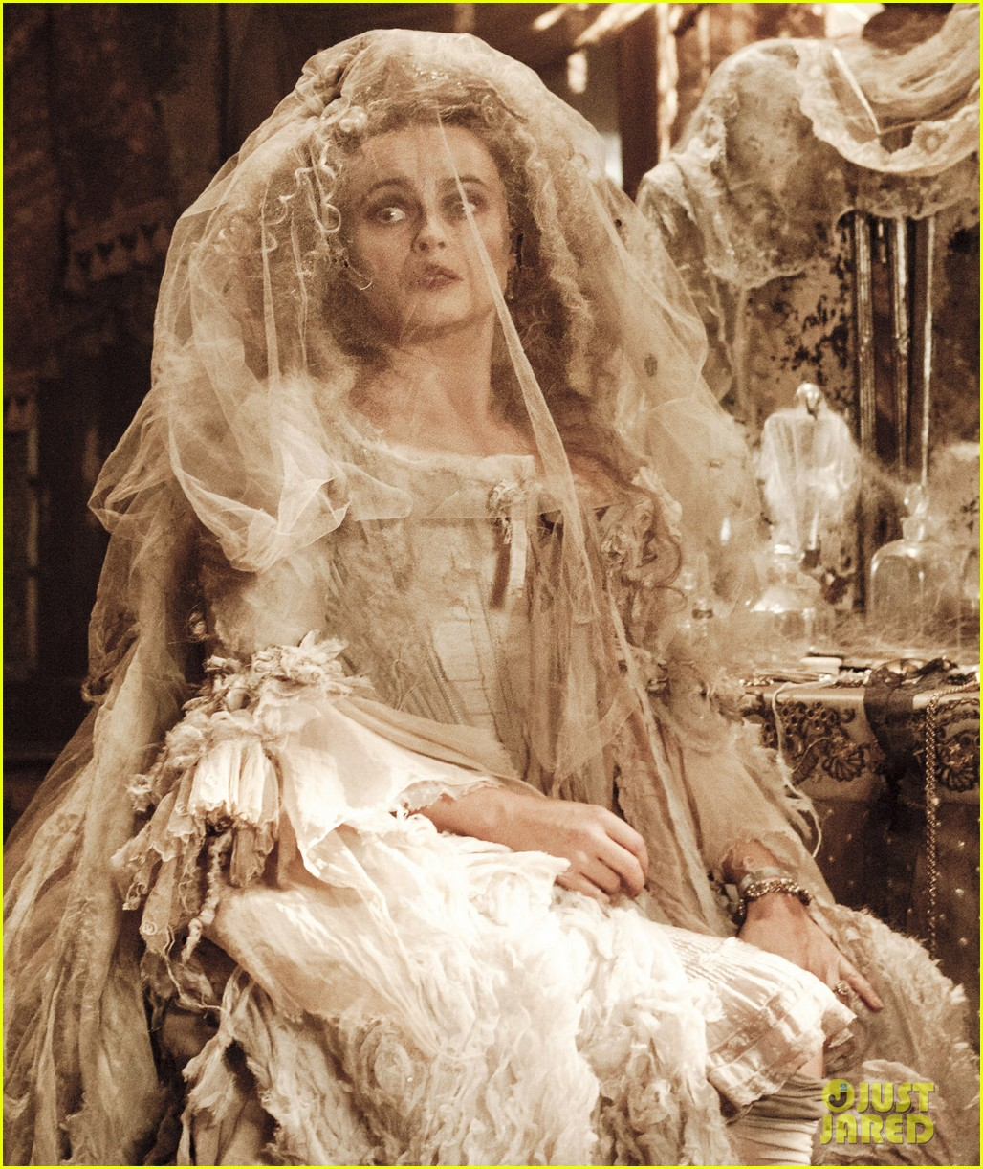
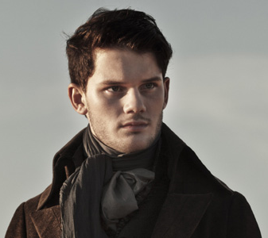
‘Everything that used to be white was faded and yellow.’
Pip on Miss Havisham:

Slide 6
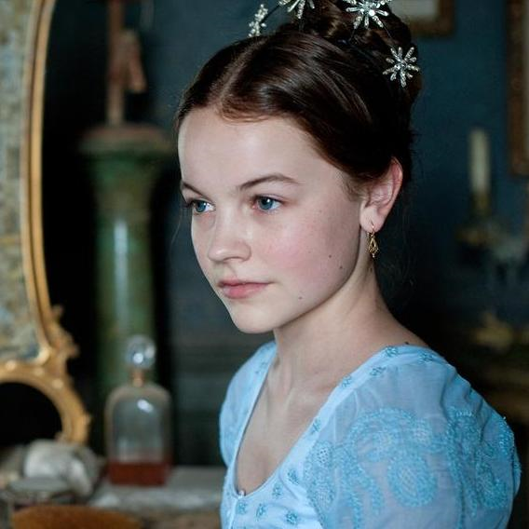
‘You can break his heart.’
Miss Havisham to Estella:

Slide 7
‘Oh!’ She cried despairingly, ‘What have I done! What have I done!’
Miss Havisham to Pip:

Slide 8
‘...Seeing her punishment in the ruin she was.’
Pip on Miss Havisham:

Slide 9
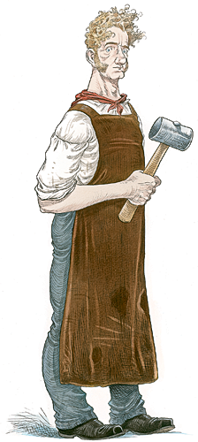
Simile: ‘They went at one another like two giants.’
Joe’s physical strength fighting with Orlick:

Slide 10
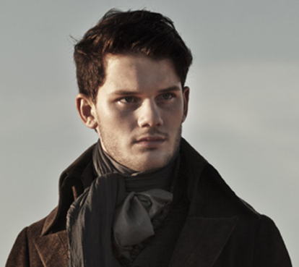
Metaphor: ‘He’s rather backward in some things.’
Pip’s opinion of Joe:

Slide 11
Lists, short sentences, lack of education: ‘I’m wrong in these clothes. I’m wrong out the forge, the kitchen, or off th’ meshes.’
Joe:

Slide 12
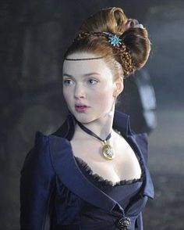
“Moths, and all sorts of ugly creatures," replied Estella, with a glance towards him, "hover about a lighted candle. Can the candle help it?”
Estella to Pip:

Slide 13
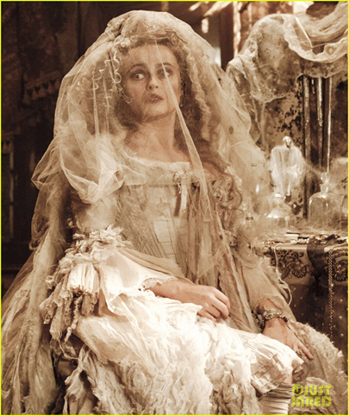
“Do you reproach me for being cold? You? […] I am what you have made me”
Estella to Miss Havisham:

Slide 14
"Do you want me then," said Estella, turning suddenly with a fixed and serious, if not angry, look, "to deceive and entrap you?"
Estella to Pip:

Slide 15
"beautiful and self-possessed"
Estella

Slide 16
‘I have been bent and broken, but - I hope - into a better shape’
Estella to Pip at the end:

Slide 17
“I have no heart”
Estella

Slide 18
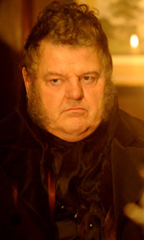
"... he washed his clients off, as if he were a surgeon or a dentist."
Jaggers’ approach to work:

Slide 19
"Take nothing on its looks; take everything on evidence. There's no better rule.”
Jaggers

Slide 20
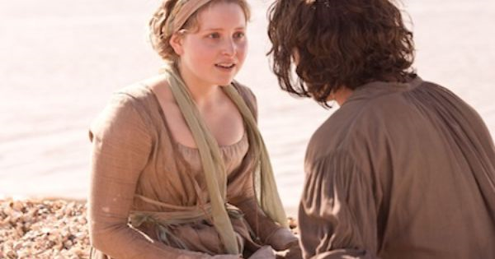
“Either I am very stupid, or you are very clever."
Pip questions Biddy’s intelligence:

Slide 21
‘I will never stir from your side.’
Pip to Magwitch at the end:

Slide 22
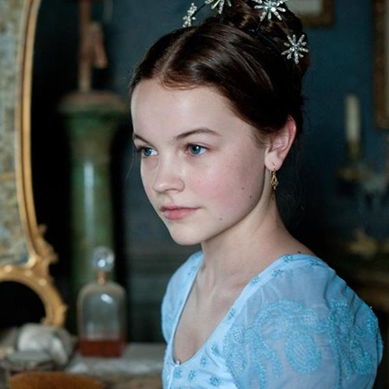
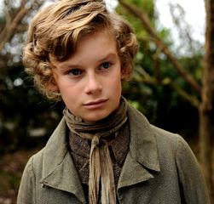
‘I had never thought of being ashamed of my hands before; but I began to consider them a very indifferent pair.’
Pip when Estella first humiliates him:

Slide 23
‘I am afraid I was ashamed of the dear good fellow.’
Pip about Joe visiting Satis House:

Slide 24
`You have always held your place in my heart,'
Pip to Estella at the end –

