Slide 1
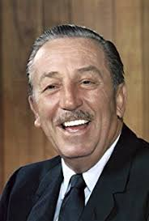
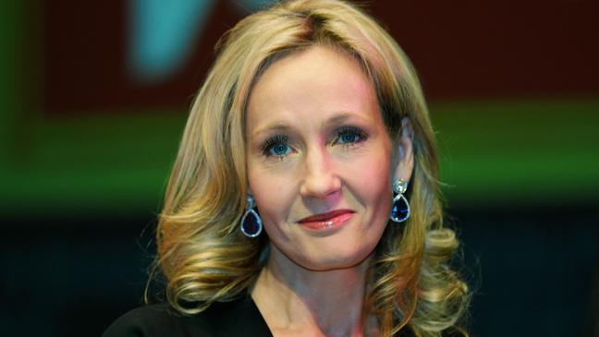
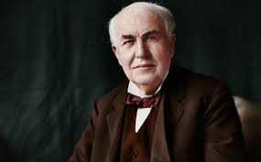
How do you feel when your teacher corrects your work? ☺ ☹
Do you like editing your work to make it better?
How do you feel when your friends give you tips of how to improve something?
Are you determined to learn a skill when you cannot do it?
Failure is essential if you are to improve. Walt Disney, Thomas Eddison (inventor of the lightbulb) J.K.Rowling, Steve Jobs etc etc have all 'failed' on their road to success.
Let your failures and mistakes motivate you to improve.

Slide 2
Growth mindset
Change your mindset from a FIXED to a GROWTH!
FAILURE is an almost essential part of developing a growth mindset…

Slide 3
Famous Failures
What do these people all have in common?
They never gave up…

Slide 4
Sesame Street and Bruno Mars do ‘Growth Mindset’…
The Power of YET!

