Slide 1
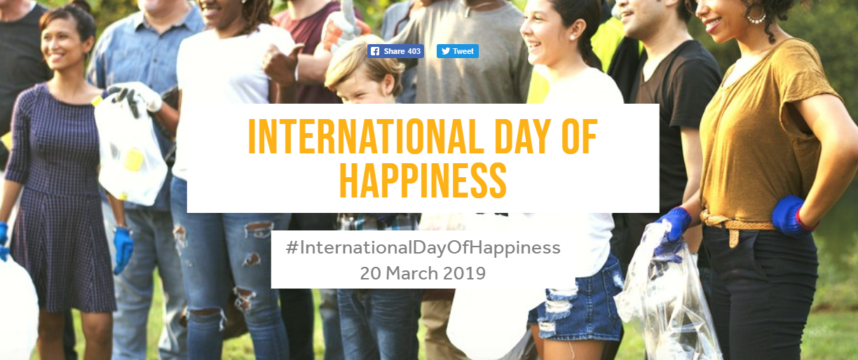
‘Happiness is about being able to make the most of the good times – but also to cope effectively with the inevitable bad times, in order to experience the best possible life overall.’

Slide 2
20th March – International Day of Happiness
For just one day, let’s see if we can all be positive and make ourselves and others feel happy.
How?
Focus on something positive
Say something nice to/about someone
Smile (even if you don’t feel like it)

