Slide 1
Thought for the Week
HUMAN RIGHTS
What are they? Human rights are the basic rights and freedoms that belong to every person in the world, from birth until death. They apply regardless of where you are from, what you believe or how you choose to live your life.
Human Rights Day –
10th December 2018
How are you affected by the these Human Rights…?

Slide 2
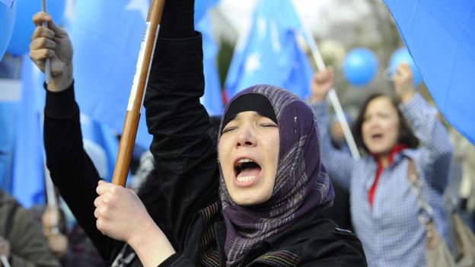
Read more…
Click on the image to read more about Human Rights across the world…

