Slide 1
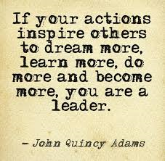
Inspirational People
Who inspires you? Why do they inspire you?
Meaning: fill (someone) with the urge or ability to do or feel something, especially to do something creative.

Slide 2
To INSPIRE – A Powerful Gift
Who inspires you? Why?
Do you display qualities which inspire others? (are you courageous, determined or wise?)

