Slide 1
Welcome to Walton-le-Dale!
“A small, popular, successful school where every young person is known as an individual”
Come and see the school “in action” – ring Mrs Hodgson on the school number 01772 335726 to make an appointment

Slide 2
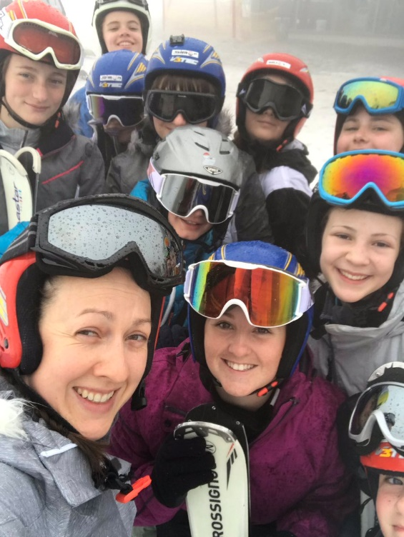
Introducing ourselves…
“Pupils, parents and carers value the school’s inclusivity. Peoples’ differences are recognised and valued.
Pupils say they feel safe and cared for at school.” Ofsted 2018
Come and see the school “in action” – ring Mrs Hodgson on the school number 01772 335726 to make an appointment

Slide 3
Our ethos drives everything that we do
We believe education can change children’s lives. We also believe that education is for life and is more than preparing students for exams.
We want our students to leave with the best exam results possible, but we also want them to leave us as well rounded people.
Come and see the school “in action” – ring Mrs Hodgson on the school number 01772 335726 to make an appointment

Slide 4
“I am aspirational for myself and for others…”

Slide 5
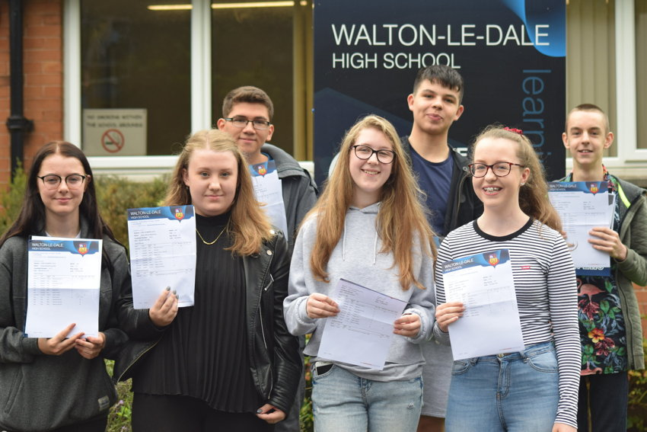
“Walton le Dale High School continues to move from strength to strength in terms of its inclusive practice”
“13 subjects achieved Grade 9s (or Distinction*) this year. The percentage of Grade 7+ (the old A/A*) trebled….”
Come and see the school “in action” – ring Mrs Hodgson on the school number 01772 335726 to make an appointment

Slide 6
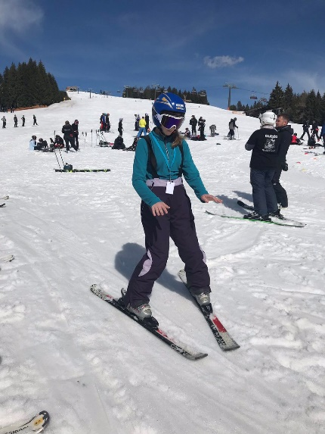
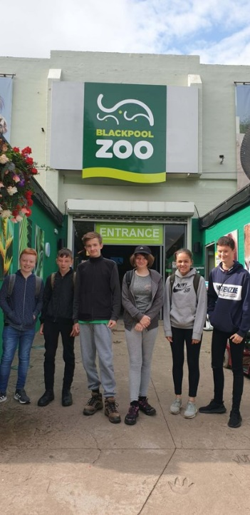
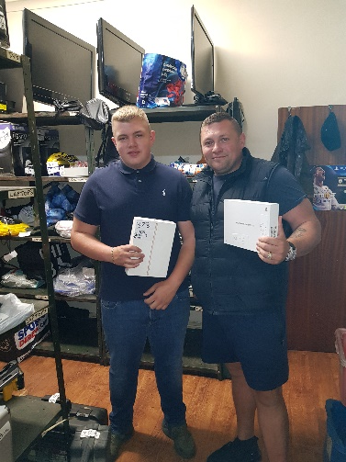
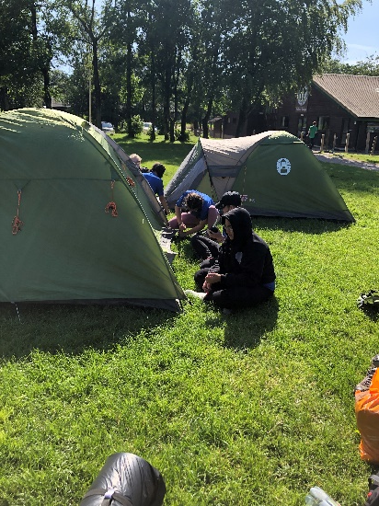
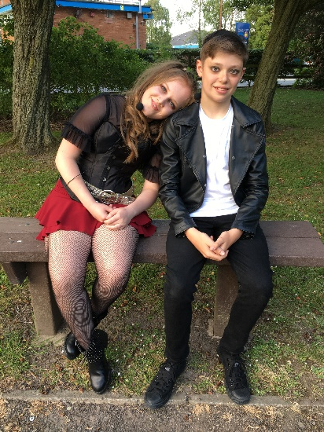
“Leaders have a sharp focus on the curriculum. They provide pupils with courses that match their needs and interests. Careers education and extra-curricular activities are strengths of the school.” Ofsted 2018
Our Offering
• • •
Art
Dance
Drama (incl. Productions)
Music (incl. Peripatetic)
Technology (range)
ICT
Amnesty
Library
Sports Leaders
Duke of Edinburgh
Languages
Public Speaking
GCSE Revision
School Council
Netball
Football
Trampolining
Basketball
Gymnastics
Badminton
Football
Social Skills
Maths Challenges
FE and HE visits
Visits to other schools
Peer mentoring and coaching
Trips overseas
Come and see the school “in action” – ring Mrs Hodgson on the school number 01772 335726 to make an appointment

Slide 7
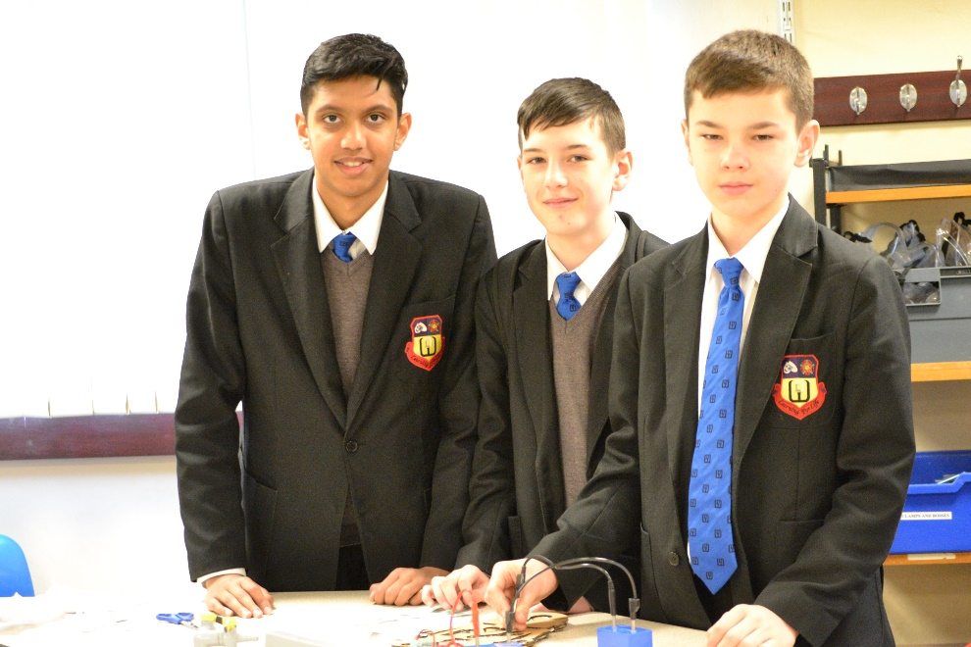
“We are aspirational for ourselves and for others”
“The headteacher has wasted no time in setting high standards and sharpening the focus on pupils’ quality of learning.” Ofsted 2018
“I am of the opinion that the school has developed significantly over the past two years and that it is poised to increase momentum over the next year” IQM review 2019
Come and see the school “in action” – ring Mrs Hodgson on the school number 01772 335726 to make an appointment

Slide 8
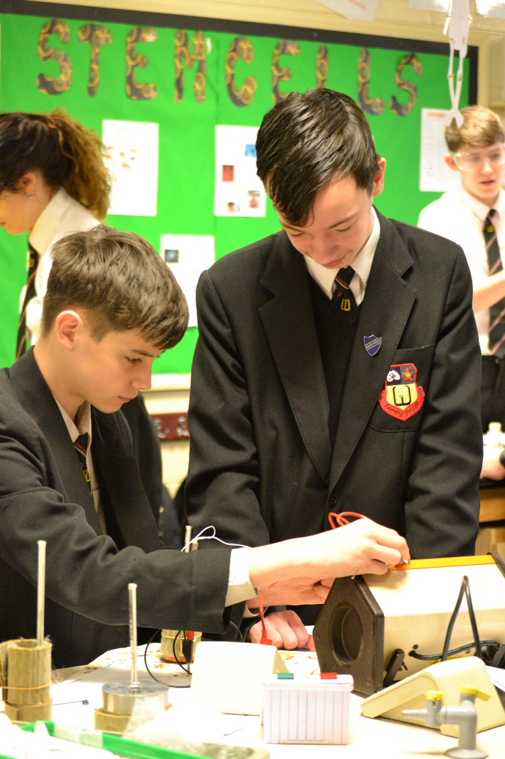
Our students are our best advertisement….
“I was able to meet with a good number of students who represented a cross selection of the student population. I found them to be polite, enthusiastic and articulate. They were very positive about their school and offered a number of largely curriculum based suggestions that they felt would improve the school still further”
Come and see the school “in action” – ring Mrs Hodgson on the school number 01772 335726 to make an appointment

Slide 9
Admissions, Transport and Transition
Our admissions are controlled by Lancashire County Council
We have been full in Year 7 every year for the last 6 years.
We draw from a wide area (Darwen, Blackburn, Fulwood, Whittle-le-Woods, Leyland, Buckshaw…) – families attracted by our ethos
We run school buses to Blackburn and Preston
New for Sept 2020 – we will run a bus to Buckshaw including Lancaster Lane
“In transition from year 6 to 7 and also post-16, school leaders have incorporated additional support for more vulnerable youngsters aiming to build their resilience.”
Come and see the school “in action” – ring Mrs Hodgson on the school number 01772 335726 to make an appointment

Slide 10
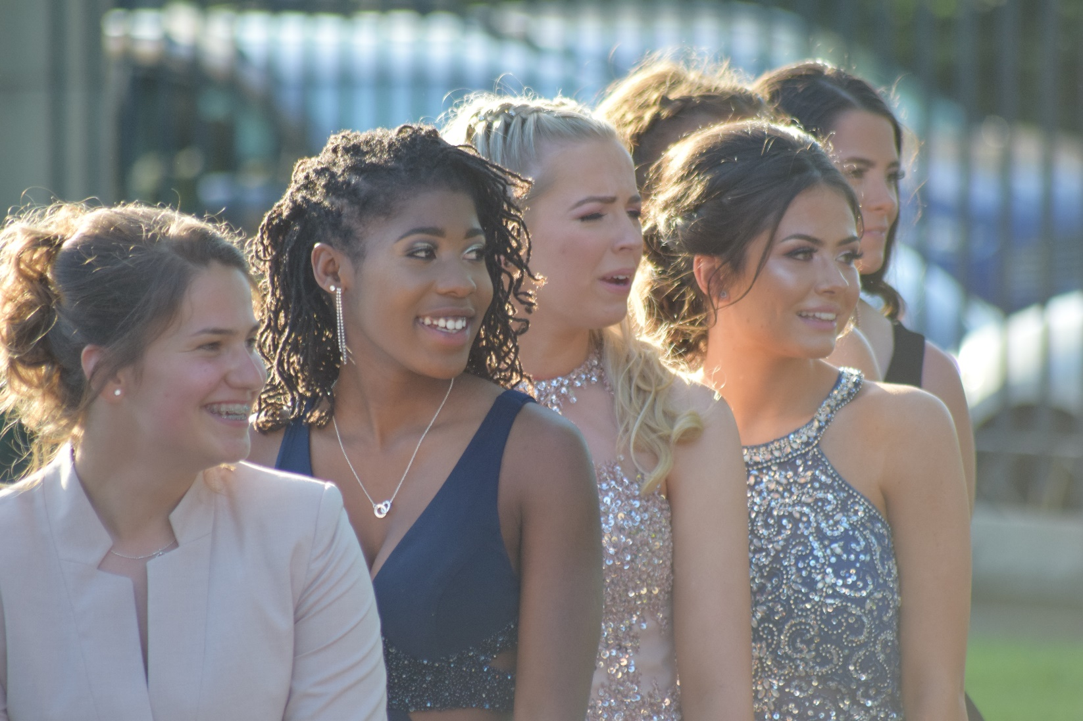
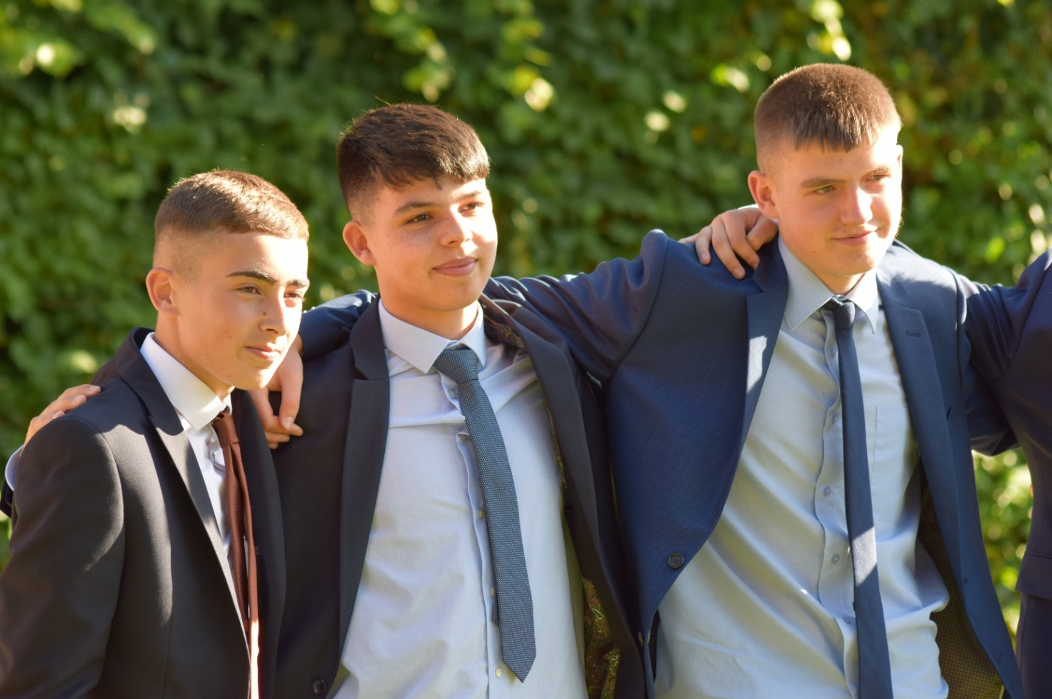
Come and see the school “in action” – ring Mrs Hodgson on the school number 01772 335726 to make an appointment

