Slide 1
How does UV light affect us?
We are having some amazing sunny and hot weather at the moment!
But we need to think about how the sun can affect us and how we can protect ourselves from harm

Slide 2
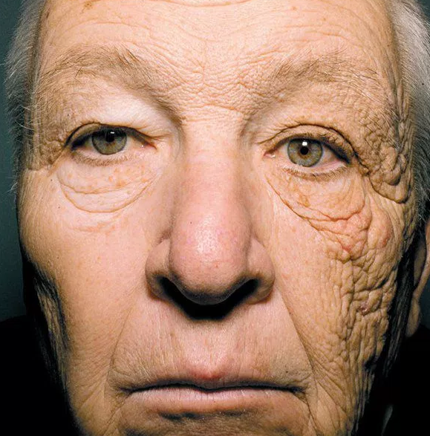
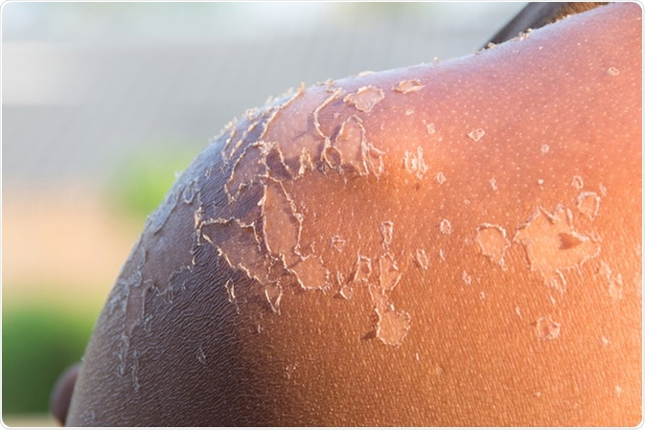
What does UV do to our bodies?
This man has been a truck driver all his life. The wrinkles on the right shows the damage of the sun shining on one side of his face!
UV can cause burns, both minor and serious. Long exposure can also lead to skin cancer.
UV can also cause problems with our eyes, like cataracts. This is where the lens of the eye goes cloudy

Slide 3
How can we protect ourselves?
Wear a high SPF sun cream (30 or above)
Reapply sun cream regularly
Try to sit in the shade
Wear long sleeves
Wear a high quality pair of sun glasses
Stay inside during the hottest part of the day
Have safe fun in the sun!

