Slide 1
Stakeholder Voice: What it is telling us 2020/21
Staff and student voice is telling us that there has been:
An increased focus on vocabulary instruction
Increased use of visualisers to model/scaffold
An increase in the confidence of teachers’ in their use of Teams/Classcharts etc
Impact as a result of interventions (BfL and CPD for technology)
Changes to the remote learning policy to optimise students’ ability to access and submit work online

Slide 2
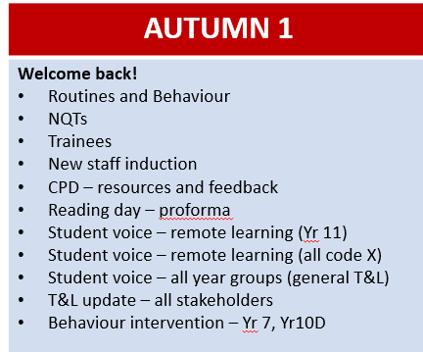
Autumn 1
Monitoring and Evaluation Schedule

Slide 3
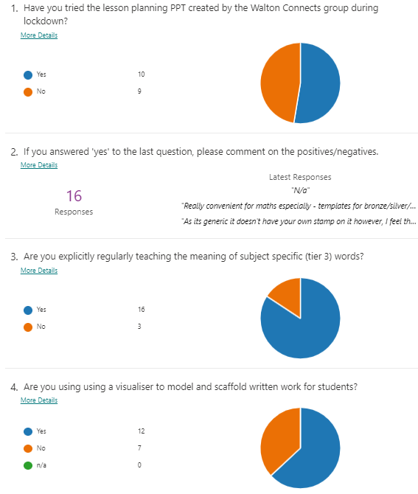
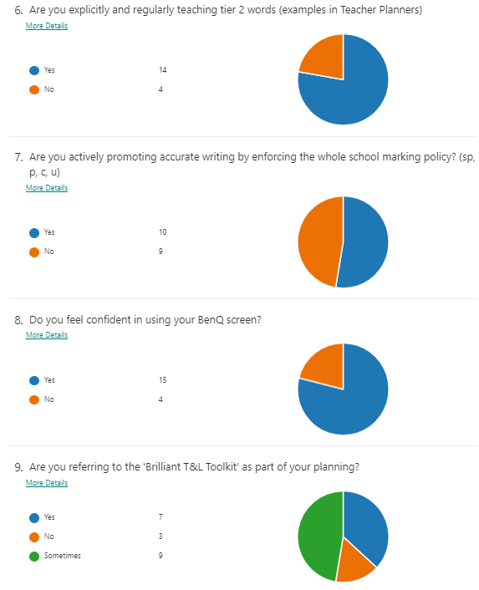

Slide 4
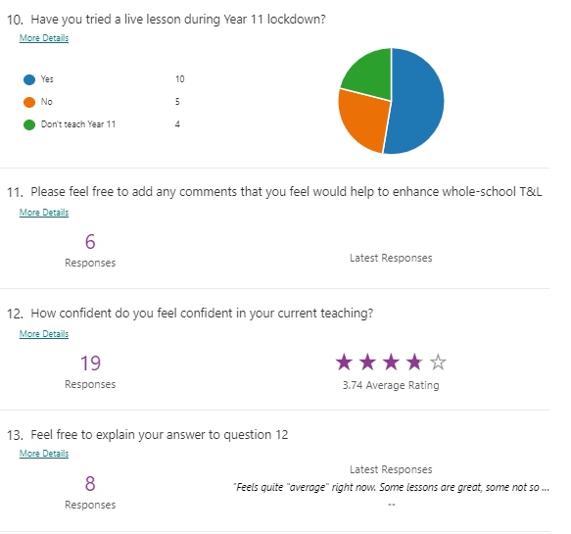
Teacher Voice: 15th October
Findings:
Vocabulary instruction is being prioritised by more than half of the staff
Just over half of the staff are using visualisers to model/scaffold written work
Average confidence with teaching is 3.74 out of 5
Resulting Actions:
Continue to embed visualiser use
Push the Frayer Model slide for use when teaching new vocabulary

Slide 5
Specific Focuses Autumn 1
New systems and routines, alongside the Basics @ WLD
Generally, students have settled into routines well.
Classrooms are calm and teaching and learning is of high quality.
Hotspots identified
Year 7s – unstructured time (i.e. between lessons, lunch etc) has seen instances of unsettled behaviour.
Solution – ‘Golden Rules’ – adopted with all classes. Staff survey – 15/16 teachers have noted an improvement in behaviour since adopting the rules.
Year 10D band – also a little unsettled in lessons.
Solution - Again, ‘Golden Rules’ adopted across core classes with success (100% of staff said that the rules work).
Establishing new and old routines…

Slide 6
Specific Focuses Autumn 1
Ensure momentum continues in improving T&L: staff improvement and CPD
Whole-school CPD menu – offered a series of specific workshops relevant to current T&L priorities (adapted due to Covid): Live lessons; use of Classcharts; use of Teams; questioning; and formative assessment.
Explicit and clear instruction (Year 7 survey – 100% feel that their teachers explain clearly)
Pushing priorities through various channels, aside from C-19.
Hotspots identified
Use of technology to deliver new routines and practices
Evaluation
Staff evaluation: 100% of staff felt that they had gained from undertaking the CPD. 100% of staff felt that the CPD session would genuinely influence their classroom practice as a result.
Establishing new T&L routines, alongside old routines

Slide 7
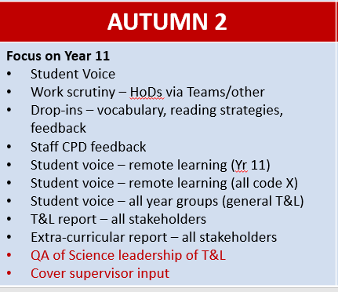
Autumn 2
Monitoring and Evaluation Schedule

Slide 8
Student Voice – Lock-down Learning
Sample of students forced to isolate surveyed about their learning
Discussion with a small sample to establish a dialogue about remote learning
Outcomes:
Positives
All had logged onto Teams whilst not in school
Seneca was the most popular platform used to access learning
19/26 students prefer email/chat rather than live lessons
Students seem to like lessons where a PPT of instructions is uploaded instead of/as well as a live lesson
Actions/next steps:
Ensure all students are accessing work from home
Continuing to work on strategies for engaging those students working at home
26 responses

Slide 9
Moving Forward…
Embedding the ‘Teaching and Learning Policy’ and the Feedback-Plan-Teach philosophy.
Visualisers to improve extended writing (64% of staff currently using one)
Explicit instruction of vocabulary (79% of staff are currently doing this; moreso of the subject-specific vocabulary, rather than the tier 2 words).
Use of formative feedback to inform planning and teaching
Effective questioning – materials available for independent/departmental CPD
Promote independent reading using the Reciprocal Reading model (64% of staff currently using one)
Adapting to the shifting situation caused by the C-19 Pandemic. CPD to be offered where needed
Ensuring all students can access Teams and submit work
…into Autumn 2

Slide 10
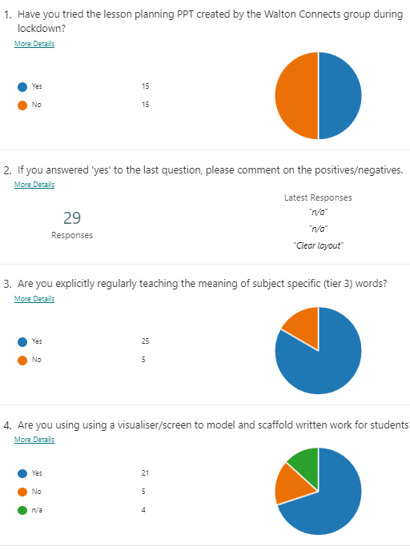
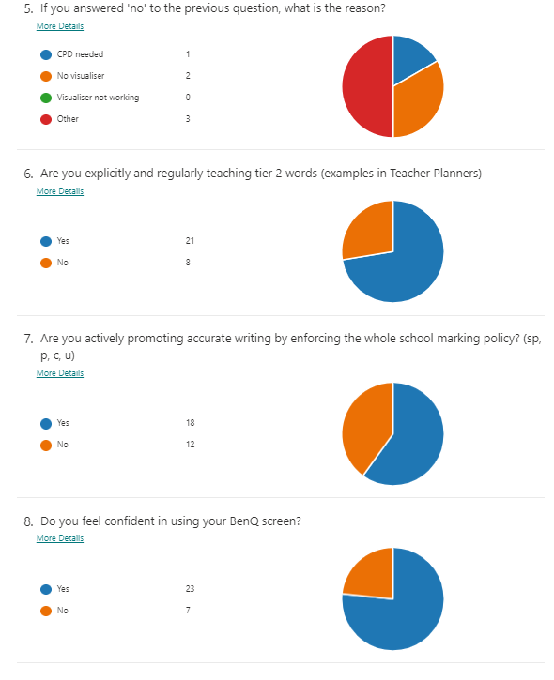

Slide 11
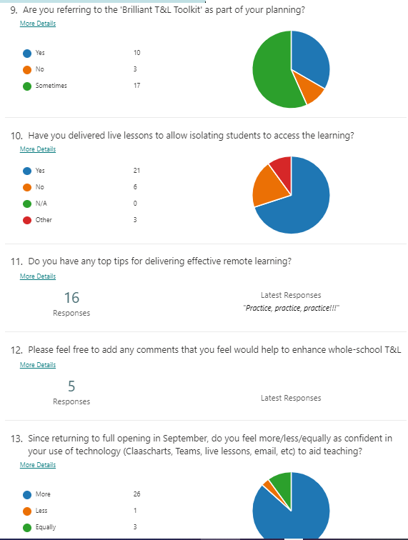
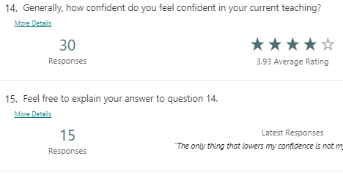
Teacher Voice: 18th December
Findings:
Vocabulary instruction is being prioritised by most staff
Most staff are using visualisers to model/scaffold written work
Average confidence with teaching is 3.93 out of 5 – grown in Autumn 2
Confidence in using Teams/Classcharts etc has grown since September
Resulting Actions:
Continue to embed use of Teams

Slide 12
Spring 1
Monitoring and Evaluation Schedule

Slide 13
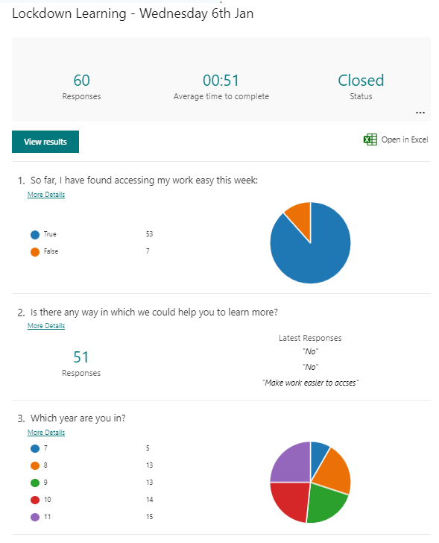
Student Voice: 6th January
Findings:
Students are managing to access their work easily
A few students struggled to find timetable online
Resulting Actions:
Continue to embed use of Teams
Reminded students of Classcharts as a way of finding timetable

Slide 14
13th January – Departmental Evaluations of Remote Learning so far
General Observations:
Using a range of packages: Oak, Seneca, AQA, Hegarty etc. Oak has been mapped onto curriculum plans (or is being at present) in several cases.
Best Practice
Mix of synchronous and asynchronous teaching.
Lots of praise (positive CC)
Popular sequence seems to be: Welcome and Teacher input (live or on Teams) ------Video/visual material to work through independently with general Q&A through chat ------ reconvene (live or through Teams) at the end to discuss learning.
Assignments seem to be preferred to set all work as well as storing resources in weekly Teams
Use of quizzes as starters
Recording of live lessons allows students to access later
Annotation using a visualiser
Oak and audio PowerPoints are useful as they allow students to pause.
Clear and simple instructions needed.
Chunking tasks
Having a slide as a focus whilst students arrive to live lesson
Use of the lobby function in Teams
All of these are currently in our Toolkit, possibly adapted slightly.

Slide 15
13th January – Departmental Evaluations of Remote Learning so far
Suggestions
Could we set with through Assignments for every lesson? Then store resources as usual in weekly folders in Teams?
Yes – now part of updated policy
Could we have a set opening screen for live lessons?
Yes – one has been circulated and is being used by some
Could period 1 start at 9am rather than 8.45? – Yes - amended
If there are three/four lessons a week, could at least one be live to allow students some contact with their teacher?
This is the case across most subjects. More frequently in many cases.
Could we clarify to parents/students the times when we will communicate with students? – Yes – part of remote learning policy
Feedback policies need to be amended to recognise potential workload issue with students returning lots of work (i.e. all acknowledged with a symbol at least; key pieces – identified by teachers – will be awarded more detailed feedback). Frequency and nature to be clarified.
SIG – w/c 25th January – drafts to be finalised before half-term
Do we need to email work to students? They don’t seem to open emails.
RLO –checked the data on email access. It is being used. We need to push. RLO to remind students in Year group Teams.
Can we set up a dummy channel/Team to practice remote learning?
Use the ‘Remote Learning’ Team for this. Lots of staff already in there. Anyone is able to add another member of staff.

Slide 16
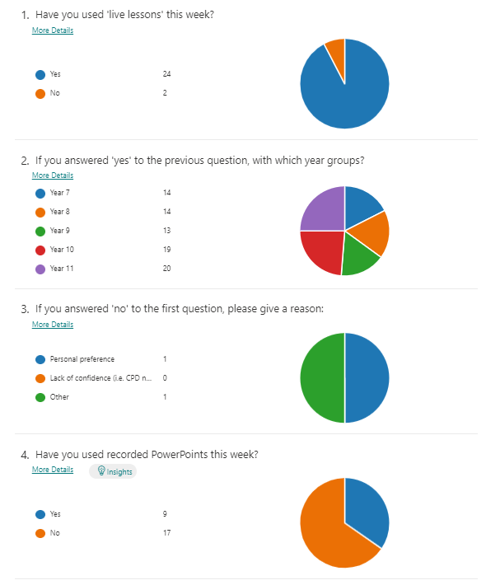
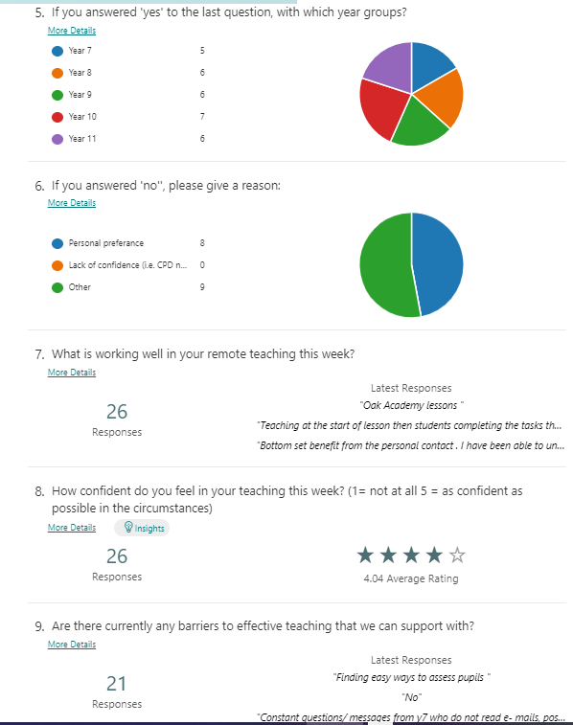
Teacher Voice: 28th Jan
Findings:
Majority of teachers are offering live lessons to all year groups;
Just under half are using recorded PowerPoints with all year groups;
Resulting Actions:
Mentors communicating with students regarding engagement
Assessment and Feedback Policies – middle leaders are on with drafting these by half-term
Positives | Negatives
Setting work through Assignments Chat for feedback Routine – fewer Qs about where to find work | KS3 attendance to live lessons Students not reading instructions (email) Planning is difficult when little engagement Assessment

Slide 17
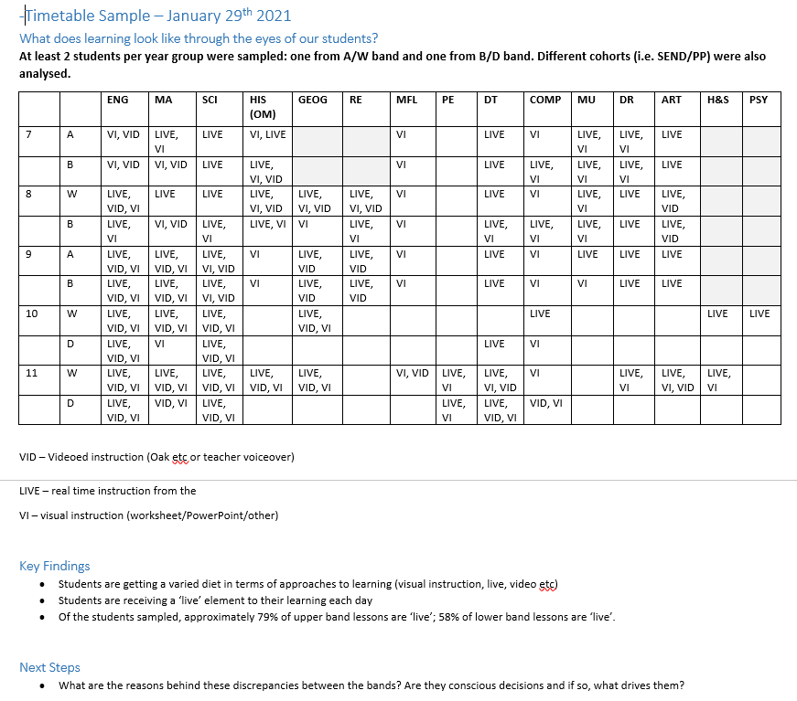
Student Sample: January 28th

Slide 18
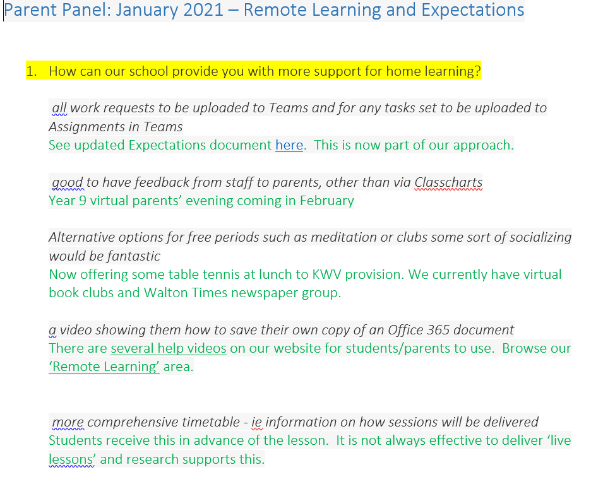

Slide 19
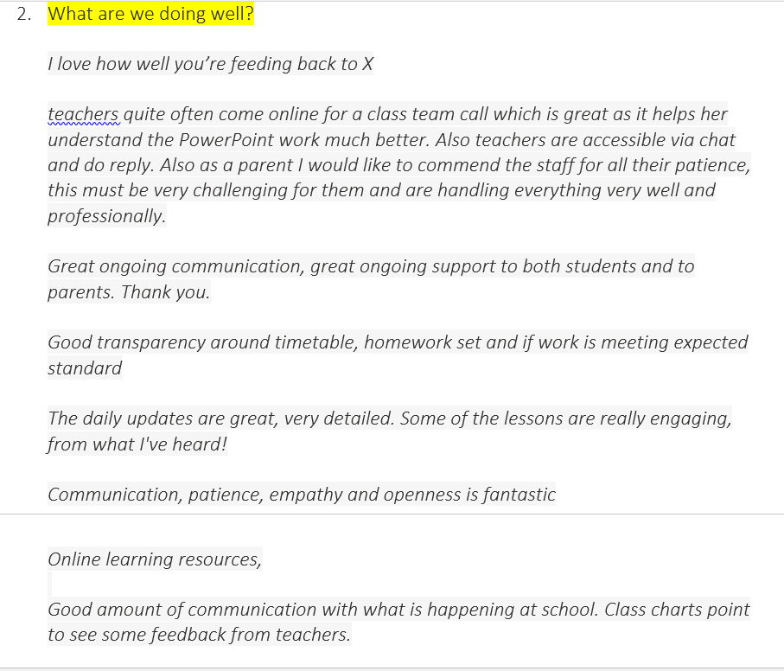

Slide 20
