Slide 1
STUDY GROUPS – LEARNING POINTS
WHOLE-SCHOOL FEEDBACK SESSION 2nd July 2018

Slide 2
Effective Feedback
L. Christie, C. Rowson, R. Long, D. Sharples, S. Smith-Sergeant, A. Snape

Slide 3
Feedback: Outline of Project
Investigated different ways of giving feedback effectively.
Conducted a student voice to see what students prefer

Slide 4
Feedback: Learning Points
Student voice showed that students do like written feedback and they act upon targets / comments
They also like the opportunity to discuss results and progress verbally.
Students are not always keen on peer assessment – depends on the class. They like to choose their own peer

Slide 5
Feedback: Learning Points
Students prefer different feedback methods depending on the subject
Change and variety is the key – within subject areas
What students like and what is effective is different

Slide 6
Feedback: Learning Points
Stickers are good for praise
Discussed the possibility of having a verbal feedback week

Slide 7
Teaching to the Top (1)
R. Holden, L. Adams, A. Christian, B. Hull, K. McPartlan, J. Curl

Slide 8
Teaching to the Top 1 – Outline of Project
Lauren: Encouraging pupils to take responsibility for their own learning. “Dazzle Me”/”Wow Me”; competitive elements; structure strips
Anita: Adapt reading ladder to enhance written responses and use WAGOLLs to enhance vocabulary and written expression
Rose: Encourage deeper thinking in problem-solving

Slide 9
(Continued)
Brian: Work from the “Austin’s Butterfly” principle; draft, re-draft and hand in your best work
Keira: Problem-solving and creating a culture of confidence to foster independent learning, perseverance and resilience

Slide 10
Teaching to the Top – Learning Points
High expectations and rigour from the start. Ban “learned helplessness”. Set a minimum standard, if students don’t meet a minimum standard and if students haven’t met the minimum standard, they must have a consequence-break, after school, complete work in own time. Do not accept mediocre responses. Encourage class to hold each other to account.
Use WAGOLLs to model exam responses, phrasing, vocabulary and written responses.
Foster a spirit of enquiry, intellectual curiosity and resilience

Slide 11
Teaching to the Top – Learning Points
Use of scoring to demonstrate progress and translate progress into a format that students understand.
Collaboration to solve problems.
Challenge off-task talk.
Encourage foundation level students to work at higher level when possible.
Encourage pupils to use full answers and to use language appropriately.

Slide 12
Teaching to the Top – Learning Points
Encourage pupils to help themselves and to access resources that can help them (e.g. dictionaries). Ban “learned helplessness”.
Ensure pupils can see that there may be more than one right answer and to find different solutions to the same problem/challenge. Ask them to work backwards from the answer.
Using the deeper questions in class helped pupils to focus on longer and more complex responses. The 2-1-0 marking system also helped them to see where they needed to develop a longer answer.
Scholarship is important – there is a need to keep up to date with innovators in educational thinking and to experiment with new ideas and strategies. This links to being prepared to take risks and learn from them and to innovate.

Slide 13
Teaching to the Top (2)
A. Lyons, S. Hunt, A. McCann, J. Mayor.

Slide 14
Teaching to the Top 2 – Outline of Project
After much discussion each member of the group decided to focus on a different aspect of Teaching to the Top.
Ly looked at the start of the lesson and how having a more focussed and higher objective for the lesson can have an impact on teaching to the top.
AM Looked at several teaching strategies that have applications for both Higher and lower previous attainer’s. The Use of modelling as opposed to scaffolding and summative assessment.
JM Looked at how asking the ‘Big question’ at the start of the lesson and working backwards rather than looking at small parts building up can impact progress.
HU looked at how pupil attitude affects teaching to the top and at the use of Knowledge organisers in music.

Slide 15
Teaching to the Top 2 – Learning Points
LY: Move towards the Gold Standard.
Pupils were not given a learning objective, rather they were given “the Gold Standard”. This is a much more focused end game goal rather than the smaller step approach a set of learning objectives can use.
The change in focus from Lesson objectives (almost like a tick list of objectives to complete) to the ‘Gold standard’ (the peak of a topic, sometimes represented as a question, sometimes as a skill) has changed my focus in planning. I now actively look for situations where I can build in some extra links to not only the topic but also cross-curricular.
Student were equally frustrated as a list of objectives leads to a gamification of learning. Some students wanted to learn the next point to tick of the next objective on the list. This often led to shallower learning where a student would learn the skill but not understand the underlying maths behind the skill. Moving to the ‘Gold Standard’ has removed this artificial game that some students were playing.

Slide 16
Teaching to the Top 2 – Learning Points
AM:
Research has shown that modelling is key to success in assessment. This was described differently to scaffolding as it shows modelling to encourage independent work.
5 Steps to better modelling
1. Have a clear criteria for success
2. Plan for errors
3. Model live
4. Model the errors
5. Remove the scaffolding
Summative assessment was a key tool in the focus of teaching to the top.

Slide 17
Teaching to the Top 2 – Learning Points
JM: Jumping in with the big picture.
All about setting up the ethos of high expectation and ‘jumping in’ with the big question and working backwards, rather than building up in small steps.
Tried to apply the theory to the teaching about the war in Syria and refugees.
Giving suggestions for independent reading and research.
Tweaking O.M SOWs to ensure that challenge is planned for.
That teaching from the top is not a few simple strategies that you can use in your classroom, it is a culture, an ethos which needs to be created and nurtured within my planning, teaching practice and also in my behaviour towards students, the feedback I give them, the questions that I ask and the expectations that I have of their behaviour, learning, success and failure.

Slide 18
Teaching to the Top 2 – Learning Points
HU: Having the correct attitude
Make the high attainers drive you as a teacher.
Plan everything with the highest attainers in mind.
Celebrate intellectual curiosity – never dumb it down.
Make it normal to do things that are difficult or academic
Expect more and get more
Don’t accept mediocrity
Eliminate dumbed downed activities – eg: cover page / word searches
Knowledge organisers
High attaining students like to know the big picture – they like to know where everything is going and what is the end result.
Give students the course outlines, spelling out required knowledge, reading and resources.
Use high challenging questioning strategies. Show students what the highest standards look like, eg the expected length and quality of a piece of writing – an A* piece of work at A level.
The only way to find limits is to push students beyond them!

Slide 19
Managing Homework Effectively
D. McClelland, A. Ritson, H. Rowe, S. Youssouf

Slide 20
Managing Homework Effectively – Outline of Project
Discussed current homework policies and decided on the issues which were barriers ensuring the policies were adhered to by staff.
Surveyed staff and students to identify issues relating to homework completion and barriers to adhering to current policies.
Identified 3 key areas to develop and research

Slide 21
Managing Homework Effectively – Learning Points
There is a disparity between policy and practise for homework at WLD. This exists due to many barriers.
The team feel very strongly from findings and outside reading that the policies and systems need to evolve to reduce that gap.
This will ensure that staff work load is reduced, student attitudes are improved and parental support is high in regards to student learning beyond the classroom.
Key areas to develop and research were:
1. Sanction review
2. Timetable and policy review
3. Quality of homework

Slide 22
1. Sanction review - Findings
Analysed current department policies.
Findings showed some similarities, but lacked a whole school consistency.
Many departments offer a chance if homework is not handed in on time before giving a detention.
One department issues a detention without a second chance.
Some departments cancel the detention if the homework is handed in at the start of the detention.

Slide 23
1. Sanction review – Suggested Policy
Providing a whole school policy will offer a more consistent approach to the sanctioning of missing homework.
We suggest that a chance should be given if homework is not handed in on time.
If the homework is not handed in by the following lesson a break/lunch time detention should be issued with the class teacher.
The homework should still be completed and handed in at the detention.
Failure to attend the detention or complete the homework to be handed in at the detention should be escalated to the Head of Department for an after school detention.

Slide 24
2. Timetable and policy review
General Overview
Staff generally do not stick to the present homework timetable.
Present policies regarding setting of homework according to the homework timetable do not match current practice.
There is some unclarity regarding whether the homework should be SET on the allocated day or completed by the students on this day.

Slide 25
2. Timetable and policy review
Present Practice
Staff set homework on a regular basis as it fits in with the sequence of lessons and consolidation.
Staff allow sufficient time for students to complete homework fully to avoid overload.
There is a wide range of the types of homework set depending on the subject area.

Slide 26
2. Timetable and policy review
Student Survey
The results of the student survey around the setting of homework showed the following:
Only a third of students use or follow the homework timetable.
Students generally feel the student planner is helpful in organising their independent learning.

Slide 27
3. What makes good homework
A good homework task can provide students with practice with a skill already taught, can prepare students for an upcoming test, and can extend a project or topic under study. A poorly designed homework assignment can bring tears and frustration and a lost opportunity to build a bridge between what's being taught in school and talked about at home.

Slide 28
Make it purposeful for them
Our goal is to give students methods that are purposeful for them, methods that work for their learning styles.
Eg. “Learn 10 spellings or Write the 10 spelling words 3 times each” could be “Create your own method to practice spelling words or choose one of the following: Write or type the words three times, spell them out loud, use Scrabble tiles to spell them, trace them with your finger, or create a puzzle using the words”
E.g. “Write definitions of the 15 science vocabulary words” could be “Show that you know the meaning of the science vocabulary words by using them in sentences or in a story.”
E.g. Instead of the traditional 20–30 practice problems in a night, a better math assignment is two-tiered— for example, three questions or problems to check for understanding of today's lesson and 10 questions or problems to practice previous learning. Distribute practise is better to ensure mastery.

Slide 29
Make the work efficient
Some tasks can be inefficient—either because they show no evidence of learning or because they take a long time but yield little.
Projects that require non academic skills (such as cutting, gluing, or drawing) are often inefficient. Even content-rich projects can be inefficient in terms of time spent.
Instead - Instead of building a model of the solar system, students could create a poster to show the planets' temperature extremes, periods of rotation in Earth time, and the importance of inertia and gravity to the motion of the planets. Students could create a video to demonstrate their knowledge of the steps in a process, such as how the digestive system works, or how to solve an algebra problem

Slide 30
Make sure they are competent to do it
Homework that students can't do without help is not good homework
Students are discouraged when they are unable to complete homework on their own.
Differentiated homework is ideal: An idea could be to give 20 problems, questions that they are all given, they are differing in difficulty. Students re asked to do the 8 most challenging for them, with guidance from the teacher or what the teacher expects them to do.

Slide 31
Give students ownership
This make the work their work and not the homework. This may come from giving them flexibility in how they do the task or a choice of task from a selection provided.
E.g. Students chose an organ from the digestive system. For that organ they need to find what type of cells and tissue it is made from, what type of process happens in that organ, where it is in relation to the other organs. They can present this as a poster, written work, ICT based methods. Mini sound or video recording.

Slide 32
Formative Assessment
J. Fiddler, S. Allen, G. Moore, M. Richardson, L. Shaw

Slide 33
Outline of discussion and plan
Formative assessment - what is it?
how can we look to improve?
What issues are there? E.g. students being trained in the use of formative assessment, consistency
Could there be a tool that could be consistently used throughout school that could effectively be used as a form of formative assessment?

Slide 34
What is assessment?
Within the classroom, assessment is the process of observing and measuring pupil’s attainment levels to ensure that the students are meeting their targets and progressing consistently. Formative assessment, also referred to as ‘assessment for learning’ has been defined as “all those activities undertaken by teachers, and by their students, which provide information to be used as feedback to modify the teaching and learning activities” Black and Williams (1998).

Slide 35
The Research
Formative Assessment is defined by the Assessment Reform Group (2002) as "the process of seeking and interpreting evidence for use by learners and their teachers to decide where the learners are in their learning, where they need to go and how best to get there”.
Formative: Given throughout the learning process, formative assessments seek to determine how students are progressing through a certain learning goal.
Summative: Given at the end of the year or unit, summative assessments assessa student's mastery of a topic after instruction.

Slide 36
What is it?
Formative assessment, including diagnostic testing, is a range of formal and informal assessment procedures conducted by teachers during the learning process in order to modify teaching and learning activities to improve student attainment.
Formative assessment refers to a wide variety of methods that teachers use to conduct in-process evaluations of student comprehension, learning needs, and academic progress during a lesson, unit, or course. ... In other words, formative assessments are for learning, while summative assessments are of learning.

Slide 37
According to the Pollard (2008) literature there are five separate strategies of formative assessment in school education:
1) Adjusting teaching to take into account learning – implementing the plans to meet learners’ needs.
2) Sharing lesson aims and objectives – According to Sadler’s (1989) he stated that pupil’s level of attainment is improved when pupil’s understand the aim or goal and what they need to do to reach it. “… We need to be clear about our aims for students’ learning- not just what we want them to learn, but how we want them to learn…”(Clarke, 2008)
3) Use of effective questioning – questioning can be very effective in assessing each pupil on their subject knowledge. They can either be open that requires detailed response or closed that usually requires one word answer (Fautley and savage, 2008).
4) Self- assessment and peer- assessment – this is proven to be an effective use of formative assessment, but only when the pupils understand the learning objectives ( strategy b)
5) Feedback and marking – According to the AfL checklist report (2008) it states “Feedback is most effective when it confirms that pupils are on the right track and when it stimulates correction or improvement of a piece of work”. Marking coursework or homework can also be formative assessment when it is given constructive feedback on how to improve. If there are no comments, then it is no more than summative assessment.

Slide 38
Self- assessment and peer-assessment is another strategy deemed as an important part of formative assessment.
This strategy is supported by Sadler (1993), “self-assessment is essential for progress as a learner: for understanding of selves as learners, for an increasingly complex understanding of tasks and learning goals, and for strategic knowledge of how to go about improving”.

Slide 39
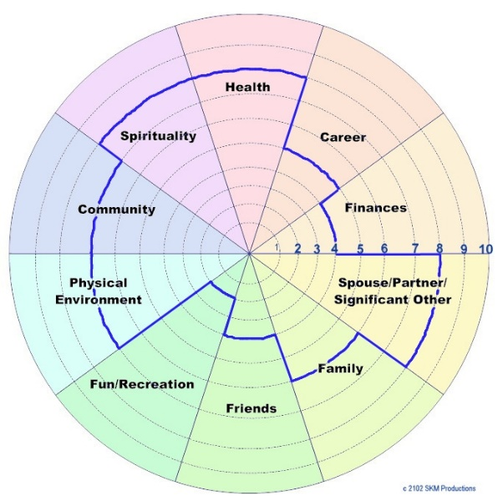
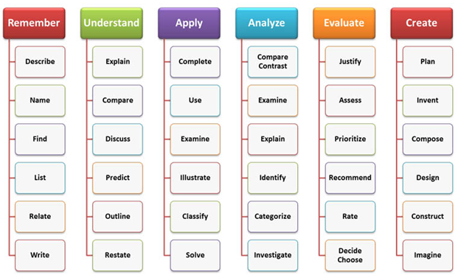
Examples of Formative Assessment

Slide 40
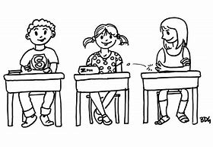
Subject specific research
The aim of this study was to find out how our year 7 students work was assessed at primary school. Also to look at the different methods used to show how students work was assessed to show progress.
Students completed a questionnaire in lesson.

Slide 41
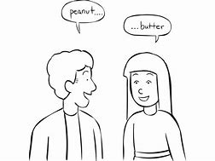
Primary school findings. How work is assessed at primary.
Out of Miss Shaw’s year 7 class the majority of students said that more often than not their work was assessed by written teacher assessment in their class books.
Six students said they received regular verbal feedback from their class teacher.
Seven students said they received both regular verbal and written feedback.

Slide 42
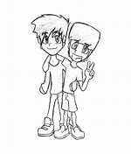
What type of assessment helped you make the most progress?
The overwhelming response from 13 students was that written teacher assessment helped students progress.
2 boys thought verbal feedback helped them make progress in lessons and 2 students said they thought both written and verbal also helped them make further progress.

Slide 43
Marking work!
The class was split on this feedback half said work was marked daily whilst the other half said their work was marked weekly.

Slide 44
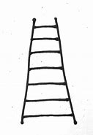
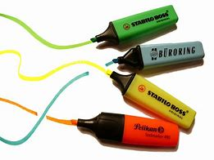
Progress a 3 way process.
The most interesting finding was that all students said they had some sort of progress ladder in their classwork book for each subject, at the end of each half term the teacher would highlight the areas on their ladder showing the progress that had been made. Targets linked to the ladder had been set at the start of each half term, students had to write down why they felt they had not made progress based on the targets that had been set, thus giving students more ownership for their progress. These ladders, targets and written dialogue was used at parents evening.
Some students may have had poor attendance for a short time and this would be reflected in the written dialogue produced by students, they may have missed a topic/theme covered in class again this would be brought up at parents evening for discussion.

Slide 45
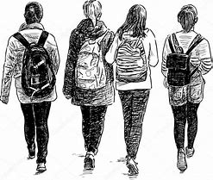
Year 11 feedback on assessment in Food.
The aim of asking year 11 about assessment was to find out what type of assessments in my subject area worked well and if I could make any improvements. Year 11 completed a questionnaire.
Type of assessment!
Out of the 15 year 11 students that answered my questionnaire 5 said verbal assessment and feedback worked better for them, 5 said written assessment and 5 said both verbal, peer and written assessment helped them make further progress.

Slide 46
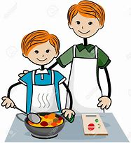
How feedback has helped progress.
Students feedback stated that assessment had:
Informed how to get a higher grade through stating clear and specific tasks to improve the work .
Assessment to make improvements to practical work. This is heavily weighted in the new specification.
Improved answering the questions in the written paper.
Improved the quality of coursework produced.
Helped with knowledge of the subject covering different topics.

Slide 47
Improvements.
I encouraged students to feedback how I could improve my assessment .
More specific comments in books.
Accurate grade boundaries (THERE ARE NO GRADE BOUNDARIES FOR 2018) however this is something to use next year and in the future.
Polished assessment = better progress.

Slide 48
What could we use to meet our needs?
Some staff looked at methods that could be used consistently that could be specific in highlighting key areas for development
Allow for feedback either individually by students or by teachers.

Slide 49
The Evaluation/self assessment wheel
A self assessment wheel is a valuable tool for supporting self-evaluation, exploring current reality and helping students to critically reflect on their own learning.
Self evaluation should support students to:
Reflect on what they have done
Think about what they might do next
Consider their own progress and development
An self assessment wheel can help students clarify which areas they need to focus and improve on.
Formative assessment allows pupils to be assessed individually in preparation for further learning to take place, “Teachers assess their pupils’ progress and difficulties with learning so that they can adapt their work to meet their needs—needs which vary from one pupil to another” (Black and William 1998).

Slide 50
Benefits of the self assessment wheel
The wheel is a visual tool where students and teachers can instantly see where a student is at and what they need to progress on.
The wheel can be adjusted to any subject/topic. Sections / categories can be added to suit your needs. For example, in the picture opposite, this particular wheel uses a 0-9 system of bronze, silver and gold.
Teachers are able to assess the students understanding with a quick simple diagram that can be used to modify their teaching and activities next lesson.
Students can set learning goals for next lesson

Slide 51
Example of how a wheel
May be used and look like.

Slide 52
Examples of use
To make summative assessments into formative assessments!
I trialled using the wheels to review a summative assessment and lead students to review topics they struggled with and therefore improve their understanding of the topic.
With year 7 I gave them specific question numbers that the class generally underperformed in and they self assessed based on how they did in test. We then reviewed paper with me talking through model answers then gave them time to review the topics they struggled on Mathswatch to improve their understanding. Students then reflected on this and re did their wheel.
With year 10 I trialled giving them a blank wheel and they chose the topics they stuggled with from a full GCSE paper based on the questions they didn’t get marks on but that they recognised they had seen before. I repeated the same process as year 7 then by giving model answers and time for them to review on Mathswatch in lesson and at home.

Slide 53
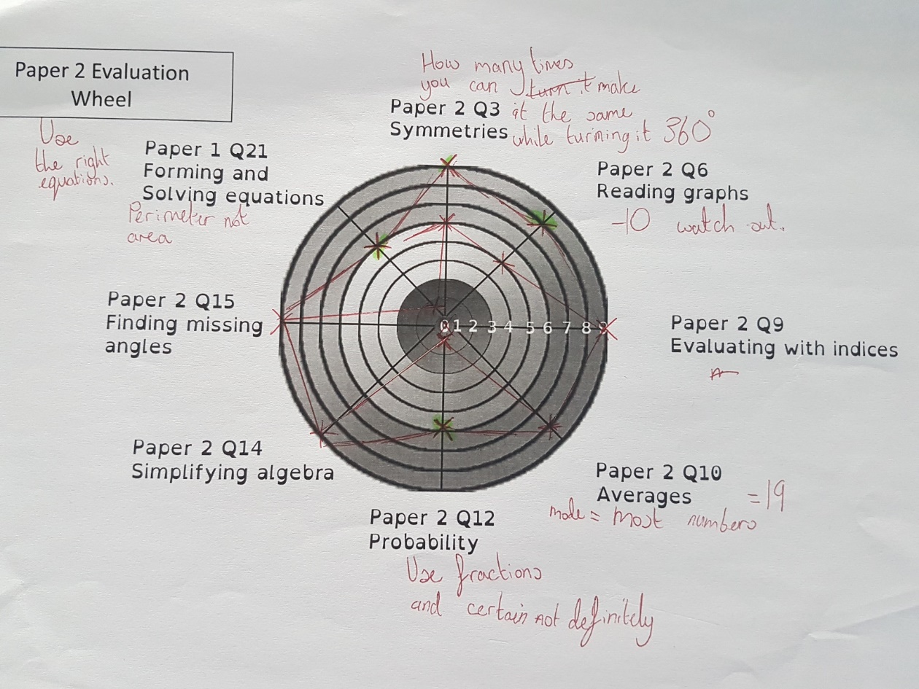
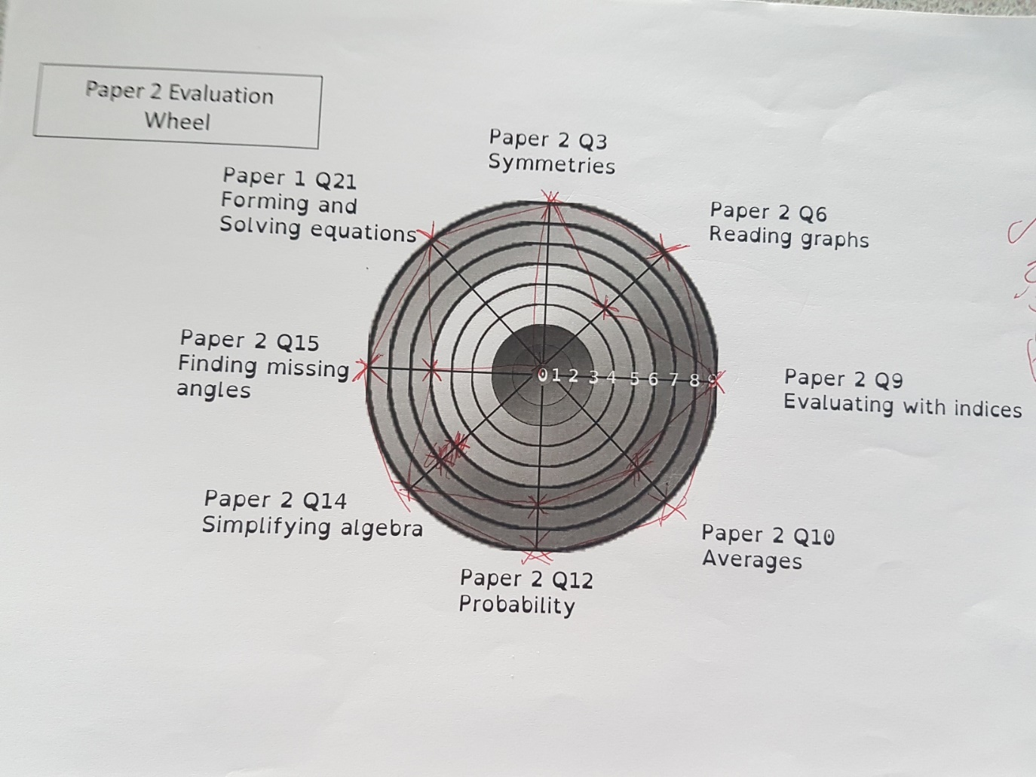
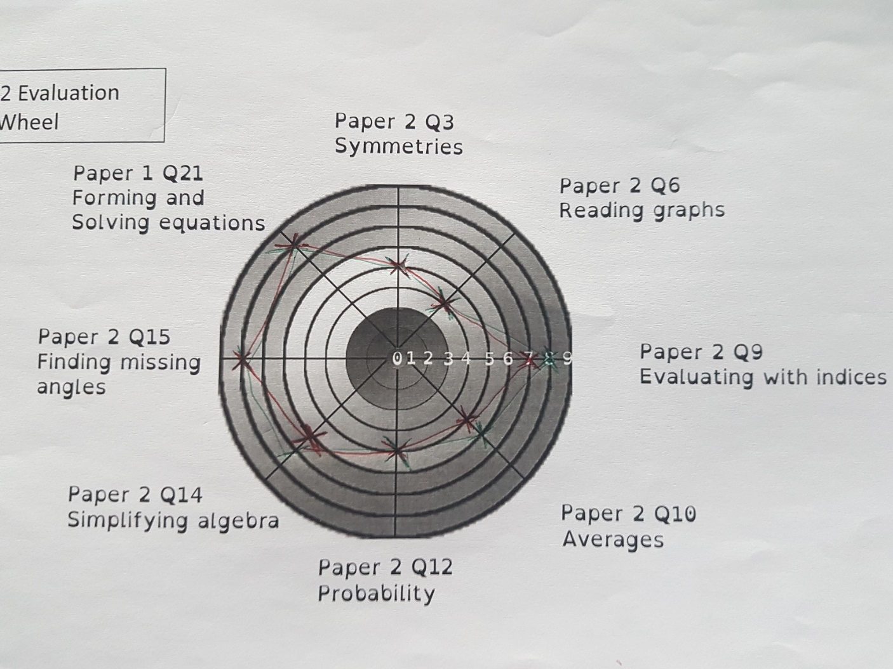
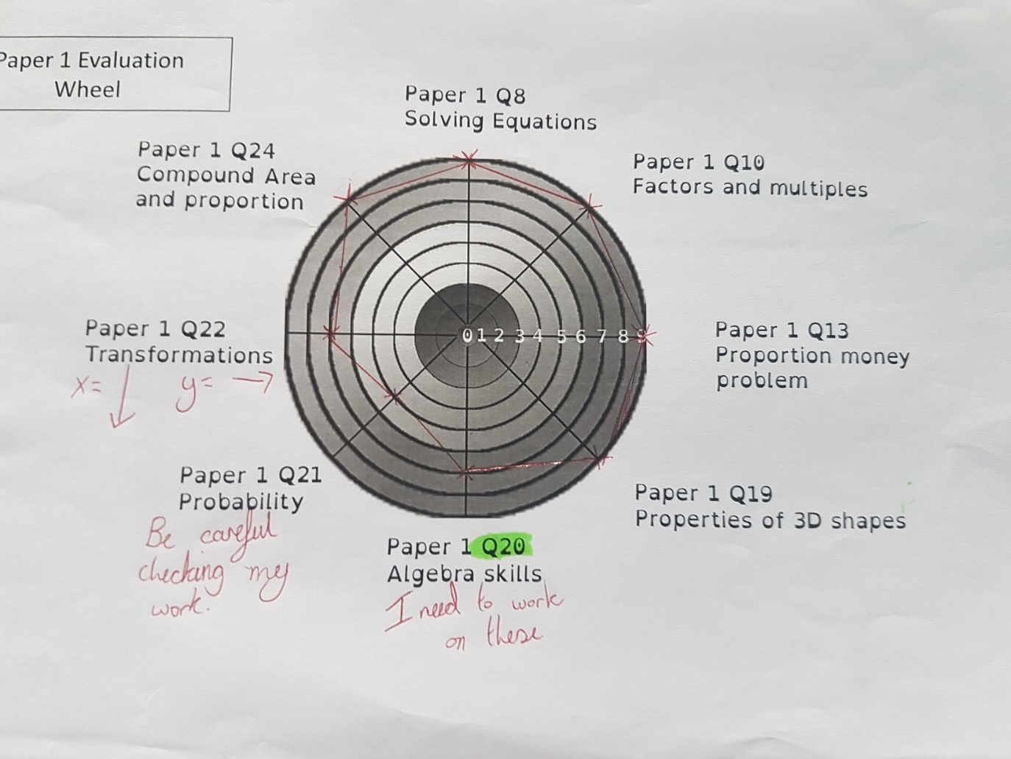

Slide 54
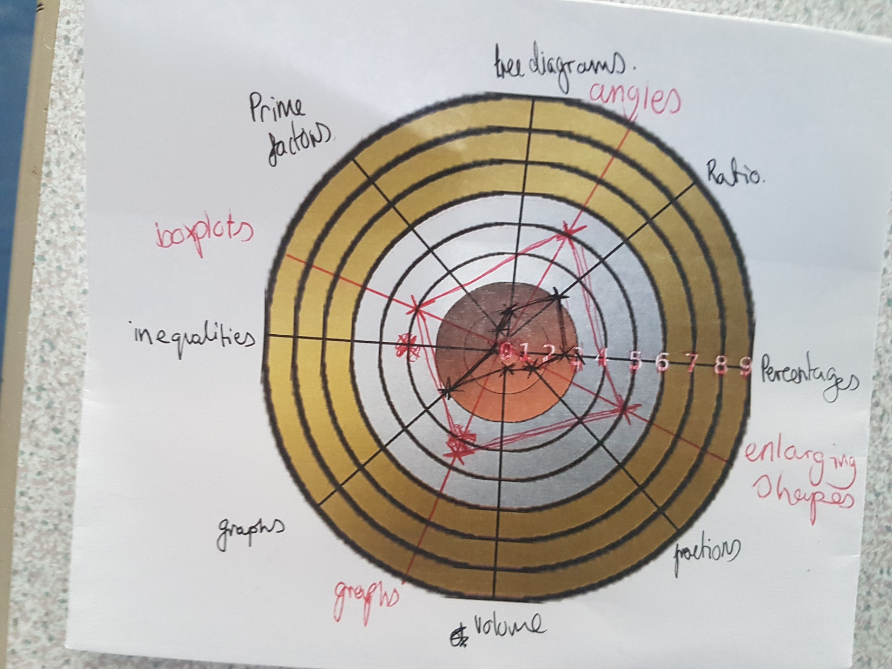
Students choosing their own topics from summative assessment

Slide 55
Examples of use
To break down a topic into core skills and reflect on each element
With year 9 I gave them a wheel at the beginning of teaching a couple of lessons on solving quadratic equations by factorising. I broke down the topic into the core skills and I expected them to be able to achieve at the end of the lessons.
They reviewed this before any teaching based on prior knowledge and their feeling – we regularly asses understanding at the end of lessons by grading out of 10. After teaching the lessons and using questions differentiated by Bronze/silver/gold students then self reflected on how they felt their understanding was now and if it had improved. More importantly where it didn’t improve they could highlight and look to revise these elements in preparation for their chapter test.

Slide 56
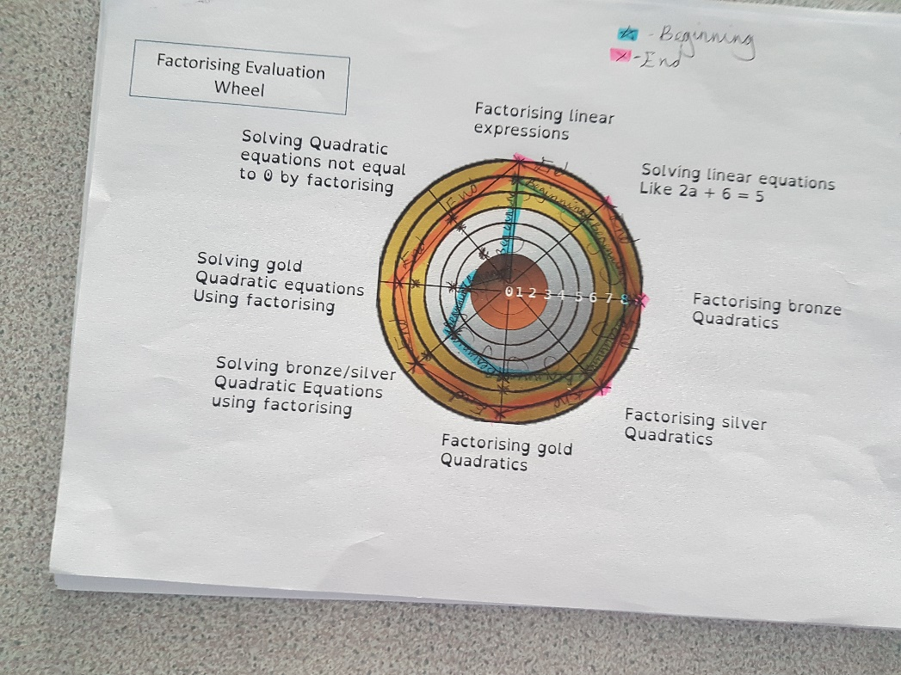
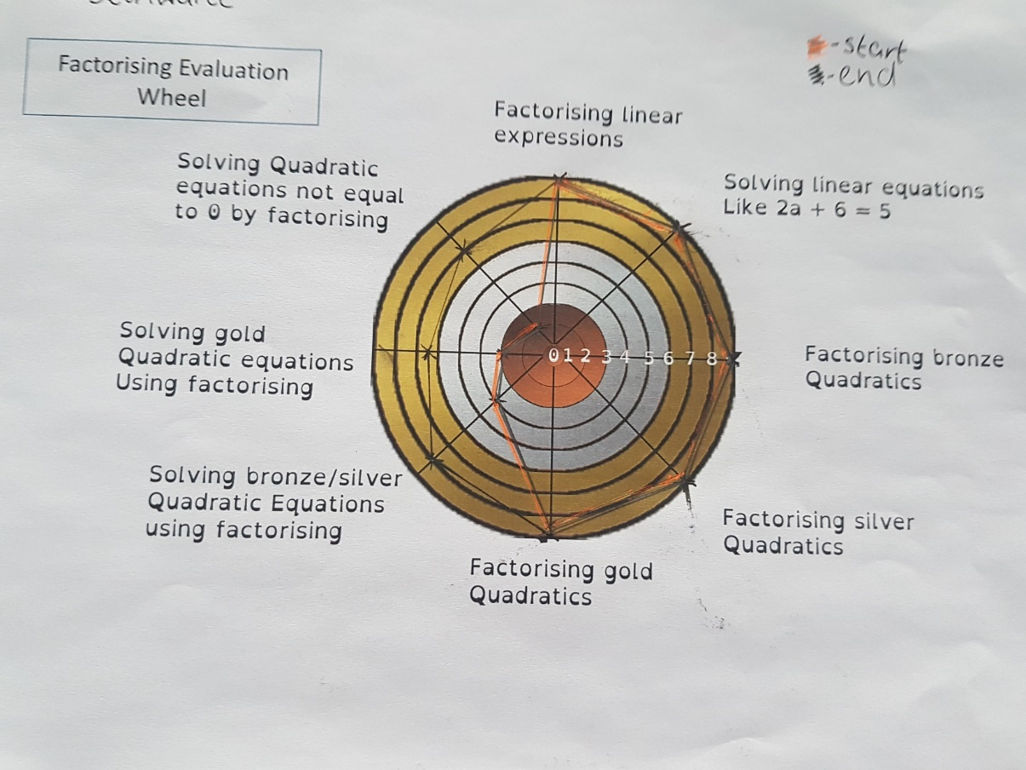
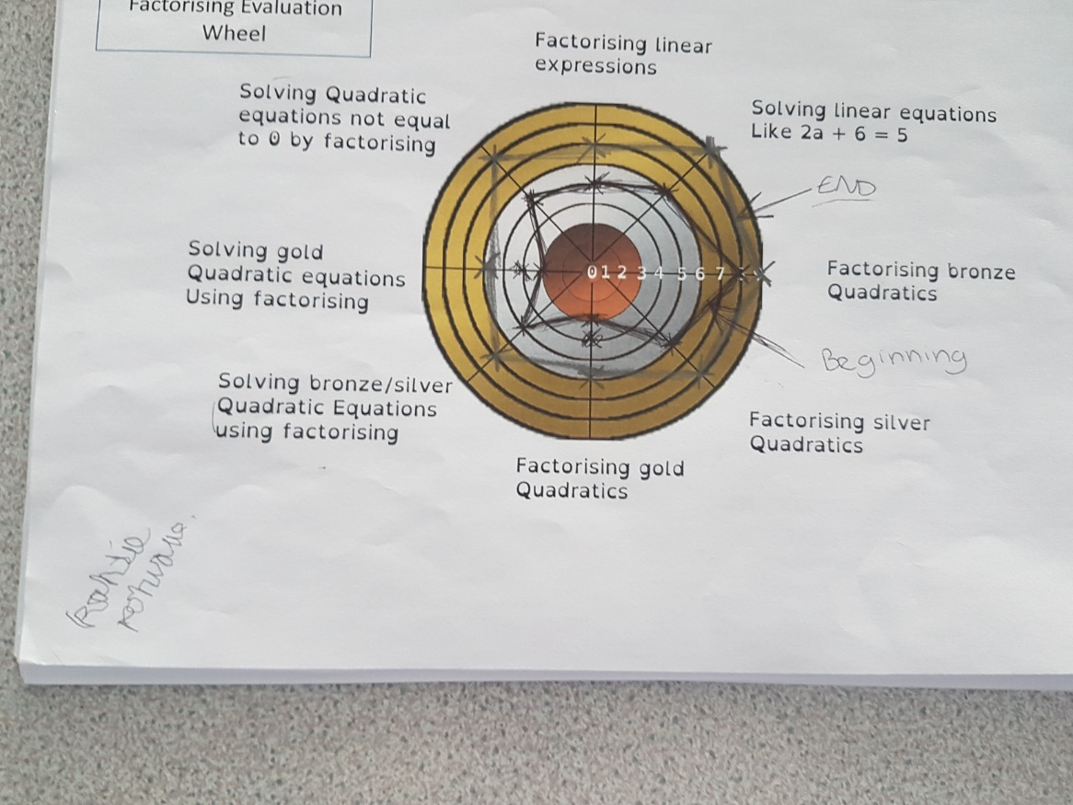

Slide 57
Reflection
General consensus of students was that this was quick and easy for them to do and they liked being able to reflect on how they were improving.
Year 9 in particular felt it gave them a clear understanding of how to improve with the majority liking the process – however this was only trialled with 9A1 and it would be interesting to try with a lower ability class.
It didn’t feel time consuming to complete however if doing this for every topic it could be and would take time to create a bank of these resources for use.
It may not work for all subjects!

Slide 58
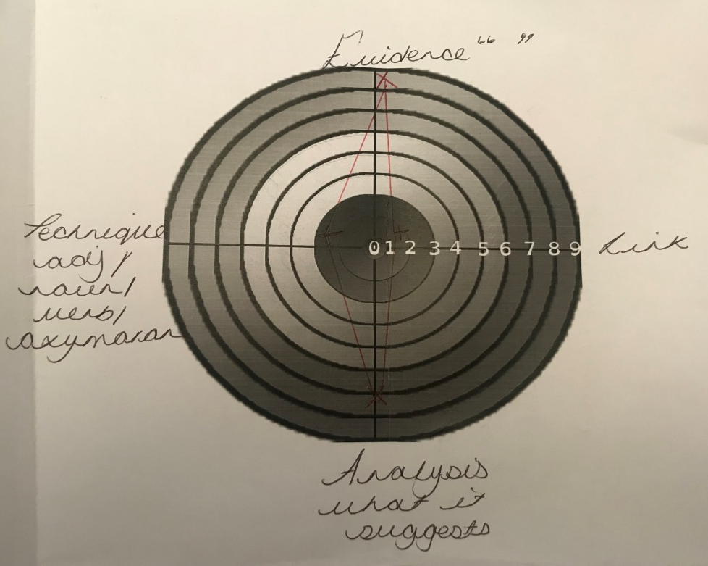
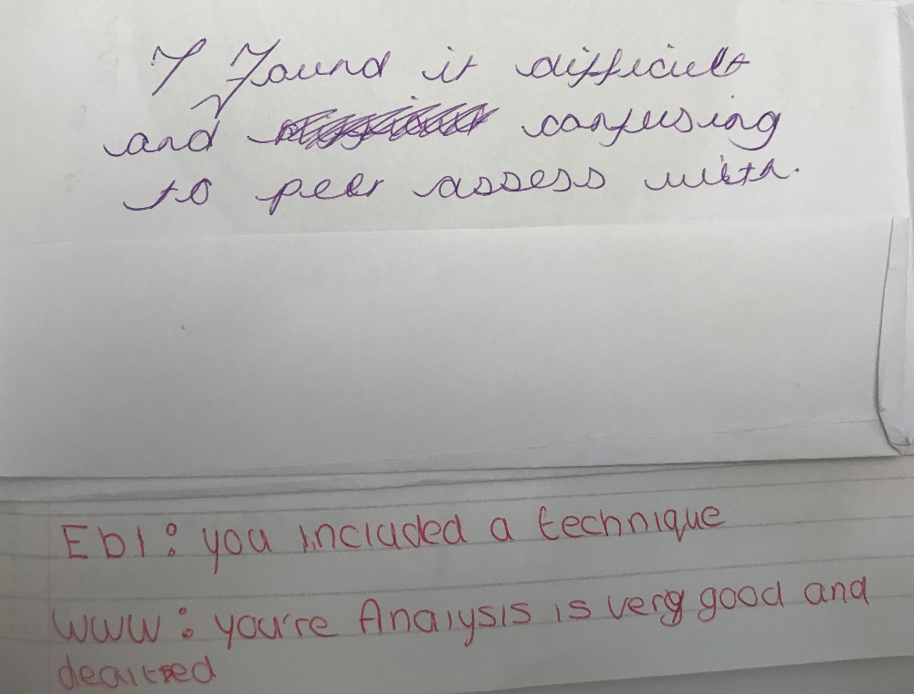
Students require set instructions and guidance to complete peer and self assessment well.
I found other examples work much more accurately…

Slide 60
Growth Mindset
J. Anatsui, A. Halsall, E. Hand, D. Turner, E. Harris

Slide 61
Growth Mindset – Outline of Project
Aim to use Growth Mindset strategies to engage and raise attainment with disaffected pupils.
Found that all of the least performing pupils in school registered as the least growth mindset
“Success is the ability to go from one failure to another with no loss of enthusiasm.”~ Winston Churchill

Slide 62
Growth Mindset – Learning Points
“What can I learn from this? What will I do next time I’m in this situation?”~ Carol Dweck
Not using the word 'can't' 'don't, 'cannot' banned from classroom
Promoting pupils to find answers independently
Raising expectations and a can do spirit
Celebrating achievement steps leading up to big achievements
Enforcing links to wider field of work /relevance to futures
“You’re in charge of your mind. You can help it grow by using it in the right way.”~ Carol Dweck

Slide 63
Routines for Ensuring Effective Organisation of Work
R. Sweeney, D. Cairns, R. Bury, P. Heywood-Connor, P. Wall

Slide 64
Routines for Effective Organisation – Outline of Project
As a group we discussed how this title could relate to both staff and students
Each member of the group was given a role to research and report their findings back to the group.
Becky – Organising work, Student voice.
Paula – Planners
Pam - Routines
Dan - Outside of School Scheduling, planning and marking

Slide 65
Routines for Effective Organisation – Learning Points
Planners – New planners designed through consultation with staff and students. The new planner provides a space for each subject per week. This will allow students to clearly see which subjects have set homework during that week, they also have a larger space in which to record their homework. The planner also includes a plastic pocket for students to store any printed instructions.

Slide 66
Developing Study Skills
A. Thorpe, L. Lo, S. Schultz, S. Sharples

Slide 67
Developing Study Skills – Outline of Project
Take four areas relating to Study skills and research various practices and strategies:
Spaced Learning
Storytelling
"Make it Sticky"
Effective Revision
Embed and trial what we have learned and discovered with current Year 11 groups across our separate disciplines and subjects in school during Mock exam and final exam preparation.
Feedback to group and write a blog with our findings on "edublog"

Slide 68
Developing Study Skills – Learning Points
All members of the group participated in the "Elevate" staff CPD session. Elevate are a global company that have changed the way study skills are taught working with students across the world.
The group met shortly after the workshop and agreed that the following areas would work well with our groups in preparation for exams:
Traffic light system for syllabus'
Pre-exam practice days
Online collaboration
Handing in notes before the exam.
Wall Charts for revision.
Independent learning sessions.

Slide 69
Final Research Areas for Study Skills
Julia - Spaced Learning – ELEVATE - SMART Spaces – Yr 11 Science
Lisa - Storytelling - create a story/narrative to memories key facts.
Sarah - Make it sticky - after school revision sessions with Year 11.
Anna - Effective Revision Strategies and Techniques - rapping, creating songs. Relaxation, breathing and mindfulness techniques with Year 11 Dance group.

Slide 70
Edublog – Developing Study Skills
Please follow the link below to read our blog and discover our findings........
http://eduwld1.edublogs.org/2018/06/28/studyskills/

Slide 71
Closing the Gender Gap
V. Hill, J. Elliott, K. Hughes, D. Martin, S. Rigby, E. Cox, J. Withers

Slide 72
Closing the Gender Gap – Outline of Project
The impact of biological and social differences between male and female students.
Gender stereotypes and expectations within society and how this impacts learning and achievement .
Reasons for the underachievement of boys at Walton Le Dale .
Strategies to engage and motivate underachieving boys as well as improve expectations and attitude to learning.
Strategies that engage underachieving boys without having a negative impact on girls.
Strategies to improve girls confidence in lessons, reduce insecurities and pressure.

Slide 73
Closing the Gender Gap – gender learning styles , male underachievers
Biological and social differences between male and female students affect the way they learn.
Social influences seem to have a bigger impact caused by stereotypes, the media, classroom topics, outside influences , role models. This implies that many issues related to the gender gap can be dealt with by using the right strategies and addressing our approach to attitude , expectations, behaviour and mind set.
Using 'Teaching to the top' strategies have helped to improve expectations and challenge.
Competition, positive language and personalised rewards systems help motivate and engage.
Introducing a degree of choice to homework tasks, where students may chose from a homework list/ reading list, chose how to display, hand in their homework. This help to add ownership and improved engagement.
Making the homework have a clear point that made it necessary for the net lesson also made it relevant.
Using examples of work from other male students from different year groups as role models also had a good impact.

Slide 74
Male under achievers
Using technology, the internet, video clips, email and other social media groups helped motivate male students and add further choice and ownership to their work. This also allowed them to be more independent , by sharing ideas and checking answers before handing a piece of work in.
Using photographs of other students work and allowing them to screenshot it to use as exemplar work helped boys to improve their writing and worked efficiently.
Although many of us found that the competitive element meant that many of the boys were engaged and “on board” with the task- there then became a sole focus on winning. This, at times was to the detriment of their progress.
Also, when certain boys were not doing as well, this competitive element seemed to lead them to give up sooner-“we’re not going to win so what’s the point” mentality.

Slide 75
Focus on Boys- Does this impact girls?
Much of our research showed that what works for some of our boys works well with some of our girls too. The strategies used in many of our lessons did not seem to negatively affect any of the girls.
However, if there is too much competition and it isn't personalised to the students, teacher and topic then some students can switch off and some of the less confident pupils, who don’t like the attention will become more introverted . It important to add variety and choice.

Slide 76
Girl students- exam pressure, anxiety, confidence and positive mindset.
Many of our female students lack confidence in their abilities and achievement. They seem to have a mental block, fixed mindset on themselves , yet are very positive and reassuring about others. This makes then great as coaches, mentors and team mates to underachieving boys, but some female students can get left behind and overlooked, particularly if they are used to help encourage underachieving boys.
This would be an area for further study.
Strategies to help female students stay calm and positive and regain their focus under pressure have been used by encouraging different meditation techniques, concentration music and strategies. Displays of this are located in A4.

Slide 77
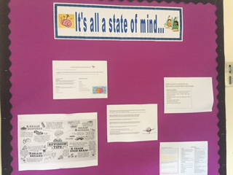
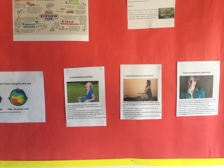
State of mind – positive thinking, stress busting ideas from female students.

Slide 78
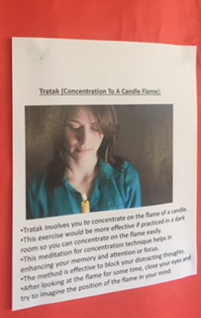
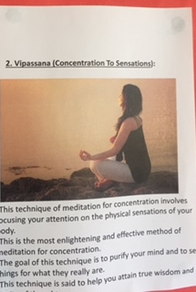
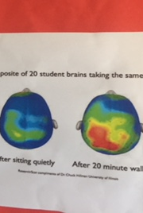
Its all a state of mind board display Meditation , concentration, stress boosting strategies . Its all a state of mind board display. This was produced after a girls only lunch time revision session. Here we researched ideas for techniques together. The girls where asked for their idea and to try some out.

