Slide 1
Walton le Dale High School Teaching and Learning Advent Calendar
Weds December 1st | Thurs December 2nd | Fri December 3rd | Mon December 6th | Tues December 7th
Weds December 8th | Thurs December 9th | Fri December 10th | Mon December 13th | Tues December 14th
Weds December 15th | Thurs December 16th | Fri December 17th

Slide 2
Card Games!
Class participation: give every student a playing card when they walk in the classroom. When a student answers a question during the lesson they hand their card in. The aim is for all students to have handed in their playing cards by the end of the lesson.
Use of number: You hold a pack of cards and use the numbers of the cards (Jack 11, Queen 12, King 13, Ace 1) to generate the number of examples you want to students to generate e.g. 9 key dates related to an event, 4 hypotheses, 7 French words related to shopping.

Slide 3
Would I Lie to You?
Plenary idea: students write three statements related to what they have learnt that lesson. Two statements are true and one is false. Choose several students to read out their statements and students show, using their fingers, which number statement they think is wrong and then you can ask a students to justify their choice.
This idea could be adapted slightly for different subjects e.g. language students have to write three sentences, 2 using correct vocabulary/ tenses and one which is wrong. The students have to pick which sentence is wrong and explain why.

Slide 4
Cops and Robbers!
Great idea as a mini-plenary mid-lesson – should literally take 3 minutes!
Students all need a copy of the table above. They act as the policeman first and fill in what evidence they have. This is a summary of their own learning.
Then they should work in talk partners to look to steal other ideas from their peers.
At the end of the activity they will have a detailed summary of what has been learnt during the lesson.

Slide 5
Gallery work
1. At the start of the task or lesson inform students that at the end their work will be 'critiqued' by other students. Outline clearly how students can perform well in the task/ lesson, maybe give them success criteria.
2. At the end of the task set the ground rules e.g. respect each piece of work, move around the classroom in silence so they can concentrate, explain how they should move around the classroom e.g. in a clockwise direction.
3. Each student 'displays' their work on their desk. Each student is given a few post-it notes.
4. The teacher will have worked out a system whereby the students can move one seat to their left to critique and give feedback on other work. They use their post-it notes to do this. The most successful outcomes are normally when students have been set feedback guidance (ABC model - 'A' agree with, 'B' build upon and 'C' for challenge or 'Kind', 'Helpful', 'Specific').

Slide 6
Ready, steady…go!
Click on the following link to take you to some classroom timers:
https://www.online-stopwatch.com/world-games-running/
Use them to add pace to your lesson!

Slide 7
A, B, C, D, E, F, G...........
Great for testing memory of new vocabulary!
Each student is given a letter of the alphabet as they enter the classroom or as a mini/ main plenary.
They have to write down as many key words starting with that letter linked to the lesson or the topic.
They have to join up with other students (letters) to spell out key words linked to the lesson or the topic.
A competition can then be played in the classroom either in small groups or as a whole class to review the words and how many they have.

Slide 8
Being a magpie!
Rather than students asking you questions during a challenging task they are given a magpie card which enables them to go and steal ideas from another group.
Give them 2 minutes to visit another group to ask questions and look over their work/answer.
Generally the students do not want to use them and so they try and complete the task without any help.

Slide 9
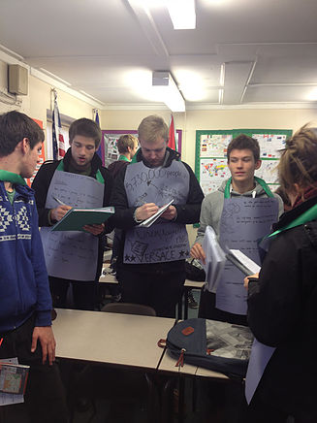
Apron Learning
Students independently research about a process/ topic/ case study and record their new learning on a piece of sugar paper (the research stage could be home learning).
This paper is then turned into an apron by stapling a neck strap (I used off cuts from some old display paper).
The students travel around the room swapping new information or teaching each other.
This could be turned into a superhero cape…!

Slide 10
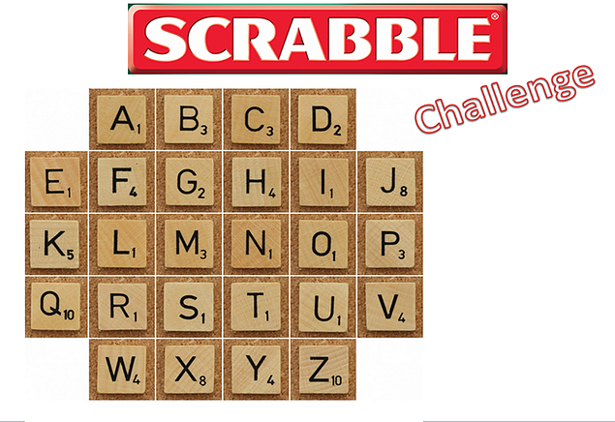
Scrabble Challenge
Give students a 'Scrabble Challenge' card (some people have made scrabble tiles out of cardboard) and they have to spell high scoring words related to the topic/ lesson.
They can then either compete as a class to find the top ten highest scoring words or students can pair up and compete against each other.
YF shared this at a top tip some time ago.

Slide 11
Snowballs – I’m dreaming of a white Christmas!
This is a great way to develop ideas in further depth
Feeling festive?
Try the snowball idea.
Pose a question.
Ask students to answer it on a piece of paper.
They scrunch it into a snowball and throw (gently) into the middle of the room.
They should collect a snowball and add to the ideas.

Slide 12
One pen, one dice
This was shared at a top tip back a while ago and one of the students’ favourites.
Each student should have a pen and a die (lots available in school – just email around).
They each have a worksheet of questions to answer
One tries to throw a 6 whilst the other answers the questions. As soon as the 6 is thrown, they swap (pen for die etc).
The first person to complete the questions, wins!

Slide 13
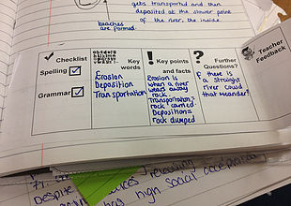
End of term Evaluations
The review and feedback section at the bottom of the page is a useful exercise to complete at the start of end of a term to focus students.
It could be used as a regular part of the week or a lesson by printing out a similar strip to stick in.

Slide 14
Presentation | Spelling | Grammar | Key Knowledge | Key Skills
Student/Teacher Comment:
Presentation | Spelling | Grammar | Key Knowledge | Key Skills
Student/Teacher Comment:

Slide 15
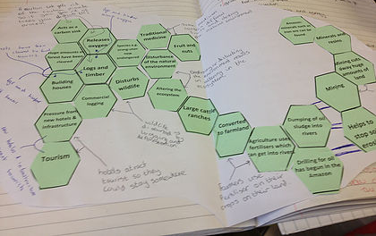
Hexagon Links
In each hexagon write a word/ phrase/ object/ skill or event.
They should be linked in some way to each other but the links can be as obvious as you want them to be.
The students have to cut our the hexagons and start to link them/ group them to each other where they think there is a link.
They have to continue to do this until each hexagon is linked to at least one other.
The hexagons are then stuck down to a piece of paper and the students have to annotate the diagram they have created to explain the links.
The hexagons and explanation can then be used to help write an exam answer if needed or it could be used as a summary of their learning.

Slide 16
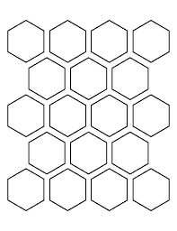

Slide 17
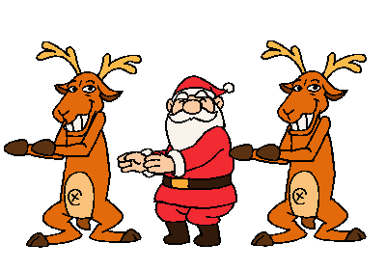
Merry Christmas and thank you for your hard work this term!
Enjoy the break!

