Slide 1
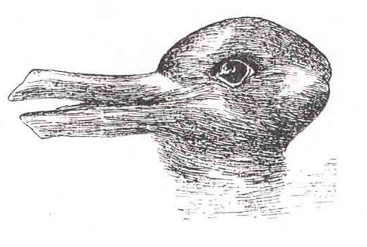
What do you see…?
Duck?
Or rabbit?

Slide 2
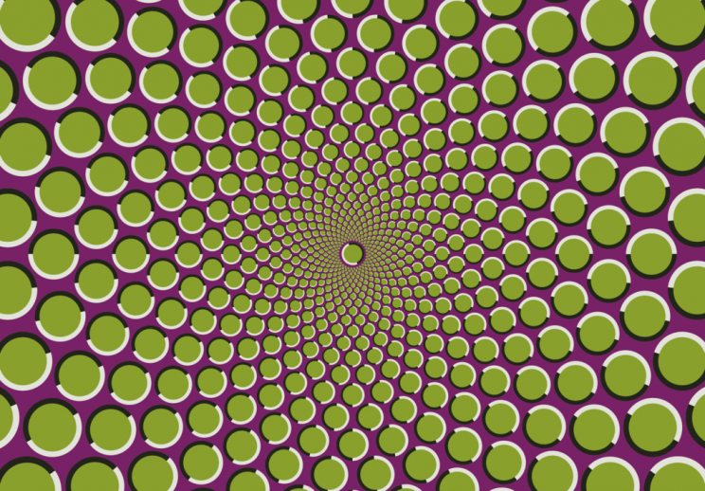
Moving?
Not moving?
Motion illusions, typically operate by presenting a pattern made up of high contrast colours or tones. These contrasting aspects trigger different neural signals simultaneously, which results in a motion-detecting effect when no motion is actually present.

Slide 3
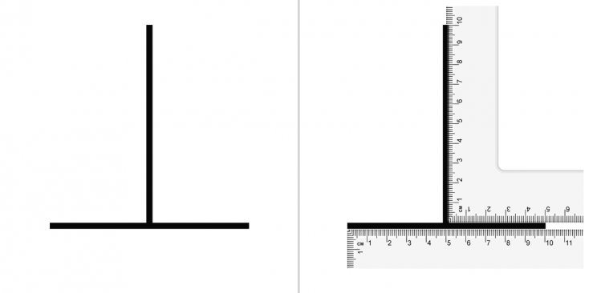
Which line is longer: the horizontal line? Or the vertical one?

Slide 4
Though most viewers perceive the vertical line as being longer, they're actually both the same length. Though the exact cause of this phenomenon is not known, it has been suggested that the positioning of the vertical line triggers our depth perception - causing us to perceive the vertical line as being further away from us than the horizontal line, and thus longer.

Slide 5
‘Truth’
You will have each looked at those optical illusions and seen different things. Which version is the ‘truth’?
Often people say, ‘tell the TRUTH’, or ‘be HONEST’. This week, think about your own honesty and truth…
If you are HONEST, you are TRUE to yourself…

