Slide 1
We Are Reading

Slide 2
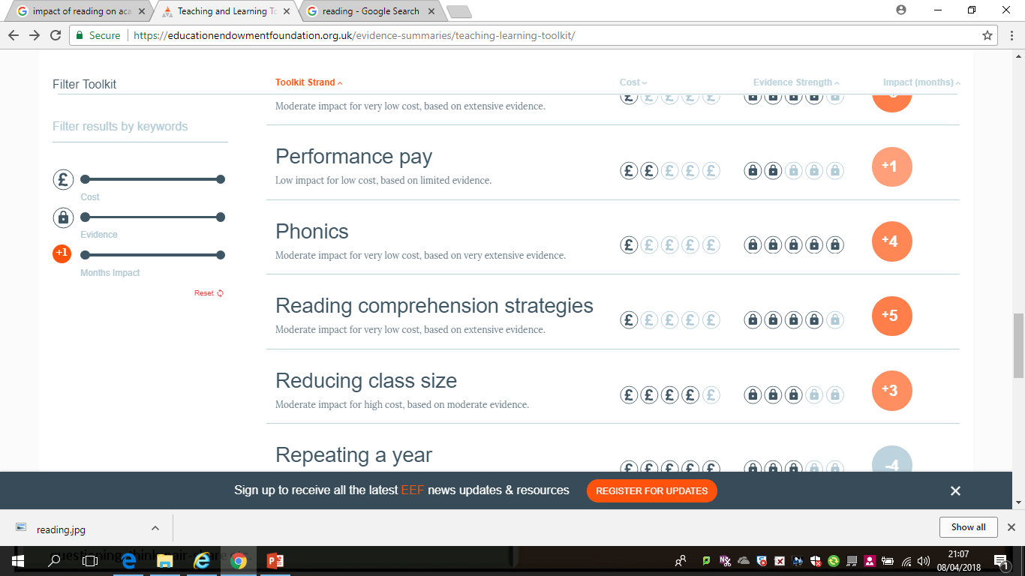
Why does Reading Matter?

Slide 3
What does this mean?
Reading comprehension approaches to improving reading focus on learners’ understanding of the text.
They teach a range of techniques that enable pupils to comprehend the meaning of what is written, such as inferring the meaning from context, summarising or identifying key points, using graphic or semantic organisers, developing questioning strategies, and monitoring their own comprehension and identifying difficulties themselves.

Slide 4
What does this mean?
On average, reading comprehension approaches improve learning by an additional five months’ progress over the course of a school year. These approaches appear to be particularly effective for older readers (aged 8 or above) who are not making expected progress.
Successful reading comprehension approaches carefully select activities for pupils according to their reading capabilities, and ensure that texts provide an effective, but not overwhelming, challenge.
Many of the approaches can be usefully combined with phonics, collaborative and peer-learning techniques. The use of techniques such as graphic organisers and drawing pupils’ attention to text structures are likely to be particularly useful when reading expository or information texts.

Slide 5
What does this mean?
Reading comprehension approaches focus on learners’ understanding of words and texts.
They seek to develop pupils’ skills through the explicit teaching and application of strategies focusing on meaning.
Examples include techniques which pupils can use to monitor their own understanding, such as inferring meaning from context, summarising or identifying key points, and developing questioning strategies.
In addition, observational evidence suggests teachers tend to rely on a narrow range of comprehension strategies in their teaching, so it is likely that this is an area where high-quality professional development is helpful.

Slide 6
Discussion
Effectively diagnosing reading difficulties is an important first step, particularly for older struggling readers. Are you confident as to whether the problem(s) a pupil has are related to decoding, the structure of language or vocabulary, which may be subject-specific?
2. Approaches to increase pupils’ vocabulary are not likely to improve reading comprehension unless vocabulary is taught in context. Is this happening?
3. Successfully adopting new reading comprehension interventions is likely to benefit from high-quality professional development. How are you planning to support teachers or teaching assistants in delivering new approaches?

Slide 7
Reading is Everyone’s Problem and Everyone’s Solution
Reading is NOT literacy –it is a fundamental part of teaching and learning
It is vital that we make the reading strategies we use explicit to students
Talk about what words mean
Talk about where these words come from
Talk about what is going on in the exam questions and resources we use
Provide students with wider reading and talk to them about it…discussion and collaboration develops comprehension
Actively question students about the meaning of the material we read
Encourage students to read widely around the subject to show enthusiasm and passion for the subject and show students the relevance of what they are learning

Slide 9
The Pledge
During the year of reading, we are committed to:
Becoming a reading school.
Seeking out every opportunity to improve standards in reading within our school.
Encouraging reading for pleasure.
Enabling children to read in depth in a wide range of subjects, deepening their knowledge and understanding across the curriculum.
Working with other schools, our local library and other partners to promote reading as a life-long skill.

Slide 10
What is already happening?
Year 7 have been set a wider reading project over the summer, with contributions from different subject areas
Wider reading and vocabulary homeworks set
Questioning and discussion in lessons

Slide 11
What do we need to do now?
Build on questioning and discussion in lessons
Encourage collaborative learning
Make the reading strategies used explicit and break them up/structure them into questions.
Encourage more wider reading for pleasure and engagement-this needs to come from us!
Celebrate and share our own reading with the students
Get students to do their own research and teach other members of the class about their findings
Discuss the etymology of the vocabulary in our subject.

Slide 12
What else?
Random Reading relaunch
Posters on doors updated
Set reading homeworks
Use the library
Celebration of reading timetabled into your subject as a starter activity??

Slide 13
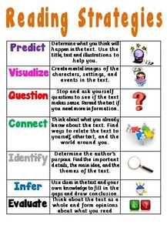
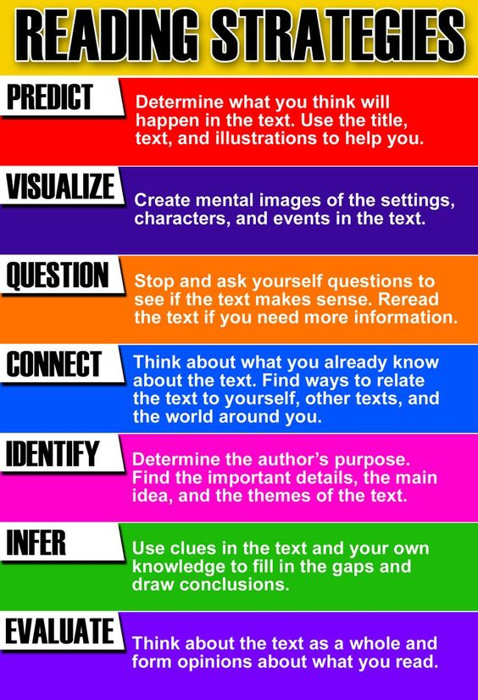

Slide 14
